Slide 1
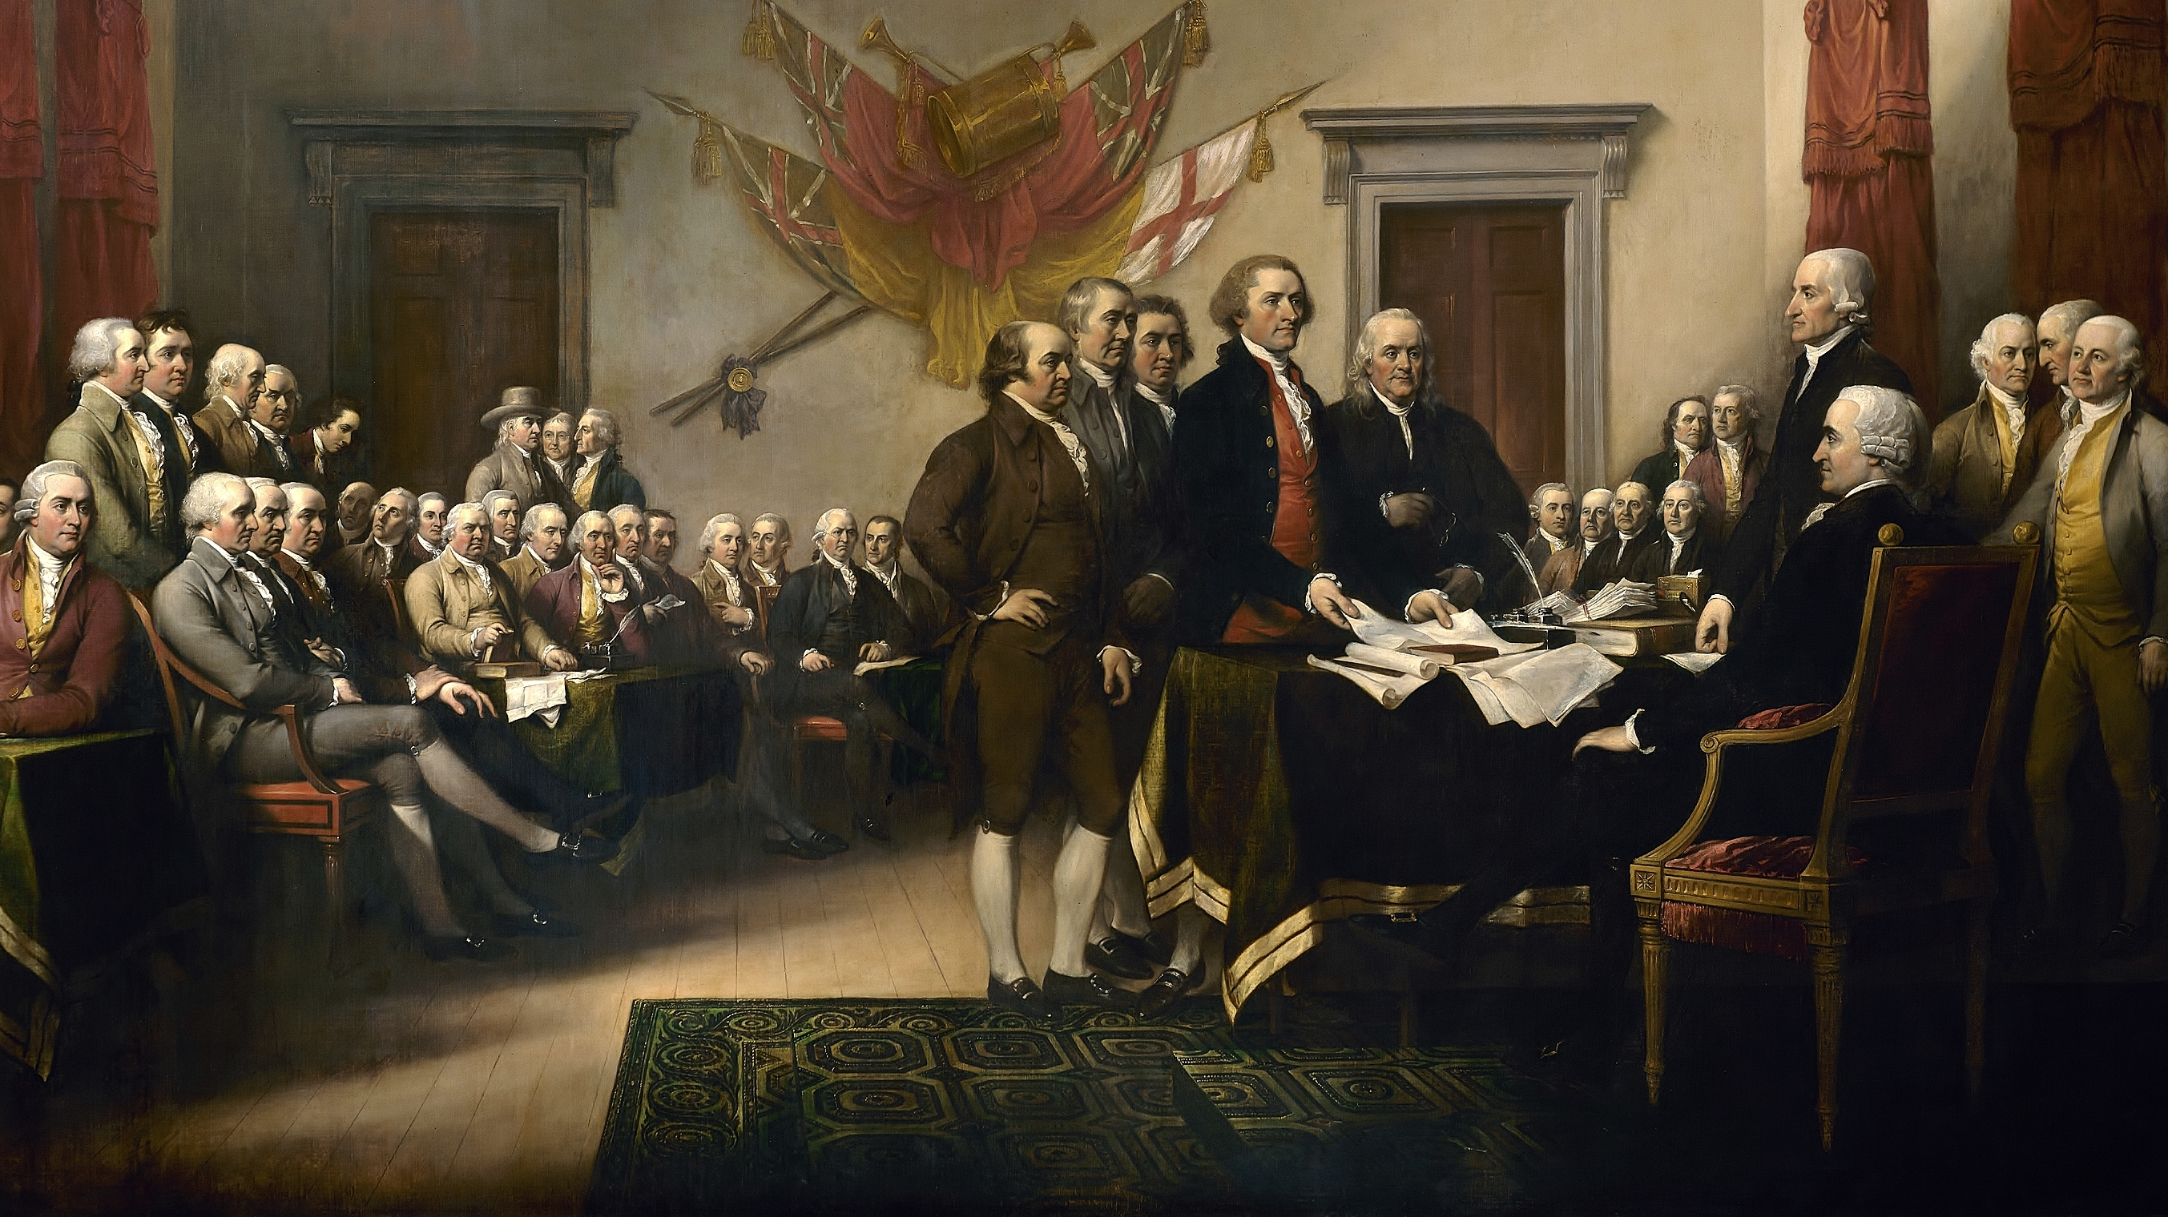
Political Philosophy
The Development of Social Contract Theory
Declaration of Independence, John Trumbull, 1819

Slide 2
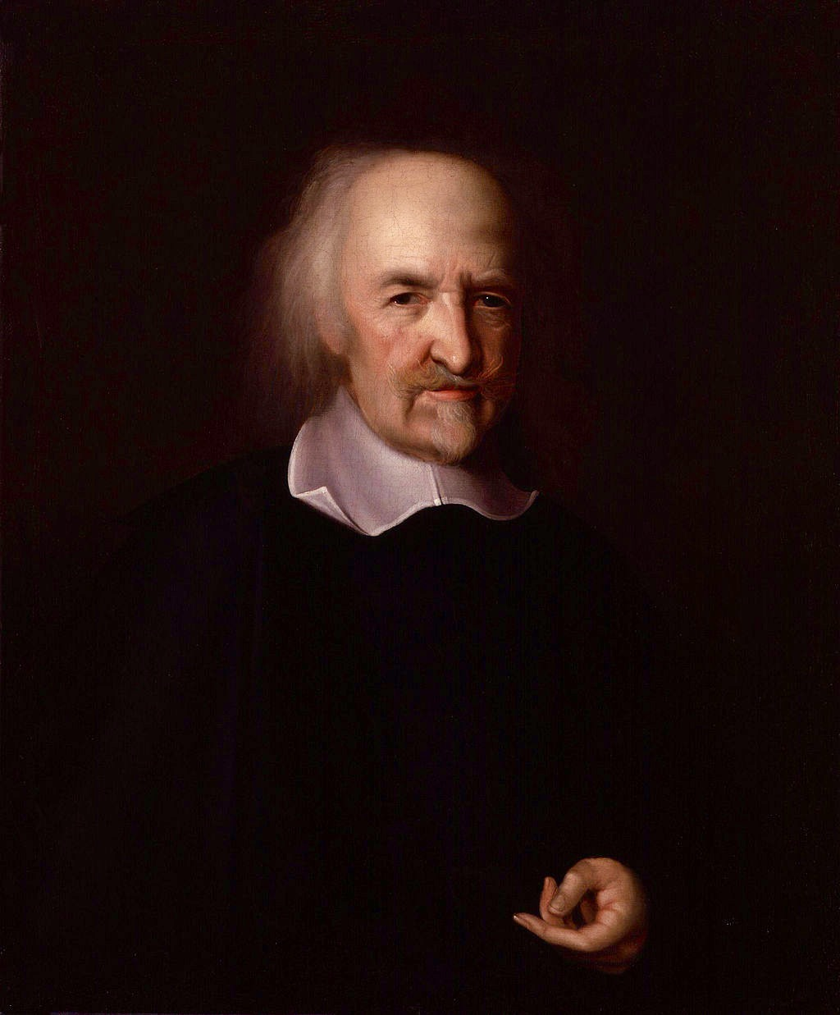
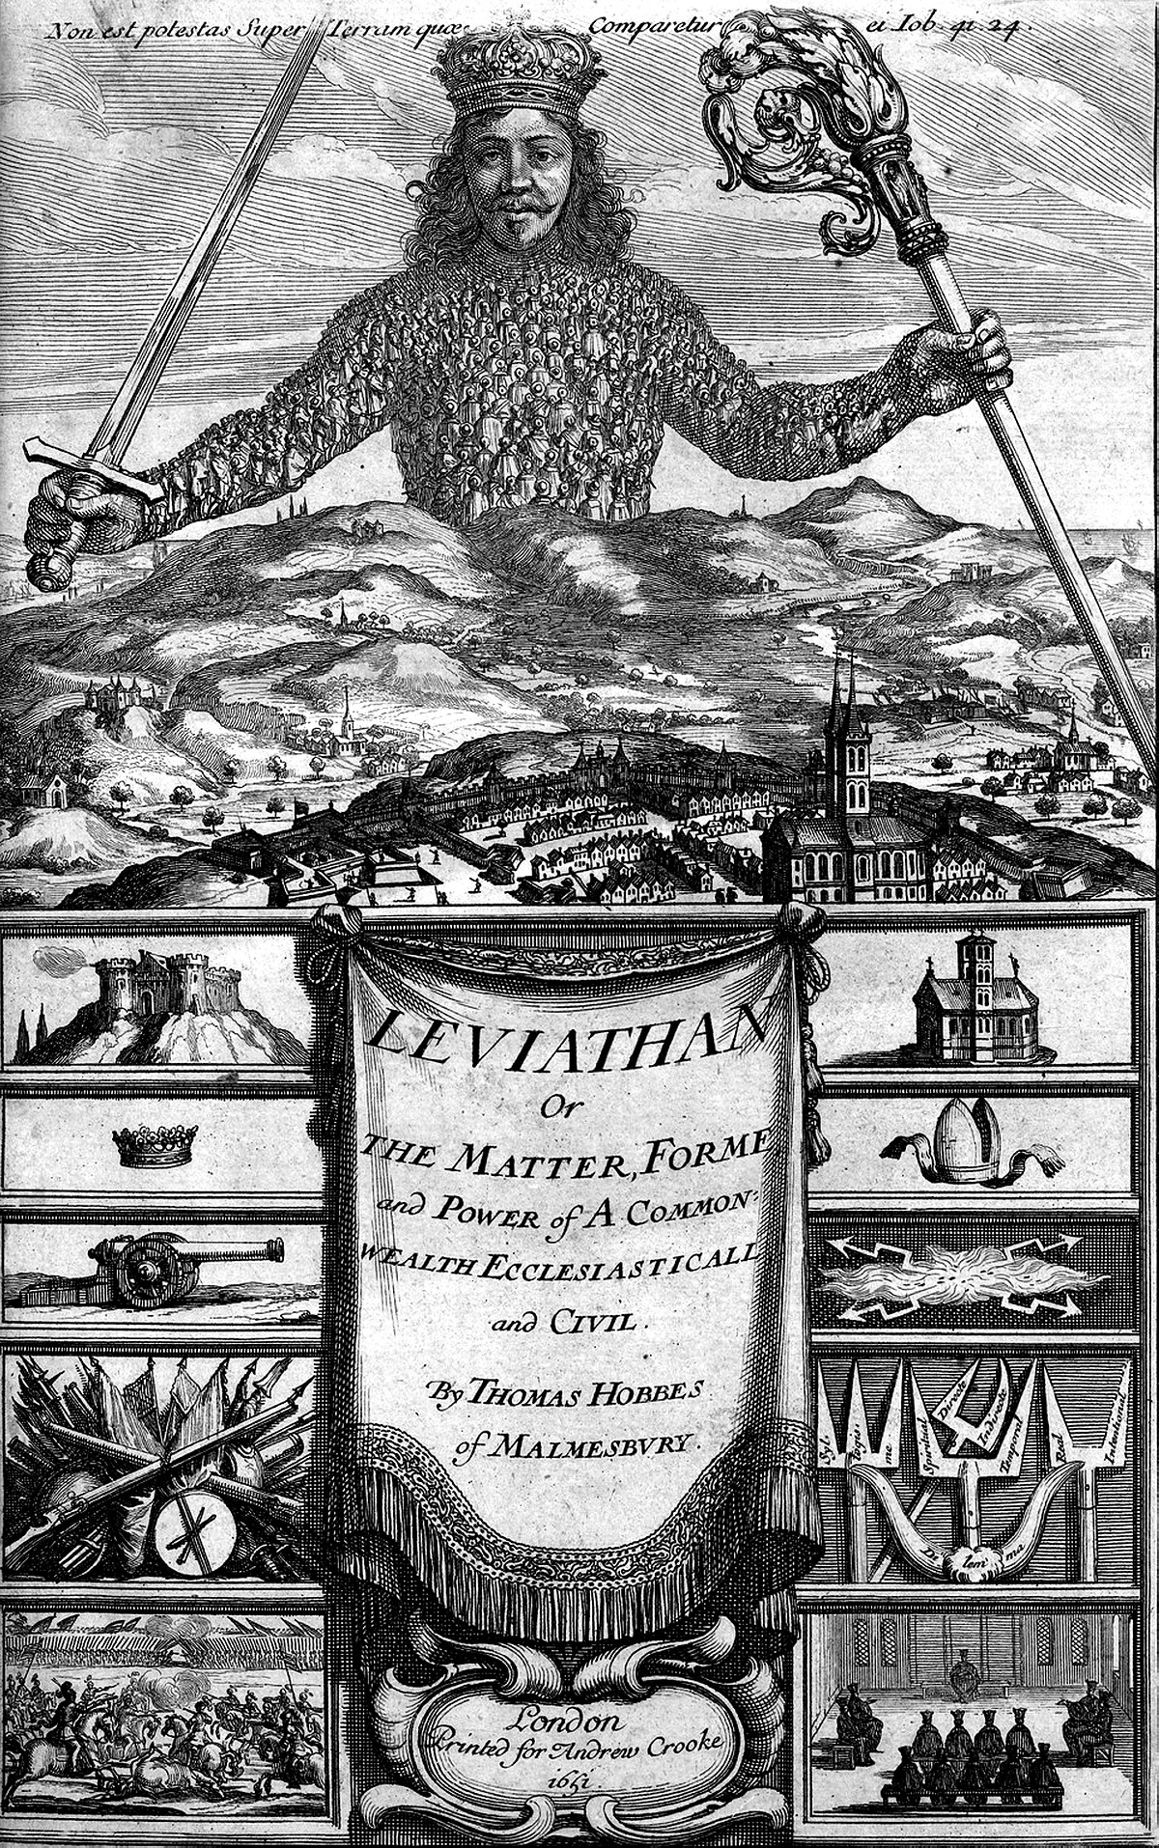
Thomas Hobbes
(1588-1679)
Leviathan

Slide 3
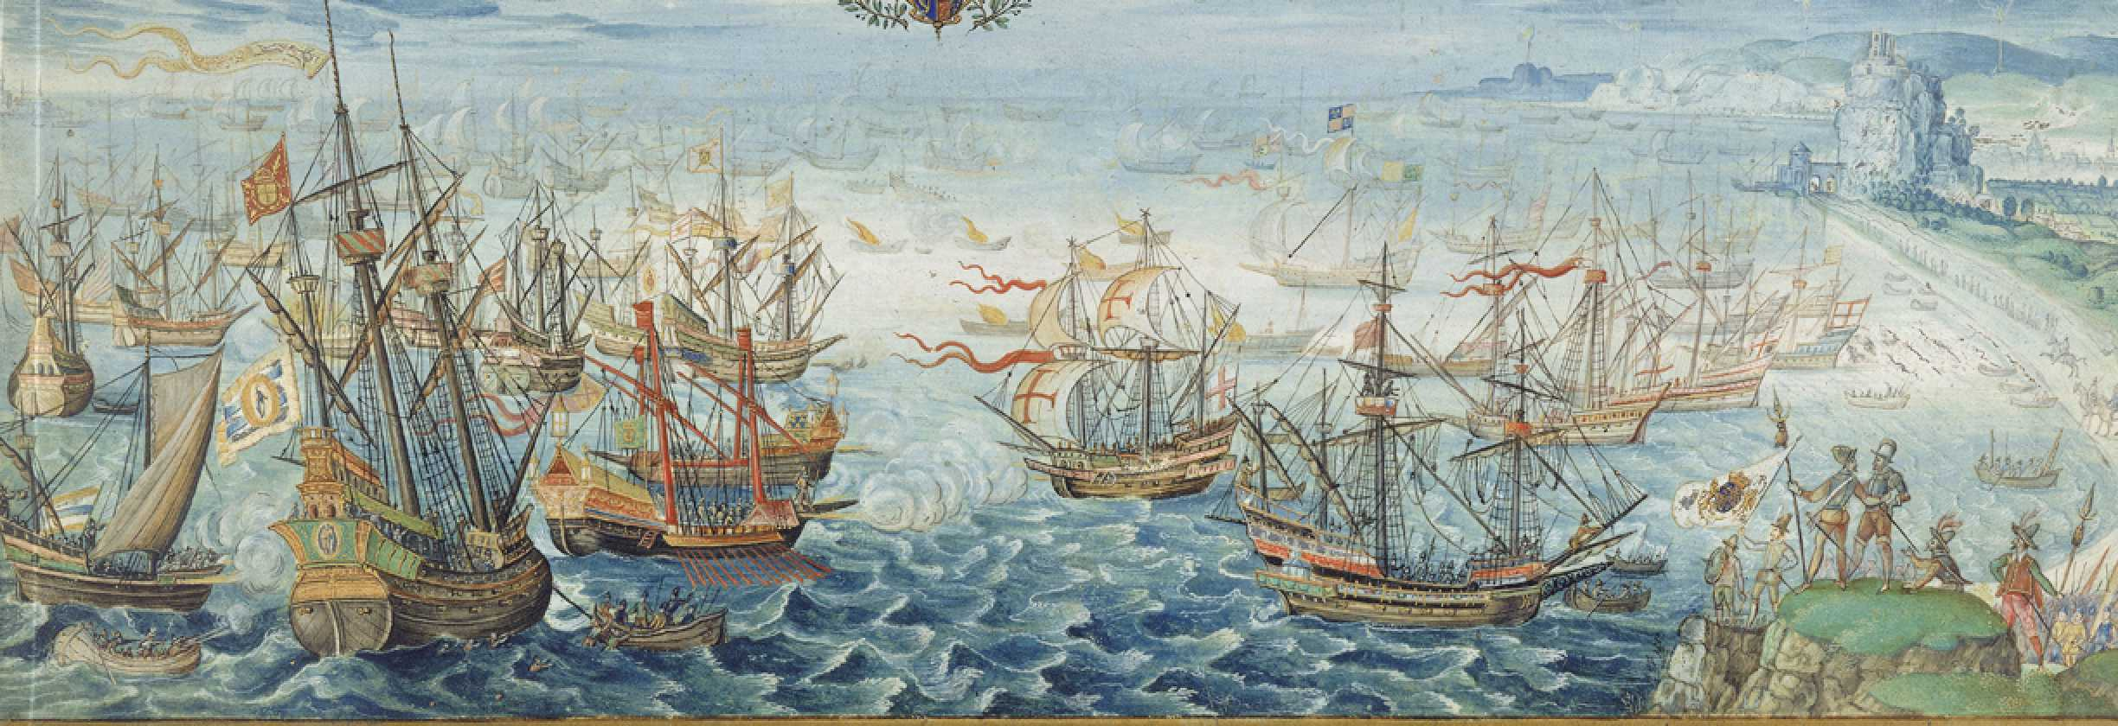
Hobbes was born prematurely because his mother panicked when she heard the Spanish Armada was approaching. “Fear and I were born twins,” he used to say, referring to his own anxious personality. (Magee 2001, 78)

Slide 4

Hobbes’ Metaphysics
Materialism
All that exists is matter—atoms in motion.
Leviathan, Chapter XLIV:
“The universe, that is the whole mass of things that are, is corporeal, that is to say body; and hath the dimensions of magnitude, namely, length, breadth, and depth. Also every part of body is likewise body, and hath the like dimensions. And consequently, every part of the universe is body, and that which is not body is no part of the universe. And because the universe is all, that which is not part of it is nothing, and, consequently nowhere.” (Magee 2001, 78)

Slide 5
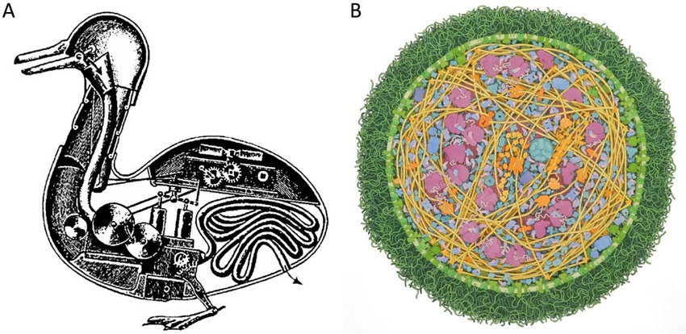

Nature as Machine.
NATURE (the art whereby God hath made and governs the world) is by the art of man, as in many other things, so in this also imitated, that it can make an artificial animal. For seeing life is but a motion of limbs, the beginning whereof is in some principal part within, why may we not say that all automata (engines that move themselves by springs and wheels as doth a watch) have an artificial life? For what is the heart, but a spring; and the nerves, but so many strings; and the joints, but so many wheels, giving motion to the whole body, such as was intended by the Artificer? Art goes yet further, imitating that rational and most excellent work of Nature, man. (Hobbes 1651, Leviathan, Introduction)
The machine analogy was (and is) often used to describe the active and complex nature of living matter. The 'digesting duck' represents an early automaton mimicking an eating and digesting duck and was created by Jacques de Vaucanson in 1739.
Artificial Owl in Blade Runner

Slide 6
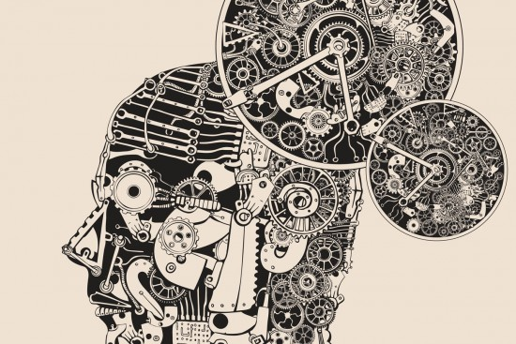
Man as a Machine
“Thus, in addition to being what one might call the founder of modern materialism, he was the first philosopher to put forward an out-and-out mechanistic view of nature. As part of this he developed a mechanistic psychology. This was something wholly new, to look at the human mind as a machine—a soft machine, of course,; but nevertheless, in Hobbes’ view, all mental processes were to be understood as consisting of movements of matter inside an individual’s skull.” (Magee 2001, 79)

Slide 7
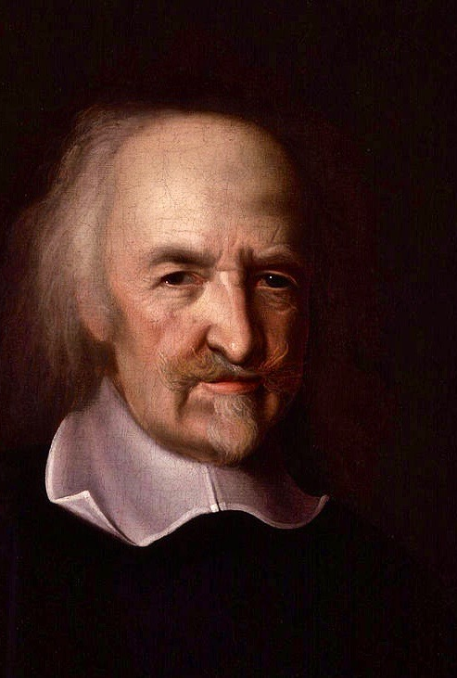
The State of Nature
Materialism—Man as Machine: human beings are hardwired to be selfish
Equality—human beings are equal enough in faculties of body and mind that no one can be powerful enough or smart enough to have security. (Diffidence—the opposite of confidence)
Scarcity of resources leads to competition.
Necessarily a state of war.
No morality, no justice.

Slide 8
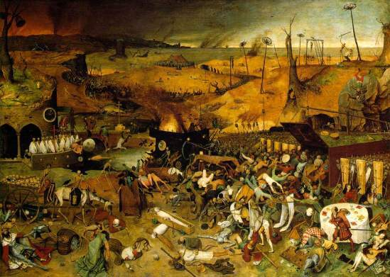
The State of Nature
“Whatsoever therefore is consequent to a time of war, where every man is enemy to every man; the same is consequent to the time, where in men live without other security, than what their own strength, and their own invention shall furnish them withal. In such condition, there is no place for industry; because the fruit thereof is uncertain: and consequently no culture of the earth; no navigation, nor use of the commodities that may be imported by sea; no commodious building; no instruments of moving, and removing, such things as require much force; no knowledge of the face of the earth; no account of time; no arts, no letters; no society; and which is worst of all, continual fear, and danger of violent death; and the life of man, solitary, poor, nasty, brutish, and short.”
(Hobbes 1651, Leviathan, Chapter 13)
The Triumph of Death,
Oil on panel, Pieter Bruegel the Elder, 1562-63.
Museo del Prado, Madrid, Spain

Slide 9
On Rights, and the Laws of Nature
A LAW OF NATURE, (lex naturalis) is a precept, or general rule, found out by reason, by which a man is forbidden to do that, which is destructive of his life, or taketh away the means of preserving the same; and to omit that, by which he thinketh it may be best preserved.
And because the condition of man, as hath been declared in the precedent chapter, is a condition of war every one against every one; in which case every one is governed by his own reason; and there is nothing he can make use of, that may not be of help unto him, in preserving his life against his enemies; it followeth, that in such a condition, every man has a right to every thing; even to another’s body.
(Hobbes 1651, Leviathan, Chapter 14)

Slide 10
On Rights, and the Laws of Nature
And consequently it is a precept, or general rule of reason, that every man, ought to endeavor peace, as far as he has hope of obtaining it; and when he cannot obtain it, that he may seek, and use, all helps, and advantages of war. The first branch of which rule, containeth the first, and fundamental law of nature, which is, to seek peace, and follow it. The second, the sum of the right of nature; which is, by all means we can, to defend ourselves.
(Hobbes 1651, Leviathan, Chapter 14)

Slide 11
On Rights, and the Laws of Nature
From this fundamental law of nature, by which men are commanded to endeavor peace, is derived this second law; that a man be willing, when others are so too, as far forth, as for peace, and defence of himself he shall think it necessary, to lay down this right to all things; and be contented with so much liberty against other men, as he would allow other men against himself.
(Hobbes 1651, Leviathan, Chapter 14)

Slide 12
The Social Contract
The only way to erect such a common power, as may be able to defend them from the invasion of foreigners, and the injuries of one another, and thereby to secure them in such short, as that by their own industry, and by the fruits of the earth, they may nourish themselves and live contentedly; is, to confer all their power and strength upon one man, or upon one assembly of men, that may reduce all their wills, by plurality of voices, unto one will: which is as much to say, to appoint one man, or assembly of men, to bear their person; and even one to own, and acknowledge himself to be author of whatsoever he that so beareth their person, shall act, or cause to be acted, in those things which concern the common peace and safety; and therein to submit their wills, every one to his will, and their judgments, to his judgment.
(Hobbes 1651, Leviathan, Chapter 17)

Slide 13
The Social Contract
This is more than consent, or concord; it is a real unity of them all, in one and the same person, made by covenant of every man with every man, in such manner, as if every man should say to every man, I authorize and give up my right of governing myself, to this man, or to this assembly of men, on this condition, that thou give up thy right to him, and authorize all his actions in like manner. This done, the multitude so united in one person, is called a COMMONWEALTHI, in Latin CIVITAS. This is the generation of that great LEVIATHAN, or rather (to speak more reverently) of that mortal god, to which we owe under the immortal God, our peace and defence.
(Hobbes 1651, Leviathan, Chapter 17)

Slide 14

Hobbes
The Social Contract
The purpose of government: peace and security, law and order
Individuals surrender unlimited rights in the state of nature in order to get peace and security.
Sovereign: one man or an assembly of men having absolute power—the Leviathan.
The ruler is above the law. Law determines justice (there can be no unjust laws).

Slide 15
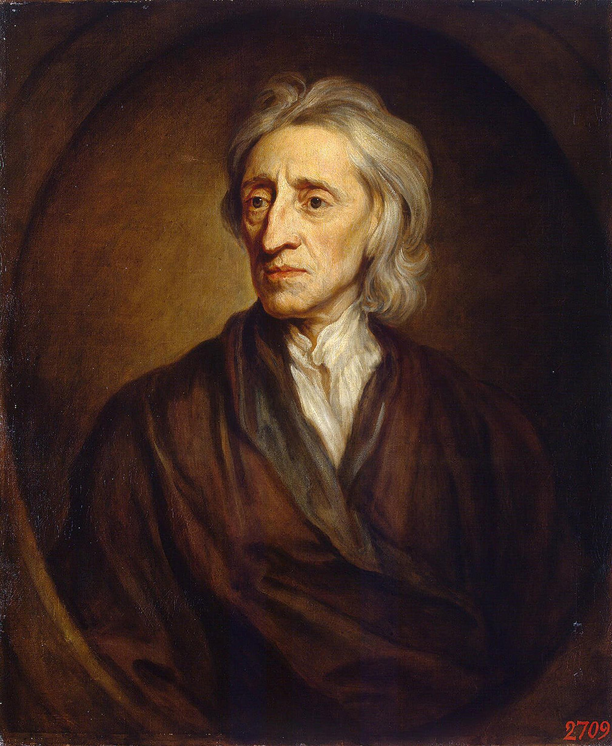
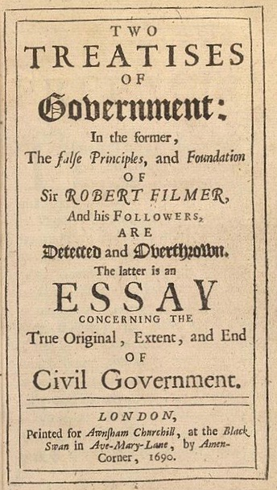
John Locke
(1632-1704)
The Second
Treatise of Government

Slide 16
The State of Nature
Dualism—accepted that mind and body are separate. Human beings are not just machines; but have free will.
Equality—human beings “should also be equal one amongst another without subordination or subjection"
Moral Law: “state of liberty, yet it is not a state of licence”
Abundant resources.
Not a state of war.
Still inconvenient enough to need a social contract.

Slide 17
Locke states the basic idea of social contract theory inherited from Hobbes:
TO understand political power right, and derive it from its original, we must consider, what state all men are naturally in, and that is, a state of perfect freedom to order their actions, and dispose of their possessions and persons, as they think fit, within the bounds of the law of nature, without asking leave, or depending upon the will of any other man.
(Locke 1690, The Second Treatise of Government, Chapter II, 4)

Slide 18
The state of nature is a state of equality:
A state also of equality, wherein all power and jurisdiction is reciprocal, no one having more than another; there being nothing more evident, than that creatures of the same species and rank, promiscuously born to all the same advantages of nature, and the use of the same faculties, should also be equal one amongst another without subordination or subjection, unless the lord and master of them all should, by any manifest declaration of his will, set one above another, and confer upon him, by an evident and clear appointment, an undoubted right to dominion and sovereignty.
(Locke 1690, The Second Treatise of Government, Chapter II, 4)

Slide 19
The state of nature is a state of liberty, but not licence:
But though this be a state of liberty, yet it is not a state of licence: though man in that state have an uncontroulable liberty to dispose of his person or possessions, yet he has not liberty to destroy himself, or so much as any creature in his possession, but where some nobler use than its bare preservation calls for it. The state of nature has a law of nature to govern it, which obliges everyone: and reason, which is that law, teaches all mankind, who will but consult it, that being all equal and independent, no one ought to harm another in his life, health, liberty, or possessions.
(Locke 1690, The Second Treatise of Government, Chapter II, 6)

Slide 20
In the state of nature every man has the right to punish an offender and be executioner of the law of nature.
And thus, in the state of nature, one man come by a power over another; but yet no absolute or arbitrary power, to use a criminal, when he has got him in his hands, according to the passionate heats, or boundless extravegency of his own will; but only to retribute him, so far as calm reason and conscience dictate, what is proportionate to his transgression, which is so much as may serve for reparation and restraint: for these two are the only reasons, why one man may lawfully do harm to another, which is that we call punishment. . . . And in the case, and upon this ground, every man hath a right to punish the offender, and be executioner of the law of nature.
(Locke 1690, The Second Treatise of Government, Chapter II, 8)

Slide 21
A social contract is still necessary as remedy for the inconveniences in the state of nature; but the ruler should not be an absolute monarch.
I easily grant, that civil government is the proper remedy for the inconveniencies of the state of nature, which must certainly be great, where men may be judges in their own case, since it is easy to be imagined, that he who was so unjust as to do his brother an injury, will scarce be so just as to condemn himself for it: but I shall desire those who make this objection, to remember, that absolute monarchs are but men; and if government is to be the remedy of these evils, which necessarily follow from men’s being judges in their own cases, and the state of nature is therefore not to be endured, I desire to know what kind of government that is, and how much better it is than the state of nature, where one man, commanding a multitude, has the liberty to be judge in his own case, and may do to all his subjects whatever he pleases, without the least liberty to any one to question or controul those who execute his pleasure?
(Locke 1690, The Second Treatise of Government, Chapter II, 13)

Slide 22
Natural liberty vs Civil liberty legitimate government requires consent
THE natural liberty of man is to be free from any superior power on earth, and not to be under the will or legislative authority of man, but to have only the law of nature for his rule. The liberty of man, in society, is to be under no other legislative power, but that established by consent, in the common-wealth; nor under the dominion of any will, or restraint of any law, but what that legislative shall enact, according to the trust put in it. . . .
(Locke 1690, The Second Treatise of Government, Chapter IV, 22)

Slide 23
On slavery:
This freedom from absolute, arbitrary power, is so necessary to, and closely joined with a man’s preservation, that he cannot part with it, but by what forfeits his preservation and life together: for a man, not having the power of his own life, cannot, by compact, or his own consent, enslave himself to any one, nor put himself under the absolute, arbitrary power of another, to take away his life, when he pleases. Nobody can give more power than he has himself; and he that cannot take away his own life, cannot give another power over it. . ..
This is the perfect condition of slavery, which is nothing else, but the state of war continued, between a lawful conqueror and a captive…
(Locke 1690, The Second Treatise of Government, Chapter IV, 23-24)

Slide 24
On private property: one takes property out of the commons and makes it one’s private property by mixing one’s labour with it.
Though the earth, and all inferior creatures, be common to all men, yet every man has a property in his own person: this no body has any right to but himself. The labour of his body, and the work of his hands, we may say, are properly his. Whatsoever then he removes out of the state that nature hath provided, and left it in, he hath mixed his labour with, and joined to it something that is his own, and thereby makes it his property. It being by him removed from the common state nature hath placed it in, it hath by this labour something annexed to it, that excludes the common right of other men: for this labour being the unquestionable property of the labourer, no man but he can have a right to what that is once joined to, at least where there is enough, and as good, left in common for others.
(Locke 1690, The Second Treatise of Government, Chapter V, 27)

Slide 25
On limits of private property: one cannot gather too much perishable goods that they spoil; one cannot enclose too much land that one cannot use:
But the chief matter of property being now not the fruits of the earth, and the beasts that subsist on it, but the earth itself; as that which takes in and carries with it all the rest; I think it is plain, that property in that too is acquired as the former. As much land as a man tills, plants, improves, cultivates, and can use the product of, so much is his property. He by his labour does, as it were, inclose it from the common. Nor will it invalidate his right, to say every body else has an equal title to it; and therefore he cannot appropriate, he cannot inclose, without the consent of all his fellow-commoners, all mankind. . . .
God gave the world to men in common; but since he gave it them for their benefit, and the greatest conveniencies of life they were capable to draw from it, it cannot be supposed he meant it should always remain common and uncultivated. He gave it to the use of the industrious and rational, (and labour was to be his title to it;) not to the fancy or covetousness of the quarrelsome and contentious. . . .
(Locke 1690, The Second Treatise of Government, Chapter V, 33-34)

Slide 26
On limits of private property:
But one can exchange perishable goods for gold and silver and thus acquire wealth:
But since gold and silver, being little useful to the life of man in proportion to food, raiment, and carriage, has its value only from the consent of men, whereof labour yet makes, in great part, the measure, it is plain, that men have agreed to a disproportionate and unequal possession of the earth, they having, by a tacit and voluntary consent, found out, a way how a man may fairly possess more land than he himself can use the product of, by receiving in exchange for the overplus gold and silver, which may be hoarded up without injury to any one; these metals not spoiling or decaying in the hands of the possessor. This partage of things in an inequality of private possessions, men have made practicable out of the bounds of society, and without compact, only by putting a value on gold and silver, and tacitly agreeing in the use of money: for in governments, the laws regulate the right of property, and the possession of land is determined by positive constitutions.
(Locke 1690, The Second Treatise of Government, Chapter V, 50)

Slide 27
The Social Contract:
Absolute monarchy inconsistent with civil society
Hence it is evident, that absolute monarchy, which by some men is counted the only government in the world, is indeed inconsistent with civil society, and so can be no form of civil-government at all: for the end of civil society, being to avoid, and remedy those inconveniences of the state of nature, which necessarily follow from every man’s being judge in his own case, by setting up a known authority, to which every one of that society may appeal upon any injury received. . . .
(Locke 1690, The Second Treatise of Government, Chapter VII, 90)

Slide 28
The Social Contract:
Government requires consent of the people
Every man being, as has been shewed, naturally free, and nothing being able to put him into subjection to any earthly power, but only his own consent; it is to be considered, what shall be understood to be a sufficient declaration of a man’s consent, to make him subject to the laws of any government. There is a common distinction of an express and a tacit consent. . . . The difficulty is, what ought to be looked upon as a tacit consent, and how far it binds. . . . And to this I say, that every man, that hath any possessions, or enjoyment, of any part of the dominions of any government, doth thereby give his tacit consent, and is as far forth obliged to obedience to the laws of that government. . . .. . . .
(Locke 1690, The Second Treatise of Government, Chapter VIII, 119)

Slide 29
The Social Contract:
The people have the right to change government if the government fails in protecting the rights to life, liberty, and property.
There is one way more whereby such a government may be dissolved, and that is, when he who has the supreme executive power, neglects and abandons that charge. . . . This is demonstratively to reduce all to anarchy, and so effectually to dissolve the government. . . .
In these and the like cases, when the government is dissolved, the people are at liberty to provide for themselves, by erecting a new legislative, differing from the other, by the change of persons, or form, or both, as they shall find it most for their safety and good.
(Locke 1690, The Second Treatise of Government, Chapter XIX, 219-220)

Slide 30
The Social Contract
Government requires consent of the people.
Purpose of the government is to protect individual rights to life, liberty, and property.
Against absolute power; the ruler is also subject to the law.
The people have the right to revolution, to change the government if the government fails to protect the rights of the people.

Slide 31
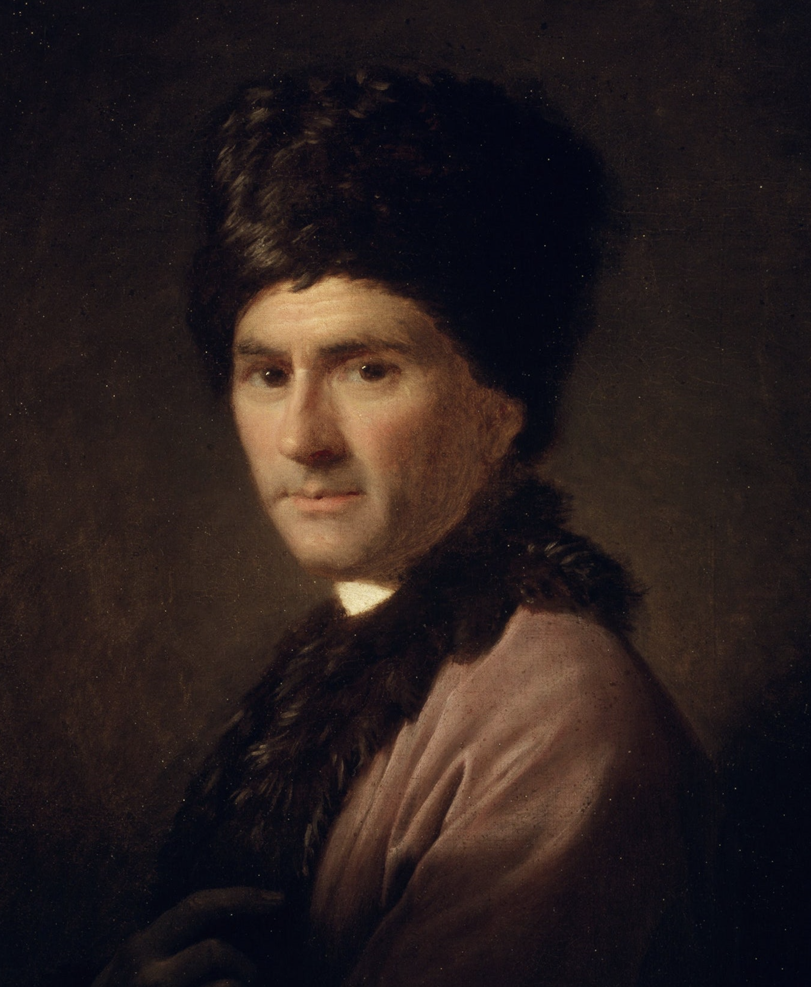

Jean-Jacques Rousseau
(1712-1778)
The Social
Contract

Slide 32
Critic of Civilization
Jean-Jacques Rousseau was an important writer, composer, and political philosopher. Although from Geneva, Switzerland, he was mostly active in France and exerted a great influence on the French Revolution, on the Enlightenment across Europe in his day, and on the movement known as Romanticism which would develop in the next century.
“Rousseau introduced three revolutionary ideas into the mainstream of Western philosophical thought which have played a role of immense importance ever since” (Magee 2001, 127).

Slide 33
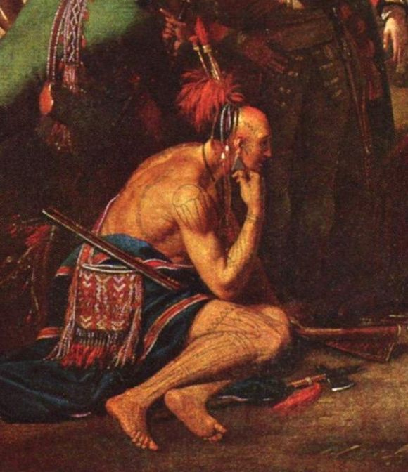
The Noble Savage
“The first is that civilization is not a good thing, as everyone had always assumed; and not even a value-neutral thing; but positively a bad thing” (Magee 2001, 127).
In the Discourse on the Origin of Inequality (1754) Rousseau conceives of man in the state of nature as a noble savage, one who naturally loves the good and who lives freely. In this text, Rousseau delivers a harsh judgment on modern society—it is society that corrupts this noble savage, creating an unnatural inequality based on power and wealth. He thought that it was modern society thus brings about a fall from happiness of the noble savage into misery of the modern man. This conception of the noble savage is purely a hypothetical and imaginative reconstruction, not based at all on historical fact or anthropological analysis, but is rather a philosophical fiction, conceived to illustrate Rousseau's conception of human nature.
A detail from Benjamin West's heroic, neoclassical history painting, The Death of General Wolfe (1771), depicting an idealized American Indian.

Slide 34
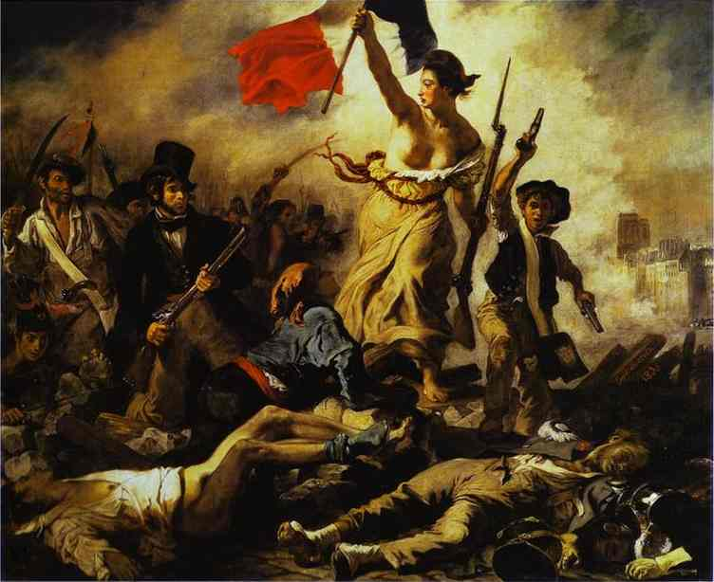
Romanticism
“The second is that we should ask of everything in our lives, whether our private or public lives, that it meet the requirements not of reason but of feeling and natural instincts: in other words, feelings should replace reason as our guide to life and our judge” (Magee 2001, 127).
This emphasis on feelings as the guide to life would have a great influence on the development of Romanticism. Rousseau’s novel Julie, ou la nouvelle Héloïse (1761) emphasized that one should trust one’s “secret principles” and feelings rather than rational moral principles. His novel Emile (1762) had a profound impact on education, emphasizing that education should not focus on repression and discipline of a child’s natural tendencies, but instead encourage their expression and development.
Liberty Leading the People
oil on canvas, Eugène Delacroix, 1830.
Musée du Louvre, Paris

Slide 35
The Social Contract
“The third is that a human society is a collective being with a will of its own that is different from the sum of the wills of its individual members, and that the citizen should be entirely subordinate to this ‘general will’” (Magee 2001, 127).
Rousseau’s idea is that what matters most in the social contract is not the protection of merely individual rights, as Locke had emphasized, but rather the good of the society, the common good. This idea, taken to one extreme, would influence Marx in the next century, and thus the development of socialist totalitarian governments in the 20th century; but it would also influence American founding fathers like Thomas Jefferson and John Adams who would emphasize the importance of the common good of the people.

Slide 36

Discourse on the Origin of Inequality
Rousseau’s concern in The Social Contract (1762) goes back to the central problem he faced in his earlier work, the Discourse on the Origin of Inequality (1754), Here he argues that the great inequities that divide rich and poor in civilized societies are really contrary to the laws of nature: "This is enough to determine what we ought to think, in this respect, of the kind of inequality that prevails in all civilized nations, because it is obviously contrary to the laws of nature, however it may be defined, for a child to command an old man, for an imbecile to lead a wise man, and for a handful of people to wallow in luxury while the starving multitude lacks the necessities of life" (Rousseau, 1974, 201).
Rousseau, Jean-Jacques. 1974. Discourse on the Origin of Inequality in The Essential Rousseau, Lowell Bair trans. New York: Penguin Books.

Slide 37
Discourse on the Origin of Inequality
Toward the end of the Discourse on the Origin of Inequality, Rousseau criticizes Locke's version of the social contract as something of a great swindle pulled off by the rich and powerful who obviously have the most to gain from a social contract that is designed primarily to protect private property. Thus, the inequalities between rich and poor already established by hook or crook become, by social contract, entitlements protected by law. In Locke's version of the social contract, as Rousseau famously put it: “All ran headlong to their chains, in hopes of securing their liberty” (Rousseau, 2005, 292). A society based solely on self-interest leaves man still in chains. Rousseau continues: "Such, was, or may well have been, the origin of society and law, which bound new fetters on the poor, and gave new powers to the rich; which irretrievably destroyed natural liberty, eternally fixed the law of property and inequality, converted clever usurpation into unalterable right, and, for the advantage of a few ambitious individuals, subjected all mankind to perpetual labor, slavery, and wretchedness" (Rousseau, 2005, 292).
Rousseau, Jean-Jacques. 2005. Discourse on the Origin of Inequality in Political Philosophy: The Essential Texts, Stephen M. Cahn ed. Oxford: Oxford University Press.

Slide 38
The Social Contract
"Man is born free, and everywhere he is in chains.”
This opening line of The Social Contract is one of the most famous opening lines of all time. This defines the problem of politics for Rousseau: how can we have a government that preserves our freedom instead of leaving people still in chains as he thought Locke’s social contract did? Rousseau’s conception of the social contract is quite complex; on the one hand, it was concerned primarily with the problem of freedom, with conceiving a form of government that protected the liberty and rights of all citizens. The solution, for Rousseau, was a social contract that did more than protect merely private interests. Are there ever laws that are necessary to protect the public good?

Slide 39
On Slavery
To renounce liberty is to renounce being a man, to surrender the rights of humanity and even its duties. For him who renounces everything no indemnity is possible. Such a renunciation is incompatible with man's nature; to remove all liberty from his will is to remove all morality from his acts. Finally, it is an empty and contradictory convention that sets up, on the one side, absolute authority, and, on the other, unlimited obedience. . . .
So, from whatever aspect we regard the question, the right of slavery is null and void, not only as being illegitimate, but also because it is absurd and meaningless. The words slave and right contradict each other, and are mutually exclusive.
Rousseau, Jean-Jacques. 2005. The Social Contract in Political Philosophy: The Essential Texts, Stephen M. Cahn ed. Oxford: Oxford University Press.

Slide 40
The Problem
"The problem is to find a form of association which will defend and protect with the whole common force the person and goods of each associate, and in which each, while uniting himself with all, may still obey himself alone, and remain as free as before." This is the fundamental problem of which the Social Contract provides the solution.
Rousseau, Jean-Jacques. 2005. The Social Contract in Political Philosophy: The Essential Texts, Stephen M. Cahn ed. Oxford: Oxford University Press.

Slide 41
The Solution
Finally, each man, in giving himself to all, gives himself to nobody; and as there is no associate over whom he does not acquire the same right as he yields others over himself, he gains an equivalent for everything he loses, and an increase of force for the preservation of what he has.
If then we discard from the social compact what is not of its essence, we shall find that it reduces itself to the following terms:
"Each of us puts his person and all his power in common under the supreme direction of the general will, and, in our corporate capacity, we receive each member as an indivisible part of the whole."
Rousseau, Jean-Jacques. 2005. The Social Contract in Political Philosophy: The Essential Texts, Stephen M. Cahn ed. Oxford: Oxford University Press.

Slide 42
The Solution
In order then that the social compact may not be an empty formula, it tacitly includes the undertaking, which alone can give force to the rest, that whoever refuses to obey the general will shall be compelled to do so by the whole body. This means nothing less than that he will be forced to be free; for this is the condition which, by giving each citizen to his country, secures him against all personal dependence. In this lies the key to the working of the political machine; this alone legitimises civil undertakings, which, without it, would be absurd, tyrannical, and liable to the most frightful abuses.
Rousseau, Jean-Jacques. 2005. The Social Contract in Political Philosophy: The Essential Texts, Stephen M. Cahn ed. Oxford: Oxford University Press.

Slide 43
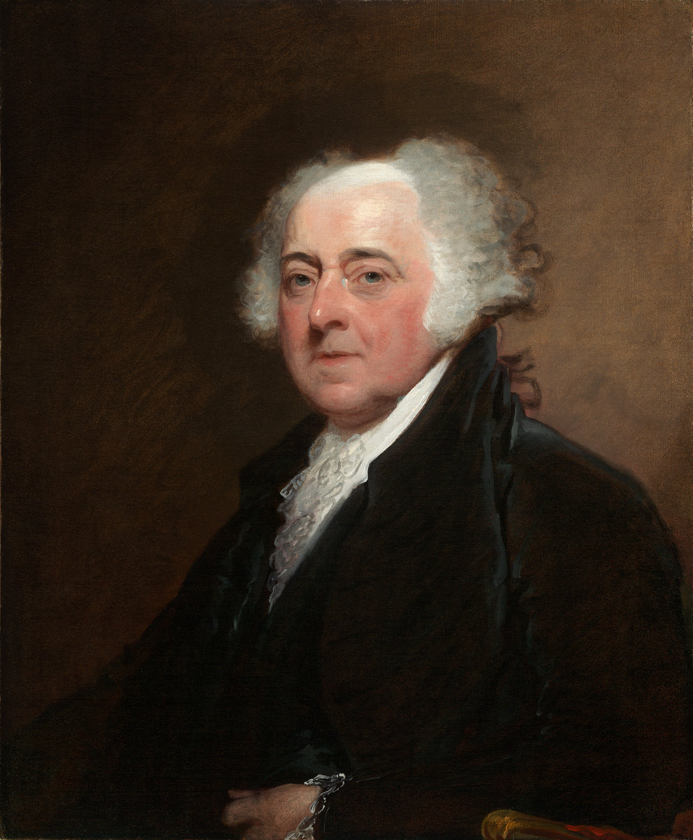
John Adams
Government is instituted for the common good, for the protection, safety, prosperity, and happiness of the people, and not for the profit, honor, or private interest of any one man, family, or class of men; therefore, the people alone have an incontestable, unalienable, and indefeasible right to institute government, and to reform, alter, or totally change the same when their protection, safety, prosperity, and happiness require it.
Thoughts on Government, 1776.

