Slide 1
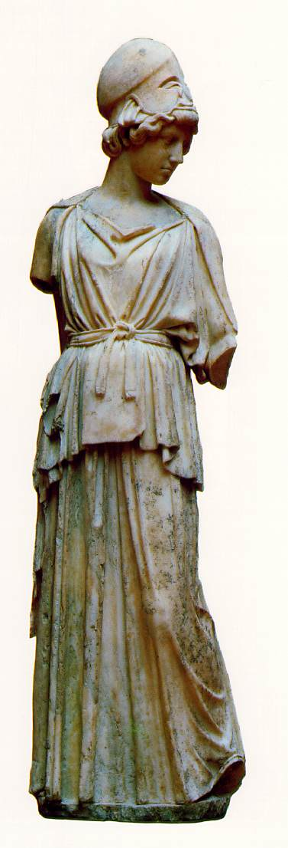
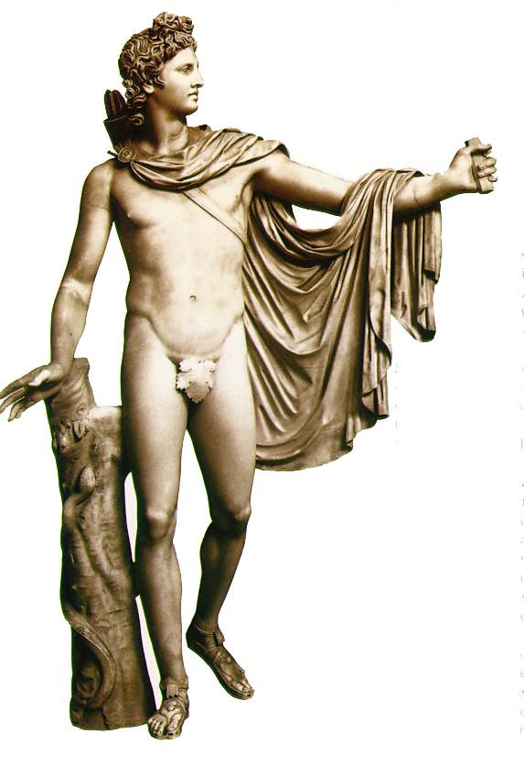
Apollonian sculpture
Athena
Apollo

Slide 2
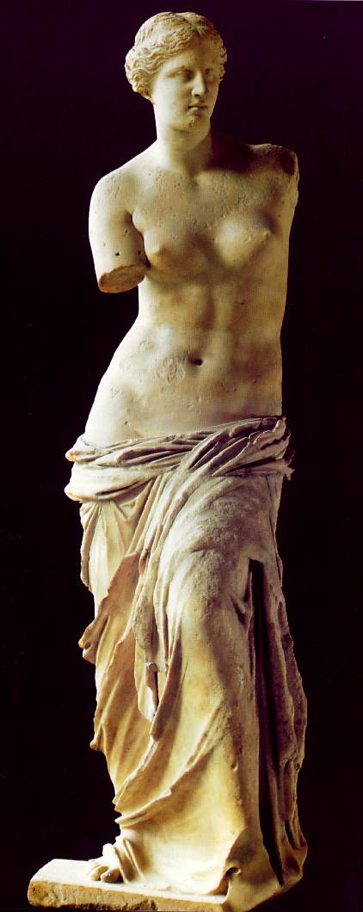
Venus de Milo

Slide 3
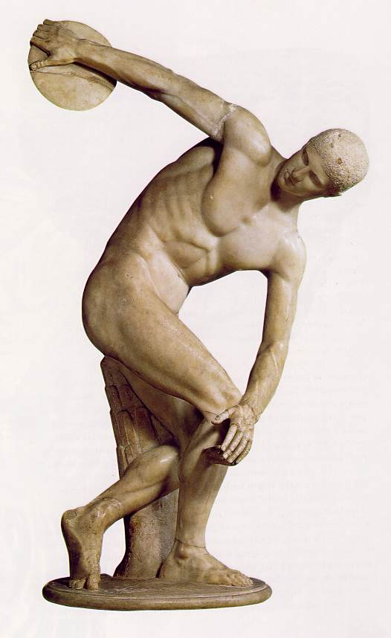
The Diskobolus of Myron

Slide 4
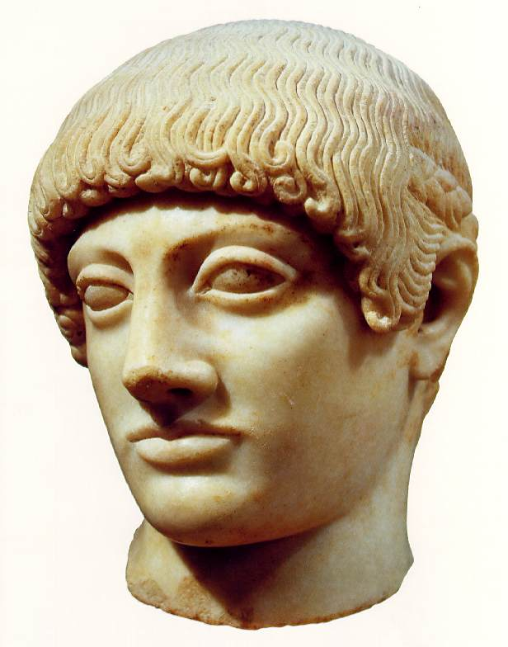
Head of Blond Ephebe (youth)

Slide 5
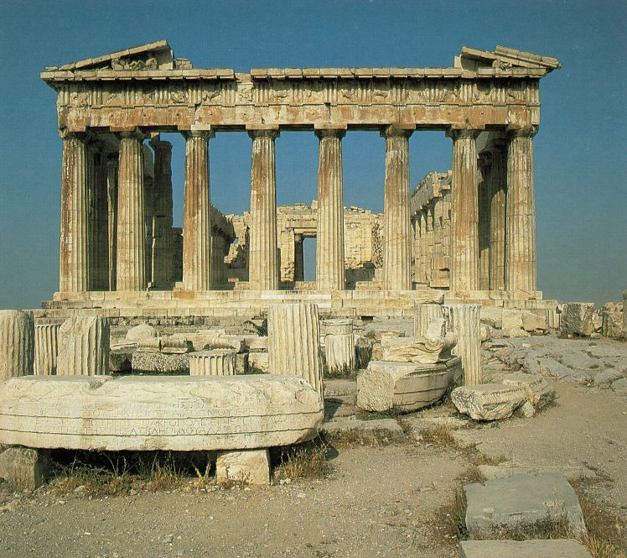
The Parthenon

Slide 6
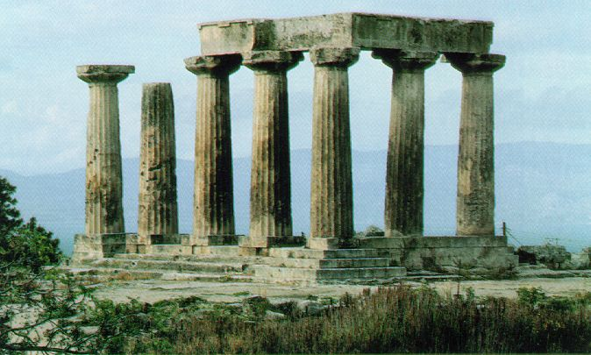
Temple of Apollo at Corinth

Slide 7
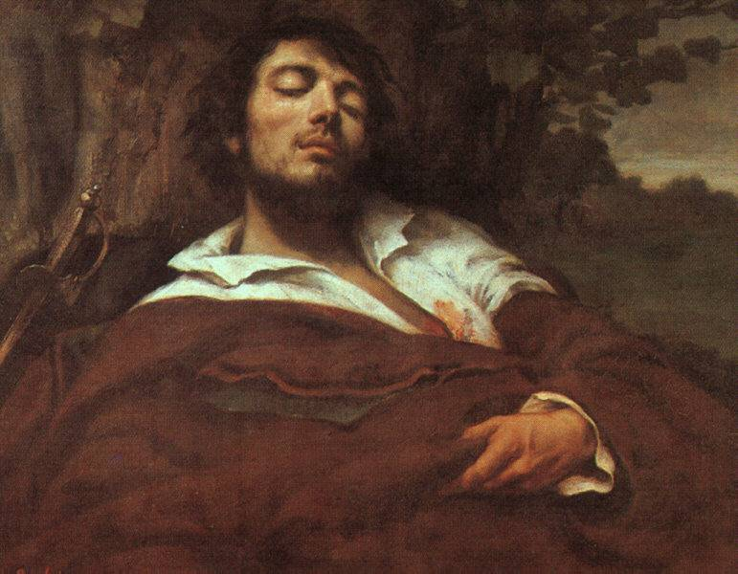
Gustave Courbet. Portrait of the Artist, called
"The Wounded Man”. 1844-54.
Oil on canvas. 31 7/8 x 38 1/4 in (81 x 7 cm)
Musee d'Orsay, Paris

Slide 8
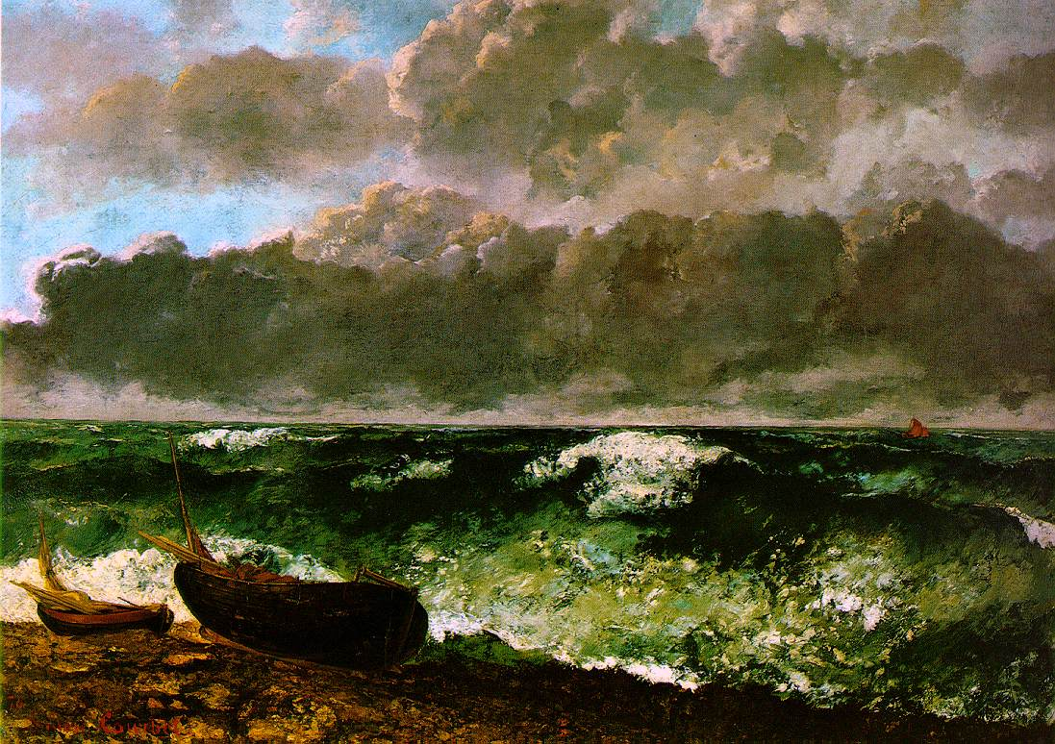
Gustave Courbet. The Stormy Sea (or The Wave). 1869.
Oil on canvas, 3' 10" x 5' 3 1/2" (117 x 160.5 cm). Musee d'Orsay, Paris

Slide 9
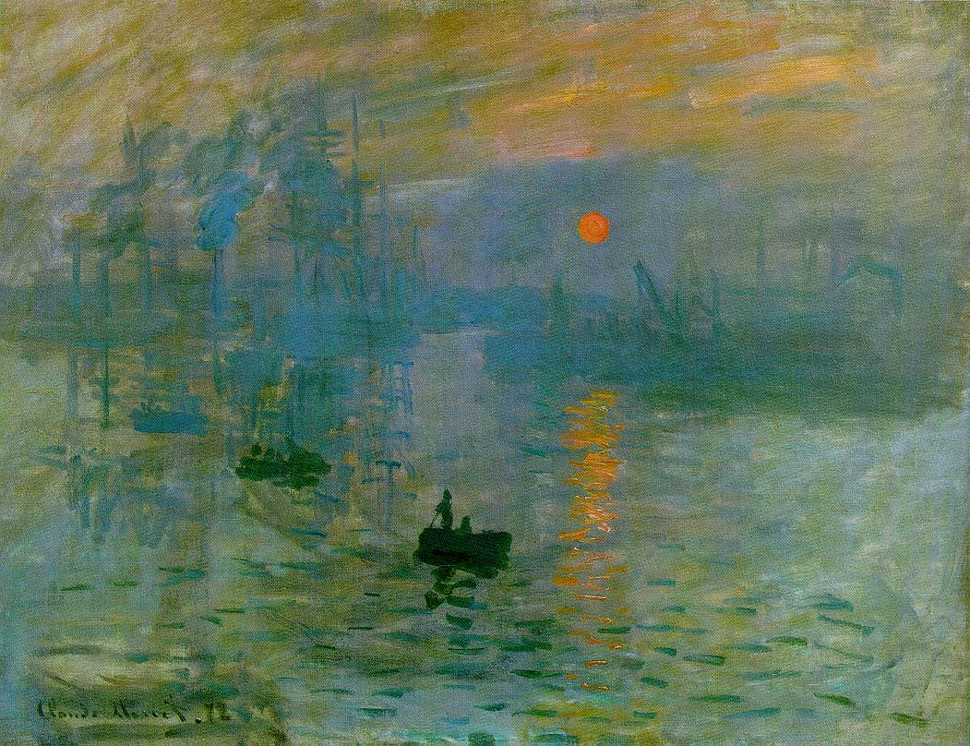

Slide 10
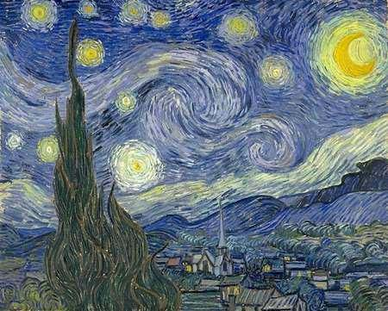

Slide 11
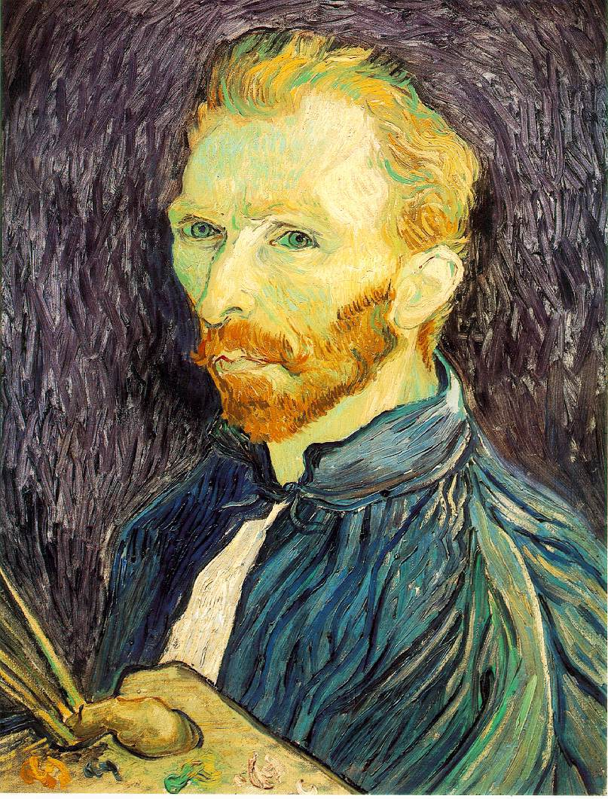

Slide 12
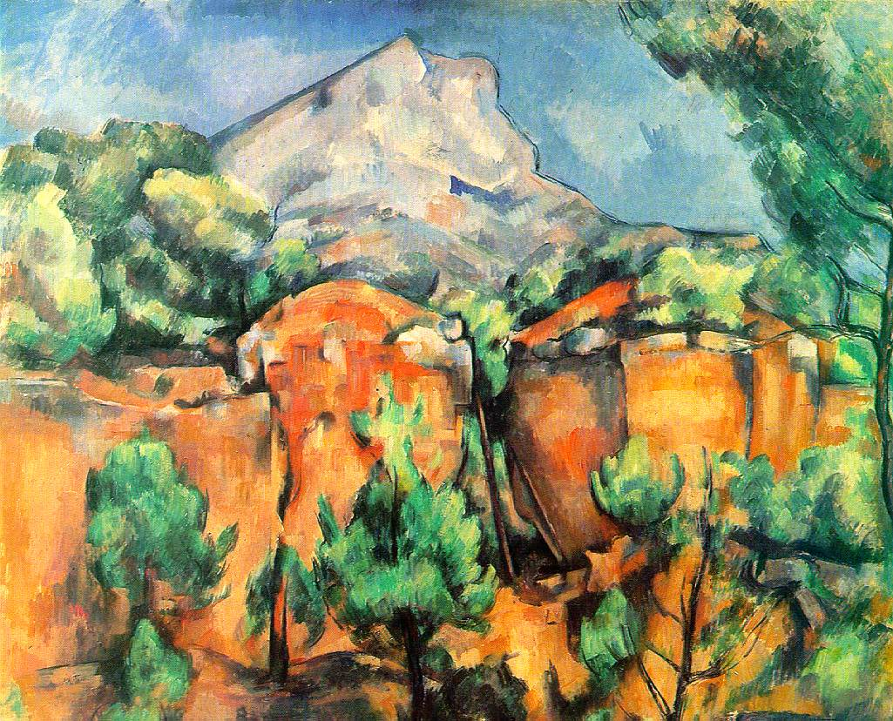

Slide 13
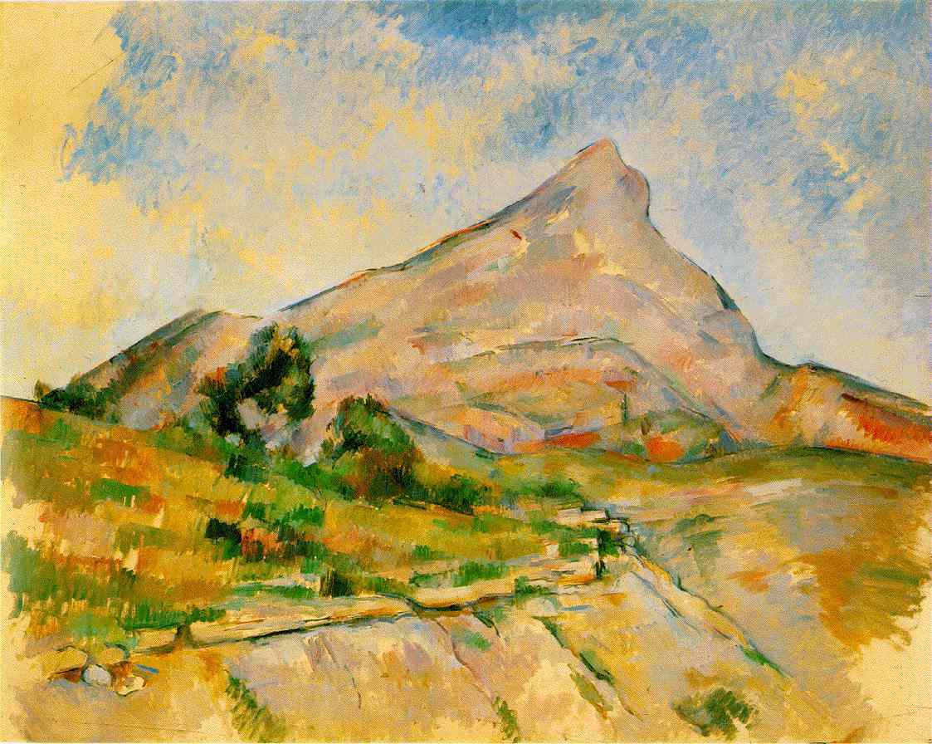

Slide 14
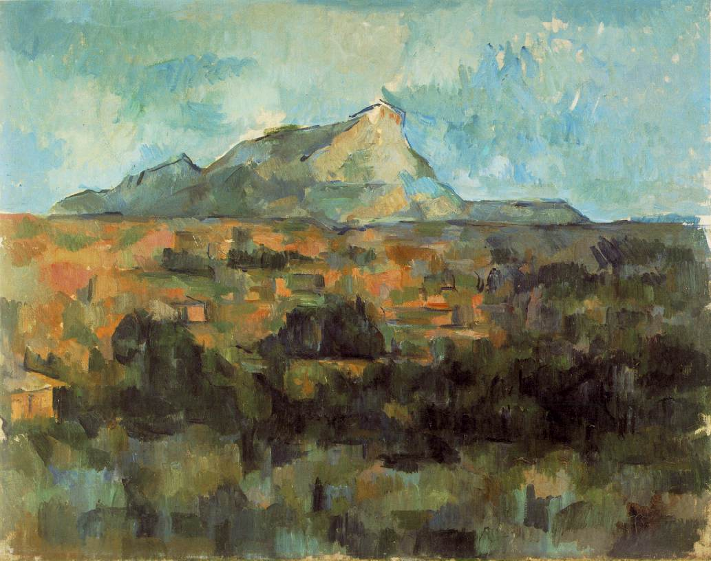

Slide 15
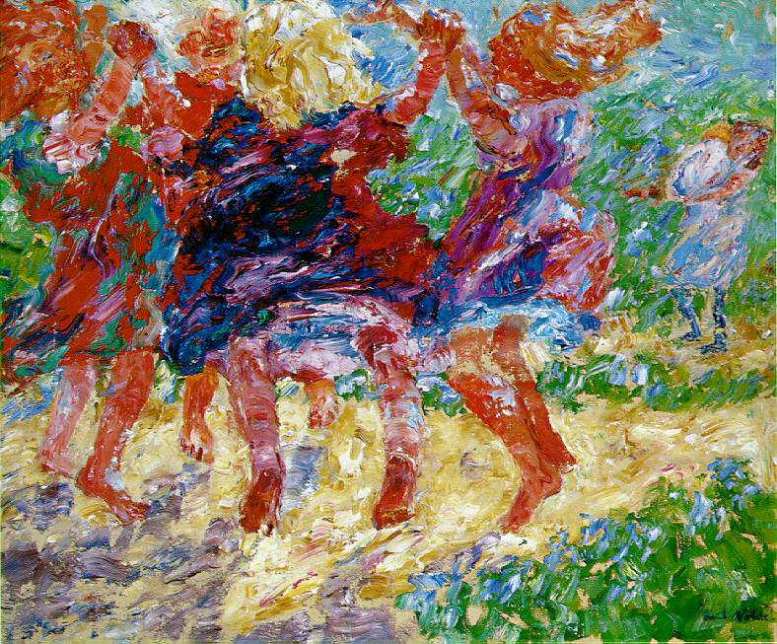

Slide 16
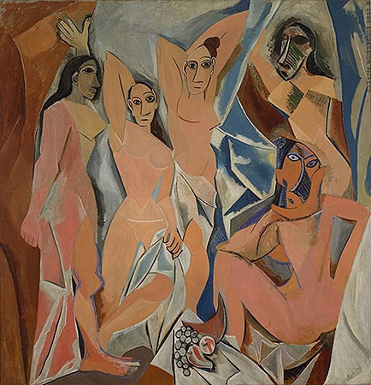

Slide 17
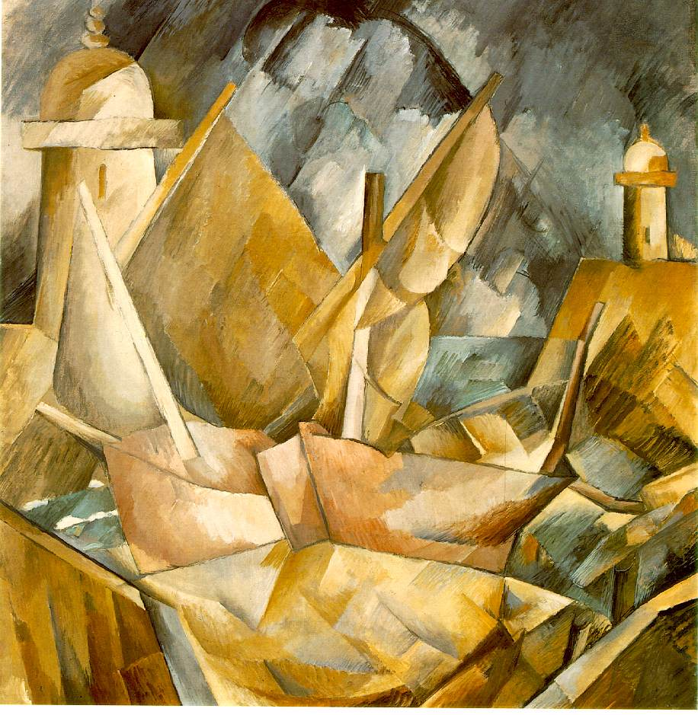

Slide 18
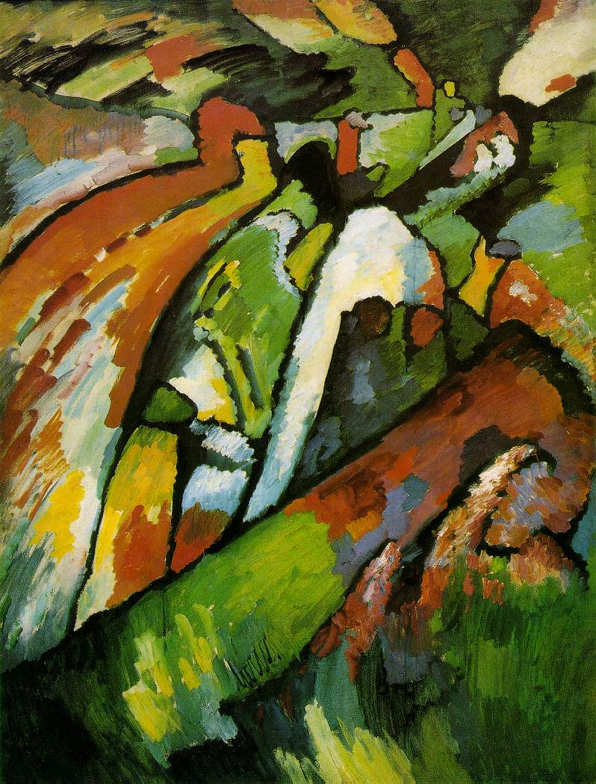

Slide 19
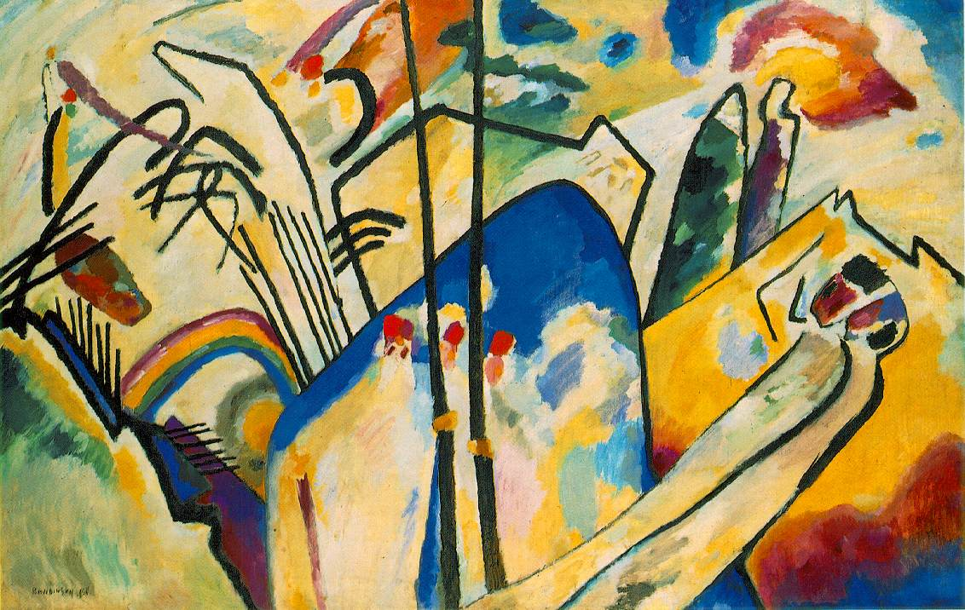

Slide 20
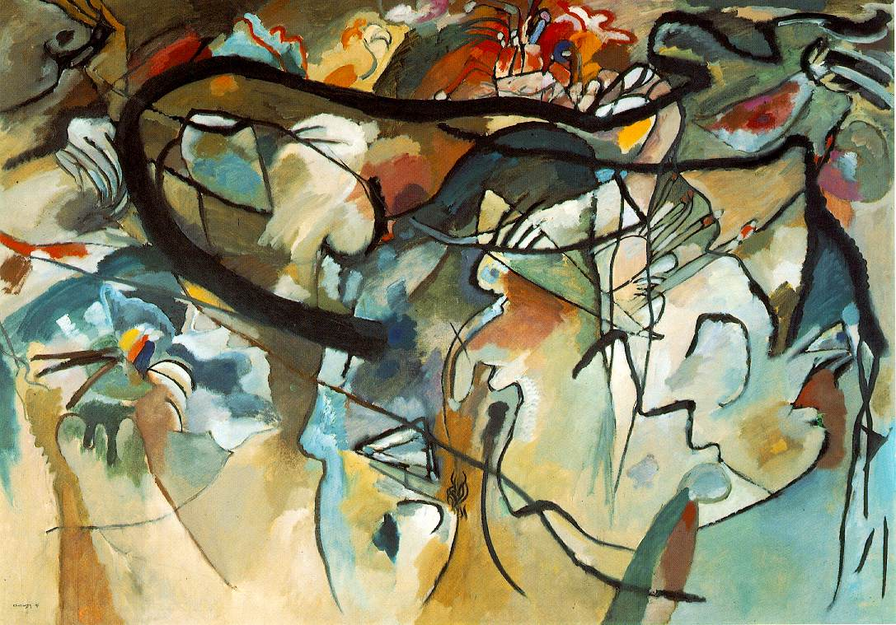

Slide 21
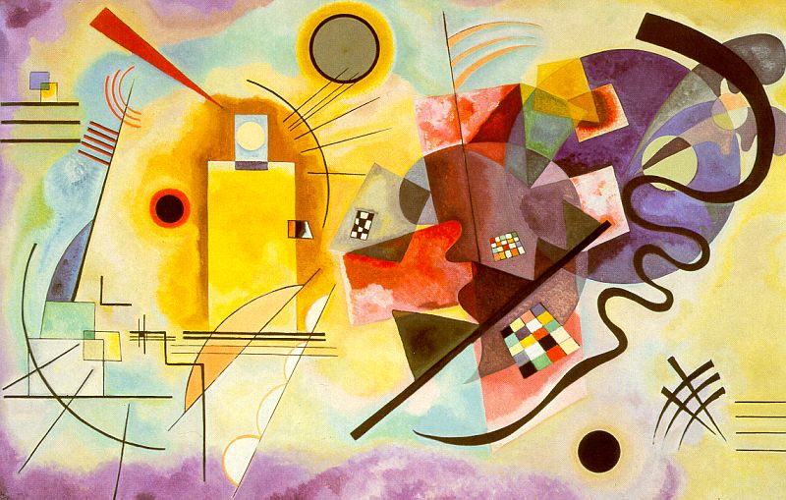

Slide 22
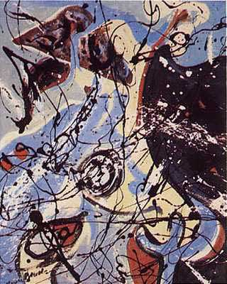
Compostion,
Jackson Pollock, 1946

Slide 23
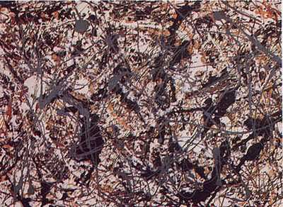

Slide 24
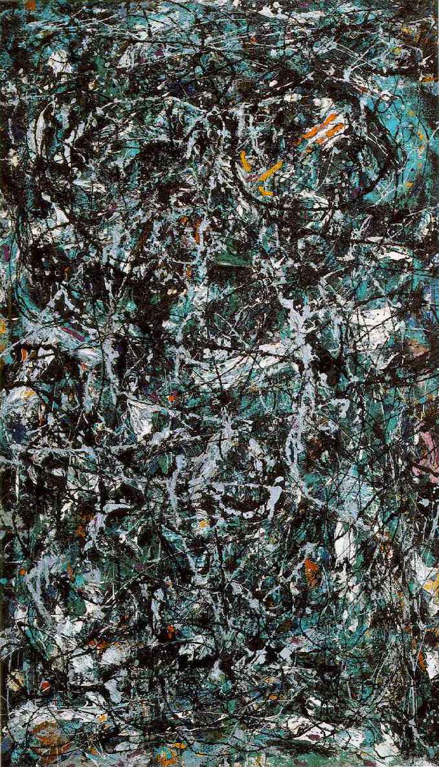

Slide 25
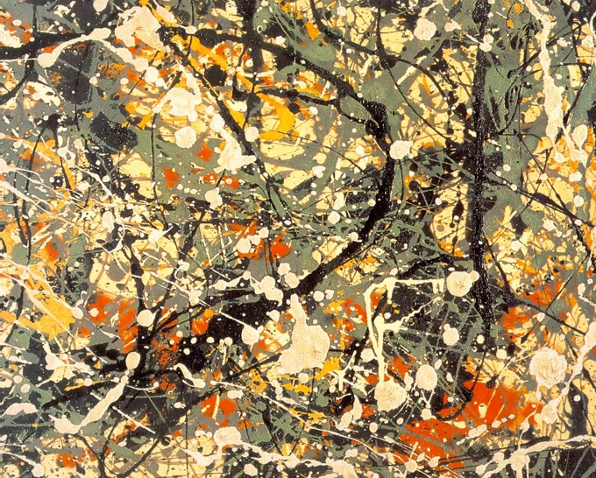

Slide 26
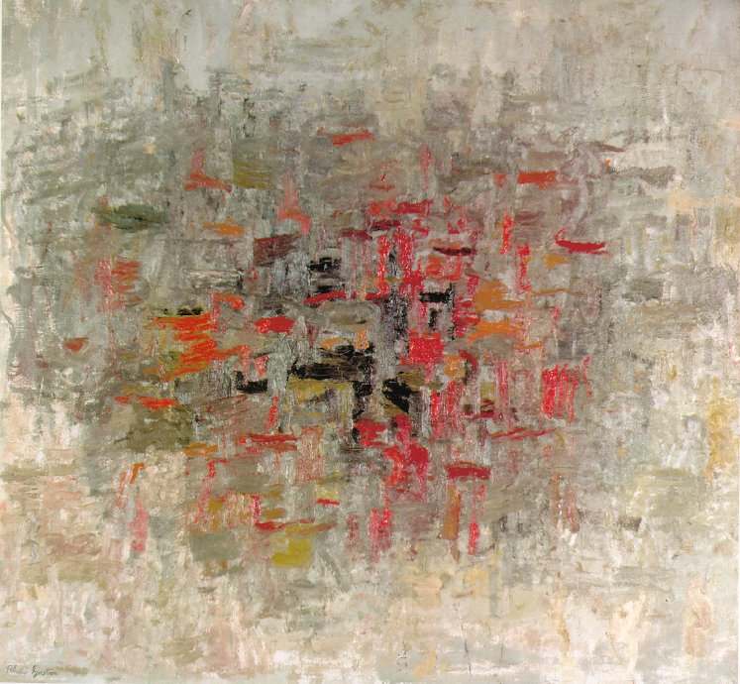
To B.W.T. Philip Guston, 1952

Slide 27
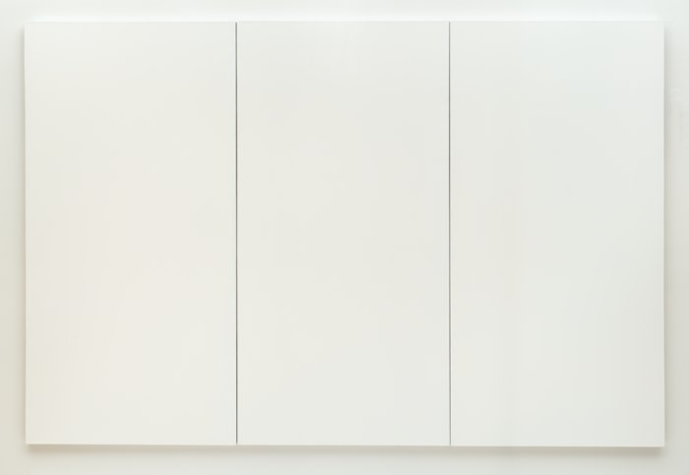

Slide 28
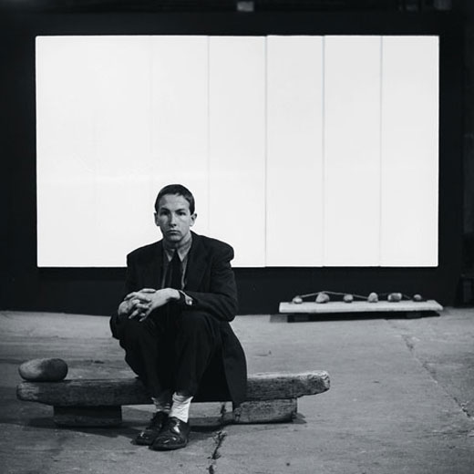

Slide 29
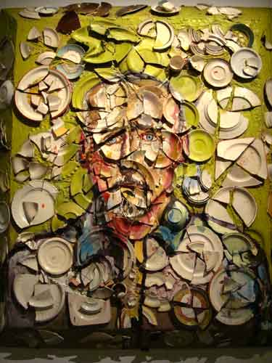

Slide 30
