Slide 1
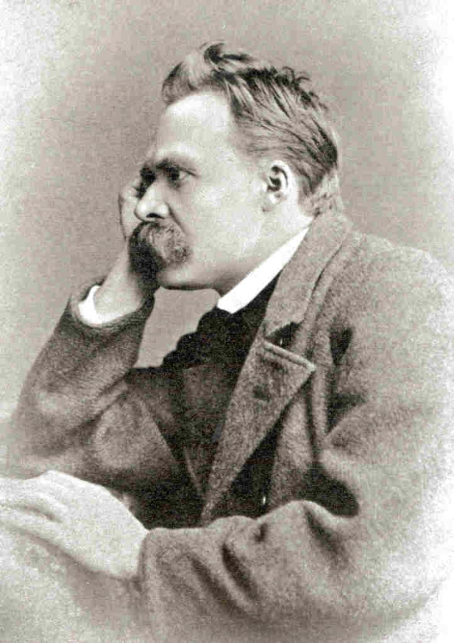
Why
Nietzsche?

Slide 2
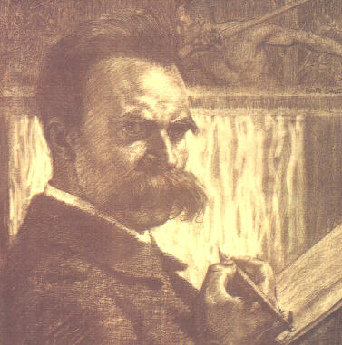
“Have
I
been
understood?”

Slide 3
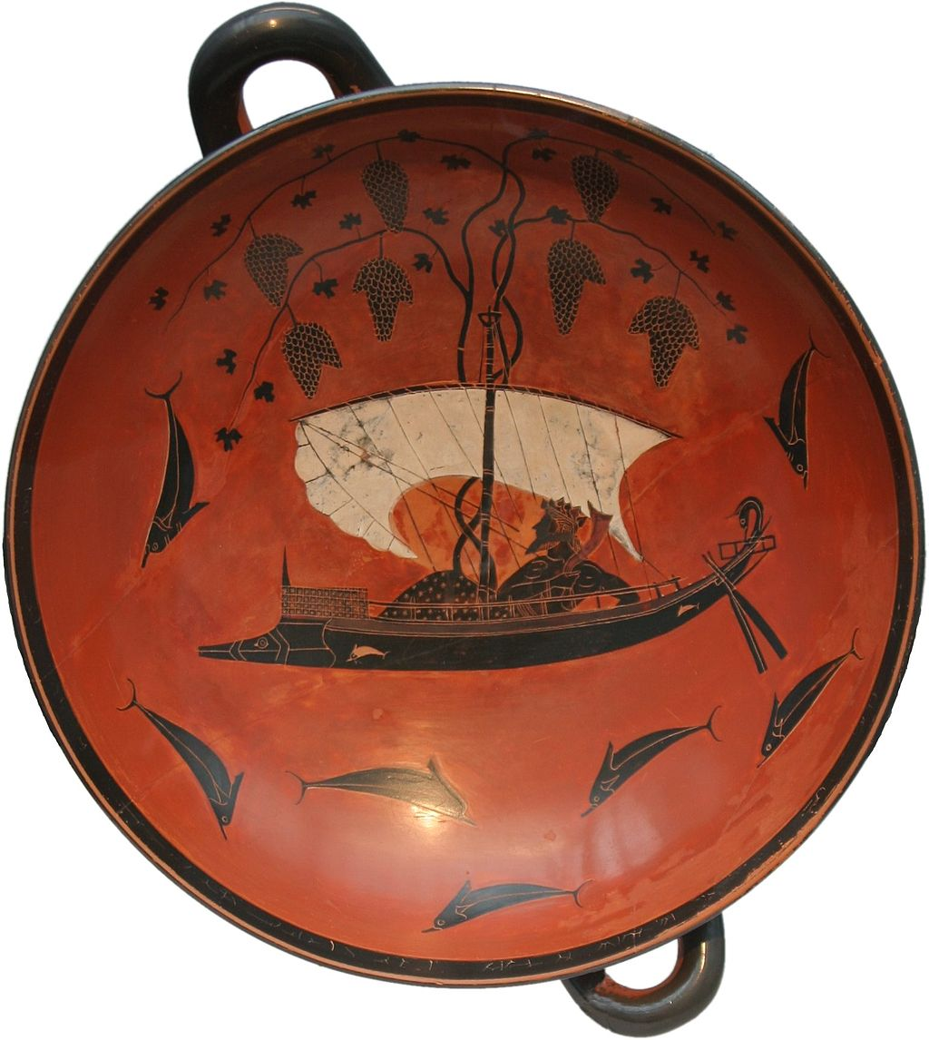
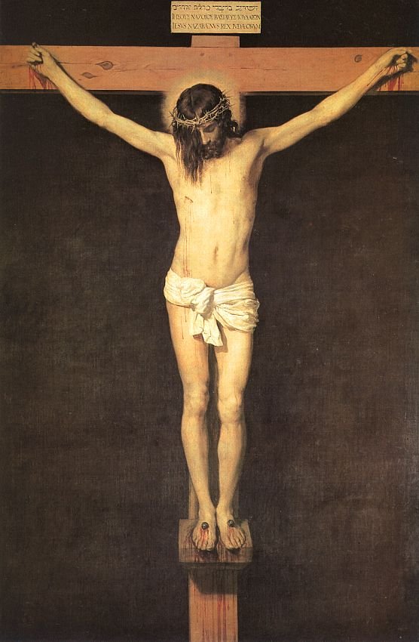
Have I been understood?—Dionysus versus the Crucified.
(Nietzsche, Ecce Homo, “Why I am a Destiny,” §9)
Dionysos Kylix, Exekias, ca. 530 B.C.E.
Christ on the Cross, Velazquez, 1632

Slide 4
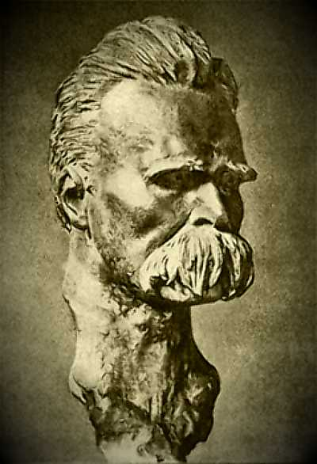
“Out of life's school of war: What does not destroy me, makes me stronger!”
Twilight of the Idols,
“Maxims and Arrows” §8

Slide 5
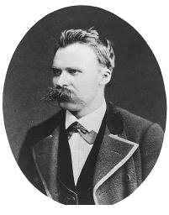
“He who has a why to live for can bear almost any how.”
Twilight of the Idols, “Maxims and Arrows” §12

Slide 6
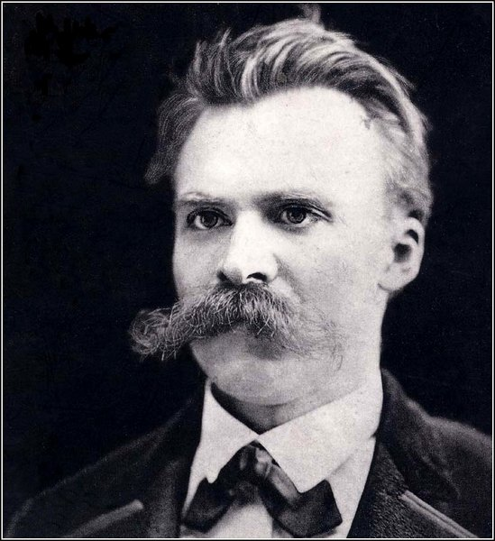
“Convictions are more dangerous enemies of truth than lies.”
Human, All Too Human, §483

Slide 7
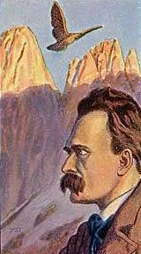
“For believe me: the secret for harvesting from existence the greatest fruitfulness and the greatest enjoyment is—
to live dangerously! Build your cities on the slopes of Vesuvius!”
The Gay Science §283

Slide 8
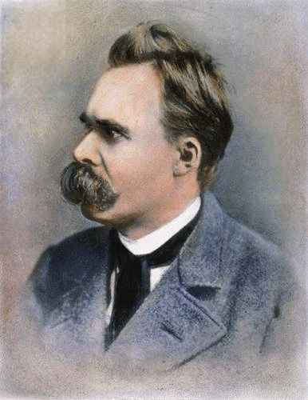
“I say unto you: One must still have chaos in oneself to give birth to a dancing star.”
Thus Spoke Zarathustra, Prologue, §5

Slide 9
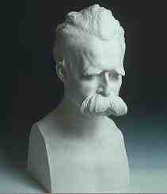
“Terrible it is to be alone with the judge and avenger of one's own law. Thus is a star thrown out into the void and into the icy breath of solitude...”
Thus Spoke Zarathustra, Pt. I,
“On the Way of the Creator”

Slide 10
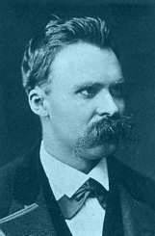
“One repays a teacher badly if one always remains nothing but a pupil....”
Thus Spoke Zarathustra, Pt. I,
“On the Gift-Giving Virtue” §3

Slide 11
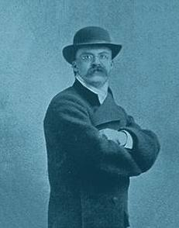
“Whoever fights monsters should see to it that in the process he does not become a monster. And when you look into the abyss, the abyss also looks into you.”
Beyond Good and Evil §146

Slide 12
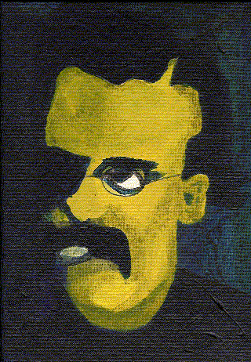
“Which is it, is man one of God's blunders or is God one of man's?”
Nietzsche
Twilight of the Idols
“Maxims and Arrows” §7

Slide 13
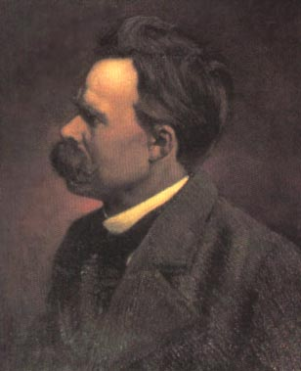
“Whoever praises him as a god of love does not have a high enough opinion of love.”
Thus Spoke Zarathustra,
Pt. IV, “Retired”

Slide 14
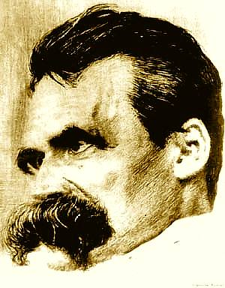
“God is Dead”
“New struggles.—After Buddha was dead, his shadow was still shown for centuries in a cave—a tremendous, gruesome shadow. God is dead; but given the way of men, there may still be caves for thousands of years in which his shadow will be shown.—And we—we still have to vanquish his shadow, too.”
The Gay Science §108

Slide 15
The madman. —Have you not heard of that madman who lit a lantern in the bright morning hours, ran to the market place, and cried incessantly: "I seek God! I seek God!" —As many of those who did not believe in God were standing around just then, he provoked much laughter. Has he got lost? asked one. Did he lose his way like a child? asked another. Or is he hiding? Is he afraid of us? Has he gone on a voyage? emigrated? —Thus they yelled and laughed.
The madman jumped into their midst and pierced them with his eyes. "Whither is God?" he cried; "I will tell you. We have killed him—you and I. All of us are his murderers. But how did we do this? How could we drink up the sea? Who gave us the sponge to wipe away the entire horizon? What were we doing when we unchained this earth from its sun? Whither is it moving now? Whither are we moving? Away from all suns? Are we not plunging continually? Backward, sideward, forward, in all directions? Is there still any up or down? Are we not straying as through an infinite nothing? Do we not feel the breath of empty space? Has it not become colder? Is not night continually closing in on us? Do we need to light lanterns in the morning? So we hear nothing as yet of the noise of the gravediggers who are burying God? Do we smell nothing as yet of the divine decomposition? Gods, too, decompose. God is dead. God remains dead. And we have killed him.
"How shall we comfort ourselves, the murderers of all murderers? What was the holiest and mightiest of all that the world has yet owned has bled to death under our knives: who will wipe this blood off us? What water is there for us to clean ourselves? What festivals of atonement, what sacred games shall we have to invent? Is not the greatness of this deed too great for us? Must we ourselves not become gods simply to appear worthy of it? There has never been a greater deed; and whoever is born after us—for the sake of this deed he will belong to a higher history than all history hitherto."
Here the madman fell silent and looked again at his listeners; and they, too, were silent and stared at him in astonishment. At last he threw his lantern on the ground, and it broke into pieces and went out. "I have come to early," he said then; "my time is not yet. The tremendous event is still on its way, still wandering; it has not yet reached the ears of men. Lightning and thunder require time; the light of the stars requires time; deeds, though done, still require time to be seen and heard. This deed is still more distant from them than the most distant stars—and yet they have done it themselves." (The Gay Science §125)

Slide 16
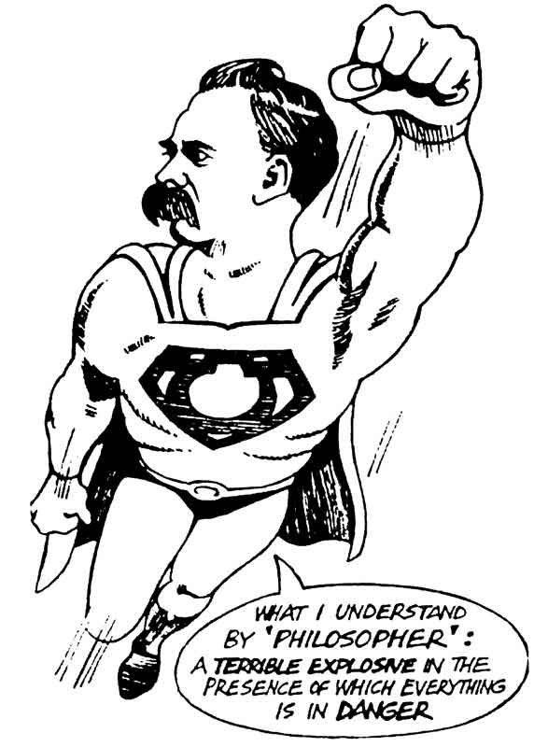
“I teach you the
Superman.”
Thus Spoke Zarathustra, Prologue § 3

Slide 17
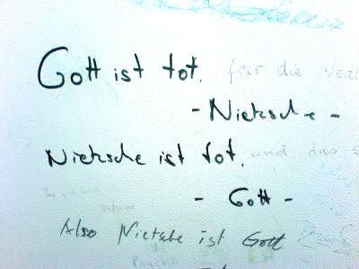

Slide 18
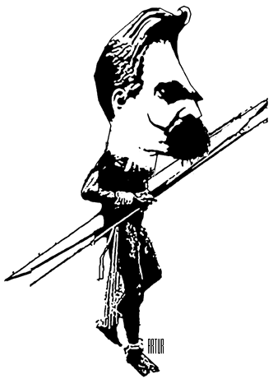
“some are born posthumously”
Posthumous people—like me, for example—are less well understood than timely ones, but better heard. More strictly: we are never understood—and hence our authority . . .
Twilight of the Idols, “Maxims and Arrows” §15

Slide 19
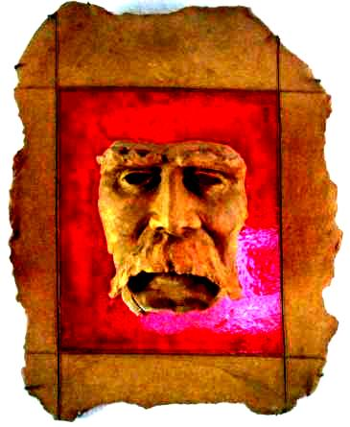
“Everything profound loves a mask. . . . Every profound spirit needs a mask: even more, around every profound spirit a mask is growing continually, owing to the constantly false, namely shallow, interpretation of every word, every step, every sign of life he gives”
Beyond Good and Evil §40

Slide 20
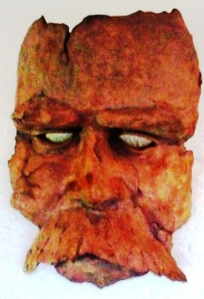
The hermit does not believe that any philosopher—assuming that every philosopher was first of all a hermit—ever expressed his real and ultimate opinions in books: does one not write books precisely to conceal what one harbors? Indeed, he will doubt whether a philosopher could possibly have "ultimate and real" opinions, whether behind every one of his caves there is not, must not be, another deeper cave—a more comprehensive, stranger, richer world beyond the surface, an abysmally deep ground behind every ground, under every attempt to furnish "grounds." Every philosophy is a foreground philosophy—that is a hermit's judgment: "There is something arbitrary in his stopping here to look back and look around, in his not digging deeper here but laying his spade aside; there is something suspicious about it." Every philosophy also conceals a philosophy; every opinion is also a hideout, every word also a mask.
Beyond Good and Evil §289

Slide 21
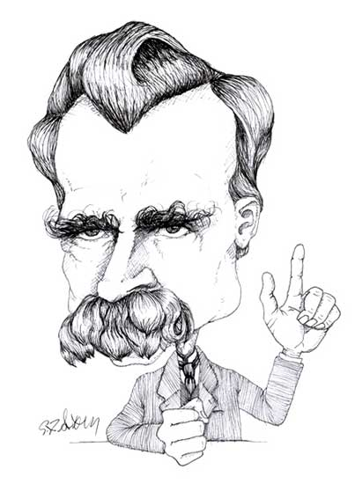
“Seeing that before long I must confront humanity with the most difficult demand ever made of it, it seems indispensable to me to say who I am. Really, one should know it, for I have not left myself "without testimony." But the disproportion between the greatness of my task and the smallness of my contemporaries has found expression in the fact that one has neither heard nor even seen me. I live on my own credit; it is perhaps a mere prejudice that I live.
I only need to speak with one of the "educated" who come to the Upper Engadine for the summer, and I am convinced that I do not live.
Under these circumstances I have a duty against which my habits, even more the pride of my instincts, revolt at bottom—namely, to say: Hear me! For I am such and such a person. Above all, do not mistake me for someone else!”
Ecce Homo, Preface 1

Slide 22
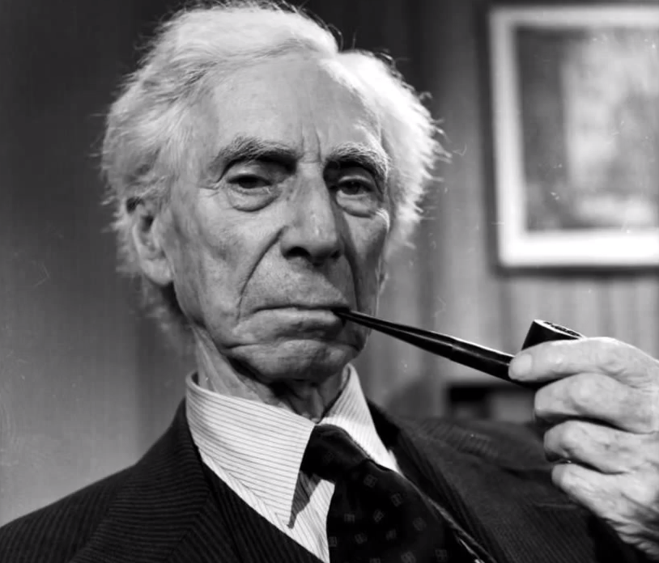
Bertrand Russell on
Nietzsche
His general outlook remained very similar to that of Wagner in the Ring; Nietzsche’s superman is very like Siegfried, except that he knows Greek. This may seem odd, but that is not my fault. . . . There is a great deal in Nietzsche that must be dismissed as merely megalomaniac… It is obvious that in his day-dreams he is a warrior, not a professor; all the men he admires were military. His opinion of women, like every man’s, is an objectification of his own emotion towards them, which is obviously one of fear. “Forget not thy whip”–but nine women out of ten would get the whip away from him, and he knew it, so he kept away from women, and soothed his wounded vanity with unkind remarks.

Slide 23
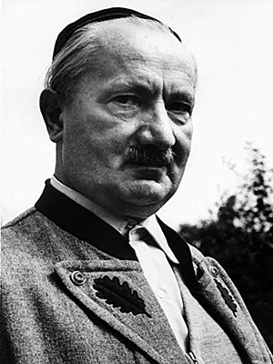
Martin
Heidegger

Slide 24
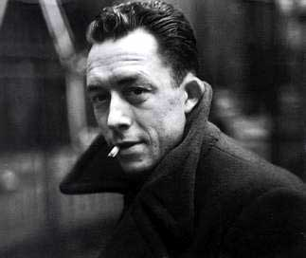
Albert
Camus

Slide 25
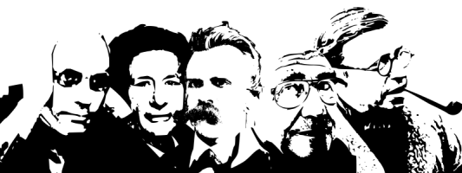
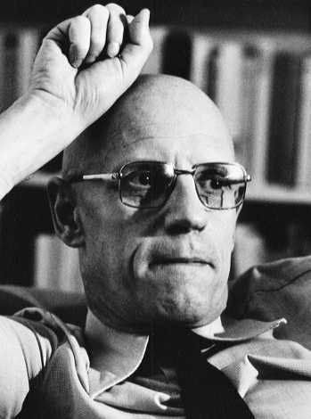
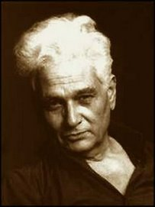
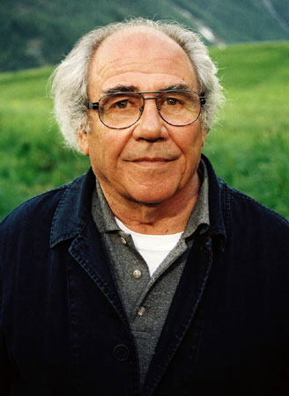
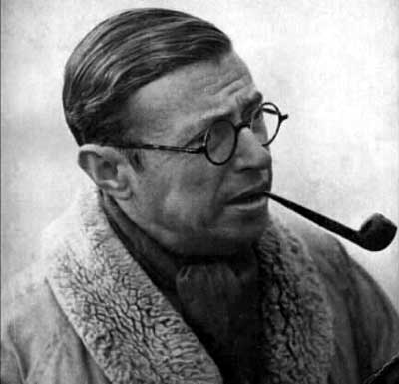
Michel Foucault (1926-1984)
Jacques Derrida
(1930-2004)
Jean Baudrillard
(1929 – 2007)
Jean-Paul Sartre
(1905-1980)

Slide 26
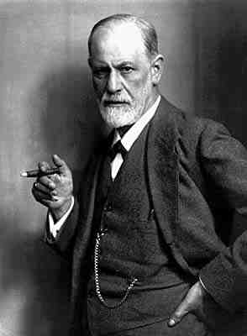
“Nietzsche had more penetrating knowledge of himself than any man who ever lived or was likely to live."
Sigmund Freud (1856-1939)

Slide 27

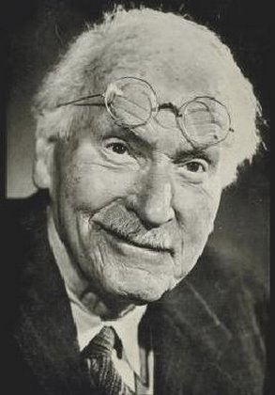

Slide 28
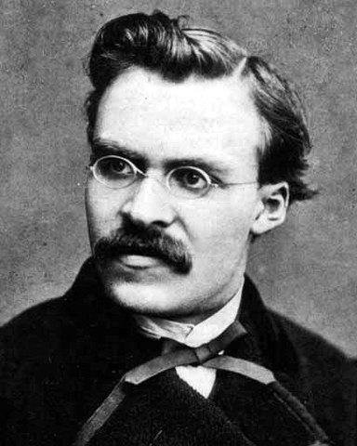
“We are unknown to ourselves, we men of knowledge —and with good reason. We have never sought ourselves—how could it happen that we should ever find ourselves.”
On the Genealogy of Morals, Preface

Slide 29
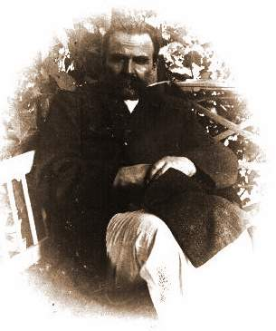
“Long experience, acquired in the course of such wanderings in what is forbidden, taught me to regard the causes that so far have prompted moralizing and idealizing in a very different light from what may seem desirable: the hidden history of the philosophers, the psychology of the great names came to light for me.”
Ecce Homo Preface §3

Slide 30
Gradually it has become clear to me what every great philosophy so far has been: namely, the personal confession of its author and a kind of involuntary and unconscious memoir; also that the moral (or immoral) intentions in every philosophy constituted the real germ of life from which the whole plant had grown.
Indeed, if one would explain how the abstrusest metaphysical claims of a philosopher really came about, it is always well (and wise) to ask first: at what morality does all this (does he) aim? Accordingly, I do not believe that a "drive to knowledge" is the father of philosophy, but rather that another drive has, here as elsewhere, employed understanding (and misunderstanding) as a mere instrument. But anyone who considers the basic drives of man to see what extent they may have been at play just here as inspiring spirits (or demons or kobolds) will find that every single one of them have done philosophy at some time and that every single one of them would like only too well to represent just itself as the ultimate purpose of existence and the legitimate master of all the other drives.
Beyond Good and Evil, “On the Prejudices of Philosophers” §6

Slide 31
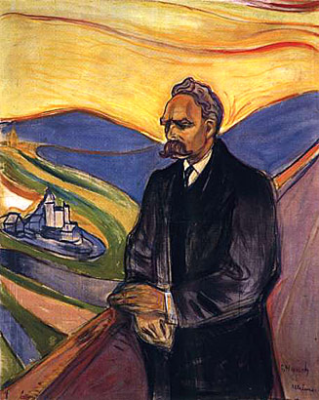
Nietzsche’s Influence on Modern Culture
Novelists
Hermann Hesse, Thomas Mann, Franz Kafka, D.H. Lawrence, James Joyce, Henry Miller, André Gide, André Malraux, Maxim Gorky, and Nikos Kazantzakis
Poets
Rainer Maria Rilke, Stefan George, William Butler Yeats, and Paul Valéry
Dramatists
August Strindberg, George Bernard Shaw, and Eugene O'Neill
Painters
Henri Matisse, Max Ernst, Max Beckmann, Erich Heckel, Gustav Klimt, Edvard Munch, Wassily Kandinsky, Paul Klee, Francis Bacon
Sculptors
Auguste Rodin, Aristide Maillol, and Otto Dix
Composers
Bela Bartok, Alban Berg, Richard Strauss, Frederick Delius, Gustav Mahler, and Alexander Skriabin
Architecture
Le Corbusier and Walter Gropius
Theologians
Martin Buber and Paul Tillich.
Nietzsche, Edvard Munch, 1906

Slide 32
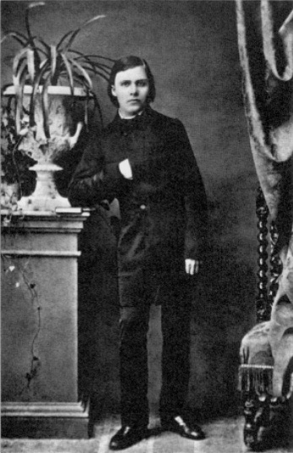
Biographical Chronology
1844, 15 October. Nietzsche is born in Röcken near Leipzig, in the Prussian province of Saxony on October.
1846, 10 July. Birth of Elisabeth Nietzsche.
1848, February. Birth of Joseph Nietzsche.
1849, 30 July. Nietzsche’s father, a Lutheran minister dies of a brain tumor at the age of 36.
1850, January. Joseph Nietzsche dies. Family moves to Naumburg.
1858, October. Starts school at Pforta.
1864, October. Nietzsche enrolls as student of theology and philology at the University of Bonn.
1865, October. Begins studies in philology at the University of Leipzig. Discovers the works of Schopenhauer in a second-hand bookshop.
Nietzsche at 16

Slide 33
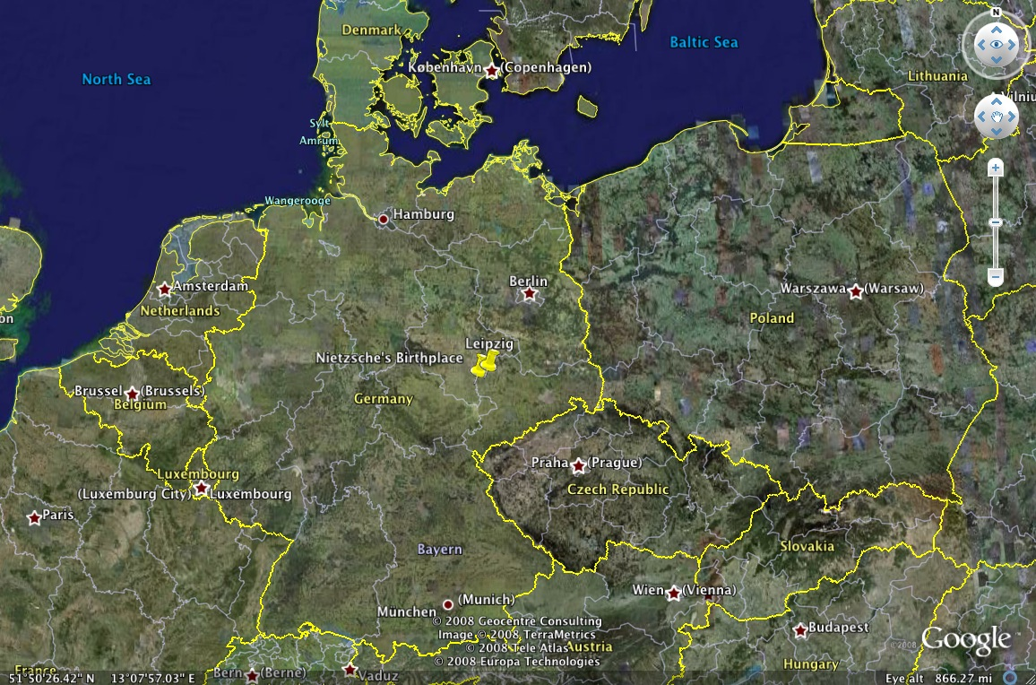

Slide 34
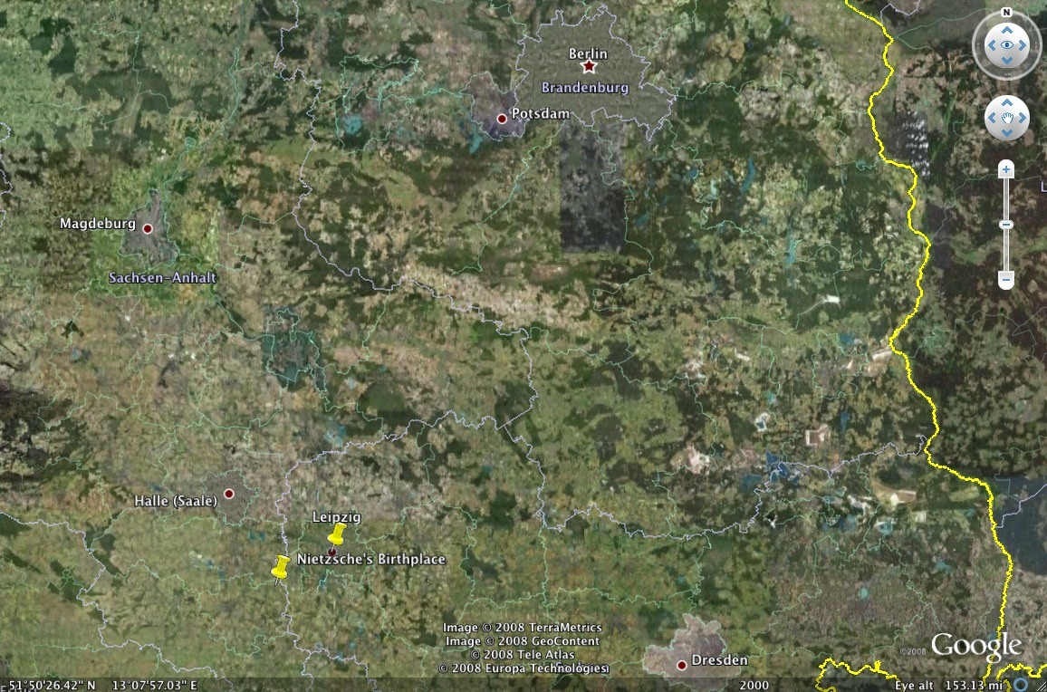

Slide 35
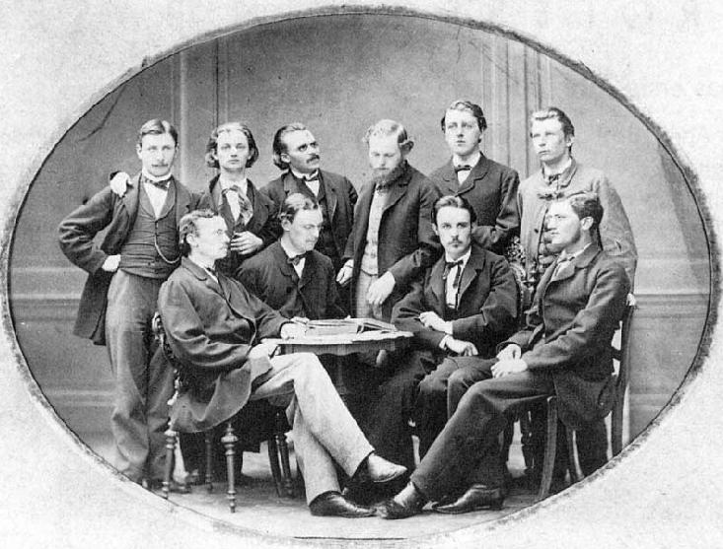
Classical Philological Association, The University of Leipzig, Winter Semester 1867/1868

Slide 36
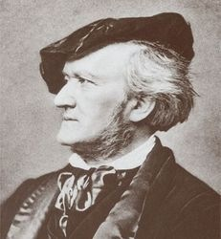
Richard Wagner
1813-1883

Slide 37
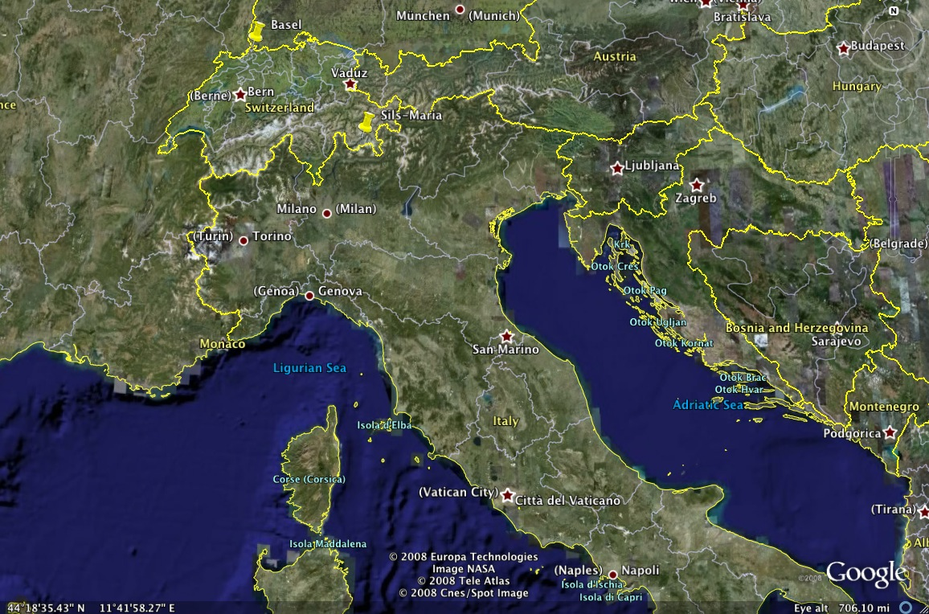

Slide 38
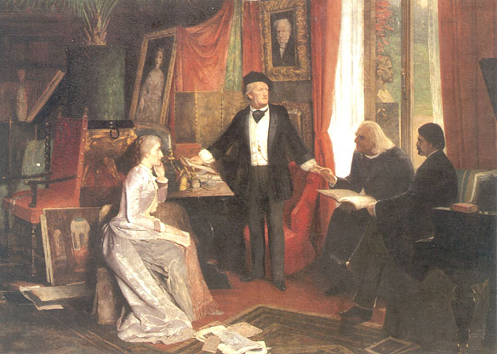
Painting by W. Beckmann, 1881, depicting Richard Wagner, standing beneath a portrait of Schopenhauer, espousing his theories to a young man identified as either Nietzsche or another disciple, Hans von Walzogen, with Cosima Lizst Wagner and her father, Franz Liszt, also present. To me this looks more like Nietzsche rather than Walzogen, but if it were painted live in 1881 it wouldn’t have been Nietzsche. In any case, we can imagine this scene with Nietzsche occurred many times in the early 1870’s at the Wagner’s home at Tribschen, Switzerland.

Slide 39
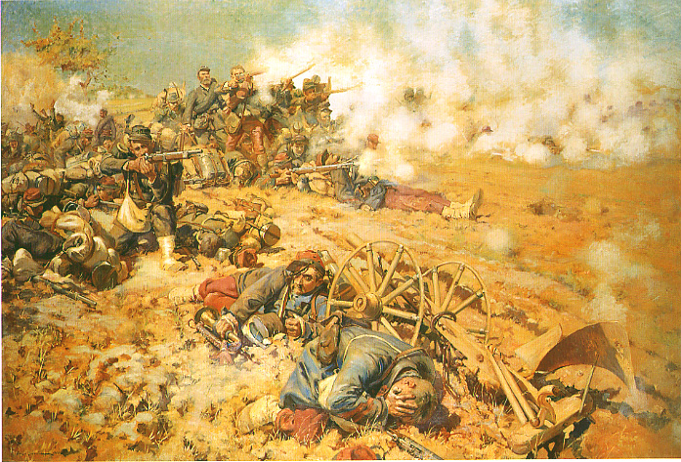
Franco-Prussian War (July 1870-May 1871)
“Confidentially, I consider the Prussia of today to be one of the powers most dangerous of all of culture.”
Letter to Erwin Rohde, 23 October 1870

Slide 40
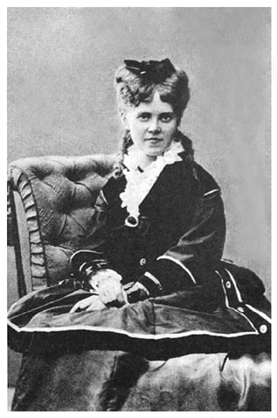
1868, November. Nietzsche meets Richard Wagner.
1869, January. Appointed professor of Classical Philology at the University of Basel, Switzerland.
1870. Becomes tenured professor at University of Basel. Serves briefly as a medical orderly with the Prussian forces in the Franco-Prussian war.
1872, 2 January. The Birth of Tragedy is published on January 2. Enthusiastic reception in Tribschen. After reading the book, Wagner remarks to Cosima: “that is the book I have always wished for myself”. Mid-May attends laying of the foundation stone at Bayreuth.

Slide 41
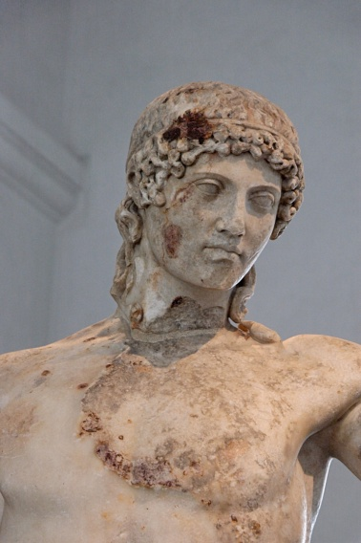
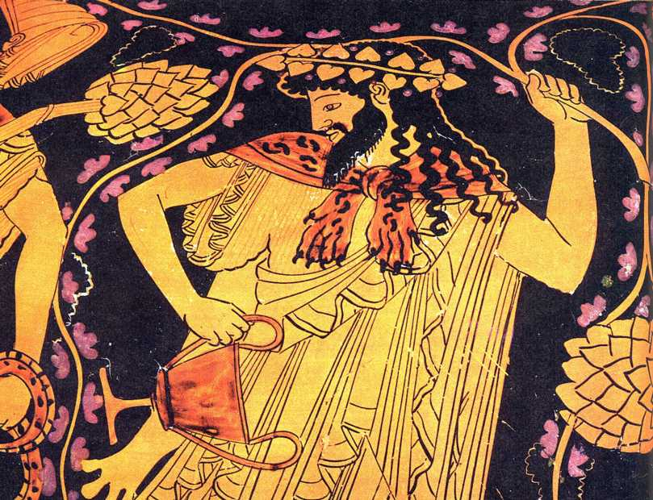

The Birth of Tragedy out of the
Spirit of Music
1872

Slide 42
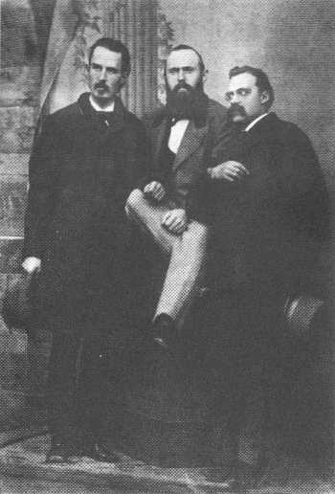
1873. Nietzsche meets Paul Rée. Writes the fragment On Truth and Lie in an Extra-Moral Sense. Publication of the first Untimely Meditation: David Strauss, the Confessor and the Writer.
1874, Publication of On the Use and Abuse of History for Life. Publication of the third Untimely Meditation: Schopenhauer as Educator.
1875. Begins work on the fourth Untimely Meditation: Richard Wagner in Bayreuth.
1876. Writes the first part of Human, All Too Human. Requests leave of absence from University of Basel (granted June 2, 1876). Break with Wagner. Nietzsche leaves inaugural festival at Bayreuth with Paul Rée.

Slide 43
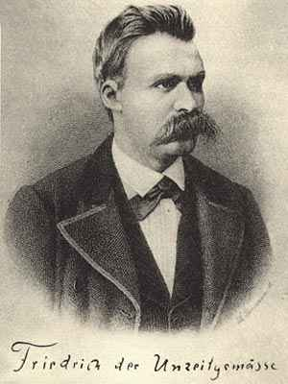

Untimely Meditations
Untimely Reflections
Thoughts Out of Season
David Strauss, The Confessor and the Writer (1873)
On the Uses and Disadvantages of History for Life (1874)
Schopenhauer as Educator (1874)
Richard Wagner in Bayreuth (1876)

Slide 44

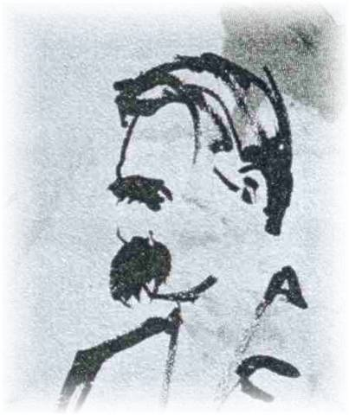
Human,
All Too Human, a Book for Free Spirits
1878
Two Sequels Added for the second edition:
Assorted Opinions and Sayings (1879)
The Wanderer and his Shadow (1880)

Slide 45
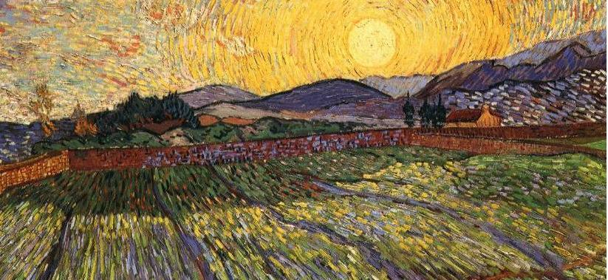

The Dawn
Daybreak
Sunrise
Thoughts on Moral Prejudices
Wheat Field with Rising Sun, Vincent van Gogh, 1888.
1877. Requests extension of leave of absence from University of Basel.
Requests extension of leave of absence from University of Basel. He spends the rest of his active life in Switzerland and Italy. Publication of Human, All Too Human.
1879. Resigns from the University.
1880. Travels to Venice and Genoa. Works on The Dawn.

Slide 46

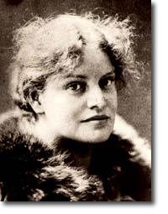
The Joyful Science
The Gay Science
The Joyful Wisdom
1881, Early July through September: Sils-Maria, Switzerland. In early August, the revelation of eternal recurrence strikes Nietzsche. Working on The Gay Science.
1882. First four books of The Gay Science completed. Travels to Messina and then Rome where he meets Lou Salomé.

Slide 47

1882, October. The ‘trinity’ of Nietzsche, Lou and Reé stay together in Leipzig for five weeks. Plans to live together in Paris are thwarted in part by Elizabeth. Lou and Reé leave Nietzsche.
Nietzsche writes in a letter to his friend Overbeck: “Unless I can learn the alchemist trick of turning this filth into gold I am lost.”
1883, January. Writes first book of Thus Spoke Zarathustra in Rapallo. July, writes second part in Sils-Maria. Travels to Frankfurt, Freiburg, Genoa, La Spezia, Villafranca, finally settling in Nice for the winter.
1884, January. Breach with Elizabeth over her impending marriage to Bernard Förster. Back in Sils-Maria for the summer. Writes third part of Thus Spoke Zarathustra. December, works on part four.
Lou Salomé, Paul Reé and Nietzsche in 1882

Slide 48



Slide 49


Beyond Good and Evil
Prelude to a Philosophy of the Future
1885, May. Elizabeth married to Bernard Förster. June, Nietzsche begins work on Beyond Good and Evil. Travels to Florence and then Nice for the winter
1886, January . Completes Beyond Good and Evil. February, Elizabeth and Förster leave for Paraguay. March to August writes new prefaces to Human, All Too Human and The Birth of Tragedy. Summer again in Sils-Maria, Autumn in Ruta, near Rapallo, Winter in Nice. Writes fifth book of The Gay Science.

Slide 50


The Joyful Science
Book V

Slide 51


On the Genealogy of Morals
A Polemic
1887

Slide 52

Wheat Field Under Threatening Skies, Vincent van Gogh, 1890
1888: A Year of Shattering Climax
In the last year of Nietzsche’s creative life he would write four books as well as publish
a collection of writings on Wagner from previously published works. The year begins in Turin, Italy where he writes The Case of Wagner. In the summer he travels back to Sils-Maria and writes Twilight of the Idols. In the last months he returns to Turin and puts together the collection Nietzsche Contra Wagner and brings his career to a shattering climax withThe Antichrist and Ecce Homo.

Slide 53


The Case of Wagner
A Musician’s Problem

Slide 54


Twilight of the Idols or How to Philosophize with a Hammer

Slide 55


The Antichrist
The Anti-Christian
1888

Slide 56

Nietzsche contra Wagner
Out of the Files of a Psychologist
1888

Slide 57

Ecce Homo
How One Becomes What One Is
1888
Frontispiece for the 1908 edition

Slide 58



Slide 59

“Actually, I would much rather be a Basel professor than God, but I have not ventured to carry my private egoism so far as to desist from creating the world on his account. You see, one must make sacrifices, however one may be living, and wherever. . . . Since I am condemned to while away the next eternity with bad jokes, I have a writing business here which really leaves me nothing to be desired—very pleasant and not at all exhausting. The unpleasant thing, which offends my modesty, is that fundamentally I am every name in history. . .”
Letter to Jacob Burckhardt, 6 January, 1889
1889, 3 January. Turin. After seeing a coachman flogging a horse, Nietzsche collapses in the street while putting his arms around the horse’s neck. Brought back to Basel by longtime friend Franz Overbeck. 13 January, Mother arrives in Basel and eventually takes Nietzsche back to Germany.

Slide 60

Nietzsche and his sister

Slide 61


Slide 62


Slide 63
“It is not at all necessary or even desirable to side with me; on the contrary, a dose of curiosity . . . and an ironic resistance would be an incomparably more intelligent position to adopt.”
Letter to Carl Fuchs,
29 July 1888

Slide 64

. . . As for your principle that truth is always on the side of the more difficult, I must admit this in part. However, it is difficult to believe that 2 times 2 is not 4; does that make it true? On the other hand, is it really so difficult simply to accept everything that one has been brought up on and that has gradually struck deep roots—what is considered truth in the circle of one’s relatives and of many good men, and what, moreover, really comforts and elevates man? Is that more difficult than to strike new paths, fighting the habitual, experiencing the insecurity of independence and the frequent wavering of one’s feelings and even one’s conscience, proceeding often without any consolation, but ever with the eternal goal of the true, the beautiful, and the good? Is it decisive after all that we arrive at that view of God, world, and reconciliation which makes us feel most comfortable? Rather, is not the result of his inquiries something wholly indifferent to the true inquirer? Do we after all seek rest, peace, and pleasure in our inquiries? No, only truth—even if it be the most abhorrent and ugly. Still one last question: if we had believed from childhood that all salvation issued from someone other than Jesus—say, from Mohammed—is it not certain that we should have experienced the same blessings? . . . Faith does not offer the least support for a proof of objective truth. Here the ways of men part: if you wish to strive for peace of soul and pleasure, then believe, if you wish to be a devotee of truth, then inquire. . . .
Letter to his sister, 1865

Slide 65
“What I relate is the history of the next two centuries. I describe what is coming, what can no longer come differently: the advent of nihilism. This history can be related even now; for necessity itself is at work here. This future speaks even now in a hundred signs, this destiny announces itself everywhere; for this music of the future all ears are cocked even now. For some time now, our whole European culture has been moving as toward a catastrophe, with a tortured tension that is growing from decade to decade: restlessly, violently, headlong, like a river that wants to reach the end, that no longer reflects, that is afraid to reflect.”
The Will to Power, Preface §2

Slide 66

“I know my fate. One day my name will be associated with the memory of something tremendous—a crisis without equal on earth, the most profound collision of conscience, a decision that was conjured up against everything that had been believed, demanded, hallowed so far. I am no man, I am dynamite.”

Slide 67

“…Yet for all that, there is nothing in me of a founder of a religion—religions are affairs of the rabble; I find it necessary to wash my hands after I have come into contact with religious people.—I want no “believers”; I think I am too malicious to believe in myself; I never speak to masses.—I have a terrible fear that one day I will be pronounced holy; you will guess why I publish this book before; it shall prevent people from doing mischief with me. . . .”

Slide 68
“… I contradict as has never been contradicted before and am nevertheless the opposite of a No-saying spirit. I am a bringer of glad tidings like no one before me; I know tasks of such elevation that any notion of them has been lacking so far; only beginning with me are there hopes again. For all that, I am necessarily also the man of calamity. For when truth enters into a fight with the lies of millennia, we shall have upheavals, a convulsion of earthquakes, a moving of mountains and valleys, the like of which has never been dreamed of. The concept of politics will have merged entirely with a war of spirits; all power structures of the old society will have been exploded—all of them are based on lies: there will be wars the like of which have never yet been seen on earth. It is only beginning with me that the earth knows great politics.”
Ecce Homo, “Why I am a Destiny” §1

Slide 69
“If we could dispense with wars, so much the better. I can imagine more profitable uses for the twelve billion now paid annually for the armed peace we have in Europe; there are other means of winning respect for physiology than field hospitals.—Good, very good even; since the old God is abolished, I am prepared to rule the world.”

Slide 70
And perhaps there will come a great day on which a nation distinguished for wars and victories and for the highest development of military discipline and thinking, and accustomed to making the heaviest sacrifices on behalf of these things, will cry of its own free will: ‘we shall shatter the sword’ – and demolish its entire military machine down to its last foundations. To disarm while being the best armed, out of an elevation of sensibility – that is the means to real peace, which must always rest on a disposition for peace: whereas the so-called armed peace such as now parades about in every country is a disposition to fractiousness which trusts neither itself nor its neighbor and fails to lay down its arms half out of hatred, half out of fear. Better to perish than to hate and fear, and twofold better to perish than to make oneself hated and feared – this must one day become the supreme maxim of every individual state!
Human, All Too Human, “The Wanderer and His Shadow” §284

Slide 71
Raging Discordance Between Art and Truth
Unpublished notes from Autumn 1888:
“Very early in life I took the question of the relation of art to truth seriously: even now I stand in holy dread in the face of this discordance. My first book was devoted to it. The Birth of Tragedy believes in art on the background of another belief—that it is not possible to live with truth, that the "will to truth" is already a symptom of degeneration.”
“We possess art lest we perish of the truth.” (The Will to Power § 822)

