Slide 1
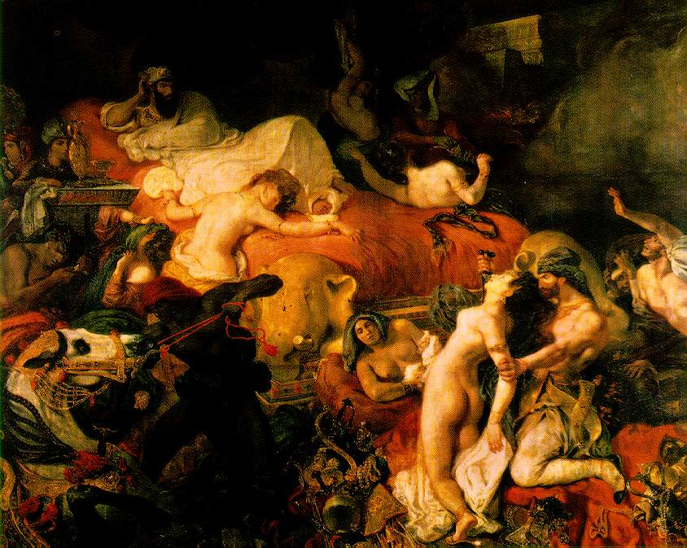
Nothing is more difficult to pin down than Romanticism. The term is usually applied to certain aspects of European intellectual life in late 18th and early 19th centuries, roughly between 1790-1850. It brought important developments in the visual arts, literature, music, poetry, and philosophy. Romanticism took different forms in different countries: Germany, England, France.
Romanticism
Death of Sardanapalus
Oil on canvas, Eugène Delacroix, 1827.
Musée du Louvre, Paris

Slide 2
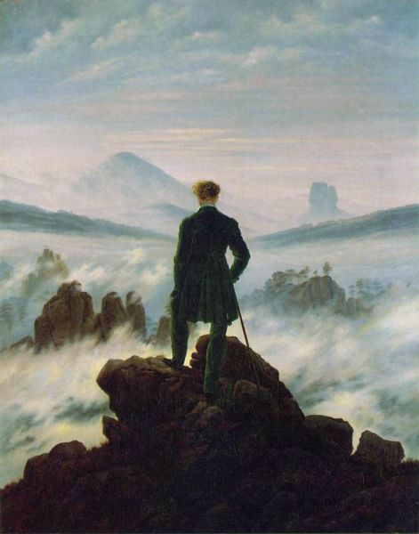
Romanticism developed in response to a growing sense of disillusionment with the values of the Enlightenment. Philosophical skepticism undermined the Enlightenment confidence in reason. Many were already feeling a sense of alienation in modern society as a result of the Industrial Revolution. The Reign of Terror that had broken out in Paris during the French Revolution further shattered the confidence of the Enlightenment. In response to the perceived failures of the Enlightenment, and its confidence in science, reason, and order, Romanticism emphasized the importance of art, the imagination, the emotions, and a different conception of Nature. In contrast to the Enlightenment view of Nature as mechanistic, something to be taken apart and used as a mere resource for industry, Romanticism conceived of Nature as an organic whole, and a place to go to for healing, in order to escape the alienation experienced in modern life.
Wanderer Above the Sea of Fog,
oil on canvas, Caspar David Friedrich, c. 1818.
Kunsthalle, Hamburg, Germany

Slide 3
The Enlightenment
Romanticism
The confidence in reason and science.
Human progress through science and technology.
Emphasis on individual liberty and religious tolerance.
Nature viewed as a machine, and a mere resource for industrial development.
An emphasis on feelings and emotions.
The elevation of aesthetic experience, both in Fine Art and in Nature.
The importance of artistic creativity and genius.
Nature viewed as an organic whole, a place to go for healing.

Slide 4
Important Artists, Writers, and Composers of Romanticism
Painters
Thomas Cole
Francesco Hayez
Ivan Aivazovsky
Theodore Gericault
John Constable
William Blake
Eugene Delacroix
Caspar David Friedrich
J.M.W. Turner
Francisco Goya
Literature
Jane Austen
Charlotte Brontë
Lewis Carroll
Mary Shelley
Robert Louis Stevenson
Johann Wolfgang von Goethe
Nathaniel Hawthorne
Victor Hugo
Herman Melville
Ralph Waldo Emerson
Poetry
Samuel Taylor Coleridge
Percy Bysshe Shelley
Robert Burns
Alexander Pushkin
John Keats
Victor Hugo
Lord Byron
William Wordsworth
Edgar Allan Poe
William Blake
Music
Hector Berlioz
Fryderyck Chopin
Robert Schumann
Franz Liszt
Richard Wagner
Giuseppe Verdi
Anton Bruckner
Giacomo Puccini
Pyotr Il'yich Tchaikovsky
Johannes Brahms

Slide 5
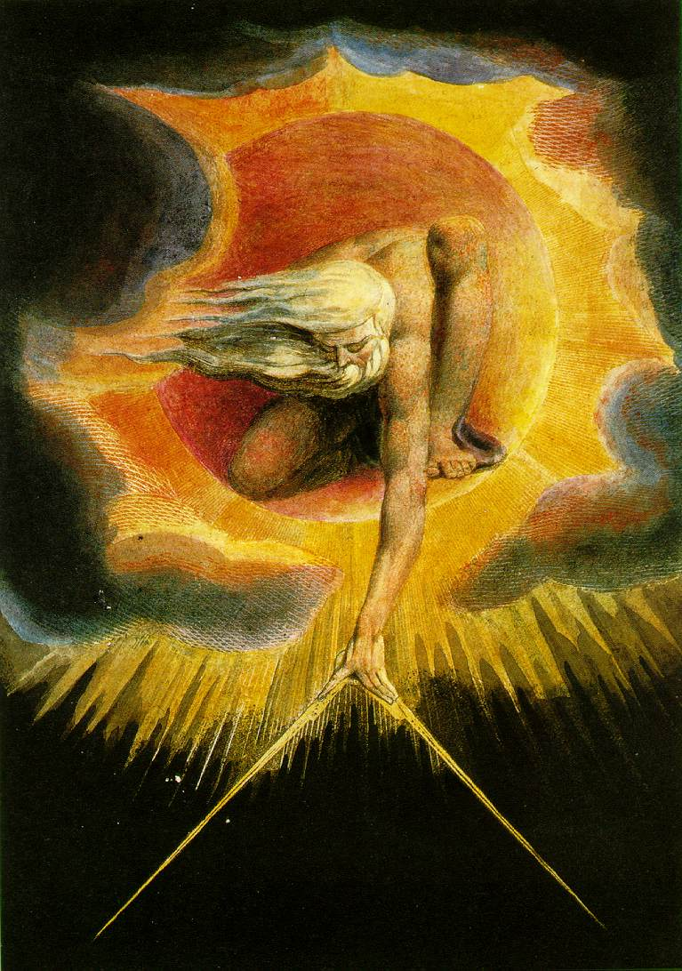
The Ancient of Days
Relief etching with watercolor, William Blake, 1794.
British Museum, London

Slide 6
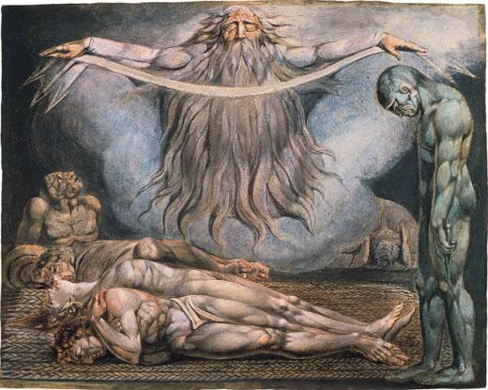
The Lazar House (The House of Death)
Color print, William Blake, 1795.
British Museum, London

Slide 7
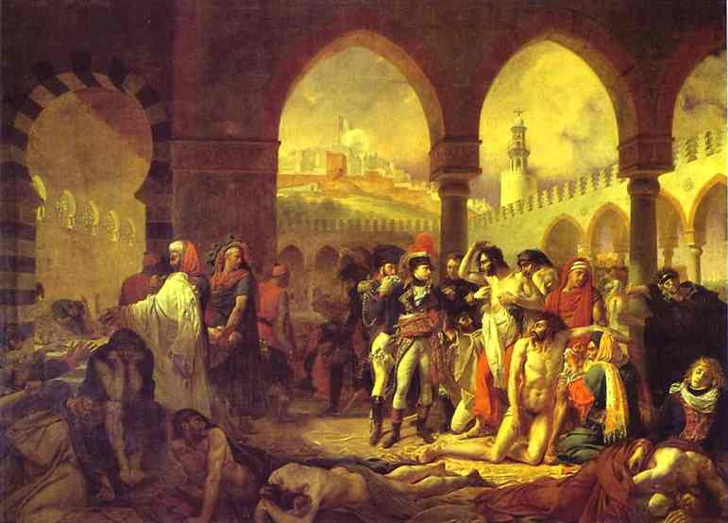
Napoleon in the Pesthouse at Jaffa, 11 March 1799
Oil on canvas, Antoine-Jean Gros, 1804.
Musée du Louvre, Paris

Slide 8
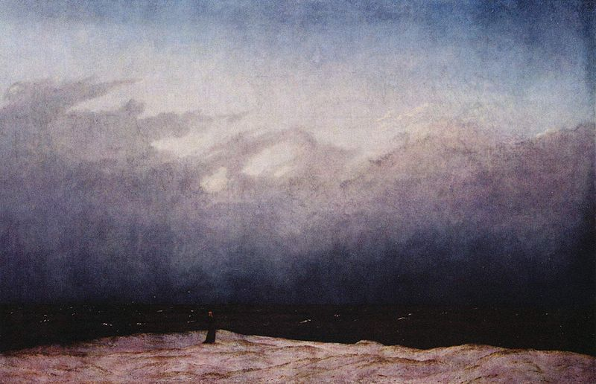
The Monk by the Sea
oil on canvas, Caspar David Friedrich, 1808-1810.
Alte Nationalgalerie, Berlin

Slide 9
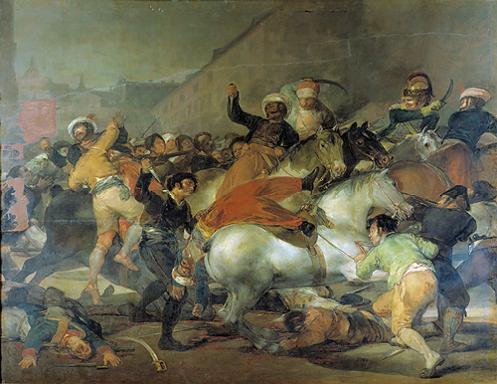
The Second of May
Oil on canvas, Francisco de Goya, 1808, 1814.
Museo Nacional del Prado, Madrid, Spain

Slide 10
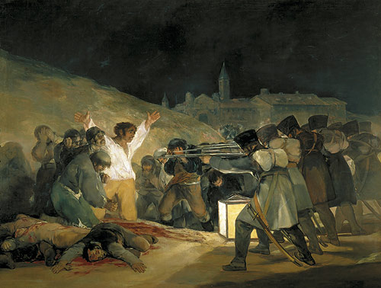
The Third of May
Oil on canvas, Francisco de Goya, 1808, 1814.
Museo Nacional del Prado, Madrid, Spain

Slide 11
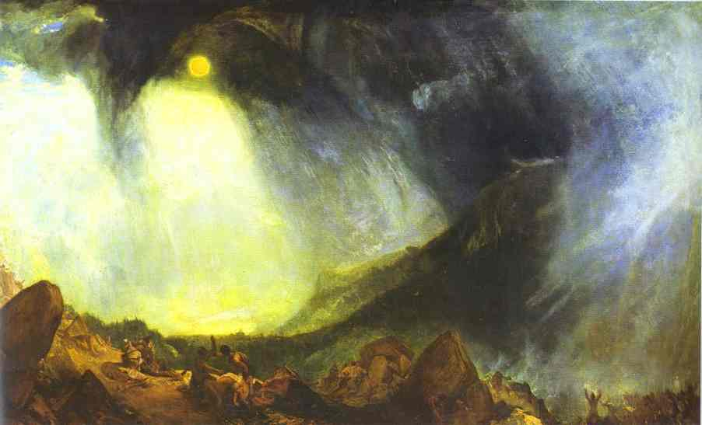
Snow Storm: Hannibal and His Army Crossing the Alps
Oil on canvas, J.M.W. Turner, 1812.
Tate Gallery, London

Slide 12
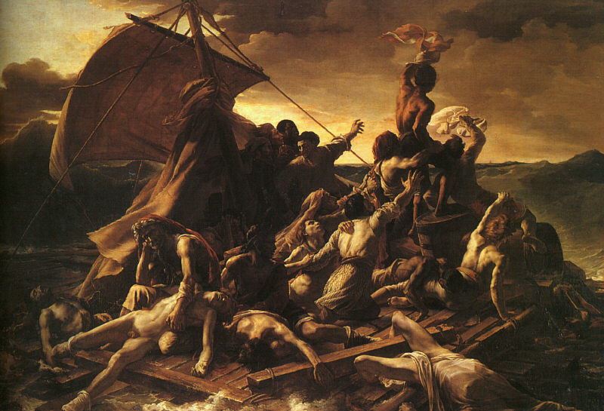
The Raft of the Medusa
oil on canvas, Théodore Géricault, 1818-1819.
Musée du Louvre, Paris

Slide 13
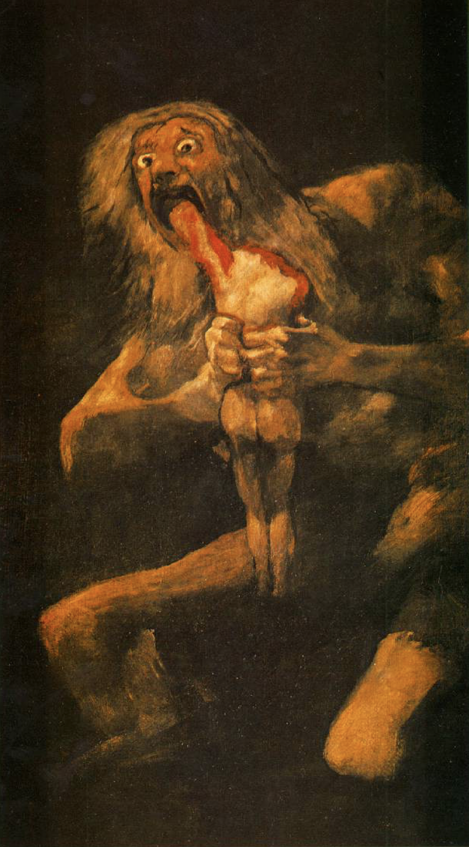
Untitled (Saturn Devouring One of His Children)
Detached fresco mounted on canvas, Francisco de Goya, ca.1819-1823.
Museo Nacional del Prado, Madrid, Spain

Slide 14
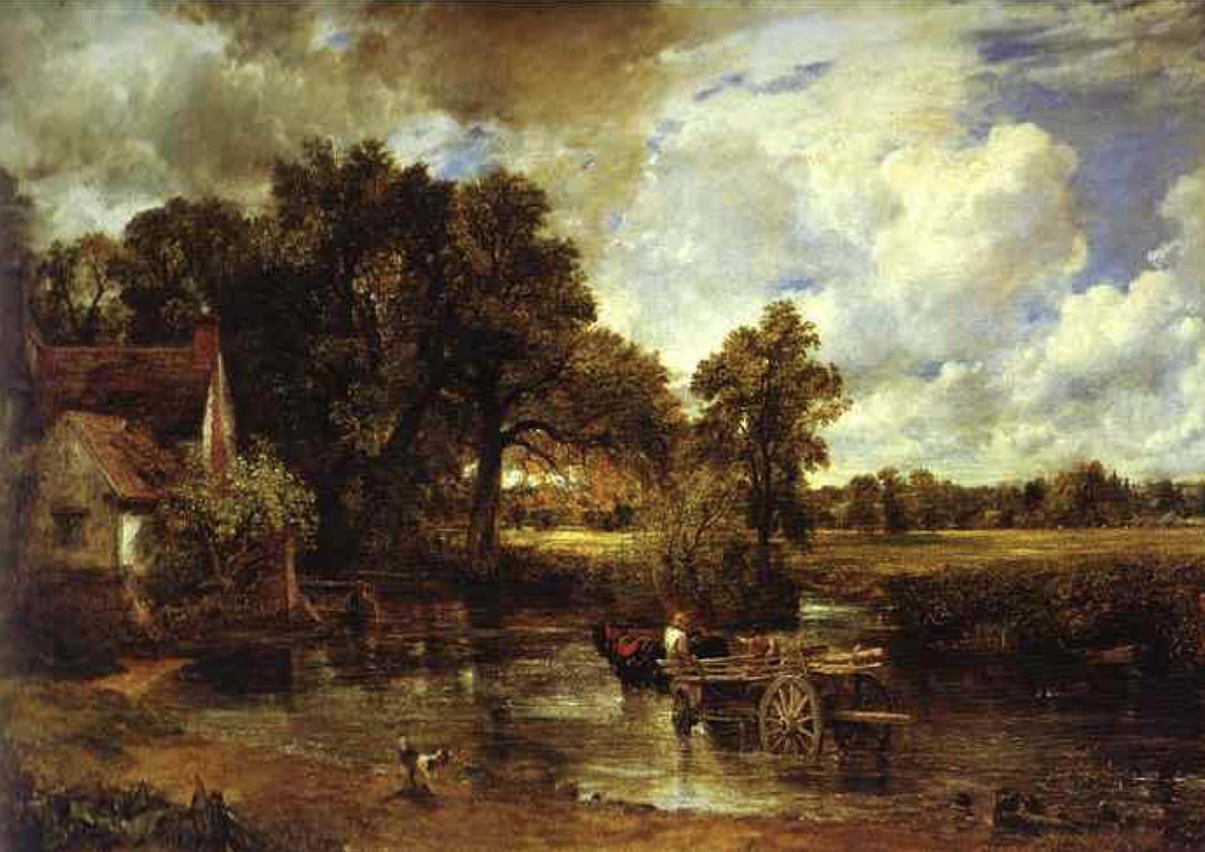
The Haywain (Landscape: Noon)
Oil on canvas, John Constable, 1821.
National Gallery, London

Slide 15
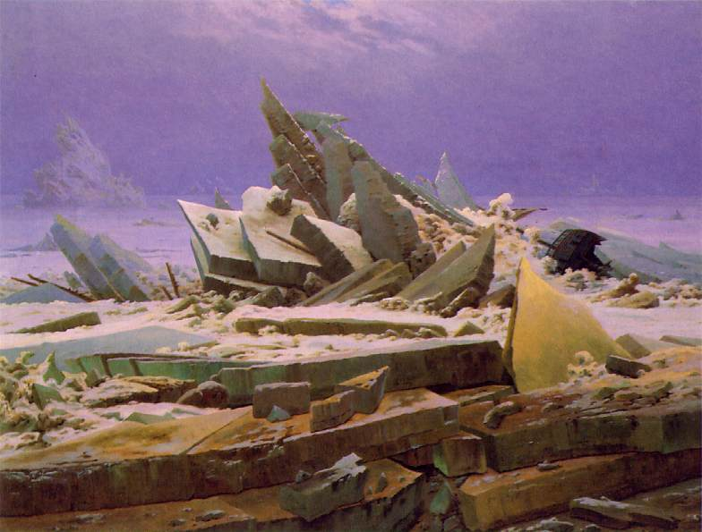
The Sea of Ice
oil on canvas, Caspar David Friedrich, 1823-25.
Kunsthalle, Hamburg, Germany

Slide 16
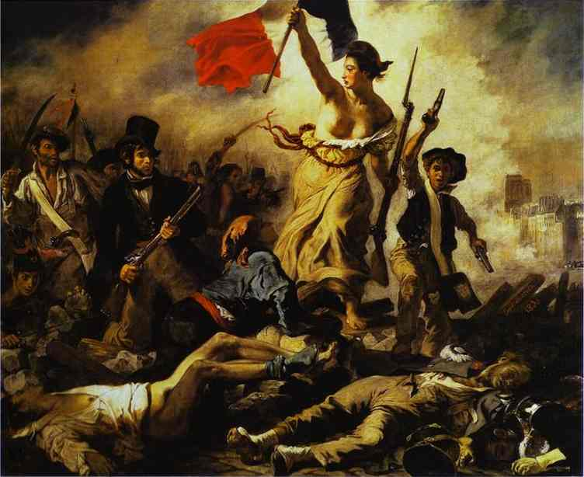
Liberty Leading the People
oil on canvas, Eugène Delacroix, 1830.
Musée du Louvre, Paris

Slide 17
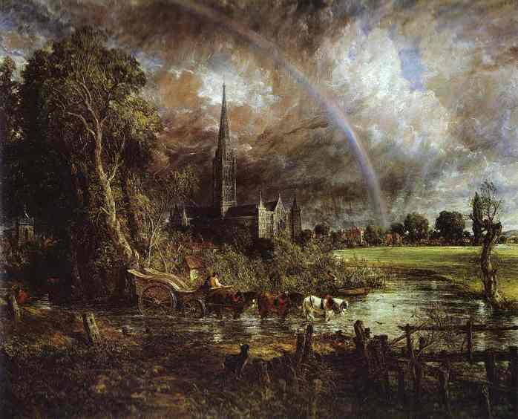
Salisbury Cathedral from the Meadows
Oil on canvas, John Constable, 1829-34.
National Gallery, London

Slide 18
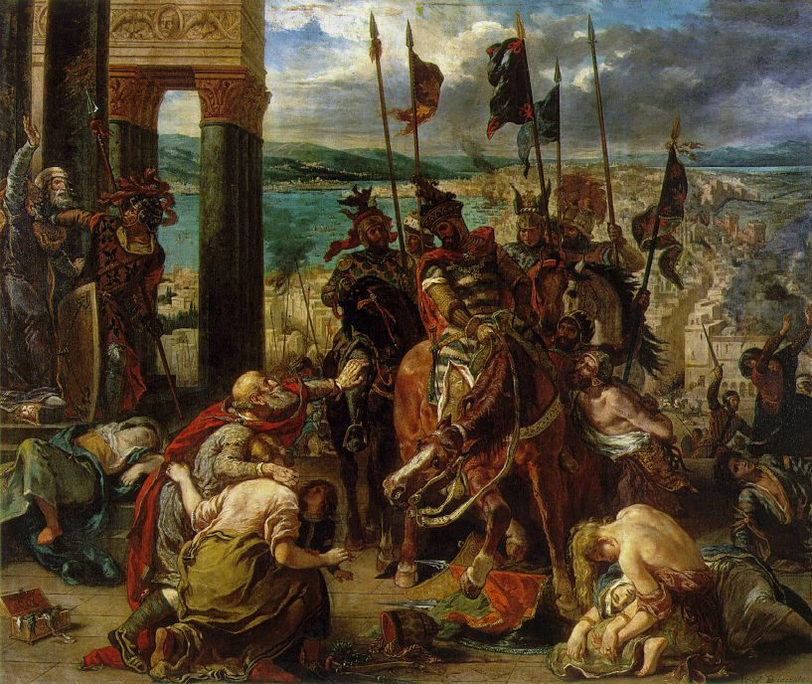
The Entry of the Crusaders into Constantinople
oil on canvas, Eugène Delacroix, 1840.
Musée du Louvre, Paris

Slide 19
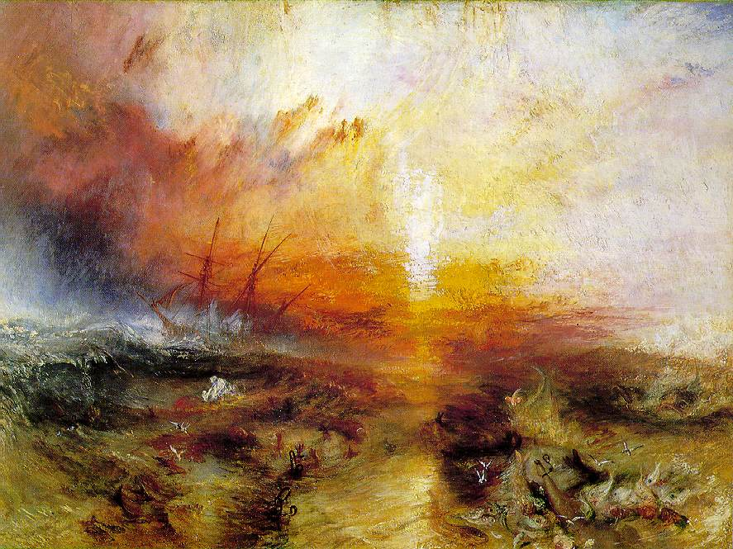
The Slave Ship
Oil on canvas, J.M.W. Turner, 1840.
Museum of Fine Arts, Boston

Slide 20
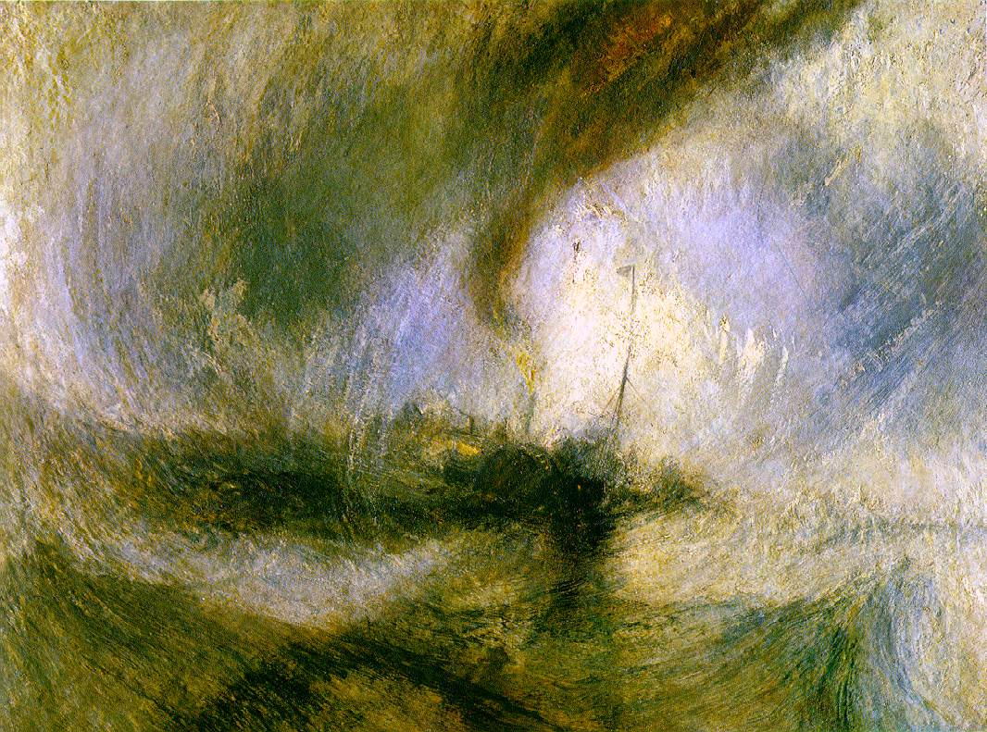
Snowstorm
Oil on canvas, J.M.W. Turner, 1842.
Museum of Fine Arts, Boston

Slide 21
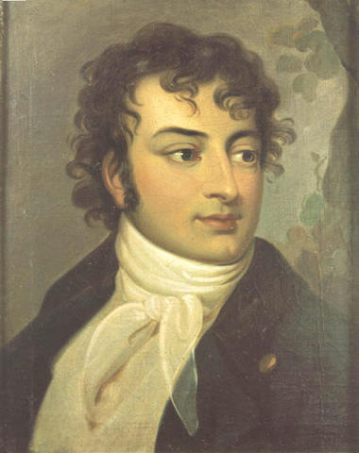
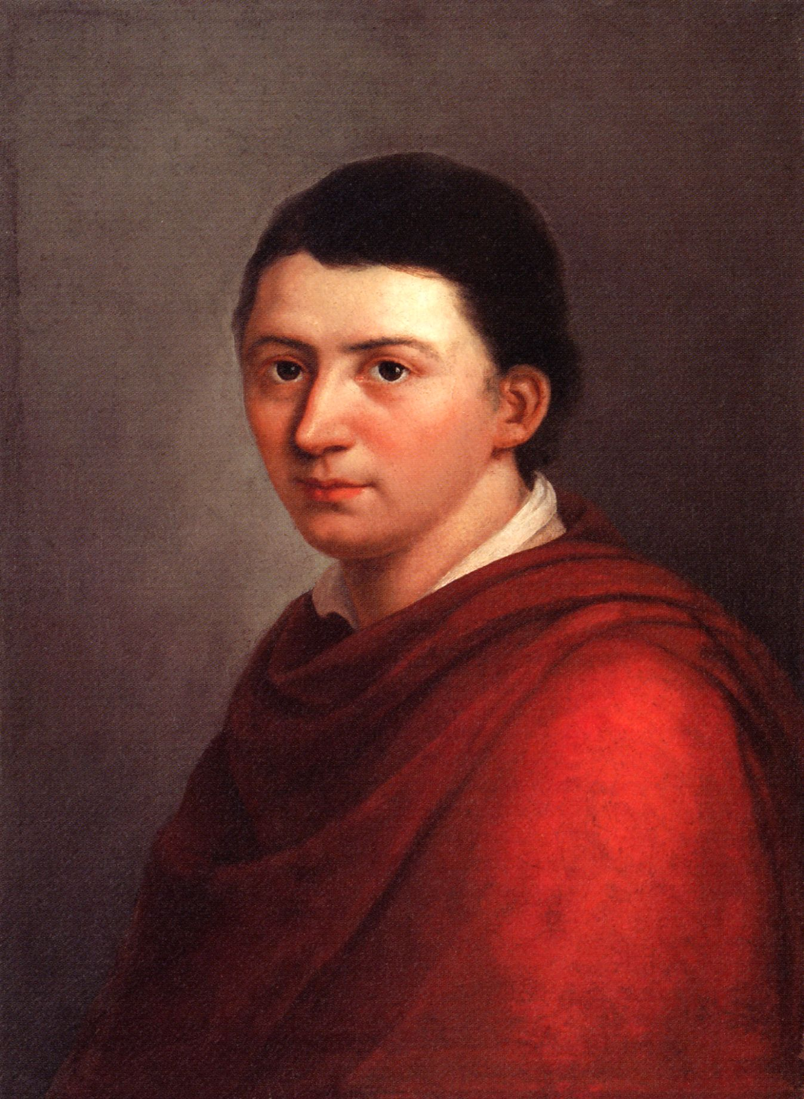
The Philosophy of Romanticism
Romanticism begins in Germany with the Schlegel brothers. The term “Romanticism” was coined by August Schlegel in his Vienna lectures of 1809-11. He used it to distinguish “modern” poetry and art from the Classical. In these lectures Schlegel describes Romantic poetry as a striving for the infinite. This striving for the infinite is reflected in the art of Christianity. As Schlegel described it in these lectures, this striving is an unsatisfied longing.
August Schlegel
(1767-1845)
Friedrich Schlegel
(1772-1829)

Slide 22
Some Main Features of Romanticism
1) art has a preeminent role to play in human life and culture
2) art becomes a source of truth
3) the faculty of the imagination becomes exalted
4) the notion of “aesthetic unity” of nature
5) an exaltation of artistic “genius”
6) the notion of the aesthetic as an autonomous realm
7) artistic production conceived as self-expression

Slide 23
Some Main Features of Romanticism
art has a preeminent role to play in human life and culture
There is a divination of art—art has a religious significance and role in human society, an importance that rivaled and even surpassed the role analytical reason of the Enlightenment. Art leads to a feeling of unity of the human being with nature. The discord between man and nature that is the result of the gap between nature and freedom is replaced by a notion of “organic or aesthetic unity.” Thus, an important motif of Romanticism is that of a "circuitous journey," a move from alienation, through spiritual crisis, to a redemptive reintegration with the cosmos. There is a revaluation of the relationship between philosophy and art, or art and truth. Philosophy becomes aesthetic—art becomes the “organ of philosophy.”

Slide 24
Some Main Features of Romanticism
2) art becomes a source of truth
Though Kant explicitly denied that art has “truth value,” some statements in the Critique of Judgment seemed to contradict this view. For Kant art is a matter of pleasure, not knowledge. He does hint, however, that art can put us into contact with something that cannot be grasped through concepts. Later Romanticist philosophers would develop the notion that it is through art that man can reach truth. This led to a higher value placed on art and artistic creation—a glorification of art.

Slide 25
Some Main Features of Romanticism
3) the faculty of the imagination becomes exalted
This claim to knowledge gave rise to a new theory of the imagination. Now it was not only a faculty of inventing and reassembling materials, but a faculty of seizing directly upon important truths. The influence of the Kantian Copernican revolution gave a sense of creativity to the mind. The mind is no longer viewed as passive discoverer of truth, but somehow active, creative.
Baudelaire: “Imagination is, as it were, a divine faculty, which perceives directly, without the use of philosophical methods, the secret and intimate relationships of things...”

Slide 26
Some Main Features of Romanticism
4) the notion of “aesthetic unity” of nature
Nature is understood as a single unified and interconnected whole, and not merely objective soulless matter. Goethe emphasized a deep sense of the organic unity of all nature, and man as a part of nature. He also suggested that works of art grow out of, and express man’s unity with nature. Here, again, the important thing is the notion of art as revealing nature herself, and thus having an importance rivaling science.
Shelley: “A poem is the very image of life expressed in its eternal truth.”

Slide 27
Some Main Features of Romanticism
5) an exaltation of artistic “genius”
Kant’s notion of “genius” as the talent that generates “aesthetic ideas” which provide the soul that distinguishes “fine art” had a great influence on the development of Romanticism. An “aesthetic idea” is an idea for which no adequate concept can be found, and thus cannot be made intelligible by language. The notion of an “aesthetic idea” thus pointed toward the view of art as expressing the inexpressible. This also suggested that art is something more than mere pleasure. In Romanticism art takes on a religious dimension, with the artist seen as divinely inspired in a way Plato couldn’t imagine. The artistic genius becomes a Promethean figure, rival of both Nature and God.
Novalis: “The genuine poet is always a priest.”
Goethe calls the artist “God’s anointed.”
Victor Hugo: “Nature is God’s immediate creation, and art is what God creates through the mind of man.”

Slide 28
Some Main Features of Romanticism
6) the notion of the aesthetic as an autonomous realm
Kant maintained the autonomy of aesthetic judgment (as distinguished from the theoretical and the practical). Though Kant did not explicitly demarcate an independent realm of the aesthetic, he was read by later Romanticist thinkers to have indeed distinguished the aesthetic as an autonomous realm separated from the realms of nature and freedom. Later Romanticist philosophers would develop the notion of the aesthetic as an independent, autonomous realm.

Slide 29
Some Main Features of Romanticism
7) artistic production conceived as self-expression
Artistic production becomes conceived as essentially an act of self-expression. The critic becomes more concerned with the artist—his sincerity, details of biography, inner spiritual life.
Victor Hugo: “What indeed is a poet? A man who feels strongly and expresses his feelings in a more expressive language”
We find this notion already in Voltaire: “Poetry is almost nothing but feeling.”
Thus the imitation theory of art is set aside, or relegated to a subordinate position, and a form of expression theory develops, which shifts the focus from the artwork to
the artist’s state of mind.

Slide 30
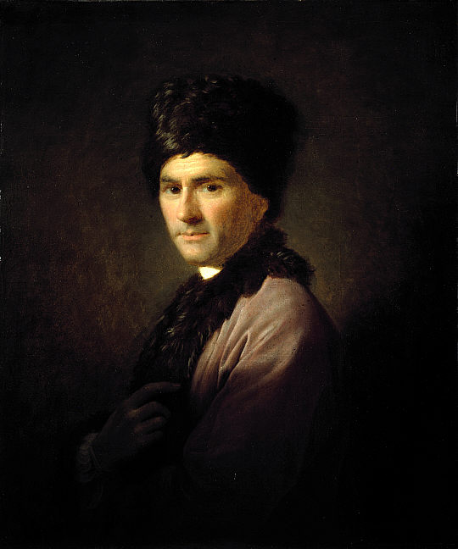
Precursors of Romanticism
Rousseau made fertile contributions to the critique of Enlightenment. He emphasized the importance of the passions and emotions and was highly critical of the Enlightenment notion of the progress of civilization. He contrasted the life of what he called the ‘noble savage’ with the life of individuals in modernity, subjected to great inequities of wealth and living in degraded cities.
Jean-Jacques Rousseau
(1712-1778)

Slide 31
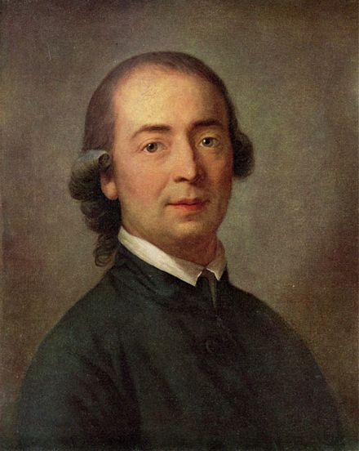
Precursors of Romanticism
Herder was a German thinker whose critique of the Enlightenment was in some ways more radical than Rousseau’s. Herder held that language is not just an instrument for expressing thoughts and ideas, but was that which makes thought possible. Different languages are thus not just alternative instruments for expressing the same ideas, but rather are themselves different ways of thinking. This idea of language undermined the Enlightenment assumption of a universal human essence. This view of language tends to emphasize national and cultural differences. It was liberating in a German-speaking world resentful of the dominance of French culture. Though not a Romanticist, Herder’s thought had an impact on the birth of Romanticism in Germany at the beginning of the 19th century.
Johann Gottfried Herder
(1744-1803)

Slide 32
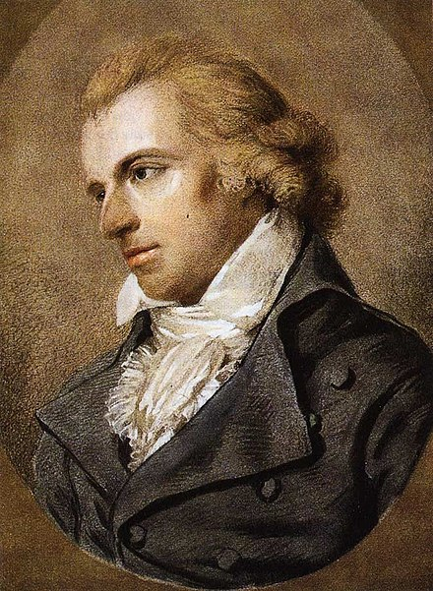
Precursors of Romanticism
Though not a Romanticist, Schiller is the bridge between Kant and Romanticism. He develops and extends Kant’s discussion of the aesthetic, and is the first to take up Kant’s suggestion of a higher role for art. In his Letter of an Aesthetic Education of Man ( 1794-95). Schiller puts forth a history of the whole of Western Culture in which the nobility and exaltation of Greek culture is contrasted with the fragmentation and alienation of modern man. For Schiller the cure for this alienation lies in art. The aim of Schiller’s aesthetic education is to establish an aesthetic state, an ideal towards which society can progress. For Schiller the artist-philosopher is the aesthetic educator who leads humanity to the ideal state. Schiller thus defines the notion of the avant-garde that informs much of 20th century art.
Friedrich Schiller
(1759-1805)

Slide 33
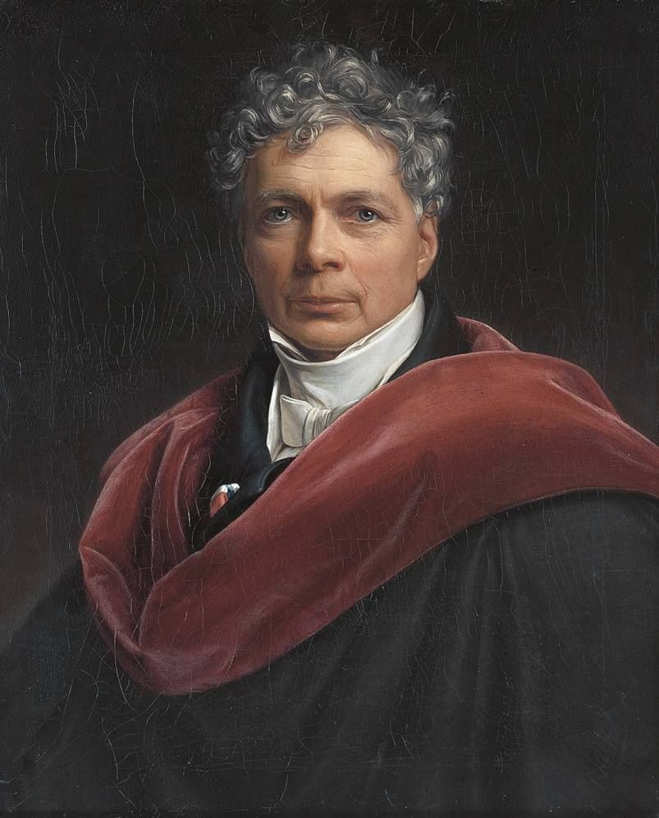
Philosophers of Romanticism
Schelling transposes Schiller’s utopian idealism into an absolute idealism in which beauty actually constitutes the original essence of reality. In a manner similar to Kant’s Third Critique, Schelling constructs a transcendental idealism to bridge the gap between nature and reason. In The Philosophy of Art (1802-3) Schelling attempts a systematic philosophical articulation of the arts. This would play a significant role in the emergence of the aesthetic that informs modernism. In his System of Transcendental Idealism (1800), Schelling saw art as the ‘organ of philosophy’ for it can see what philosophical concepts cannot: the absolute. With this Schelling thus turns philosophy in an aesthetic direction. This notion of art as the ‘organ of philosophy,’ art as a means to get to the truth of reality, becomes one of the foundational elements of Romanticism in art and philosophy.
Friedrich Wilhelm Joseph
Schelling
(1775-1854)

Slide 34
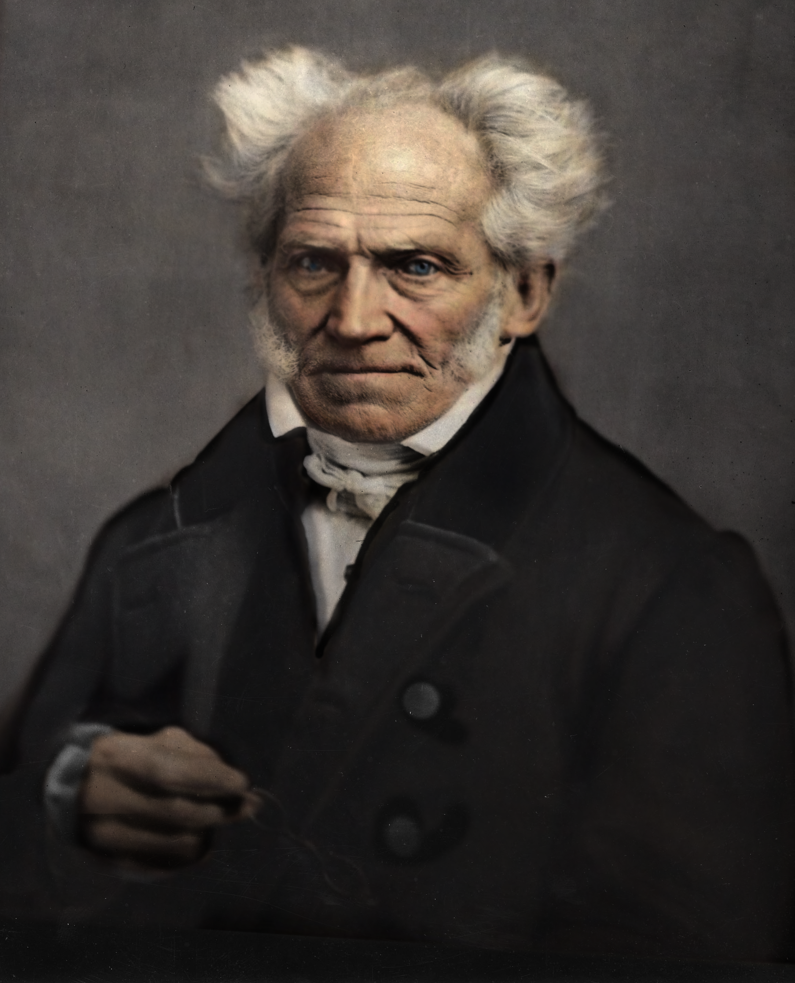
Philosophers of Romanticism
Schopenhauer’s philosophy develops out of Romanticism celebrating art, especially music, as the means to the highest knowledge. In The World as Will and Representation (1844) Schopenhauer takes Kant’s distinction between the Phenomenal World the Noumenal World, the world as it is “in-itself,” and recasts it as the distinction between the World as Representation and the World as Will. Whereas Kant thought the noumenal was unknowable, even though we must make assured postulates about it on moral grounds, Schopenhauer’s original and striking suggestion is that the thing in itself is really an irrational and limitless urge, what he called it “the Will to Live.” He thought the visual arts can reveal much about the World as Representation, but music, he thought, can reveal the deeper truth of reality, the Will underlying all existence. This emphasis on the importance of music influenced the composer Richard Wagner, and also the philosopher Friedrich Nietzsche.
Arthur Schopenhauer
(1788-1860)

Slide 35
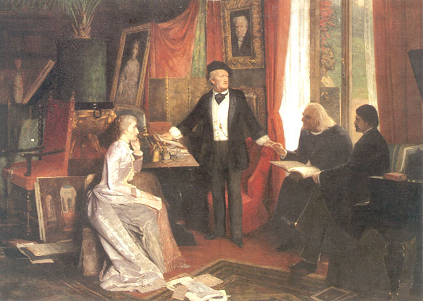
Philosophers of Romanticism
In this painting Richard Wagner stands before a portrait of Schopenhauer while he is lecturing, probably about the importance of music. To his left is Franz Liszt, the great Hungarian composer, virtuoso pianist, conductor, music teacher, arranger, and organist of the Romantic era. Liszt is widely regarded as one of the greatest pianists of all time. To Wagner’s right, listening intently, is Liszt’s daughter Cosima, who was Wagner’s wife. Also listening to Wagner is the young Friedrich Nietzsche.
After becoming a professor at Basel University in Switzerland, Nietzsche made many trips to the Wagner’s home in Tribschen. He would dedicate his first book, The Birth of Tragedy, to Wagner. The Birth of Tragedy was strongly influenced by Schopenhauer’s philosophy, and he would later criticize it for its ‘youthful Romanticism.’

