Slide 1
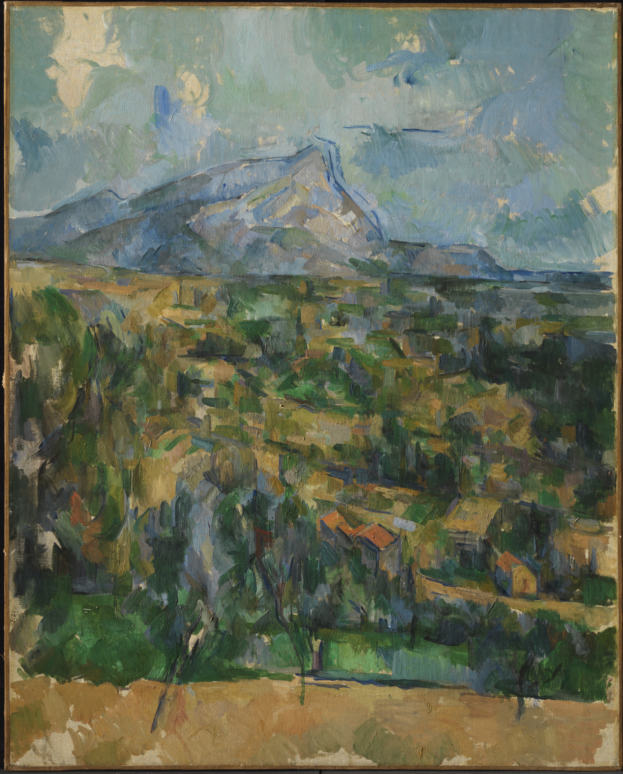
From “Eye and Mind” (1964)
“Nature is on the inside,” says Cézanne. Quality, light, color, depth, which are there before us, are there only because they awaken an echo in our body and because the body welcomes them. (Merleau-Ponty 1994, 285)
It is the mountain itself which from out there makes itself seen by the painter; it is the mountain that he interrogates with his gaze. (Merleau-Ponty 1994, 287)
Painting as Vision
Maurice Merleau-Ponty’s
Philosophy of Art
Mont Sainte-Victoire
Oil on canvas, Paul Cézanne, 1904-06.
Princeton University Art Museum, Princeton, N.J.

Slide 2
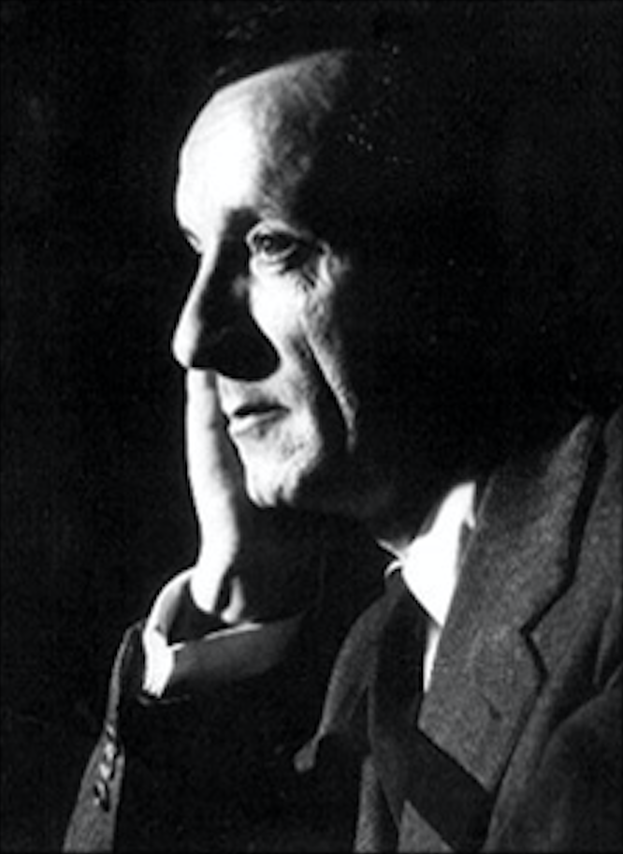
Maurice Jean Jacques Merleau-Ponty (1908–1961), French philosopher and public intellectual, was the leading academic proponent of existentialism and phenomenology in post-war France. Best known for his original and influential work on embodiment, perception, and ontology, he also made important contributions to the philosophy of art, history, language, nature, and politics. Associated in his early years with the existentialist movement through his friendship with Jean-Paul Sartre and Simone de Beauvoir, Merleau-Ponty played a central role in the dissemination of phenomenology, which he sought to integrate with Gestalt psychology, psychoanalysis, Marxism, and Saussurian linguistics.
(Stanford Encyclopedia of Philosophy)
Maurice Merleau-Ponty
Maurice Merleau-Ponty (1908-1961)

Slide 3
The term ‘existentialism’ is often used to refer to a movement in philosophy associated with a number of thinkers, beginning with Søren Kierkegaard and Friedrich Nietzsche in the nineteenth century, and then further developed in the twentieth century with the work of Martin Heidegger, Jean-Paul Sartre, Simone de Beauvoir, and Albert Camus among others. What ties these thinkers together, as Charles Guignon suggests, is that they “made the concrete individual central to their thought.” Guignon further explains: “Existentialism in this broader sense arose as a backlash against philosophical and scientific systems that treat all particulars, including humans, as members of a genus or instances of universal laws. It claims that our own existence as unique individuals in concrete situations cannot be grasped adequately in such theories, and that systems of this sort conceal from us the highly personal task of trying to achieve self-fulfilment in our lives. Existentialists therefore start out with a detailed description of the self as an ‘existing individual’, understood as an agent involved in a specific social and historical world. One of their chief aims is to understand how the individual can achieve the richest and most fulfilling life in the modern world” (Guignon 1998).
Existentialism

Slide 4
The discipline of phenomenology may be defined initially as the study of structures of experience, or consciousness. Literally, phenomenology is the study of “phenomena”: appearances of things, or things as they appear in our experience, or the ways we experience things, thus the meanings things have in our experience. Phenomenology studies conscious experience as experienced from the subjective or first person point of view. This field of philosophy is then to be distinguished from, and related to, the other main fields of philosophy: ontology (the study of being or what is), epistemology (the study of knowledge), logic (the study of valid reasoning), ethics (the study of right and wrong action), etc. The historical movement of phenomenology is the philosophical tradition launched in the first half of the 20th century by Edmund Husserl, Martin Heidegger, Maurice Merleau-Ponty, Jean-Paul Sartre, et al.
(The Stanford Encyclopedia of Philosophy)
Phenomenology

Slide 5
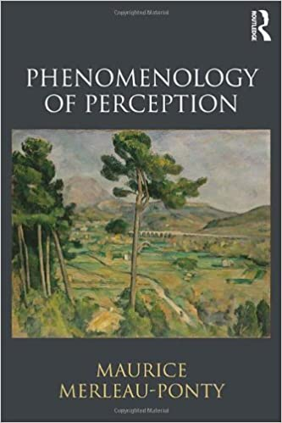
Completed in 1944 and published the following year, Phenomenology of Perception is the work for which Merleau-Ponty was best known during his lifetime and that established him as the leading French phenomenologist of his generation. Here Merleau-Ponty develops his own distinctive interpretation of phenomenology’s method, informed by his new familiarity with Husserl’s unpublished manuscripts and his deepened engagement with other thinkers in this tradition, such as Eugen Fink and Martin Heidegger.
(The Stanford Encyclopedia of Philosophy)
Merleau-Ponty’s
Phenomenology of Perception

Slide 6
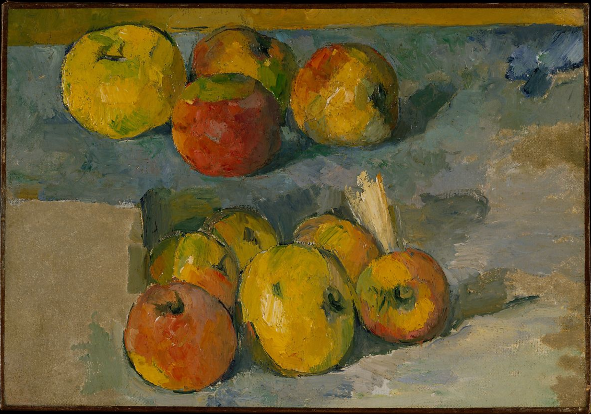
“I will astonish Paris with an apple!” Paul Cézanne (1839-1906), to whom these words are attributed, not only astonished the Parisian art world, but also became one of the most celebrated painters of all time. Indeed, the painter’s impact was so deep that he even inspired some of the seminal texts of 20th-century philosophy of art. Maurice Merleau-Ponty (1908-1961), a central figure in the philosophical tradition of phenomenology and editorial board member of the French philosophy journal Les Temps modernes, established by Jean-Paul Sartre, was particularly drawn to the painter’s work. Merleau-Ponty discusses Cézanne in two studies of central importance to contemporary philosophy of art, namely “Cézanne’s Doubt” and “Eye and Mind”.
(The Paris Institute for Critical Thinking)
Merleau-Ponty and Cézanne’s Paintings
Apples
Oil on canvas, Paul Cézanne, 1878-79.
The Metropolitan Museum of Art, New York

Slide 7
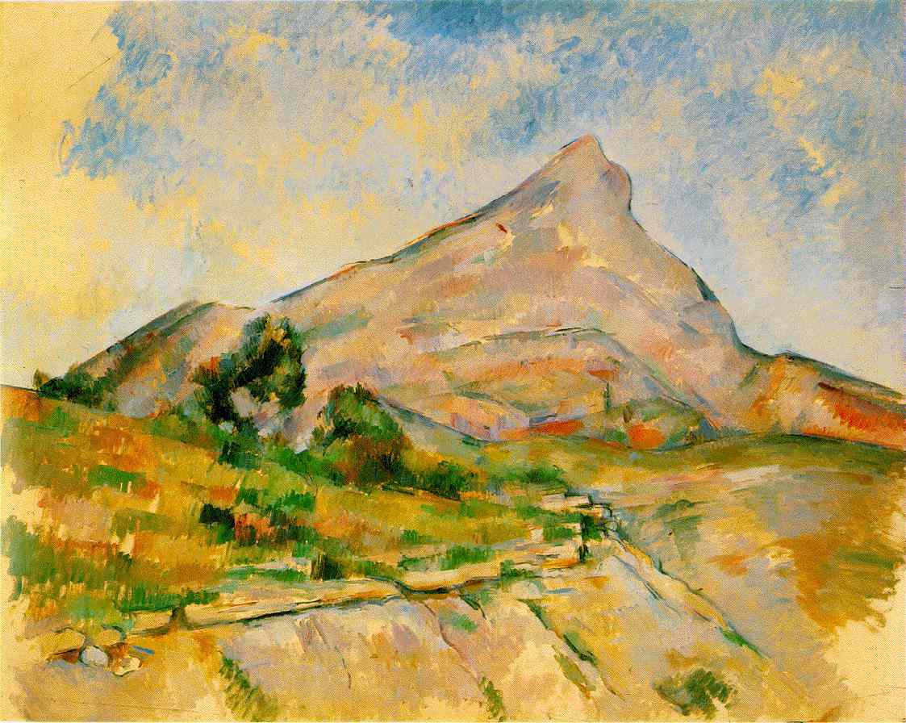
Expression, particularly in language and the arts, plays an increasingly central role in Merleau-Ponty’s thought in the years following Phenomenology, when he aimed to formulate a general theory of expression as the grounding for a philosophy of history and culture. This interest is first reflected in a series of essays addressing painting, literature, and film published in the years immediately following Phenomenology. These include Merleau-Ponty’s first essay on painting, “Cézanne’s Doubt”, which finds in Cézanne a proto-phenomenological effort to capture the birth of perception through painting. Cézanne epitomizes the paradoxical struggle of creative expression, which necessarily relies on the idiosyncracies of the artist’s individual history and psychology, as well as the resources of the tradition of painting, but can succeed only by risking a creative appropriation of these acquisitions in the service of teaching its audience to see the world anew.
(The Stanford Encyclopedia of Philosophy)
“Cézanne’s Doubt”
Mont Sainte-Victoire
Oil on canvas, Paul Cézanne, 1895.
State Hermitage Museum, St Petersburg, Russia

Slide 8
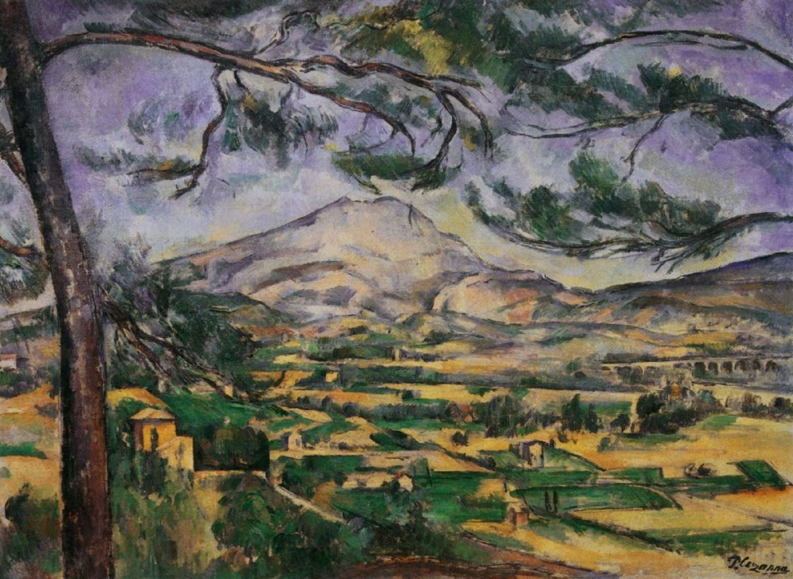
Merleau-Ponty begins the essay by emphasizing how Cézanne was constantly experimenting with painting. He painted Mont Sainte-Victoire over and over again during his career, and yet he never felt like he had succeeded. Every painting, as Merleau-Ponty says, was ”only an attempt.”
“It took him one hundred working sessions for a still life, one hundred fifty sittings for a portrait. What we call his work was, for him, only an attempt, an approach to painting” (Merleau-Ponty 1993, 59).
“Cézanne’s Doubt”
Mont Sainte-Victoire
Oil on canvas, Paul Cézanne, 1895.
Courtauld Institute Galleries, London

Slide 9
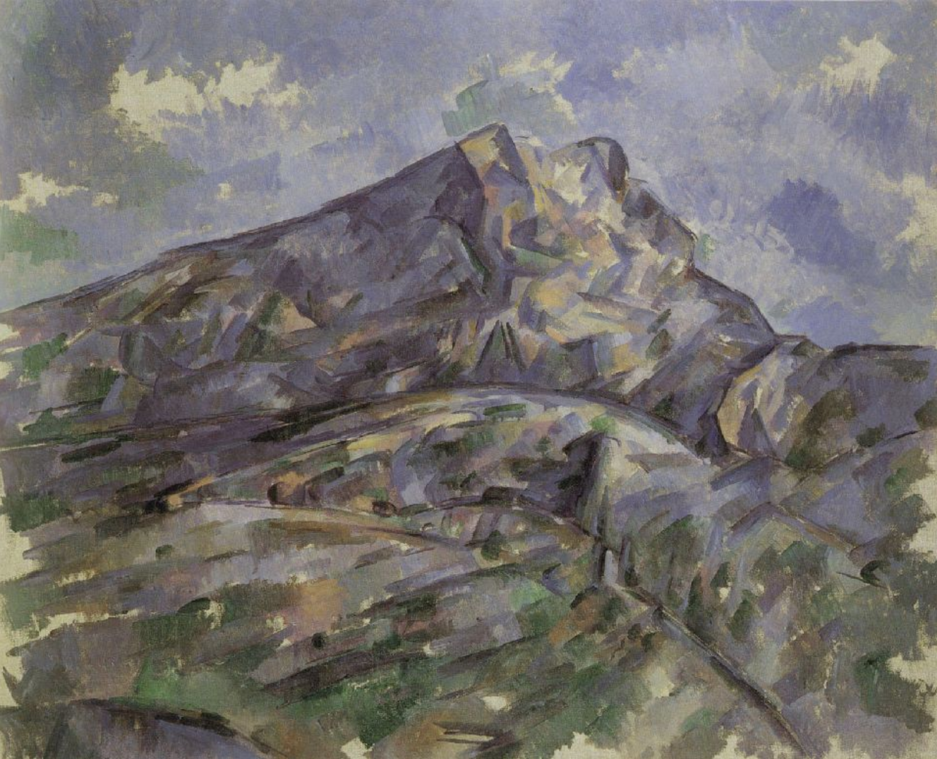
"It is clear from his conversations with Emile Bernard that Cézanne was always seeking to avoid the ready-made alternatives suggested to him: sensation versus judgment; the painter who sees against the painter who thinks; nature versus composition; primitivism as op-posed to tradition.... Rather than apply to his work dichotomies more appropriate to those who sustain traditions than to those men, philosophers or painters, who initiate these traditions, he preferred to search for the true meaning of painting, which is continually to question tradition. Cézanne did not think he had to choose be-tween feeling and thought, between order and chaos. He did not want to separate the stable things which we see and the shifting way in which they appear; he wanted to depict matter as it takes on form, the birth of order through spontaneous organization” (Merleau-Ponty 1993, 59).
“Cézanne’s Doubt”
Mont Sainte-Victoire
Oil on canvas, Paul Cézanne, 1904.
Edsel and Eleanor Ford House, Grosse Point, Michigan

Slide 10
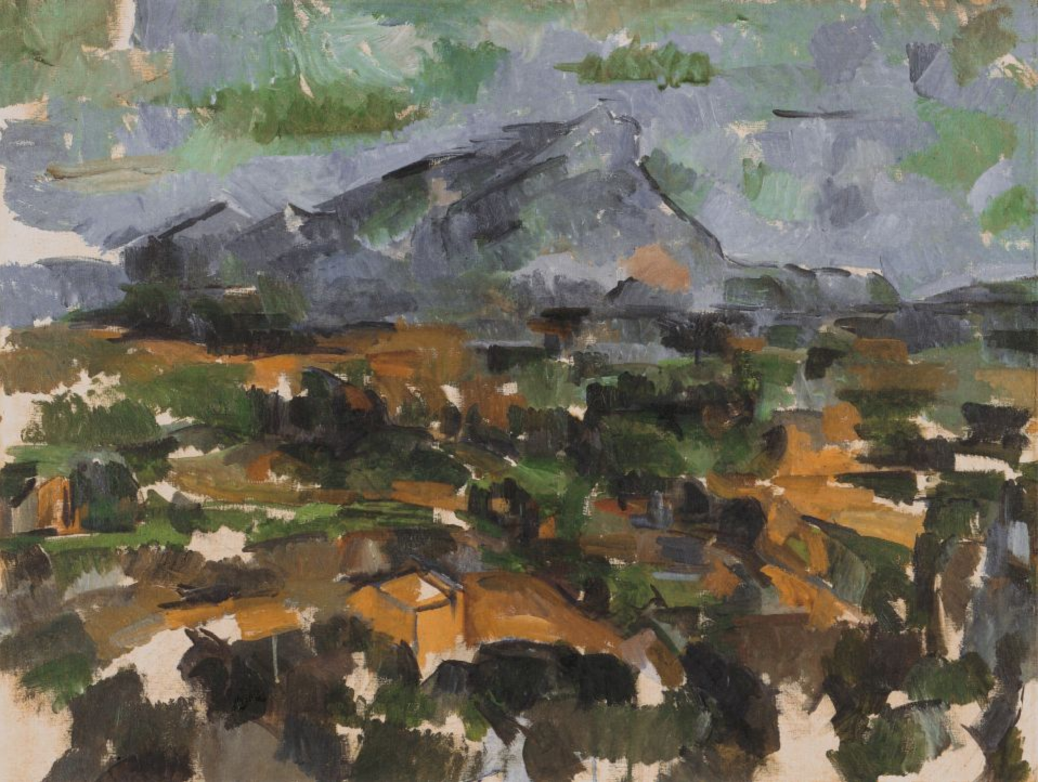
"The lived object is not rediscovered or constructed on the basis of the contributions of the senses; rather, it presents itself to us from the start as the center from which these contributions radiate. We see the depth, the smoothness, the softness, the hardness of objects; Cézanne even claimed that we see their odor. If the painter is to express the world, the arrangement of his colors must carry with it this indivisible whole, or else his picture will only hint at things and will not give them in the imperious unity, the presence, the insurpassable plenitude which is for us the definition of the real” (Merleau-Ponty 1993, 65).
“Cézanne’s Doubt”
Mont Sainte-Victoire
Oil on canvas, Paul Cézanne, 1902-06.
Kunsthaus, Zurich, Switzerland

Slide 11
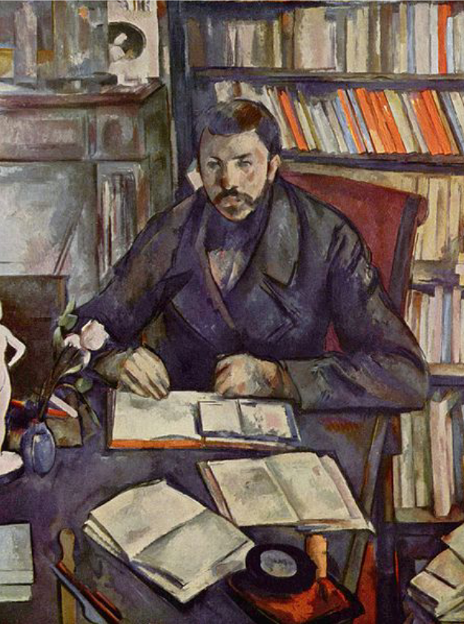
“Gustave Geffroy's table stretches into the bottom of the picture, and indeed, when our eye runs over a large surface, the images it successively receives are taken from different points of view, and the whole surface is warped. It is true that I freeze these distortions in repainting them on the canvas; I stop the spontaneous movement in which they pile up in perception and tend toward the geometric perspective” (Merleau-Ponty 1993, 64).
Nor did Cézanne neglect the physiognomy of objects and faces: he simply wanted to capture it emerging from the color. Painting a face 'as an object' is not to strip it of its 'thought.' 'I realize that the painter interprets it,' said Cézanne. 'The painter is not an imbecile.' But this interpretation should not be a reflection distinct from the act of seeing” (Merleau-Ponty 1993, 66).
“Cézanne’s Doubt”
Portrait of Gustave Geffroy
Oil on canvas, Paul Cézanne, 1895.
Musée d'Orsay

Slide 12
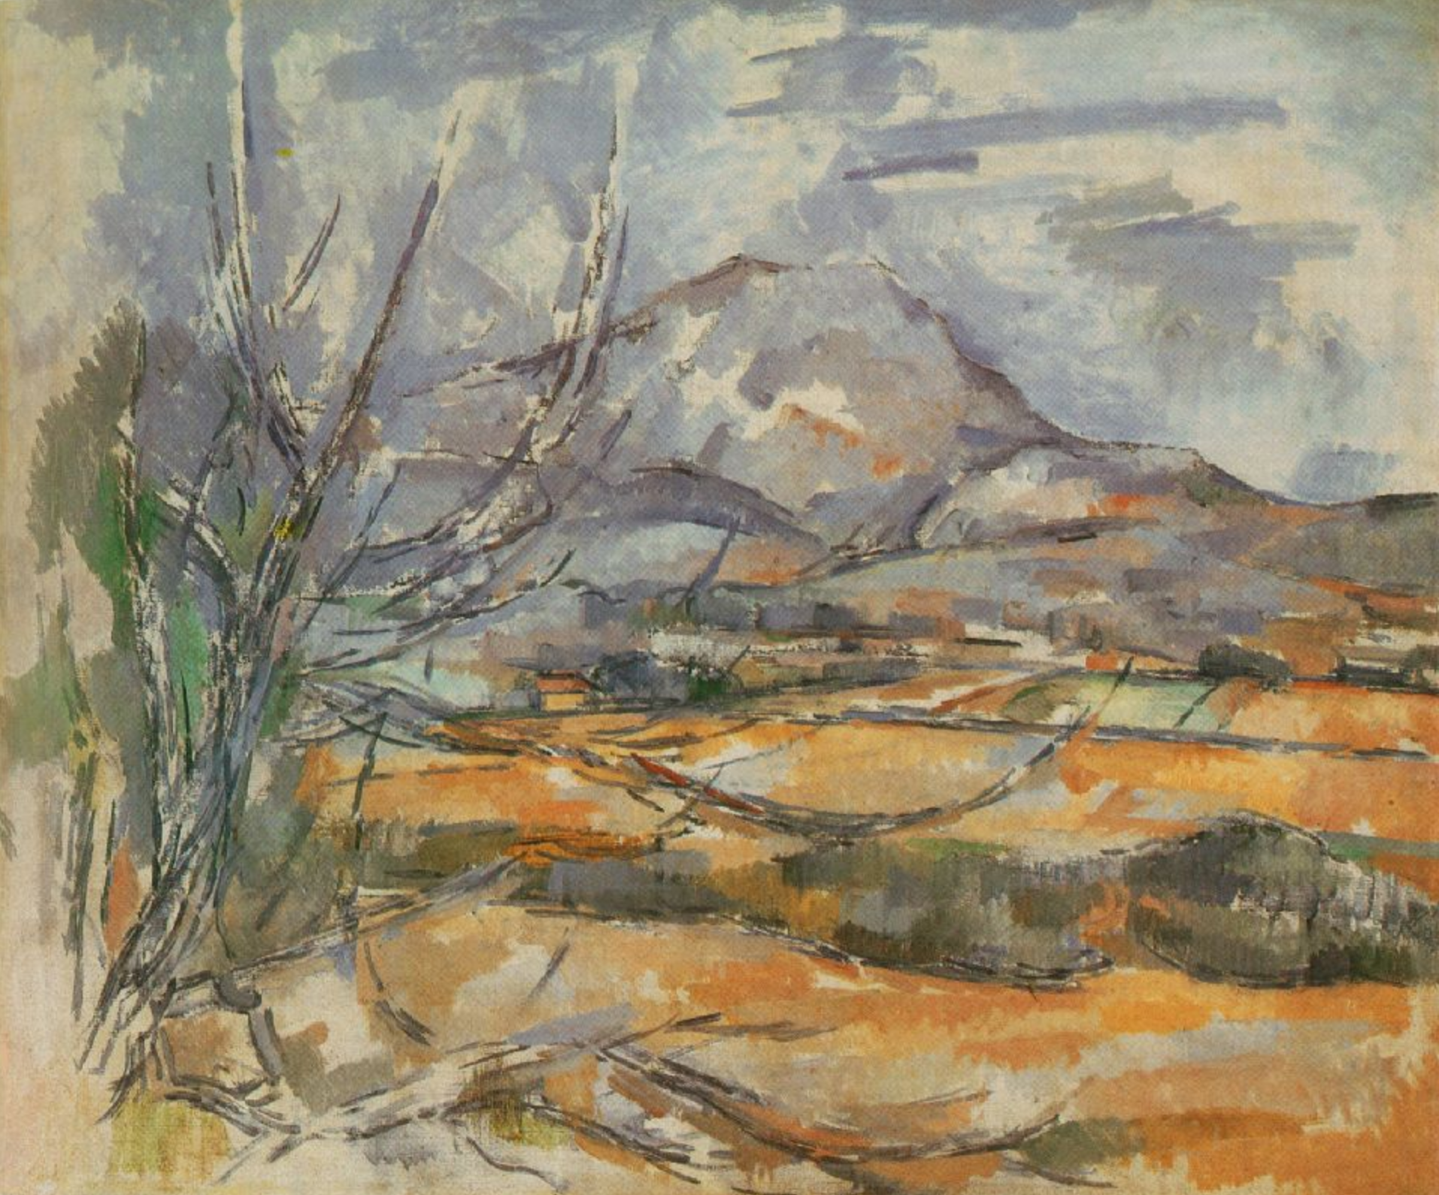
"[W]hat motivates the painter's movement can never be simply perspective or geometry or the laws governing color, or, for that matter, particular knowledge. Motivating all the movements from which a picture gradually emerges there can be only one thing: the landscape in its totality and in its absolute fullness, precisely what Cézanne called a 'motif'.... The task before him was, first to forget all he had ever learned from science and, second through these sciences to recapture the structure of the landscape as an emerging organism. To do this, all the partial views one catches sight of must be welded together; all that the eye’s versatility disperses must be reunited” (Merleau-Ponty 1993, 67).
“Cézanne’s Doubt”
Mont Sainte-Victoire
Oil on canvas, Paul Cézanne, 1900-02.
National Gallery of Scotland, Edinburgh

Slide 13
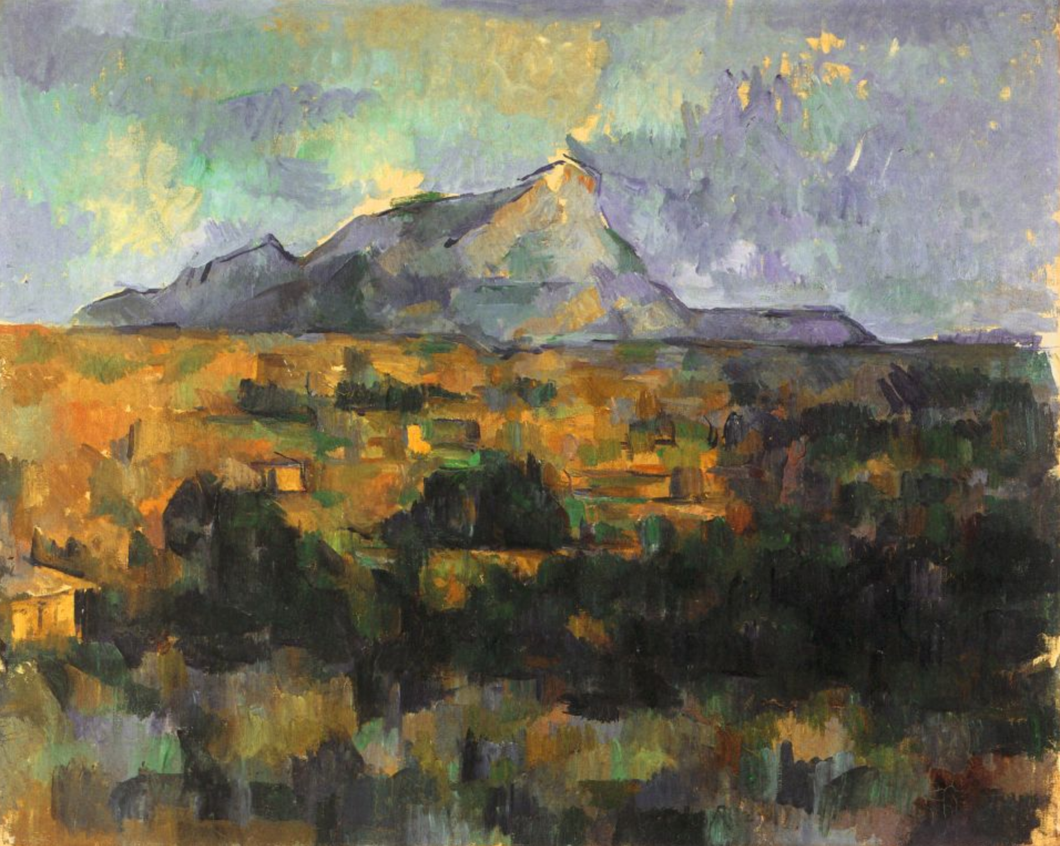
His meditation would suddenly be consummated: “I have a hold on my motif,” Cézanne would say, and he would explain that the landscape had to be tackled neither too high nor too low, caught alive in a net which would let nothing escape. Then he began to paint all parts of the painting at the same time, using patches of color to surround his original charcoal sketch of the geological skeleton. The picture took on fullness and density; it grew in structure and balance; it came to maturity all at once. "The landscape thinks itself in me,” he would say, "and I am its consciousness." Nothing could be farther from naturalism than this intuitive science. Art is not imitation, nor is it something manufactured according to the wishes of instinct or good taste. It is a process of expression. (Merleau-Ponty 1993, 67-68)
“Cézanne’s Doubt”
Mont Sainte-Victoire
Oil on canvas, Paul Cézanne, 1902-06.
Emile G Buhrle, Zurich, Switzerland

Slide 14
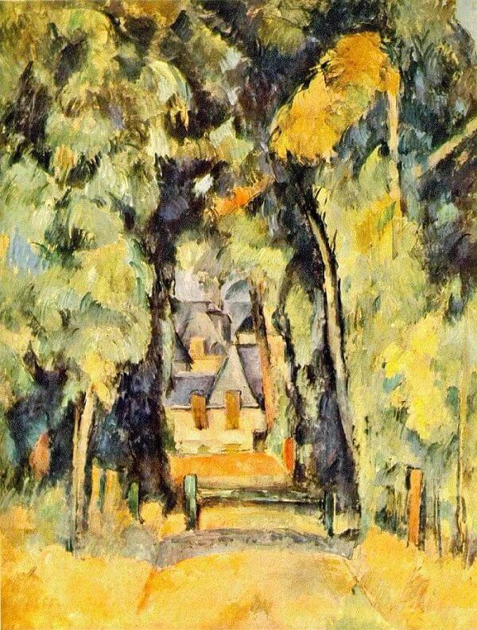
Merleau-Ponty returns to the analysis of painting in his final essay, “Eye and Mind.” Here he suggests that painting has an ontological significance—it can reveal something about existence, about what it means to be in the world; and thus it can be a way of reopening the ‘question of Being’ as Heidegger had put it. For Merleau-Ponty, modern painting, particularly the paintings of Cézanne, reveals something important about vision itself. Painting he tells us, “celebrates no other enigma but that of visibility”; it ”awakens and carries to its highest pitch a delirium which is vision itself” (Merleau-Ponty 1994, 286). What he attempts to show in his interrogation of painting is “this secret and feverish genesis of things in our body” (Merleau-Ponty 1994, 287).
“Eye and Mind”
Road at Chantilly
Oil on canvas, Paul Cézanne, 1888.
Collection Mr. and Mrs. William A. M. Burden, New York

Slide 15
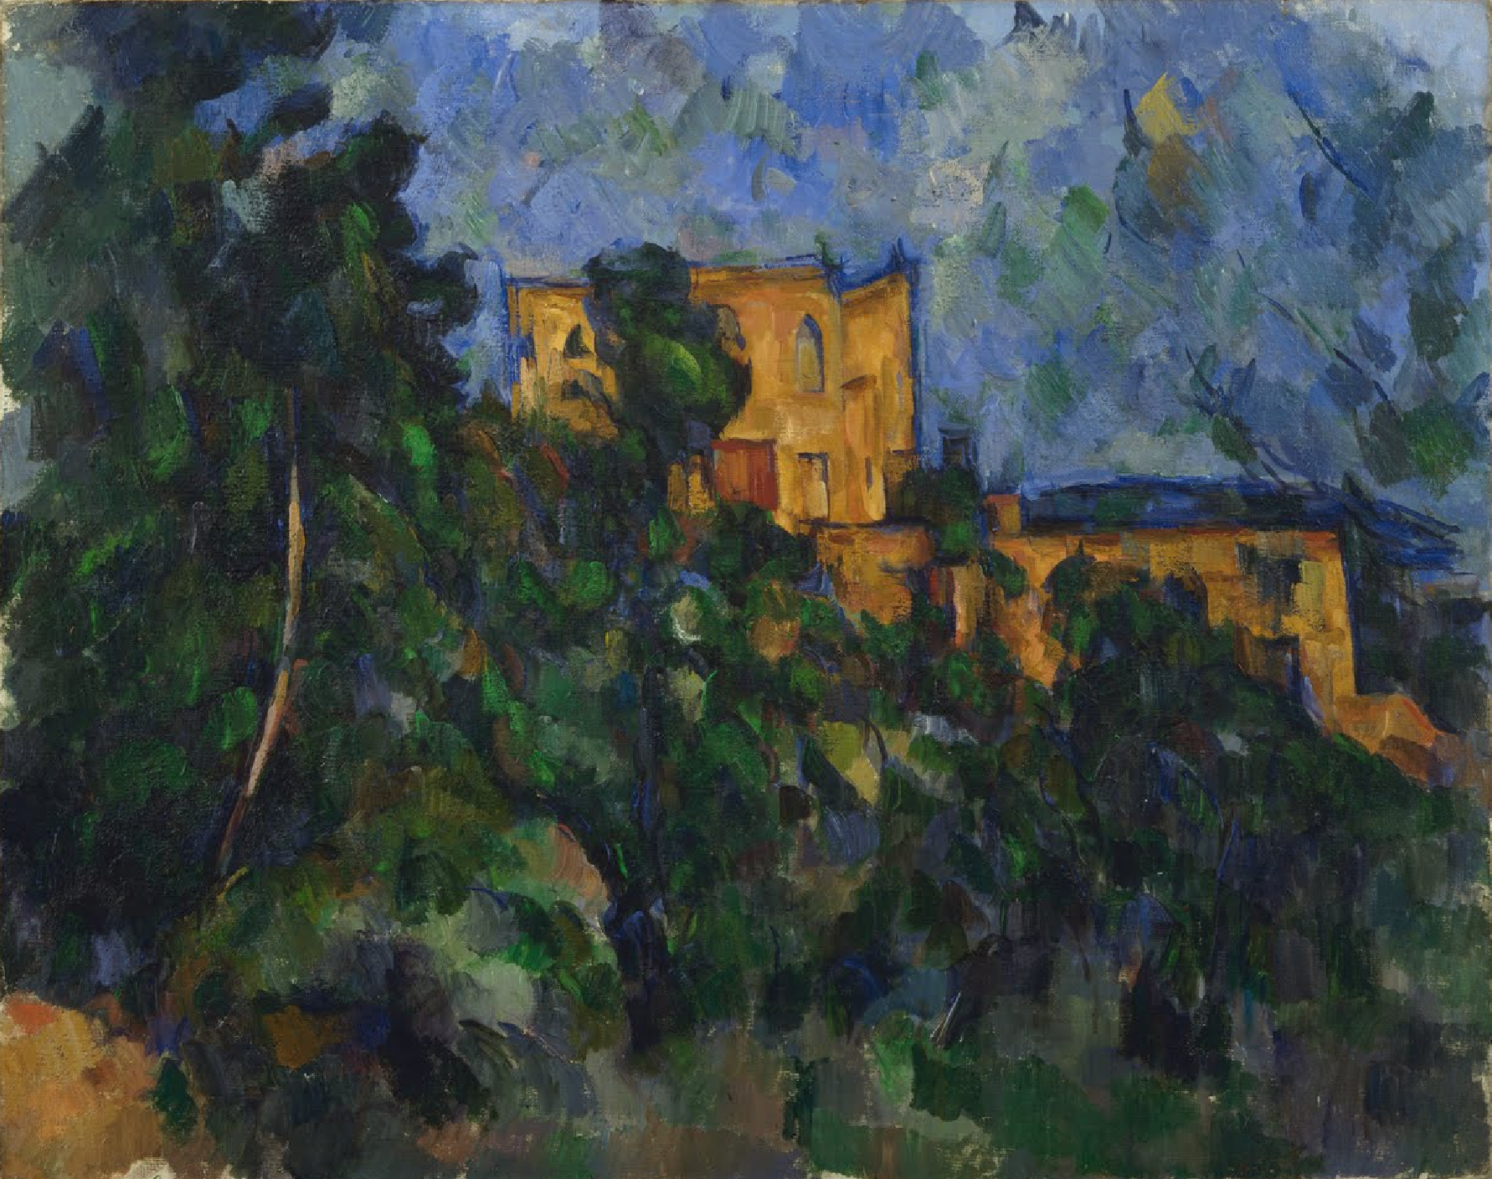
Merleau-Ponty stresses the artists immersion in the very being of the world he or she is trying to bring to visible expression. Nietzsche had suggested viewing the world as an aesthetic phenomenon in The Birth of Tragedy. Merleau-Ponty’s aesthetics could be said to be a development of this idea; his examination of painting illustrates how vision itself is painting. His analysis of the process of painting in Cézanne, Klee, Matisse and others brings out how the world is a product, in a sense, of an artistic vision. “There is no break at all in this circuit; it is impossible to say that nature ends here and that man or expression starts here” (Merleau-Ponty 1994, 296).
“Eye and Mind”
Château Noir
Oil on canvas, Paul Cézanne, 1903-04
The Museum of Modern Art, New York

Slide 16
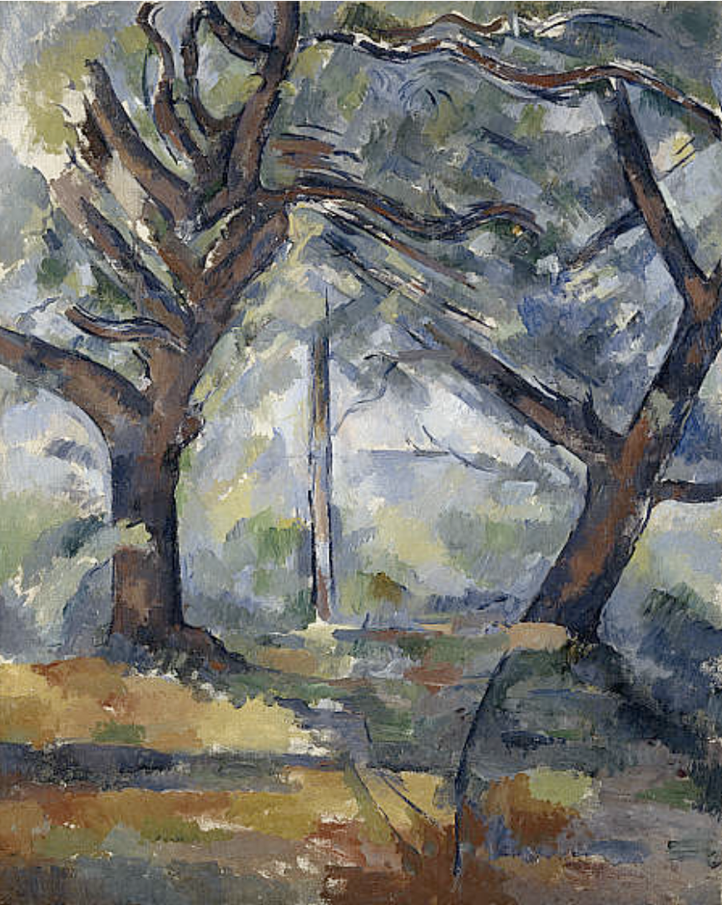
"Eye and Mind" is a complex and poetic analysis of painting as a form of vision. In this essay, Merleau-Ponty develops an alternative to the representationalist view of perception by extending Heidegger's notion of human reality as Being-in-the-World. He does this by means of an extended exploration of a paradox of human vision—that we not only see those things that make up the world, but we see ourselves in the world. In other words, the body that sees, also sees itself. This reflexivity leads to a kind of ambiguity of vision. It is the investigation of this reflexivity and its embodiment in the practice of painting that gives Merleau-Ponty's essay its subtle, intriguing, and elusive character. But if it is true that the world in which we live and to which we belong is inherently ambiguous, then "Eye and Mind" can be seen as illuminating our contingency of being rather than obscuring it.
(Quigley 2013, 1)
“Eye and Mind”
The Big Trees
Oil on canvas, Paul Cézanne, 1904.
The Museum of Modern Art, New York

Slide 17
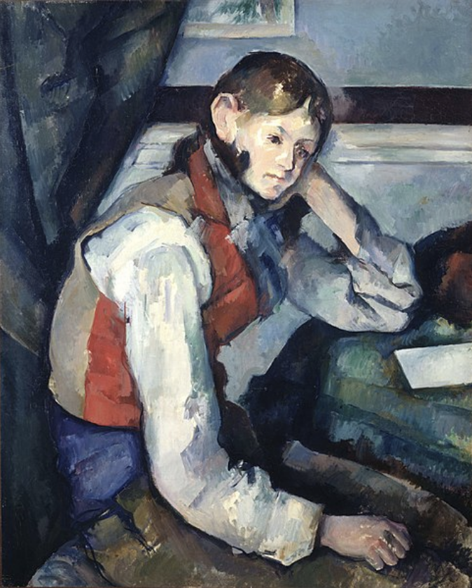
In the opening paragraph Merleau-Ponty starts out with basic phenomenological perspective, wanting to return to the primordial, pre-reflexive experience of body in a world with others. “In this primordial historicity, science’s agile and improvisatory thought will learn to ground itself upon things themselves and upon itself, and will once more become philosophy” (Merleau-Ponty 1994, 282). Merleau-Ponty suggests that art, especially painting, gives us access to this primordial experience. The writer and philosopher are not able to hold the world suspended (take the phenomenological perspective), and music is too far on the other extreme—too far beyond the world. “Only the painter is entitled to look at everything without being obliged to appraise what he sees” (Merleau-Ponty 1994, 283).
“Eye and Mind”
The Boy in the Red Vest
Oil on canvas, Paul Cézanne, 1889-90.
Foundation E.G. Bührle

Slide 18
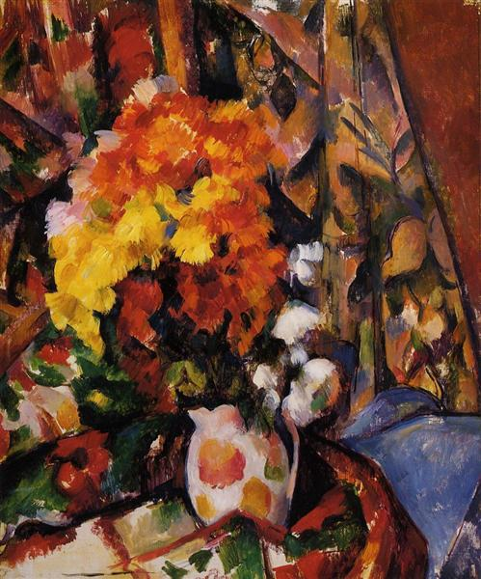
In order to understand the nature of painting—the bodily relation of the painter to the world—we must first understand what it is for a human being to be “in” the world. This must be understood phenomenologically, not theoretically or objectively. Thus, in the second section (II), Merleau-Ponty describes the nature of our bodily involvement in the world.
(Quigley 2013, 1)
Thus Merleau-Ponty begins with emphasis on bodily nature of painting: “Indeed we cannot imagine how a mind could paint” (Merleau-Ponty 1994, 283). Merleau-Ponty refuses to conceive of vision as an operation of thought, and thus challenges the Cartesian perspective that shaped modern philosophy. Vision is a matter of opening oneself to the world, not setting up before the mind a picture or representation of the world.
“Eye and Mind”
Chrysanthemums
Oil on canvas, Paul Cézanne, 1898.
Barnes Foundation, Philadelphia, PA, US

Slide 19
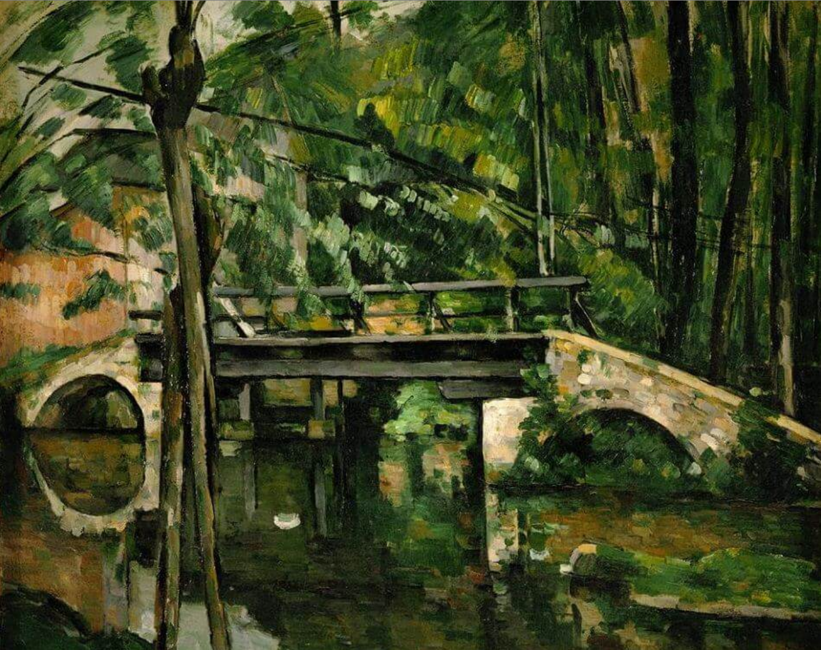
Thus, Merleau-Ponty explains that the embodied self is already caught up in the fabric of the world. The primordial experience of this self is undivided; there is no separation between mind and body, the sensing and the sensed, the self and other.
“Once this strange system of exchanges is given, we find before us all the problems of painting. These exchanges illustrate the enigma of the body, and this enigma justifies them. Since things and the body are made of the same stuff, vision must somehow take place in them; their manifest visibility must be repeated in the body by a secret visibility. ‘Nature is on the inside,’ says Cézanne. Quality, light, color, depth, which are there before us, are there only because they awaken an echo in our body and because the body welcomes them” (Merleau-Ponty 1994, 285).
“Eye and Mind”
The Bridge at Maincy
Oil on canvas, Paul Cézanne, 1879.
Musée d'Orsay, Paris, France

Slide 20
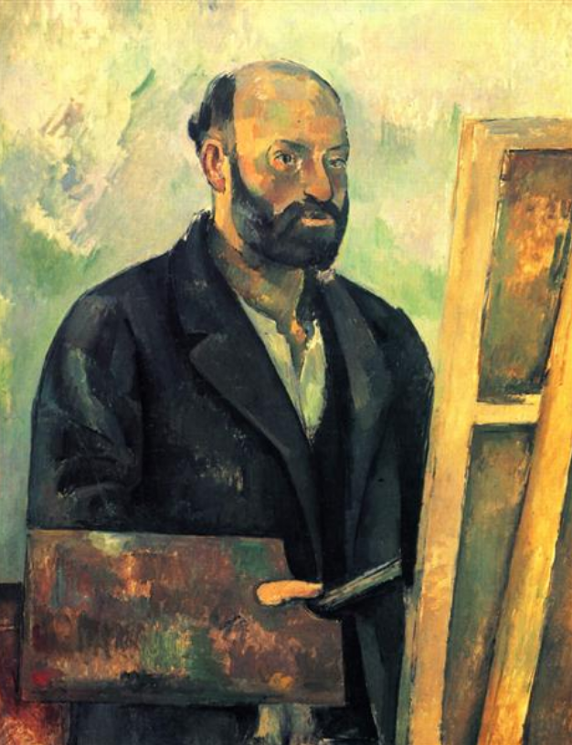
Having characterized seeing as a process through which the thing "makes itself visible in us", Merleau-Ponty claims that the painter's task is to explore this process of seeing. Thus, the painter investigates through painting the means by which an object makes itself visible before our eyes. To do this the painter must develop a sensitivity to the elements of visual experience, e.g. light, shadow, reflections, color, depth, line and movement. These are just the sort of things that people who are not artists tend to overlook. Thus, one must be trained to see them and to use them to produce paintings. This results in a unity of "inspiration and expiration"—of allowing the world to be made visible within you and to make the world visible to others by painting. This is what Merleau-Ponty means when at the beginning of this section he says, "It is by lending his body to the world that the painter changes the world into paintings” (Merleau-Ponty 1994, 283).
(Quigley 2013, 3)
“Eye and Mind”
Self-Portrait with Palette
Oil on canvas, Paul Cézanne, 1890.
E.G. Bührle Foundation, Zürich, Switzerland

Slide 21
Guignon, Charles B. 1998. “Existentialism” doi:10.4324/9780415249126-N020-1. Routledge Encyclopedia of Philosophy, Taylor and Francis, https://www.rep.routledge.com/articles/thematic/existentialism/v-1.
Merleau-Ponty, Maurice. 1993. “Cézanne’s Doubt” in The Merleau-Ponty Aesthetics Reader: Philosophy and Painting. Edited by Michael B. Smith. Evanston, Illinois: Northwestern University Press. [1945]
Merleau-Ponty, Maurice. 1994. “Eye and Mind” in Art and Its Significance, 3rd ed. Edited by Stephen David Ross. Albany: State University of New York Press. [1961]
Bibliography

