Slide 1
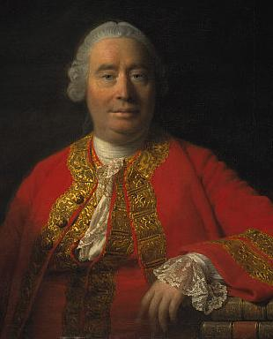
Hume’s
Philosophy of Art
Of the Standard of Taste

Slide 2
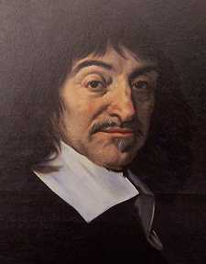
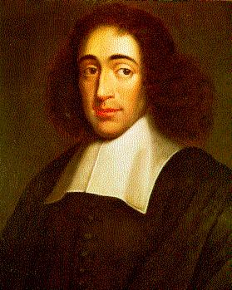
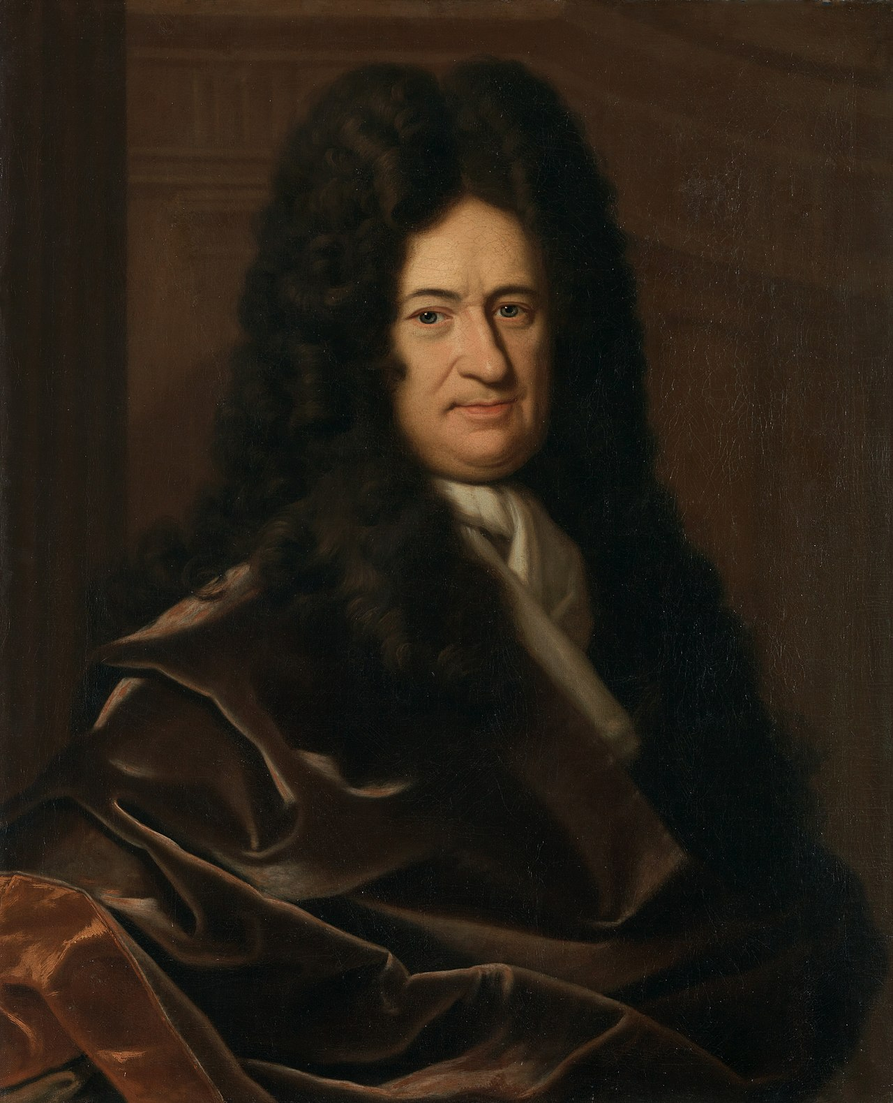
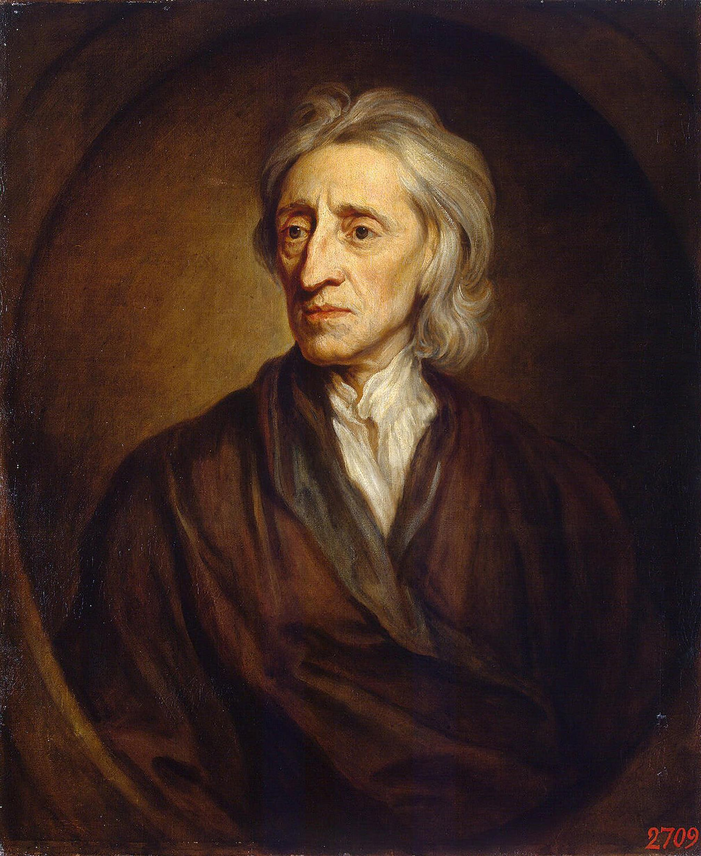
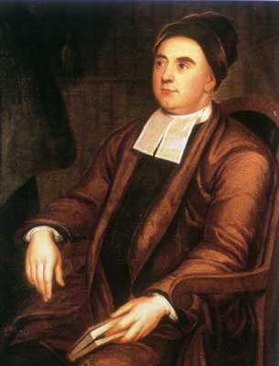
Modern Philosophy
Rationalism
Knowledge comes from Pure Reason
Empiricism
Knowledge comes from the Senses
René
Descartes (1596–1650)
France
Baruch
Spinoza
(1632–1677)
The Netherlands
Gottfried Leibniz (1646–1716)
Germany
John
Locke
(1632-1704)
England
George
Berkeley
(1685-1753)
Ireland
David
Hume
(1711-1776)
Scotland

Slide 3
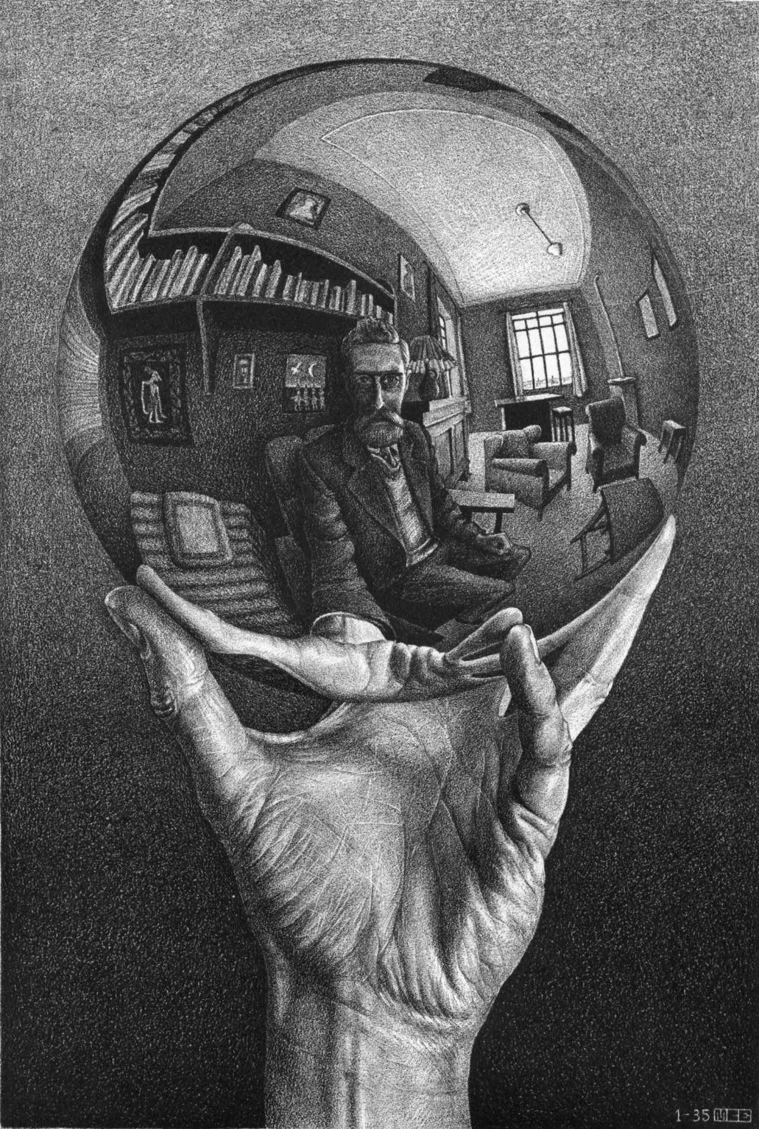

Mind as a Mirror of Nature
Mind
Thinking Substance
Ideas in Mind Reflect Reality
Nature/Reality as it is in-itself
Extended Substance

Slide 4
How Descartes Influenced 17th Century Reflection on Art
From Descartes, the ideas of reason, good sense, intelligibility were considered essential to the poet.
The concepts of Nature and Reason were crucially important. Nature is the universal underlying the particular, the reality behind appearance. Thus Nature and Reason are intrinsically allied. The influence of Aristotle’s Poetics is also clear. Poetry is an imitation of human action. With the development of the emerging concept of Nature, this basic Aristotelean idea would be further developed.
The aim of the poet is to provide “just representation of general Nature” (Samuel Johnson, 1765) “The business of the poet . . . is to examine, not the individual, but the species . . . .”
Shakespeare’s characters are praised for their universality, not their individuality. They sought “the grandeur of generality.” The aim of poetry and drama is to reveal universal traits of human nature.

Slide 5
How Descartes Influenced 17th Century Reflection on Art
Because the end of poetry can be exactly stated, the neo-classical theorists held that there could be a science to art criticism. It should be possible in principle to discover and draw up a set of general rules by which a poem can be successfully constructed, and criticism possible. The doctrine of rules, especially the three alleged Aristotelean rules of tragedy, came into its own in 17th century. This brought into the heart of aesthetics the epistemological conflict of the Enlightenment: the conflict between the rival claims of the Rationalists and Empiricists, the importance of reason in contrast to sense experience. Most of the theorists of the 17th century were united on the a priori approach. The major premise that poetry is imitation of human action was not questioned. The poet John Dryden put it thus: “ if Nature is to be imitated, then there is a rule of imitating Nature rightly.” Dryden was quite explicit that “taste” cannot be all there is to criticism.

Slide 6
How Descartes Influenced 17th Century Reflection on Art
In the 17th century there was an attempt to make painting a serious and intellectual art, comparable to tragedy and epic poetry. As Aristotle had suggested, the function of painting was to please by teaching. Painting is thus understood as imitation of Nature. In late 15th and 16th centuries, painting was conceived as imitation of nature, but more of a realistic way, with attention to the sensuous show of things. The dominant theme of 17th century painting was “ideal imitation” of Nature in the Cartesian sense. Thus ideal imitation meant the representation of the general, rather than the individual. Sir Joshua Reynolds lectures at English Royal Academy emphasized role of reason in art.If painting is an art at all it must have principles. The aim of painting has beauty as its object,
but a beauty that is general and intellectual, an idea that exists only in the mind.
The aim was thus to paint “the general form of things.”

Slide 7
How Descartes Influenced 17th Century Reflection on Art
The application of Descartes’ metaphysics to the problem of painting: if painting is taken as the imitation of human beings in action, the essential problem of representation is to depict in bodily motion states of mind and soul. This is what is called “expression” in 17th century theory.
Thus it was assumed that rules for painting will be found in a theory of expression. This required an analysis of emotions and their physiological manifestations. Thus, much effort was put into classifying the details of physiological expression.
Thus there was a general confidence that general principles to explain the goodness and badness of painting might be found.

Slide 8
The Problem of Judgment
Empirical Judgment
“Matters of Fact”
Ordinary and Scientific
“It is raining outside.”
“Wearing masks helps stop the spread of the virus.”
“Climate change is contributing to the increasing frequency and destructiveness of fires in California.”
“Human emissions of greenhouse gases is a major contributor to the problem of climate change.”
Moral Judgment
Ethics
”It is wrong to tell a lie.”
”Murder is wrong.”
“Abortion is wrong.”
Sex outside of marriage between a man and a woman is wrong.”
”Unequal treatment of black Americans by law enforcement is wrong.”
“Cutting down old-growth redwood trees is wrong.”
Aesthetic Judgment
Beauty
“Sophocles’ Oedipus Rex is the greatest of the Greek Tragedies.”
“John Milton is a better writer than John Ogilby.”
“The best portrait painters in 18th century England were Thomas Gainsborough and Joshua Reynolds.”
“Thomas Gainsborough was a better painter than George Lambert.”

Slide 9
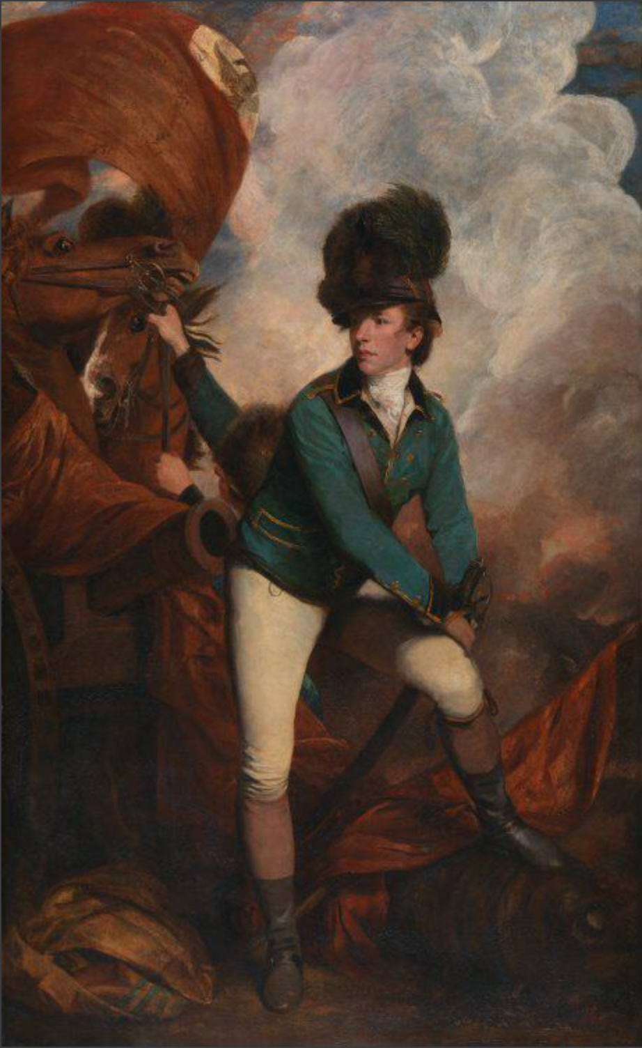
Lieutenant-Colonel Banastre Tarleton, oil on canvas, Joshua Reynolds, 1782,
National Gallery, London.

Slide 10
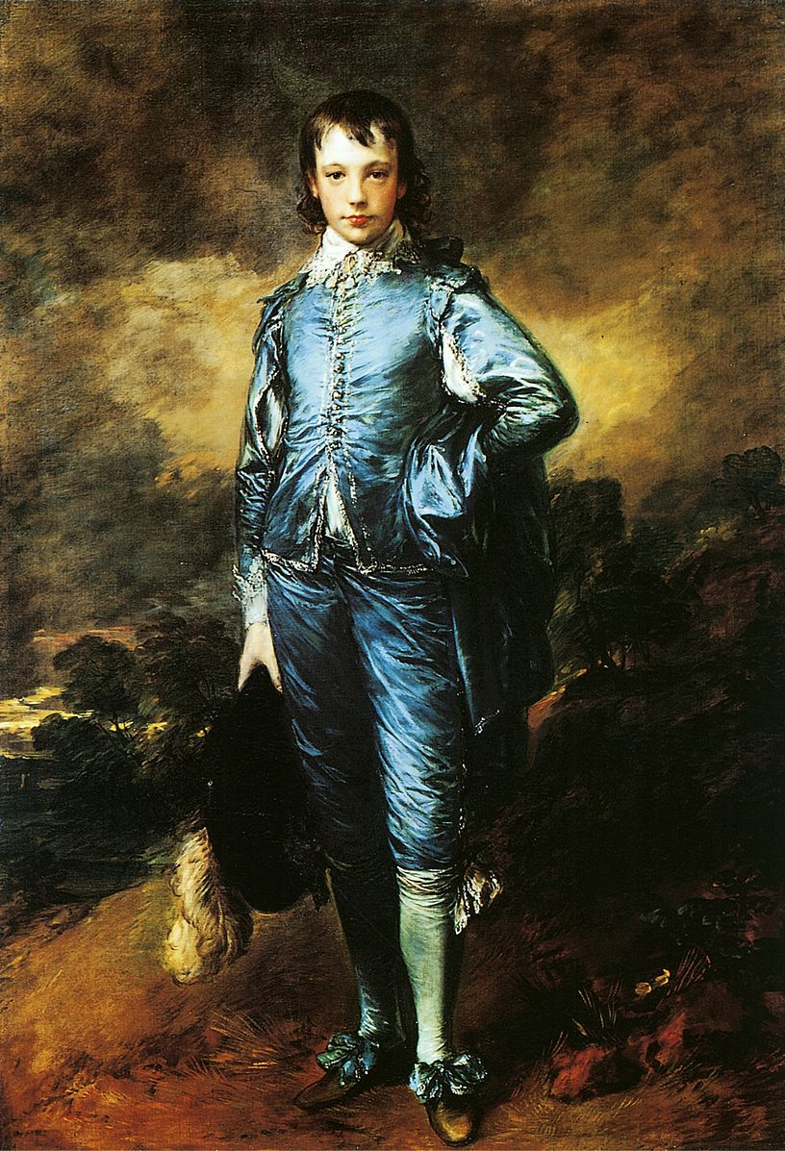
The Blue Boy, oil on canvas, Thomas Gainsborough, 1770,
The Huntington Museum, San Marino, California

Slide 11
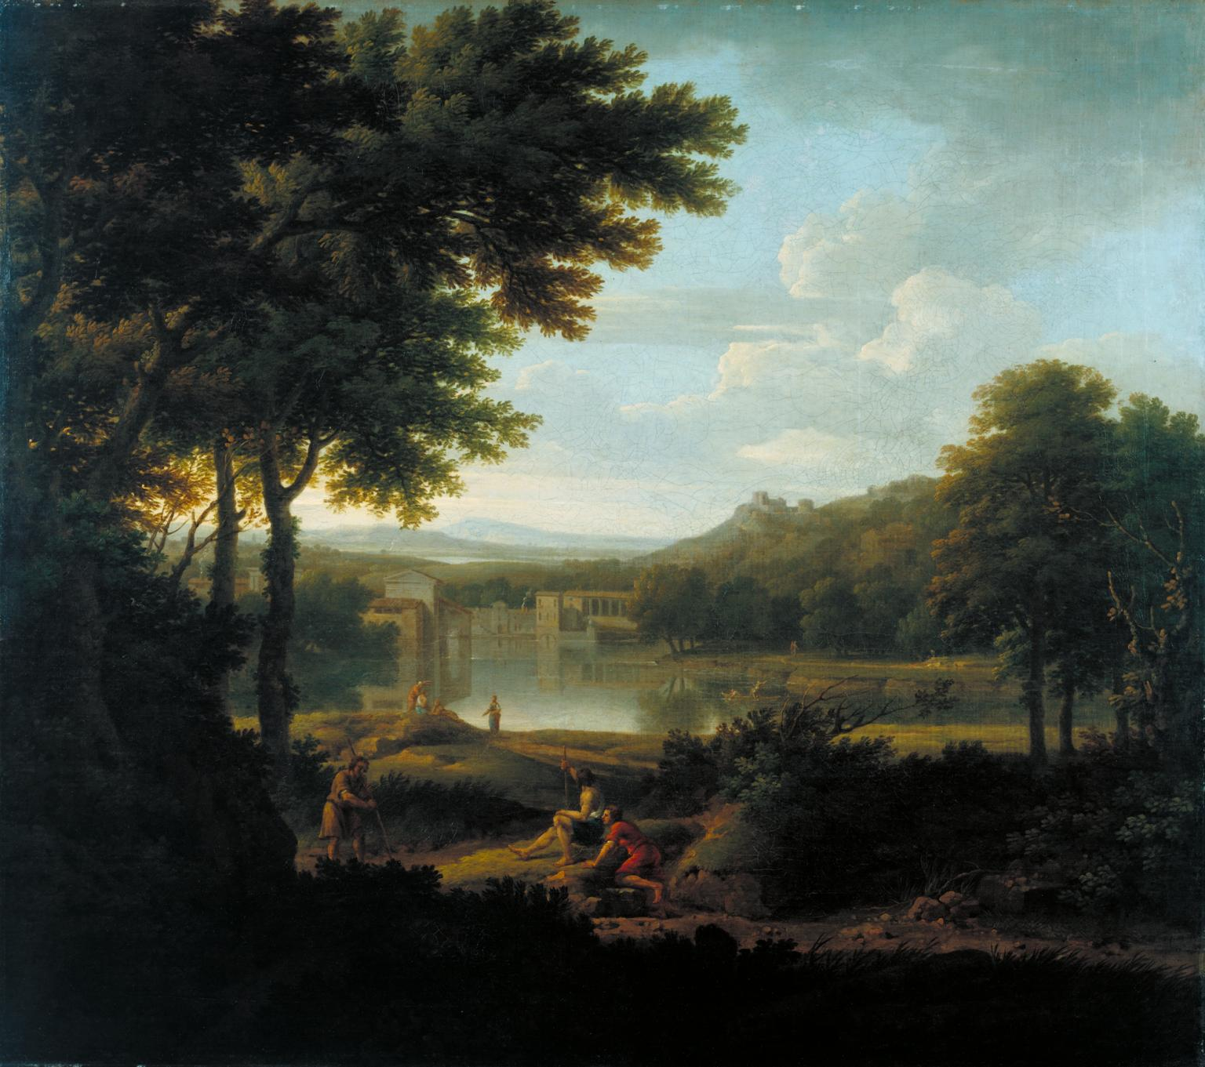
Classical Landscape, oil on canvas,
George Lambert, 1745,
Tate Gallery, London

Slide 12
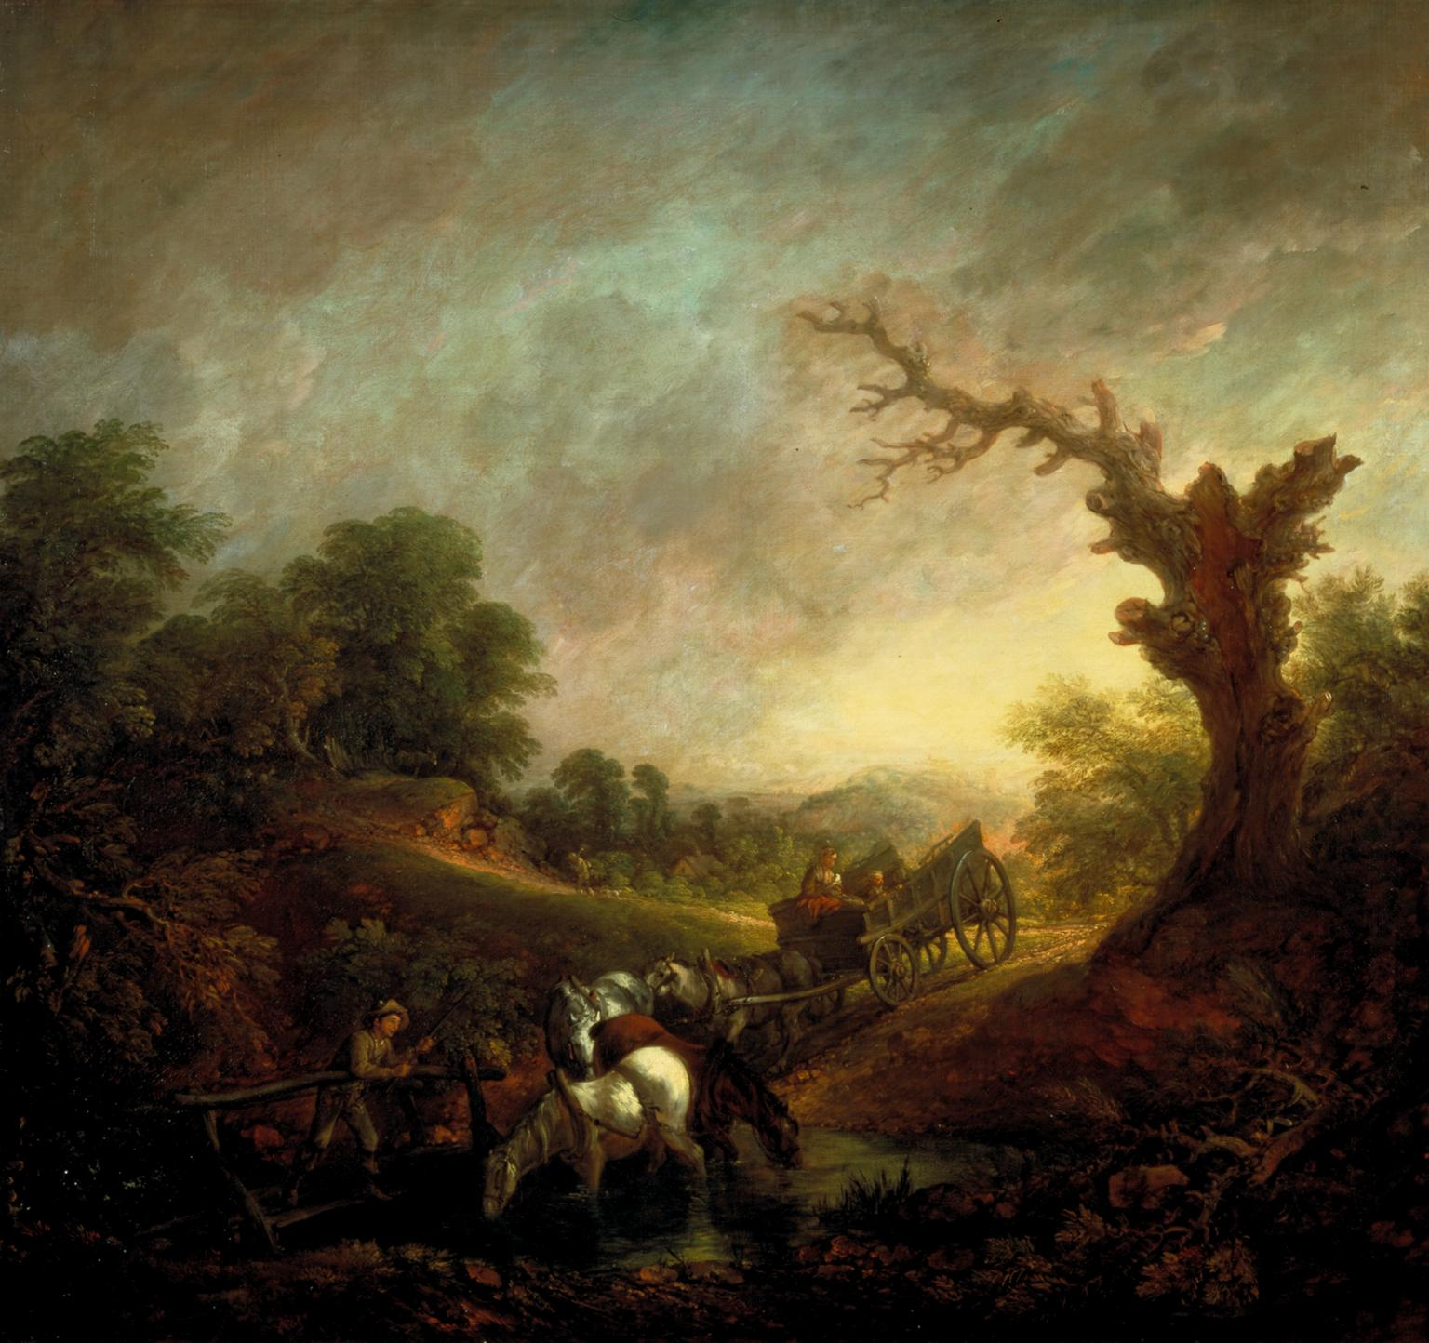
Sunset: Carthorses Drinking at a Stream, oil on canvas, Thomas Gainsborough, 1760,
Tate Gallery, London

Slide 13
For Hume Moral and Aesthetic Judgement are Similar
Hume accepted that moral and aesthetic judgment are matters of sentiment.
He accepts the subjectivity of moral and aesthetic judgment, but rejects that this leads to a pernicious relativism in morals or aesthetics.
The problem is similar. If a moral judgment expresses a speaker’s pleasure in what he sees in human conduct, in what sense can we talk of a right or wrong in morals?
If an aesthetic judgment expresses a speaker’s pleasure in what he sees in beautiful objects, or works of art, in what sense can we talk of better or worse judgments in aesthetics?

Slide 14
Of the Standard of Taste
“It is natural for us to seek a Standard of Taste; a rule, by which the sentiments of men may be reconciled; at least, a decision, afforded, confirming one sentiment and condemning another” (80).
What stands in the way of arriving at such a standard is the traditional difference between judgment and sentiment:
“All sentiment is right; because sentiment has a reference to nothing beyond itself, and is always real, wherever a man is conscious of it. But all determinations of the understanding are not right; because they have a reference to something beyond themselves, to wit, to real matters of fact” (80).

Slide 15
Of the Standard of Taste
Here Hume is restating Locke’s thesis that beauty is “no quality in things themselves.” It is merely a sentiment in the mind that sees something as beautiful:
“Beauty is no quality in things themselves: It exists merely in the mind which contemplates them; and each mind perceives a different beauty. One person may even perceive deformity where another is sensible of beauty; and every individual ought to acquiesce in his own sentiment, without pretending to regulate those of others” (80).
This leads to the view that there can be no standard of taste because taste is merely subjective. Hume wants to accept that aesthetic judgment is subjective, the result of sentiment, but argue that not all aesthetic judgment is equally valid, and thus, there can be a standard of taste.

Slide 16
Of the Standard of Taste
Against this conclusion that no standard of taste is possible, Hume notes that “there is certainly a species of common sense which opposes it, at least serves to modify and restrain it” (80).
Here he refers to some aesthetic judgments, that Milton is better than Ogilby, for example, and that anyone who says otherwise would not be taken seriously:
“no one pays attention to such a taste; and we pronounce without scruple the sentiment of these pretended critics to be absurd and ridiculous” (81).

Slide 17
Of the Standard of Taste
Hume makes it clear that there are no rules of art that are fixed by reasoning a priori—that is reasoning that doesn’t require sense evidence.
In this paragraph he is rejecting the kind of criticism that Descartes and other Rationalist philosophers had put forth in the previous century.
“It is evident that none of the rules of composition are fixed by reasonings a priori, or can be esteemed abstract conclusions of the understanding, from comparing those habitudes and relations of ideas, which are eternal and immutable. Their foundation is the same with that of all the practical sciences, experience; nor are they anything but general observations, concerning what has been universally found to please in all countries and all ages” (81).
Thus the rules of art can only be established by induction, from many observations of the actual effects that poems and paintings have on the beholder.

Slide 18
Of the Standard of Taste
Hume presupposes that there are common dispositions of human nature to be pleased or displeased by certain things.
“It appears then, that, amidst all the variety and caprice of taste, there are certain general principles of approbation or blame whose influence a careful eye may trace in all operations of the mind. Some particular forms or qualities, from the original structure of the internal fabric, are calculated to please and others to displease; and if they fail of their affect in any particular instance, it is from some apparent defect or imperfection in the organ” (82).
“Many and frequent are the defects in the internal organs, which prevent or weaken the influence of those general principles on which depends our sentiment of beauty or deformity” (82-83).

Slide 19
Of the Standard of Taste
Hume spends considerable attention to cataloguing and describing these “defects in the internal organs.”
Lack of delicacy
Failure to have practiced
Failure to have formed comparisons
Prejudice
Lack of good sense

Slide 20
Of the Standard of Taste
Hume thus states what he takes to be the standard of taste:
“Strong sense, united to delicate sentiment, improved by practice, perfected by comparison, and cleared of all prejudice, can alone entitle critics to this valuable character; and the joint verdict of such, wherever they are to be found, is the true standard of taste and beauty” (87).

Slide 21
Of the Standard of Taste
Thus, for Hume, we have a true standard of taste only when judges render a joint verdict. Such a verdict is the verdict that any ideal perceiver would give regardless of particular constitution or cultural background. They are verdicts we would all give, if only we perceived better.
With this notion of the qualified observer, Hume thinks that critical disputes are resolvable within limits. Some judgments can be disqualified or overruled on various grounds such as insensitivity, inattention, prejudice, and inexperience.
The non-relativist basis of his theory of aesthetic judgment is that the general principles of taste are uniform in human nature. Yet there is room for much explainable variability in judgment, and the possibility of unresolvable disagreements.

Slide 22
Of the Standard of Taste
Hume also acknowledges that there are some cases in which differences in affective response and thus aesthetic judgment do not result entirely to differences in perception.
He acknowledges two other sources of diversity of taste:
“the different humours of particular men”
“the particular manners and opinions of our age and country” (89)

