Slide 1
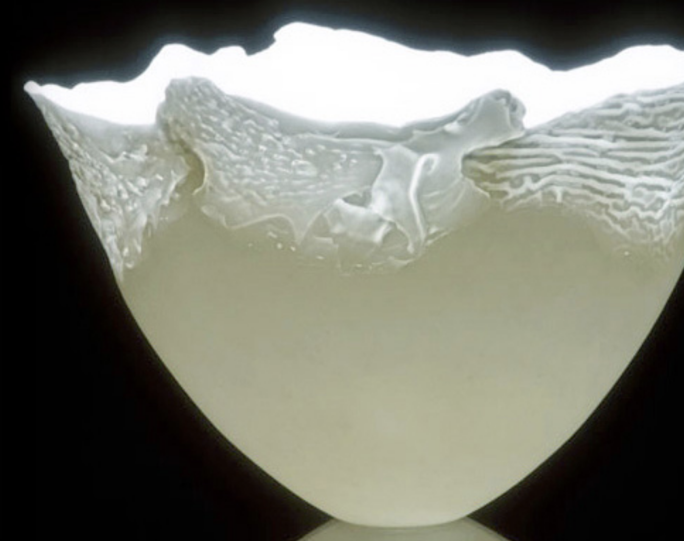
Art as Significant Form

Slide 2
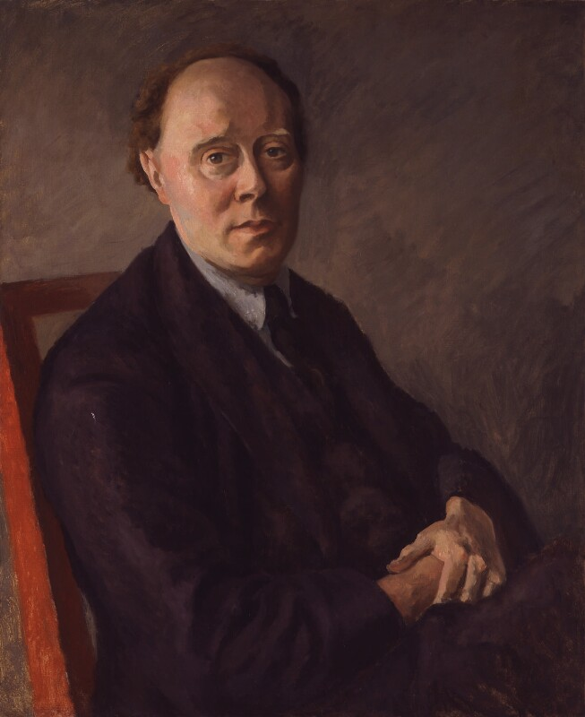
Art as Significant Form
What quality is shared by all objects that provoke our aesthetic emotions? What quality is common to Sta. Sophia and the windows at Chartres, Mexican sculpture, a Persian bowl, Chinese carpets, Giotto’s frescoes at Padua, and the masterpieces of Poussin, Piero della Francesca, and Cezanne? Only one answer seems possible—significant form.
(Bell 1994, 187)
Clive Bell (1881-1964)
painting by Roger Fry, 1924

Slide 3
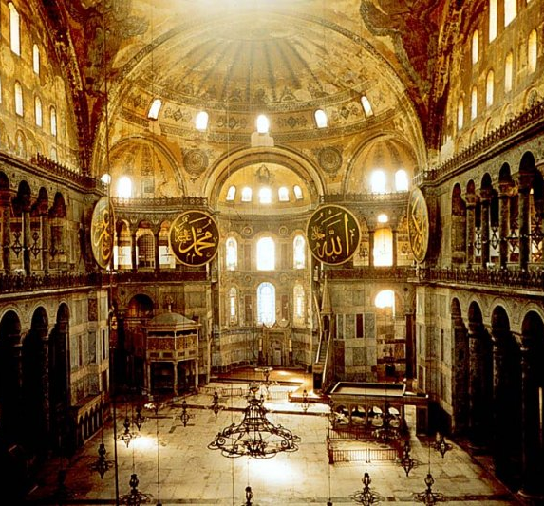
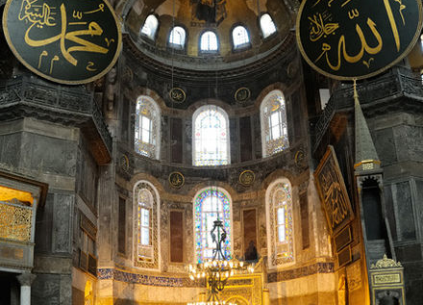
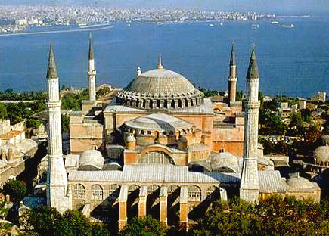

Slide 4
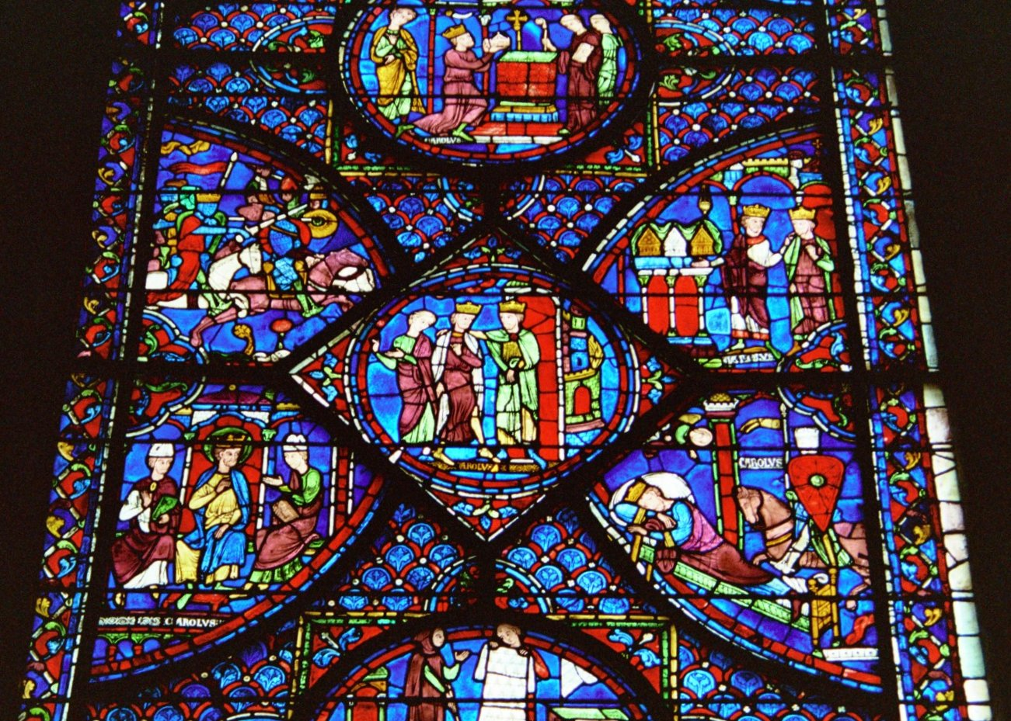

Slide 5
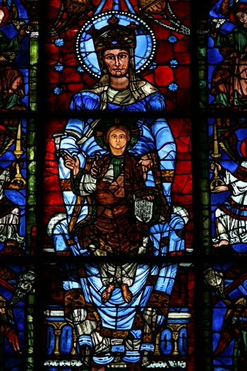

Slide 6
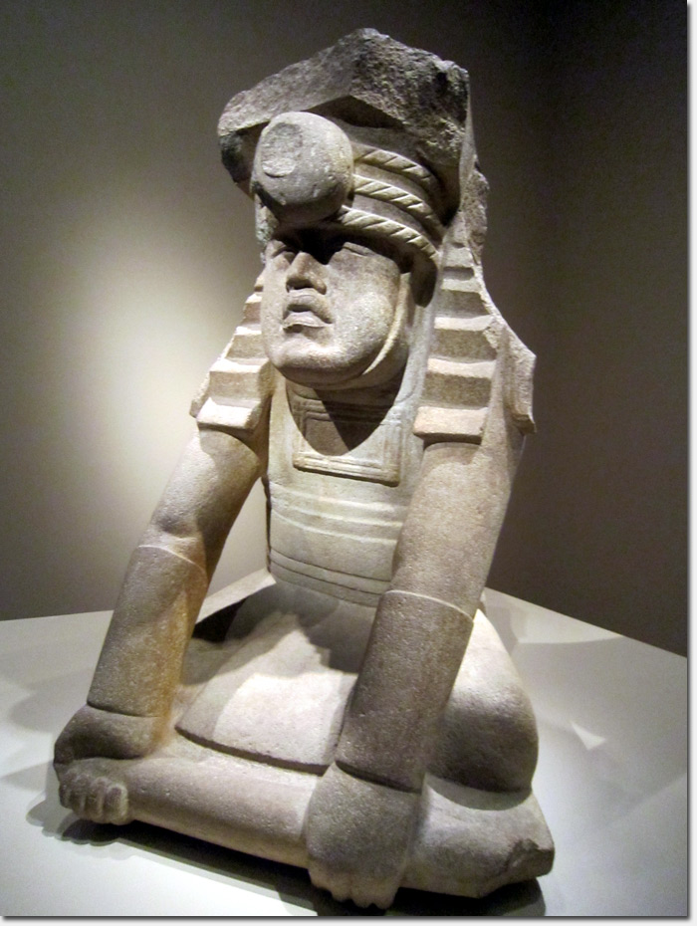

Slide 7
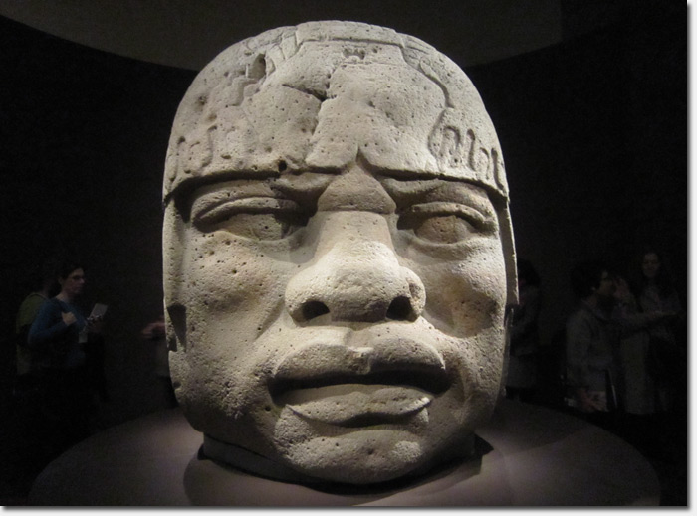

Slide 8
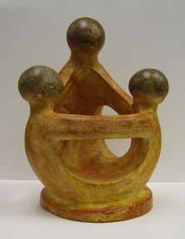

Slide 9
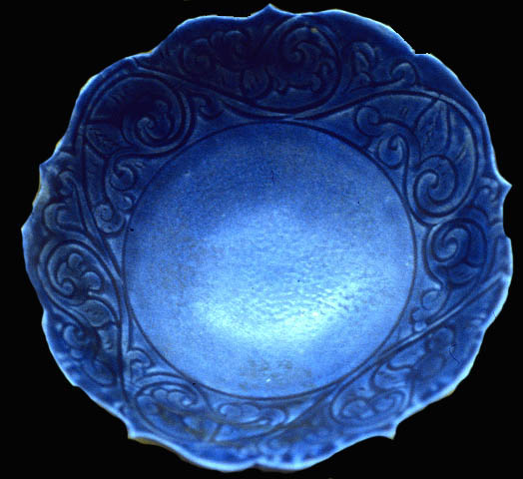

Slide 10
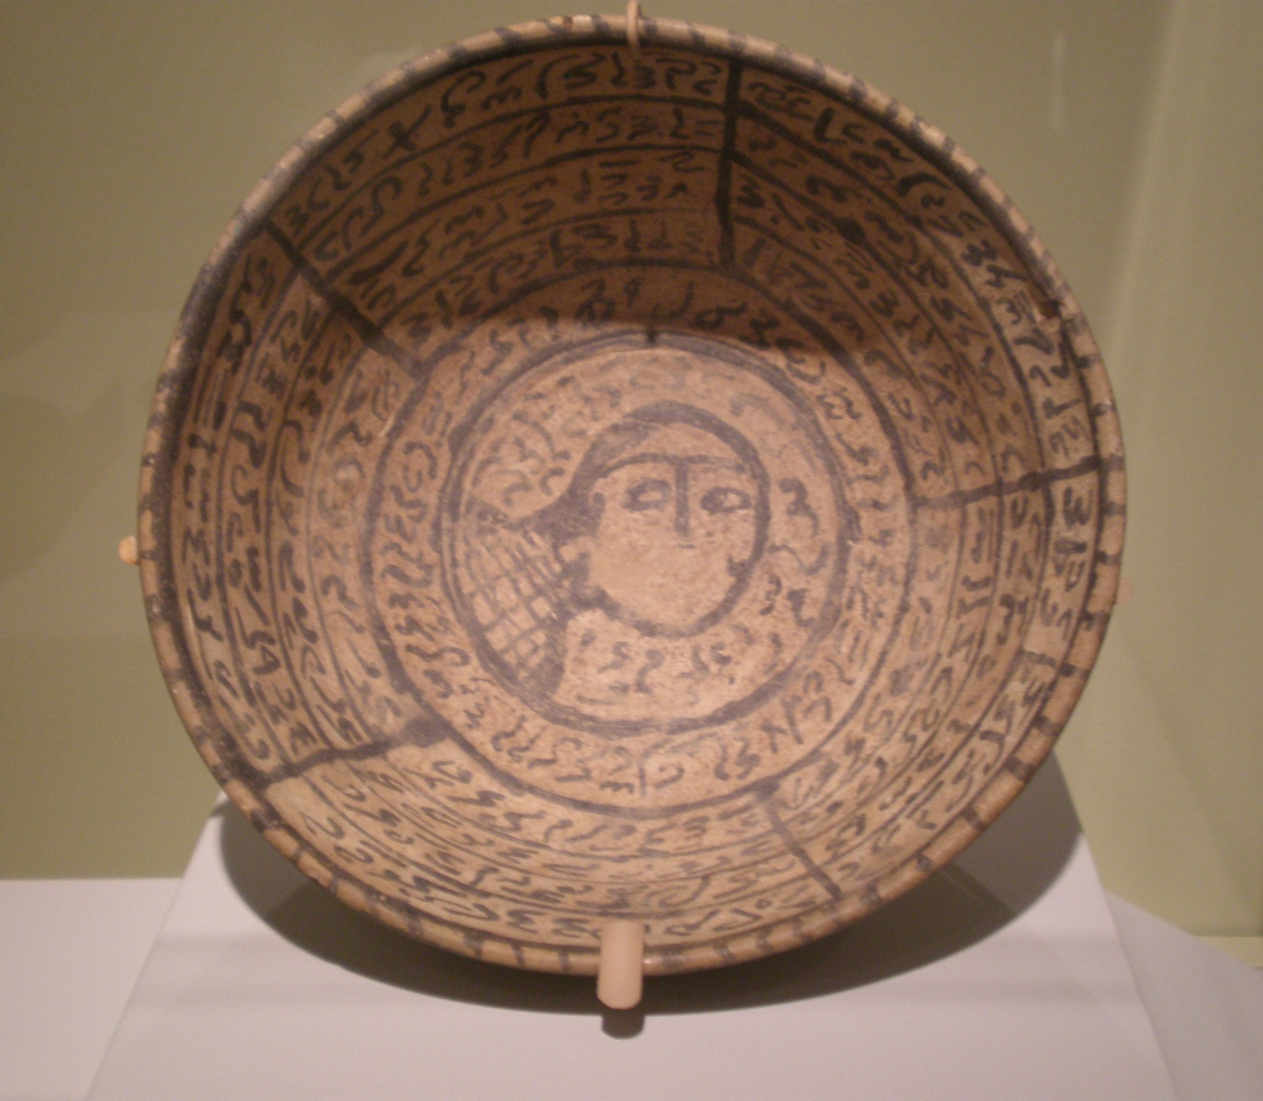

Slide 11
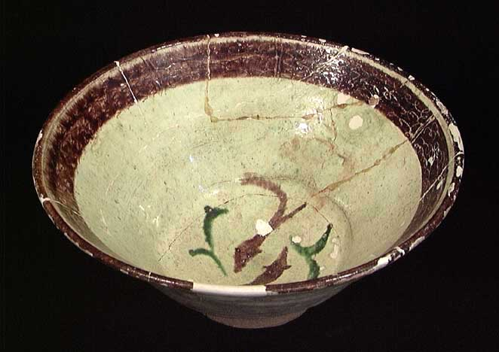

Slide 12
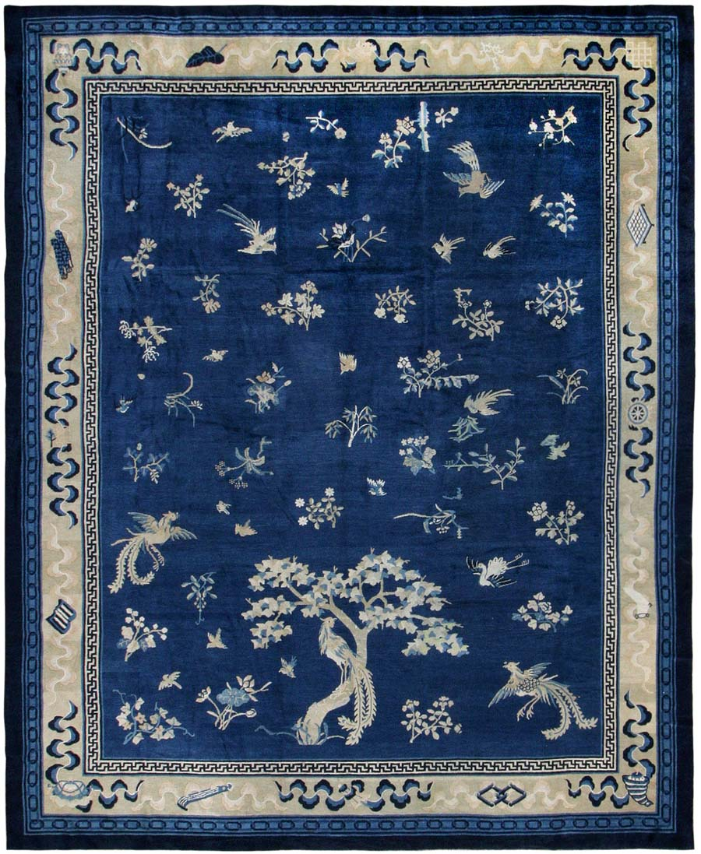

Slide 13
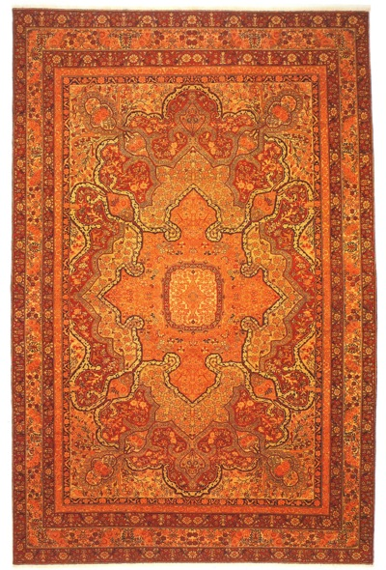

Slide 14
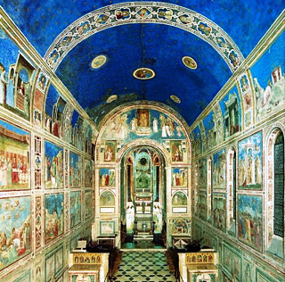

Slide 15
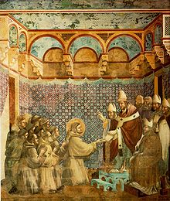

Slide 16
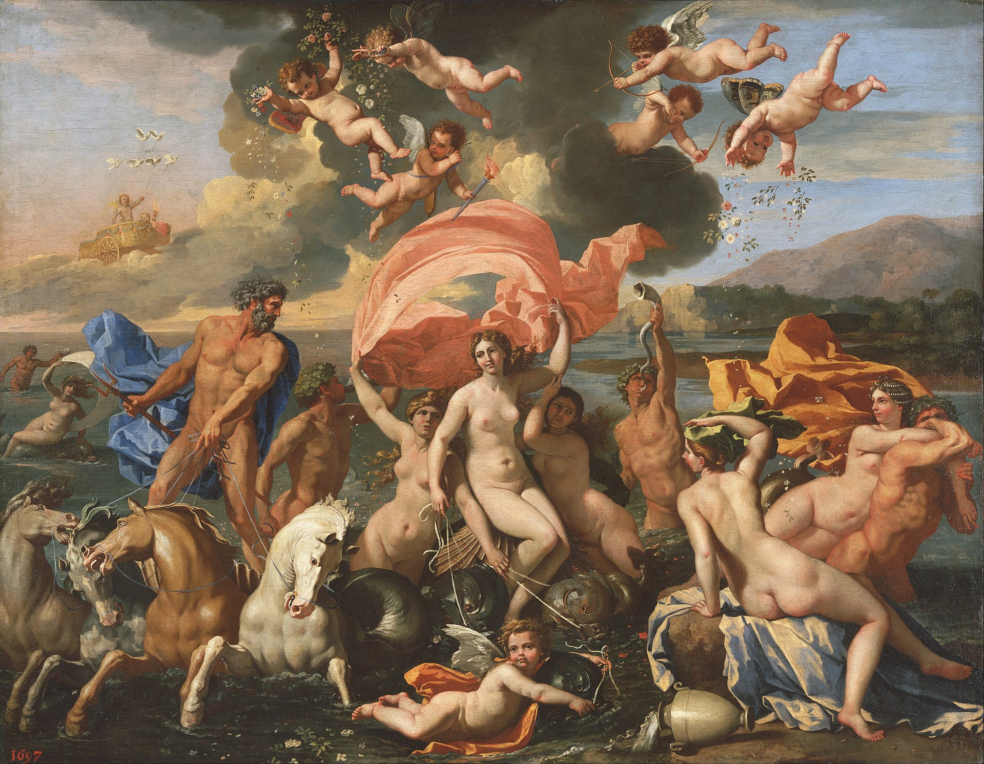
The Birth of Venus
Oil on Canvas, Nicolas Poussin, 1635-36.
Philadelphia Museum of Art, Philadelphia

Slide 17
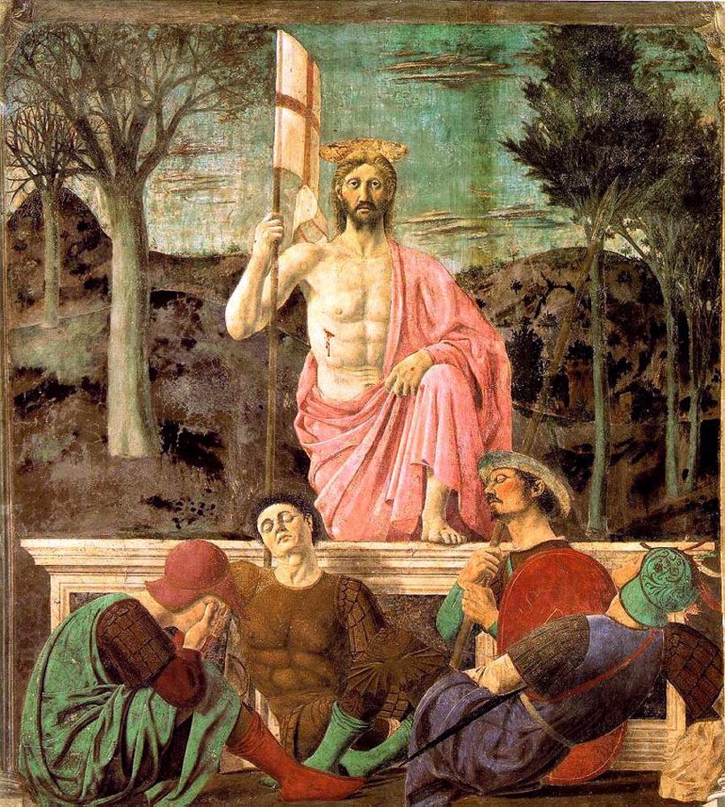
The Resurrection
Fresco, Piero della Francesca, 1460-65.
Museo Civico, Sansepolcro, Italy

Slide 18
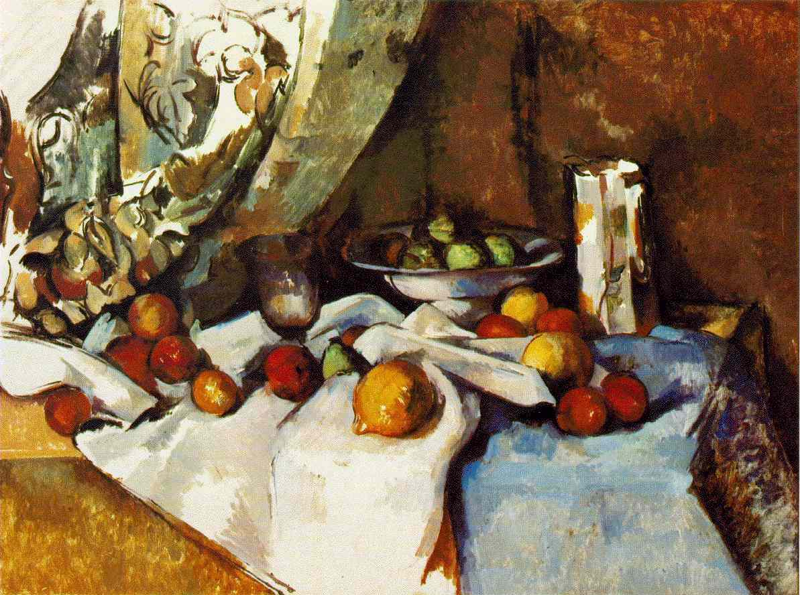

Slide 19
Bell begins his essay by emphasizing that all works of visual art provoke a particular emotion, and if we can identify this emotion we will be able to solve the central problem of aesthetics, the philosophy of art. Bell’s agenda as stated here at the outset of this work, first published in 1914, sets the agenda for much of the subsequent development of analytic aesthetics, which focuses on trying to answer the Socratic question of art, to provide a definition of art, a definition that would enable one to distinguish works of art from everything that is not art.
That there is a particular kind of emotion provoked by works of visual art, and that this emotion is provoked by every kind of visual art, by pictures, sculptures, buildings, pots, carvings, textiles, &c., &c., is not disputed, I think, by anyone capable of feeling it. This emotion is called the aesthetic emotion; and if we can discover some quality common and peculiar to all the objects that provoke it, we shall have solved what I take to be the central problem of aesthetics. We shall have discovered the essential quality in a work of art, the quality that distinguishes works of art from all other classes of objects. (Bell 1994, 186)
Clive Bell (1881-1964)
painting by Roger Fry, 1924

Slide 20
So what is this common quality that all works of visual art have that provoke the aesthetic emotion. This is what he calls “significant form.” Bell takes up the objection that he is making aesthetics purely subjective. He ridicules attempts to found aesthetics on objective truth as aesthetic judgments are matters of taste, and here we can see the influence of Hume. All systems of aesthetics must be based on personal experience and thus are subjective.
We have no other means of recognizing a work of art than our feeling for it. The objects that provoke aesthetic emotion vary with each individual. Aesthetic judgments are, as the saying goes, matters of taste; and about tastes, as everyone is proud to admit, there is no disputing. A good critic may be able to make me see in a picture that had left me cold things that I had overlooked, till at last, receiving the aesthetic emotion, I recognize it as a work of art. (Bell 1994, 187)
Clive Bell (1881-1964)
painting by Roger Fry, 1924

Slide 21
Bell goes on to argue that it does not follow that no theory of aesthetics has general validity, and here we can see the influence of Kant. We may disagree about works of art and still agree about what the common quality of works of art is—significant form. We may agree about aesthetics but differ in applying theory to particular works of art.
Yet, though all aesthetic theories must be based on aesthetic judgments, and ultimately all aesthetic judgments must be matters of personal taste, it would be rash to assert that no theory of aesthetics can have general validity. [. . .] My immediate object will be to show that significant form is the only quality common and peculiar to all works of visual art that move me; and I will ask those whose aesthetic experience does not tally with mine to see whether this quality is not also, in their judgment, common to all works that move them, and whether they can discover any other quality of which the same can be said. (Bell 1994, 187)
Clive Bell (1881-1964)
painting by Roger Fry, 1924

Slide 22
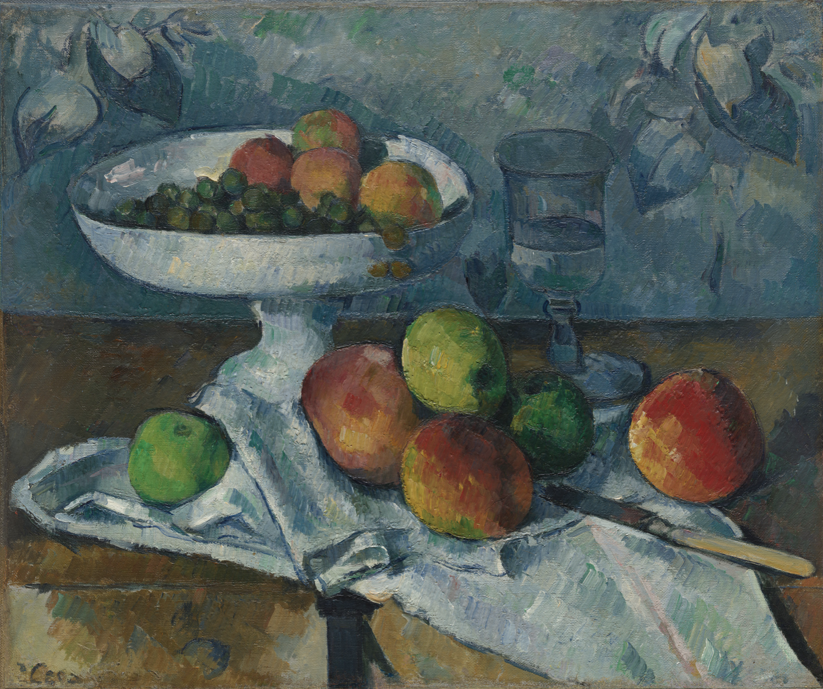
Bell takes up the objection that this leaves out color. He includes in his concept of “significant form” combinations of lines and colors. Here one may consider the paintings of Cezanne as an example.
“Are you forgetting about colour?” someone inquires. Certainly not, my term “significant form” included combinations of lines and colours. The distinction between line and colour is an unreal one [. . .] Therefore, when I speak of significant form, I mean a combination of lines and colours (counting white and black as colours) that moves me aesthetically. (Bell 1994, 188)
Still Life with Fruit Dish
Oil on Canvas, Paul Cézanne, 1879-80.
Museum of Modern Art, New York

Slide 23
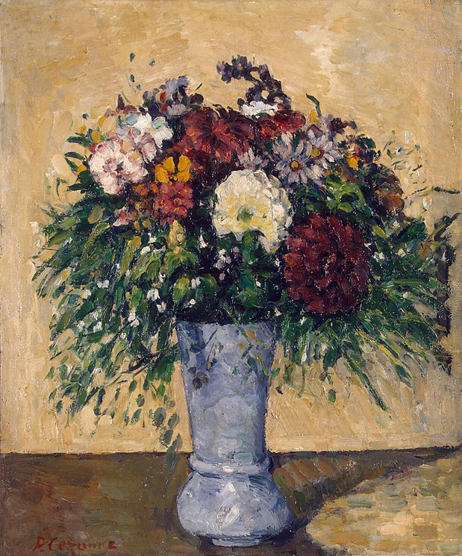
Bell then responds to why he doesn’t use the term “beauty.” He wants a term that distinguishes art from nature.
Some people may be surprised at my not having called this “beauty.” Of course, to those who define beauty as “combinations of lines and colours that provoke aesthetic emotion,” I willingly concede the right of substituting their word for mine. But most of us, however strict we may be, are apt to apply the epithet “beautiful” to objects that do not provoke that peculiar aesthetic emotion produced by works of art. Everyone, I suspect, has called a butterfly or a flower beautiful. Does anyone feel the same kind of emotion for a butterfly or a flower that he feels for a cathedral or a picture? (Bell 1994, 188)
Flowers in a Blue Vase
Oil on Canvas, Paul Cézanne, 1873-75.
State Museum of New Western Art, Moscow

Slide 24
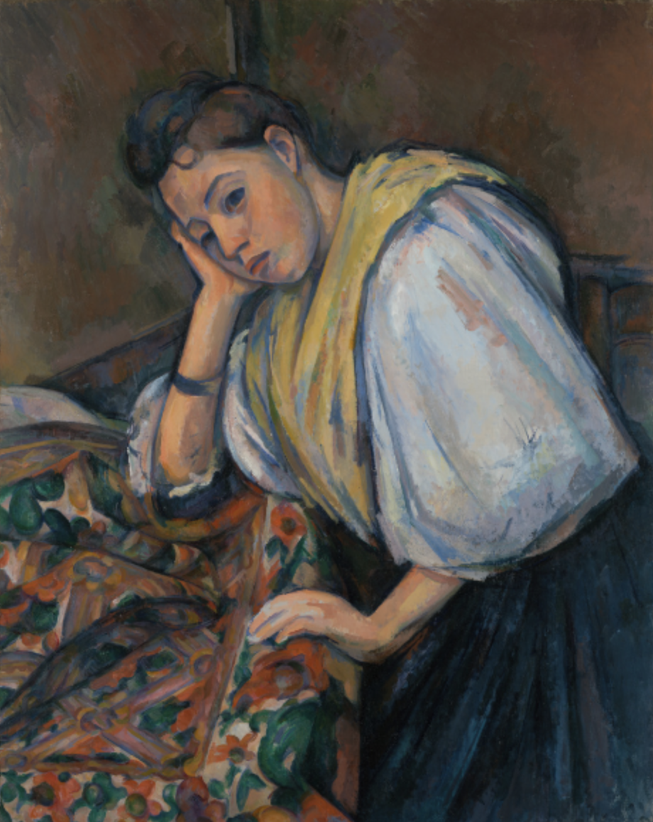
Bell goes on to distinguish an appreciation for natural beauty from the aesthetic emotion in a work of art by talking about the difference between a woman and a painting of a woman.
I have noticed a consistency in those to whom the most beautiful thing in the world is a beautiful woman, and the next most beautiful thing a picture of one. The confusion between aesthetic and sensual beauty is not in their case so great as might be supposed. [. . .] Clearly the world “beauty” is used to connote the objects of quite distinguishable emotions, and that is a reason for not employing a term which would land me inevitably in confusions and misunderstandings with my readers. (Bell 1994, 189)
Young Italian Woman at a Table
Oil on Canvas, Paul Cézanne, cz. 1875-80.
Getty Museum, Los Angeles

Slide 25
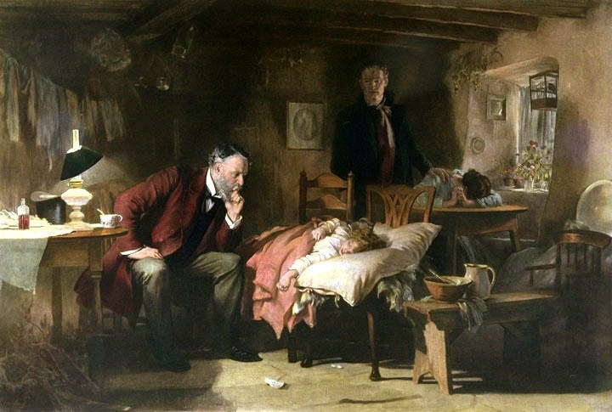
Bell thinks that the significant form hypothesis at least has the merit of explaining things about works or art. He thinks that paintings that are only a means of suggesting emotion or conveying information, what he calls “Descriptive Painting” are not works of art.
Portraits of psychological and historical value, topographical works, pictures that tell stories and suggest situations, illustrations of all sorts, belong to this class. That we all recognize the distinction is clear, for who has not said that such and such a drawing was excellent as illustration, but as a work of art was worthless? Of course many descriptive pictures, possess, amongst other qualities, formal significance, and are therefore works of art: but many do not. They interest us; they may move us too in a hundred different ways, but they do not move us aesthetically. According to my hypothesis they are not works of art. They leave untouched our aesthetic emotions because it is not their forms but ideas or information suggested or conveyed by their forms that affect us. (Bell 1994, 190)
The Doctor
Oil on Canvas, Luke Fildes, 1891.
Tate Gallery, London

Slide 26
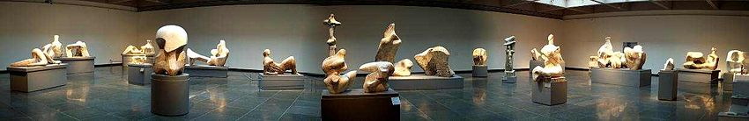
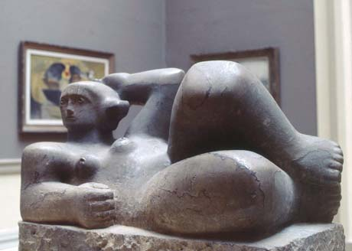
Henry Moore
The Art Gallery of Ontario's Henry Moore collection is the largest public collection of his works in the world.
Henry Moore’s work was influenced
by Mexican sculpture

Slide 27
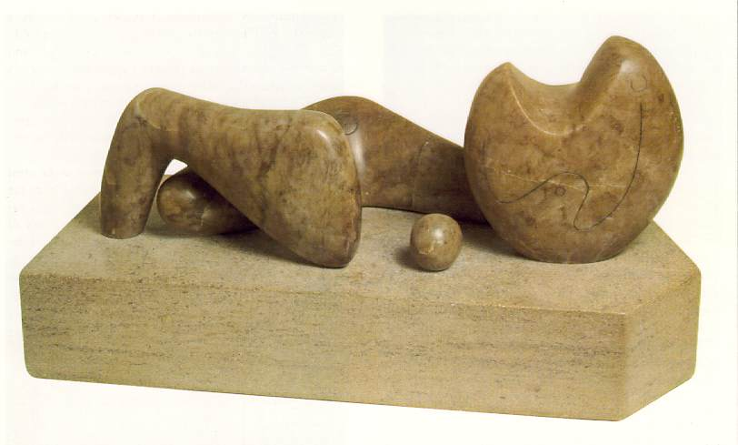
Henry Moore.
Four Piece Composition: Reclining Figure, 1934.
Cumberland Alabaster, 6 7/8 x 18 x 8 in.
Tate Gallery London

Slide 28
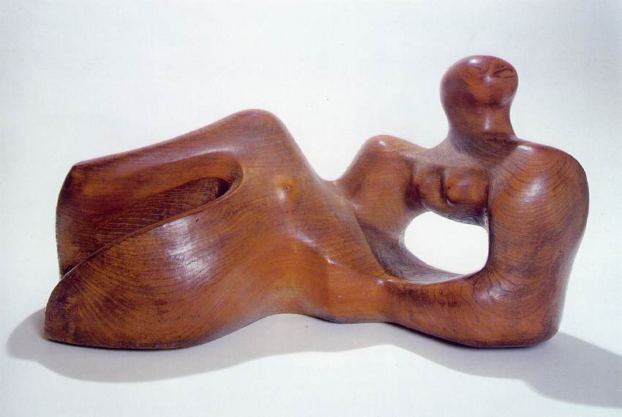
Henry Moore. Reclining Figure, 1935-36.
Elmwood, 19 x 35 x 15 in. Albright-Knox Gallery, Buffalo, NY.

Slide 29
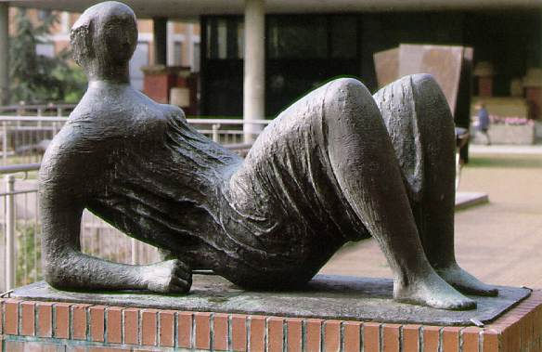
Henry Moore. Draped Reclining Figure, 1952-53.
Bronze, 102 x 152cm. Museum Ludwig, Cologne.

Slide 30
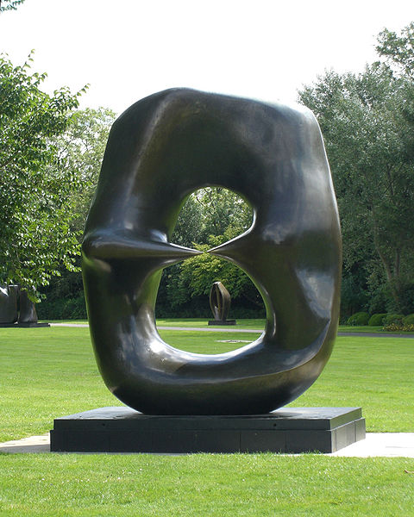
Henry Moore. Oval with Points, 1968-70.
Henry Moore Foundation.

Slide 31
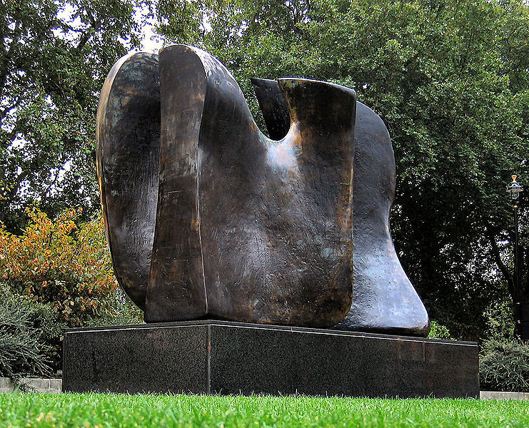
Henry Moore. Knife Edge – Two Piece, 1962.
House of Lords, London.

Slide 32
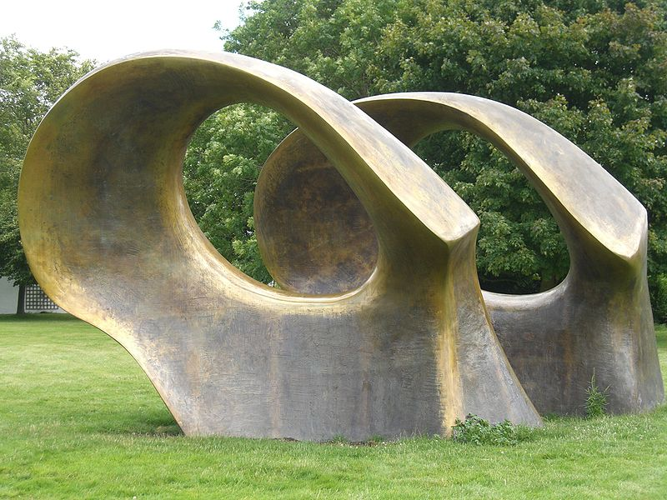
Henry Moore. Double Oval, 1966.
Henry Moore Foundation.

Slide 33
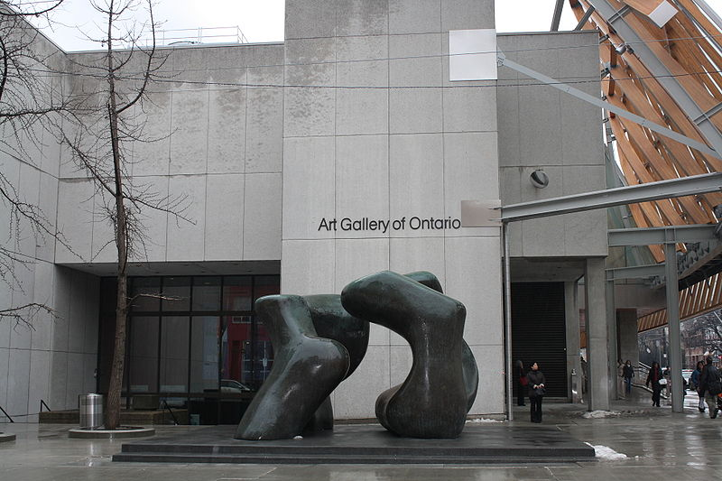
Henry Moore. Two Large Forms, 1966-69.
Art Gallery of Ontario.

Slide 34
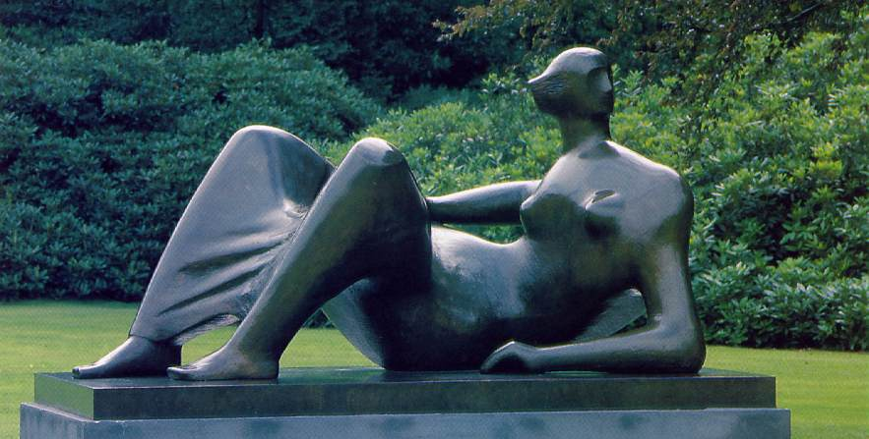
Henry Moore. Reclining Figure: Angles, 1979.
Bronze, over-life sized.
Henry Moore Foundation

Slide 35
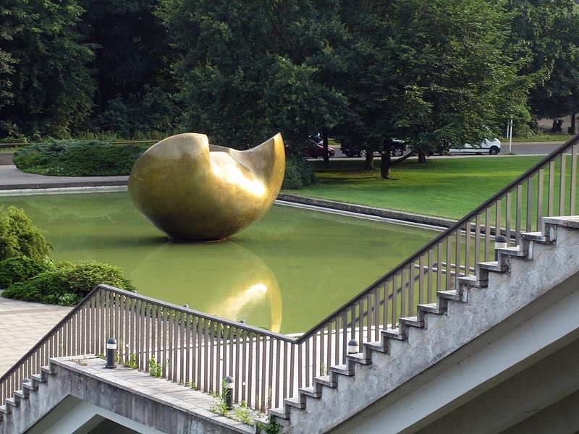
Henry Moore. Large Divided Oval: Butterfly, 1985-86.
Haus der Kulturen der Welt, Berlin.

Slide 36
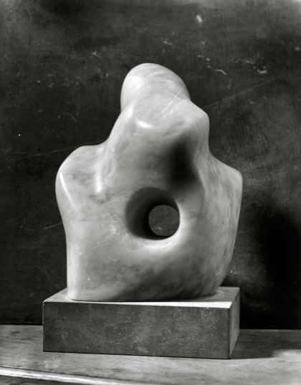
Barbara Hepworth
Barbara Hepworth.
Pierced Form, 1932.
Pink alabaster, destroyed in war.

Slide 37
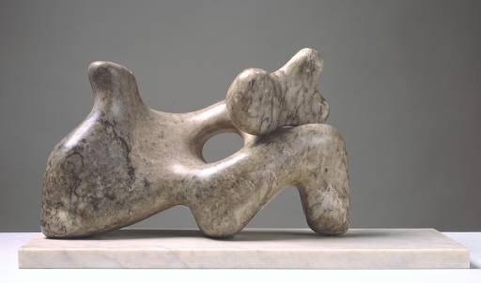
Barbara Hepworth. Mother and Child, 1934.
Cumberland Alabaster. Tate Gallery, London.

Slide 38
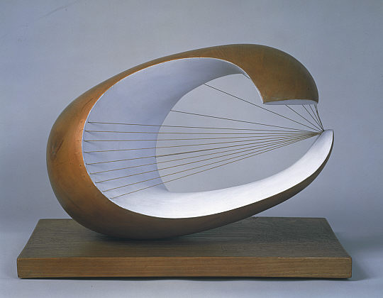
Barbara Hepworth. Wave, 1943-44.
Wood with colour and strings. Scottish National Gallery of Modern Art, Edinburgh.

Slide 39
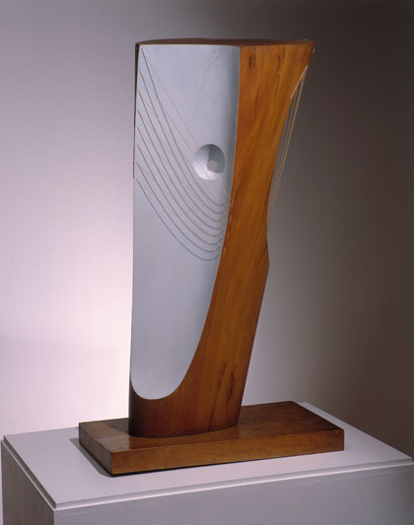
Barbara Hepworth.
Wood and Strings, 1944.
Plane wood with colour and strings.
Private Collection.

Slide 40
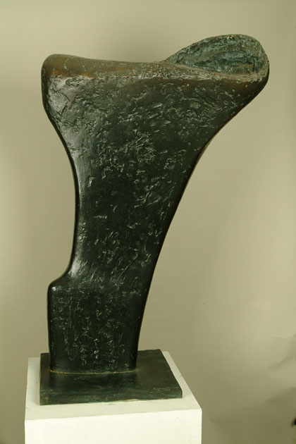
Barbara Hepworth. Torso (Ulysses), 1958.
Bronze, Art Gallery of Ontario, Toronto.

Slide 41
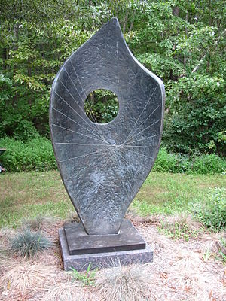
Barbara Hepworth.
Curved Form: Bryher II, 1961.
Bronze, Hirshhorn Museum and Sculpture Garden,
Smithsonian Institution. Washington, D.C.

Slide 42
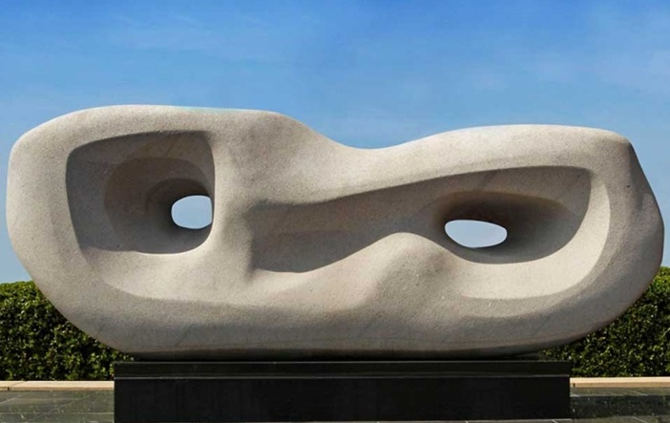
Barbara Hepworth. Curved Reclining Form (Rosewall), 1960-62.
Nebrasina stone, Chesterfield Borough Council, Chesterfield, Derbyshire

Slide 43
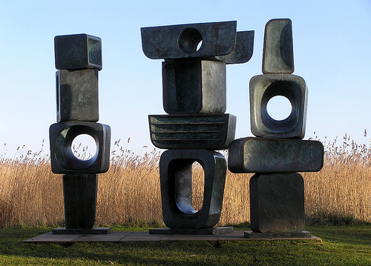
Barbara Hepworth. Three ‘figure’ from The Family of Man, 1970.
Yorkshire Sculpture Park

Slide 44
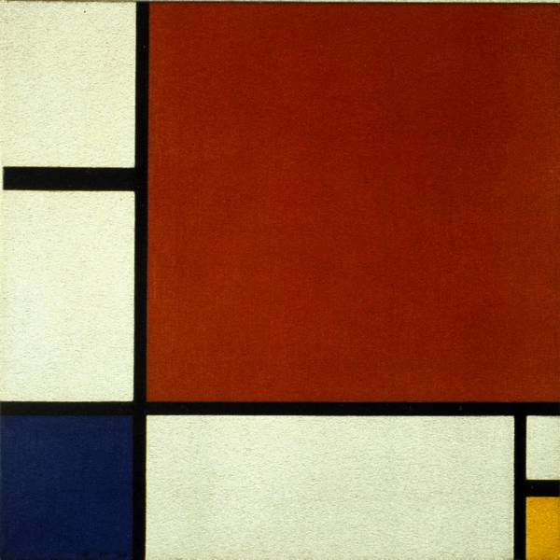
Formalist painting
Piet Mondrian.
Composition II in Red, Blue and Yellow, 1930.

Slide 45
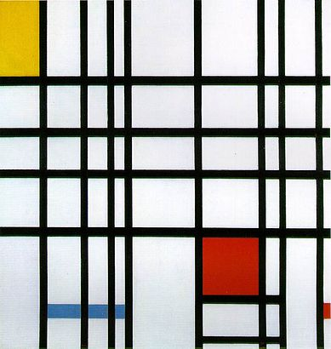
Piet Mondrian.
Composition with Yellow, Blue and Red, 1937-42.
Oil on canvas, Tate Gallery London.

Slide 46
Bibliography
Bell, Clive. 1994. Art in Art and Its Significance, 3rd ed. Edited by Stephen David Ross. Albany: State University of New York Press. [1914]

