Slide 1
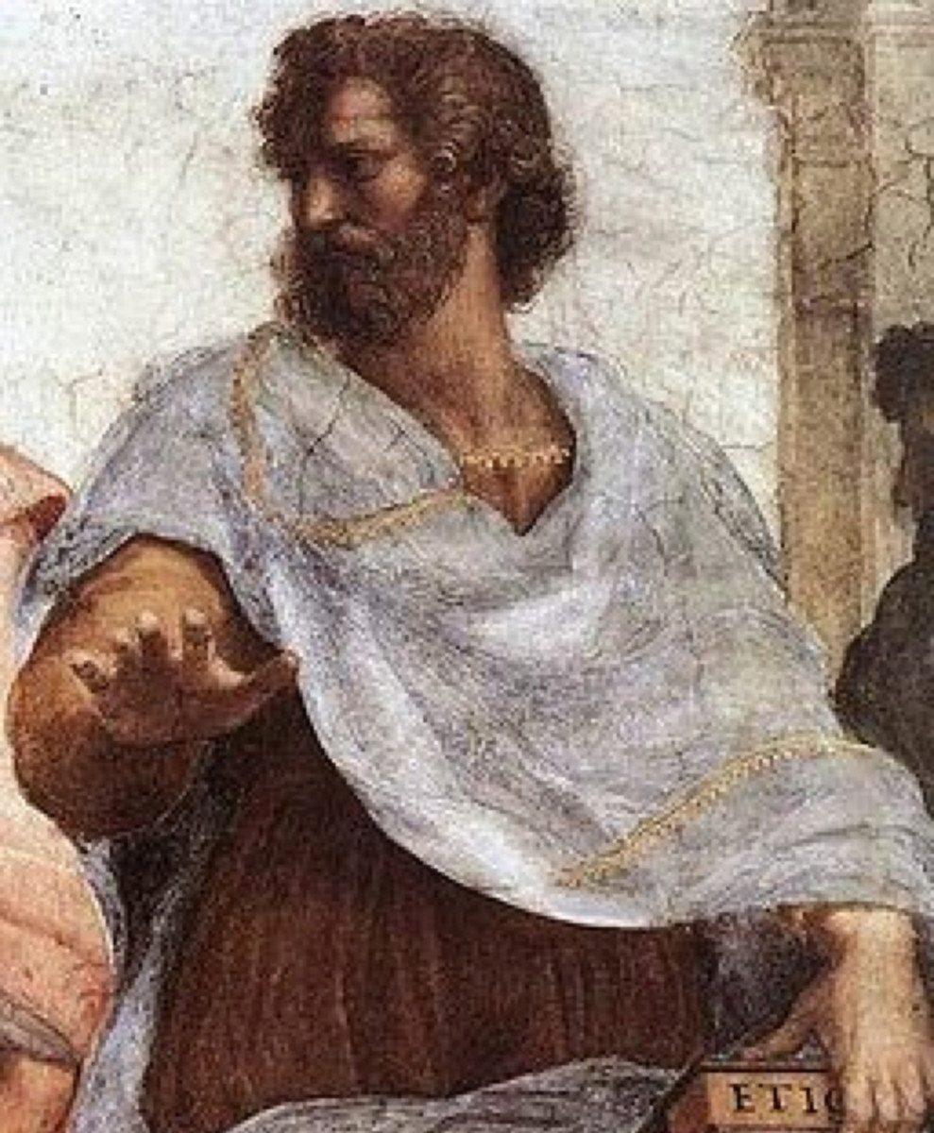
Aristotle’s
Poetics
Περὶ ποιητικῆς
(Peri poietikês)
Learning by Imitation

Slide 2
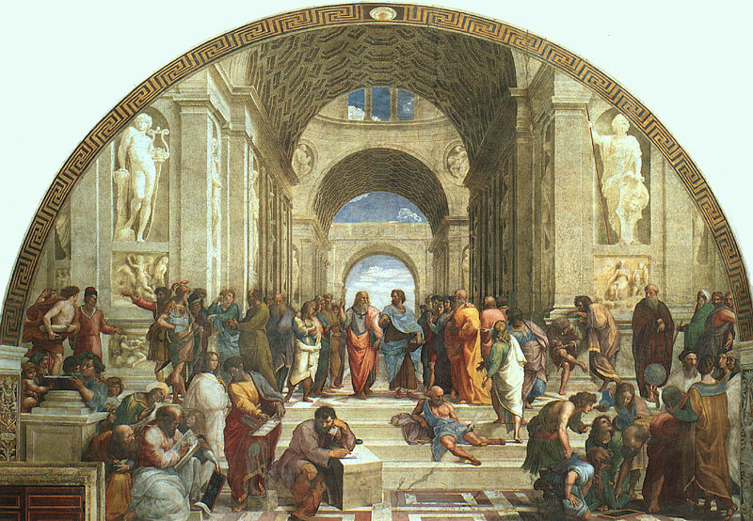
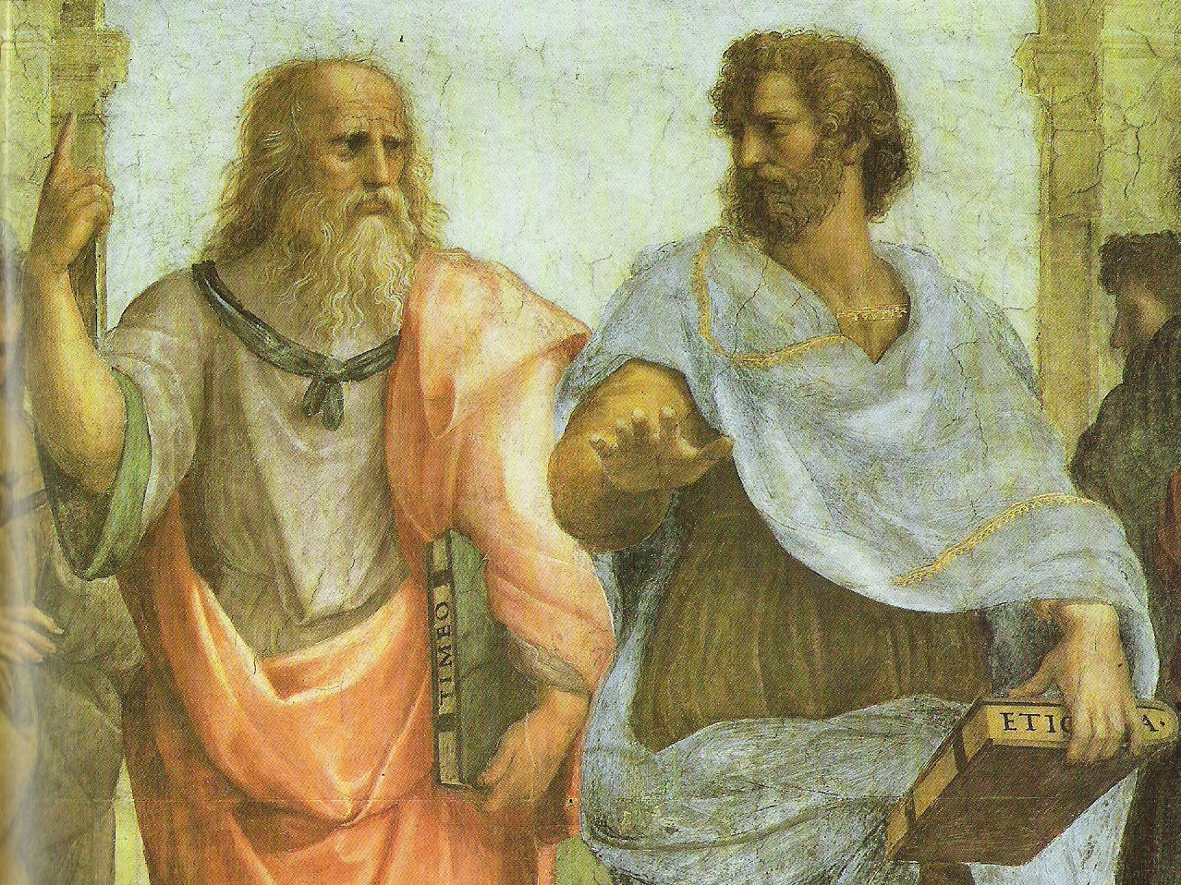
The School of Athens, fresco, Raphael, 1509-11
Apostolic Palace, Vatican City
The difference between Plato and Aristotle’s philosophy is illustrated in the way they are portrayed in Raphael’s famous painting. Whereas Plato is pointing upwards, indicating that the real world is the Upper World, the world of the Intelligible Forms, Aristotle is pointing forward, holding his hand level with the ground, as if to say, “No, this is the real world, right here, the world we see with the senses.”

Slide 3
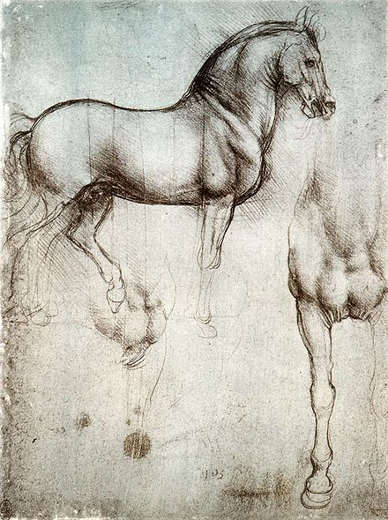
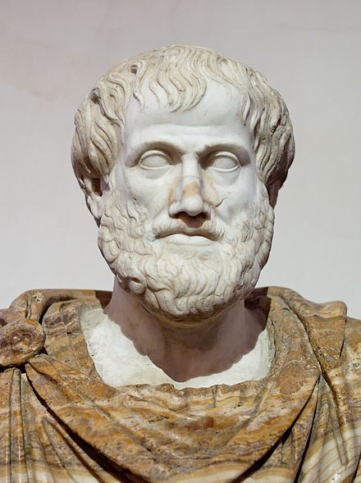
The Forms are in the Visible World
Aristotle agreed with Plato that what is real are universal, unchanging forms, but he thought the forms were in the visible realm. In contrast with Plato, he thus took the senses seriously as capable of providing knowledge. If we pay close enough attention to enough horses, we can come to gain knowledge of the form of a horse. Aristotle is thus sometimes considered the father of the sciences, as he paid close attention to the visible world and his writings covered such subjects as physics, biology, and zoology.
Bust of Aristotle,
Marble, Roman copy after a Greek bronze original by Lysippos from 330 BC; the alabaster mantle is a modern addition. Museo Nazionale Romano, Palazzo Altemps, Rome, Italy.
Leonardo da Vinci's study in silverpoint for The Horse, c. 1488

Slide 4

Aristotle’s Poetics
Aristotle also agreed with Plato that art is imitation (mīmēsis), and that what the visual arts imitate are visible things; but since the visible world is real for Aristotle, he has a more positive view of art.
“Imitation is natural to man from childhood, one of his advantages over the lower animals being this, that he is the most imitative creature in the world, and learns at first by imitation. And it is also natural for all to delight in works of imitation” (Poetics, 68).
‘Alalā,
limited edition giclée print by Marian Berger.
Volcano Art Center, Volcanoes National Park, Hawai‘i

Slide 5
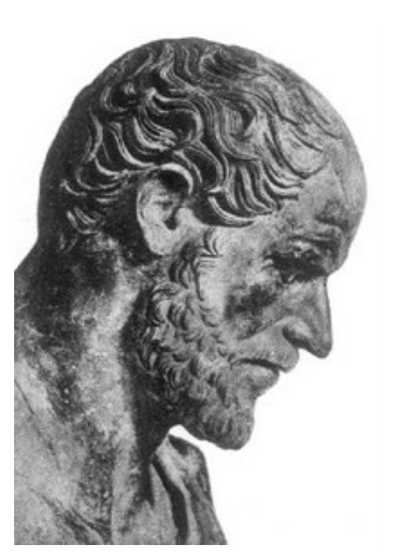
Aristotle’s Poetics
The little book known to us as the Poetics was probably written around 347-42 B.C.E. and revised some time later by Aristotle or an apt student. Its influence has been profound over the centuries in the development of aesthetics and literary criticism.
It is highly characteristic of Aristotle that, in opening up a new field of inquiry, he begins by mapping it as exactly as he can in terms of a system of classification. When he turns to the art of poetry, he sets out to mark its boundaries and study its nature independent of its moral and political connections.
In this Aristotle makes use of a very fundamental distinction between three kinds of “thought”:
1. knowing (theoria): metaphysics, mathematics, philosophy of nature
2. doing (praxis): ethics, politics
3. making (poiesis): an action which brings forth something
This distinction allows for the aesthetic, critical reflection on art, to be separate, in contrast to Plato, from the theoretical and practical.

Slide 6
Aristotle’s Poetics
The general question for Aristotle is to ask what is the genus to which the poetic art belongs, and then, in turn, what are its species?
Genus: the general family to which it belongs (imitative arts)
Species: the types within it (drama—either tragedy or comedy & epic poetry)
“Epic poetry and Tragedy, as also Comedy, Dithyrambic poetry, and most flute-playing and lyre-playing, are all, viewed as a whole, modes of imitation. But as the same time they differ from one another in three ways, either by a difference of kind, in their means, or by differences in the objects, or in the manner of their imitations” (Poetics, 66).

Slide 7
Aristotle’s Poetics
Poietike refers to productive art in general, but in the Poetics, it is taken in the narrower sense of imitation. Some, but not all, making is imitation, or representation of objects and events. The imitative art itself falls into two divisions:
1.) The art of imitating visual appearances by means of color and drawing
2.) The art of imitating human actions through verse, song and dance
Much of the Poetics takes up an investigation of this second category, the art of poetry. The art of poetry is distinguished from painting in terms of its medium (words, melody, rhythm) and from versified philosophy (cf. Empedocles) by virtue of the object it imitates. Aristotle is primarily concerned with two species of poetry:
drama (tragic or comic)
epic poetry
Tragedy and epic poetry are distinguished from comedy by the seriousness or gravity of their actions.
Tragedy differs from epic poetry by the mode of presentation (dramatic vs narrative).

Slide 8
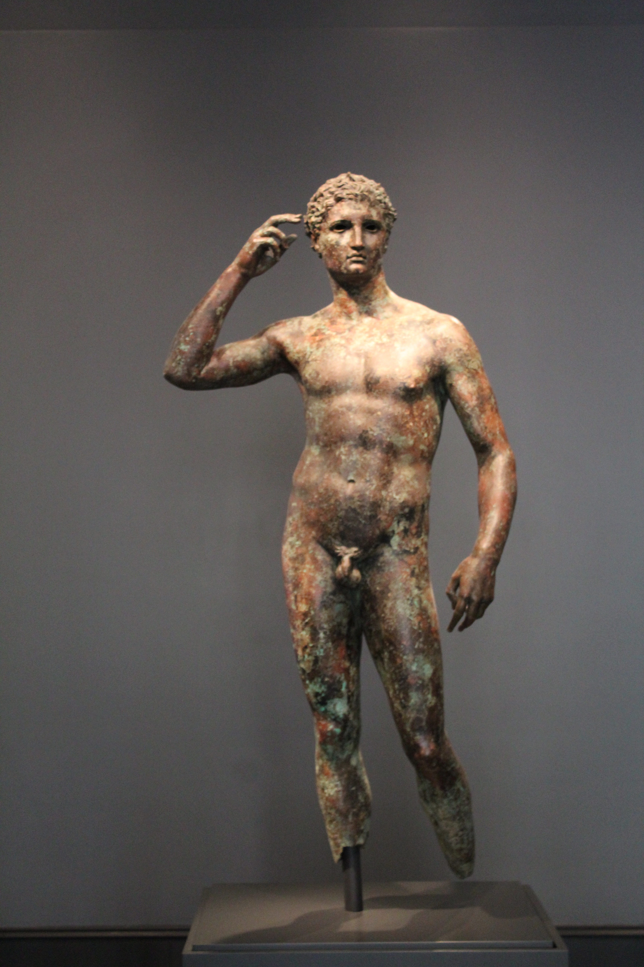
The Four Causes
Although he does not mention these in the Poetics, it is interesting that when Aristotle explains his famous theory of the four causes in the Metaphysics his example is from the arts:
1. Material cause is that from which things are made of—the matter: the bronze of the statue”
2. Formal cause is the “form”—the essence of the thing that is has in common with all the other examples of its kind, “the pattern” or “formula of the essence”: the shape of the statue.
3. Efficient cause is the origin, the productive agent, “the primary source of change or rest”: the artisan, the art of bronze-casting the statue.
4. Final cause is the purpose, “the end, that for the sake of which a thing is done”: the point or purpose of the statue.
Victorious Athlete, bronze and copper, Greek, 300-100 BCE. The Getty Museum, Malibu, California.

Slide 9
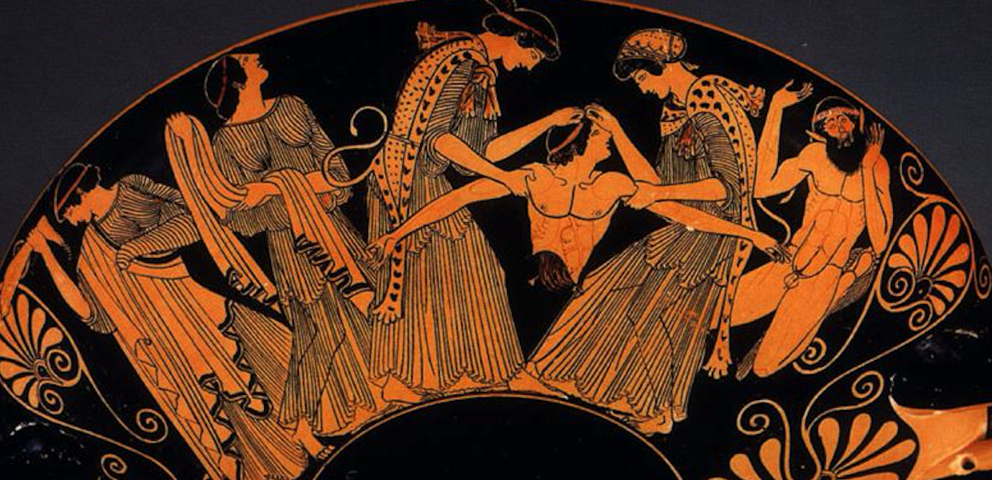
Aristotle’s View of Tragedy
The Death of Pentheus, Attic Red Figure Kylix, attributed to Douris, c. 480 BCE. Kimball Museum of Art, Dallas, Texas.
This scene depicted on the Kylix is from The Bacchae, a tragedy by Euripides. King Pentheus of Thebes is torn limb from limb by the crazed Maenads of the god Dionysus. The two central figures, draped in panther skins and holding the king's body, are the sisters Agave (mother of Pentheus) and Autonoe. A third Maenad holds the king's severed foot. One of Dionysus' Satyrs oversees the sparagmos (ritual dismemberment).

Slide 10
Aristotle’s View of Tragedy
To understand the poetic art will then require not only an objective investigation into the actual features of existing tragedies, for example, but also a conclusion about what makes a good tragedy, and this will depend on the final cause or purpose of the work.
Aristotle is thus interested in the basis of critical judgment, the reasons that can be given in support of comparative evaluations, why, for instance, he is justified as regarding Homer’s epics and Sophocles’ Oedipus Rex as the greatest of masterpieces.
After giving a full empirical study of existing tragedies, having catalogued their various characteristics, those common to all, and those that vary, there is still the need, in order to give an adequate definition of the species we are after, to understand the purpose or the final cause.
What is the purpose of tragedy? Why do we go to see a production of a tragedy, either a production of an ancient Greek tragedy, or perhaps a film that is a tragedy?

Slide 11
Aristotle’s View of Tragedy
Obviously, people go to see tragedies not because they are required to go, but because they want to. Thus, they evidently derive some enjoyment from this experience.
Because the institution of tragic performances endures, it affords a unique sort of enjoyment. The study of tragedy should thus show what the nature of this enjoyment is like, what is its “proper pleasure” (oikeia hedonē)?
If we can identify the proper pleasure of tragedy, we can say that it is the function of tragedy to produce this particular sort of pleasure; and thus we would be able to evaluate different tragedies according to how well they accomplish this end (final cause).

Slide 12
What is Aesthetics?
The term Aesthetics comes from the Greek word aisthanesthai which means “to perceive.” For Aristotle, the imitations of the real teach us to perceive things in a special way, and since he redeems the senses and perception, he allows for art to have a cognitive dimension denied by Plato.
Aristotle and Plato agree that genuine knowledge is not of particulars but of universals. But, for Plato, universals are thought of as transcendental forms, and thus remote from works of art; but when they are thought of in Aristotle’s sense, as existing only in substances, art is thus knowledge. At least the pleasure that it gives is of the same pleasure of coming to know.

Slide 13
Aristotle’s View of Tragedy
Aristotle accepts Plato’s notion of art as imitation, but he has a more positive view of art since he thinks we can learn by imitation. He also thinks that since we are rational animals, we take pleasure in imitation, even in tragedy, because it is a special case of learning.
However, even if tragedy pleases us as an imitation, it shares this value with other imitations, and so we do not have yet a proper, peculiar pleasure of tragedy. What exactly does tragedy imitate, what is proper pleasure of tragedy? Aristotle thus defines what he thinks tragedy is:
“A tragedy, then, is the imitation of an action that is serious and also, as having magnitude, complete in itself; in language with pleasurable accessories, each kind brought in separately in the parts of the work; in dramatic, not in a narrative form; with incidents arousing pity and fear, wherewith to accomplish its catharsis of such emotions” (Poetics, 70).

Slide 14
Aristotle’s View of Tragedy
Aristotle does not say only that the events of the tragedy are fearful and pitiable, he says they arouse emotions of fear and pity in the audience, not only the theater audience, but those who read the story or hear it told.
This combination, or pair, of emotions is unique to serious poetry, both tragedy and epic poetry. Both tragedy and epic poetry have the same effect, according to Aristotle, but he thinks tragedy is capable of achieving it more fully.
But fear and pity are unpleasant emotions to feel. One would think they are species of pain.
Thus, the question arises, How can there be a pleasure that “comes from pity and fear,” even “by means of imitation”?

Slide 15
Aristotle’s View of Tragedy
From these conclusions about the end, or function, of tragedy, Aristotle derives his critical criteria for evaluating a tragedy. Here he identifies those features of tragedy that enable it to fulfill that function most effectively.
Since the wholeness of tragedy is the curve of its movement to consummation, it is the plot, or course of events, that is most basic and important to get right.
Aristotle’s analyzes those features of the complex plot that contribute most tellingly to the effect of fear and pity.
The play must be unified to have a single condensed impact; and it must proceed with the greatest possible sense of inevitability. The development of the plot must arise out of the very structure of the plot.

Slide 16
Aristotle’s View of Tragedy
It is in this context that we must understand some of Aristotle’s most often quoted and puzzling remarks.
“From what we have said it will be seen that the poet’s function is to describe, not the thing that has happened, but a kind of thing that might happen, i.e. what is possible as being probable or necessary. The distinction between historian and poet is not in the one writing prose and the other verse—you might put the work of Herodotus into verse, and it would still be a species of history; it consists really in this, that the one describes the thing that has been, and the other a kind of thing that might be. Hence poetry is something more philosophical and of graver import than history, since its statements are of the nature of universals, whereas those of history are singulars” (Poetics, 73).

Slide 17
Aristotle’s View of Tragedy
Aristotle is making an important point here about the intellectual content of poetry, implicitly answering Plato’s main objection to it. Although the poet cannot plausibly pretend to knowledge of shipbuilding or military strategy which he does not have, he cannot fake psychological knowledge. He must understand human nature. He must have true genuine knowledge of psychological mechanisms in order to make a good play. There is thus an important cognitive element in Aristotle’s critical theory of tragedy.

Slide 18
Aristotle’s View of Tragedy
One line of thought still to be considered, the most difficult of all, is Aristotle’s famous concept of “catharsis.” This term appears only once in Aristotle’s account of tragedy. Over the centuries, commentators have worked out an interesting theory that has been attributed to Aristotle, though in recent years it has been challenged in a most fundamental way.
traditional interpretation: by arousing these emotions of pity and fear, tragedy has some sort of therapeutic effect upon the audience, giving a pleasurable sense of relief. By experiencing a drama we can find release for suppressed passions and uncontrollable feelings, so that we can recover our harmony. There are different interpretations of this cathartic effect, either medical — a purgation of the toxic effects in the body, or religious—a kind of spiritual-bloodletting.
art is catharsis in the sense that we are purified and educated through our encounter with art. The point is not that we rid ourselves of certain emotions; but that we, through our experiences, ennoble our mind.
structural interpretation: the purgation is a purification but does not take place in the spectator at all, but something that takes place in the play.

Slide 19
Aristotle’s View of Tragedy
One of the strongest temptations to the traditional interpretation of the Poetics is that it imputes to Aristotle a direct answer to Plato’s second main objection to poetry—that it could only feed and water the passions, and thus disrupt the harmony of the soul and rationality of the citizen. According to this interpretation Aristotle has an impressive rebuttal:
“If we look only at the immediate frenzy, the audience’s terror and weeping, it may seem that
way, but if we look at the later and deeper psychological effects of going through the experience,
the playgoer is like the religious enthusiast who feels cleansed and lightened and brightened by
his emotional release. The playgoing citizen, in the long run, is probably the calmest and the
wisest, for he gets rid from time to time of those festering emotional irritations that poison the
temperament and the mind” (Beardsley 1966, 66-67).
Beardsley, Monroe C. 1966. Aesthetics: From Classical Greece to the Present, The Macmillan
Company, New York.

