Slide 1
Social Ethics
Consequentialist Theories:
Maximize the Good
There is something in consequentialist moral theories that we find appealing. Something simple and commonsensical that jibes with everyday moral experience. This attractive core is the notion that right action must produce the best balance of good over evil. Never mind how good and evil are defined. The essential concern is how much good can result from action performed.

Slide 2
Utilitarianism
“The greatest happiness for the greatest number.”
Classic utilitarianism affirms the principle that the right action is the one that directly produces the best balance of happiness over unhappiness for all concerned.
In this initial version, called act-utilitarianism, we need only compute the amount of happiness that each possible action generates and choose the one that generates the most happiness.
There is at least some plausibility to the theory in that we tend to think that it makes sense to judge the morality of an action by the effects it has on the people involved.

Slide 3
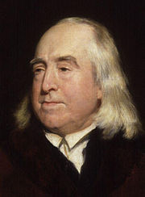
By the principle of utility is meant that principle which approves or disapproves of every action whatsoever, according to the tendency which it appears to have to augment or diminish the happiness of the party whose interest is in question: or what is the same thing in other words, to promote or to oppose that happiness. . . .
Jeremy Bentham (1748-1832)

Slide 4
Utilitarianism
Like ethical egoism, it is a consequentialist theory, but it differs from ethical egoism in considering the consequences for everyone concerned and that everyone counts equally.

Slide 5
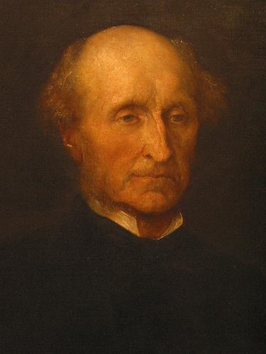
The happiness which forms the utilitarian standard of what is right in conduct, is not the agent’s own happiness, but that of all concerned. As between his own happiness and that of others, utilitarianism requires him to be as strictly impartial as a disinterested and benevolent spectator.
John Stuart Mill (1806-1873)

Slide 6
Utilitarianism
Bentham was a good friend of J.S. Mill’s father, and thus Mill grew up with a close familiarity with utilitarianism. Mill developed utilitarianism and used it to become one of the great social reformers of the day.
Mill agreed with Bentham that what counts is “the greatest happiness for the greatest number,” he also agreed that “happiness” meant pleasure and the absence of pain, but Mill thought that happiness can be measured not only by quantity but also quality.
The higher pleasures, such as pursuing knowledge, appreciating beauty, creating art, were qualitatively better than the pleasures of mere sensual pleasures of eating, drinking, and having sex.

Slide 7
Utilitarianism
In classic act-utilitarianism, knowing how to tote up the amount of utility, or happiness, generated by various actions is essential. Bentham’s answer to this requirment is the hedonic calculus, which quantifies happiness and handles the necessary calculations.
Note that in this arrangement, only the total amount of net happiness for each action matters. How the happiness is distributed among the persons involved does not figure into the calculations.

Slide 8
Whereas Bentham only considered the net quantity of happiness that resulted from an action, Mill thought that happiness can vary in quantity and quality. There are thus lower and higher pleasures.
“It is better to be a human being dissatisfied than a pig satisfied; better to be Socrates satisfied than a fool satisfied.”
John Stuart Mill (1806-1873)

Slide 9
Utilitarianism
A problem for Mill is to justify his hierarchical ranking of the various pleasures. He tries to do so by appealing to what the majority prefers. But this approach might not be helpful because people differ drastically in how they rank pleasures.

Slide 10
Utilitarianism
In Act-utilitarianism there are no rules to take into account in calculating the amount of happiness. Critics of utilitarianism pointed out the troubling consequences of this view. Sometimes an individual’s rights might be violated in order to produce the most net amount of happiness.
Rule-utilitarianism meet this problem by introducing a qualification to the basic utilitarian principle. This view says that an action is right if it conforms to a rule that leads to the greatest good for all. What if everyone followed this rule? Would it lead to the greatest happiness?

Slide 11
Evaluating Utilitarianism
Criterion 1: Consistency with Considered Judgments.
A major criticism of act-utilitarianism is that it is not consistent with commonsense views about justice, rights, and obligations.
Criterion 2: Consistency with Our Moral Experiences.
Unlike ethical egoism, utilitarianism in both its forms, is consistent with our moral experiences.
Criterion 3: Usefulness in Moral Problem Solving.
Some philosophers argue that act-utilitarianism is not that useful in moral problem solving in that it demands too much of us. In every thing we do throughout the day we can probably question whether there is something else we could be doing that would maximize happiness for everyone.

Slide 12
Learning from Utilitarianism
We must admit that the theory seems to embody a large part of the truth about morality.
Utilitarianism begs us to consider that the consequences of our actions do indeed make a difference in our moral deliberations. Whatever factors work to make an action right (or wrong), surely the consequences of what we do must somehow be among them.
Utilitarianism, perhaps more that any other moral theory, incorporates the principle of impartiality. Everyone concerned counts equally in every moral decision.
Utilitarianism is through and through a moral theory for promoting human welfare. The moral principle of beneficence, acting for the well-being of others, is the core of the theory. Beneficence is not the whole of morality, but to most people it is at least close to the heart.

