Slide 1
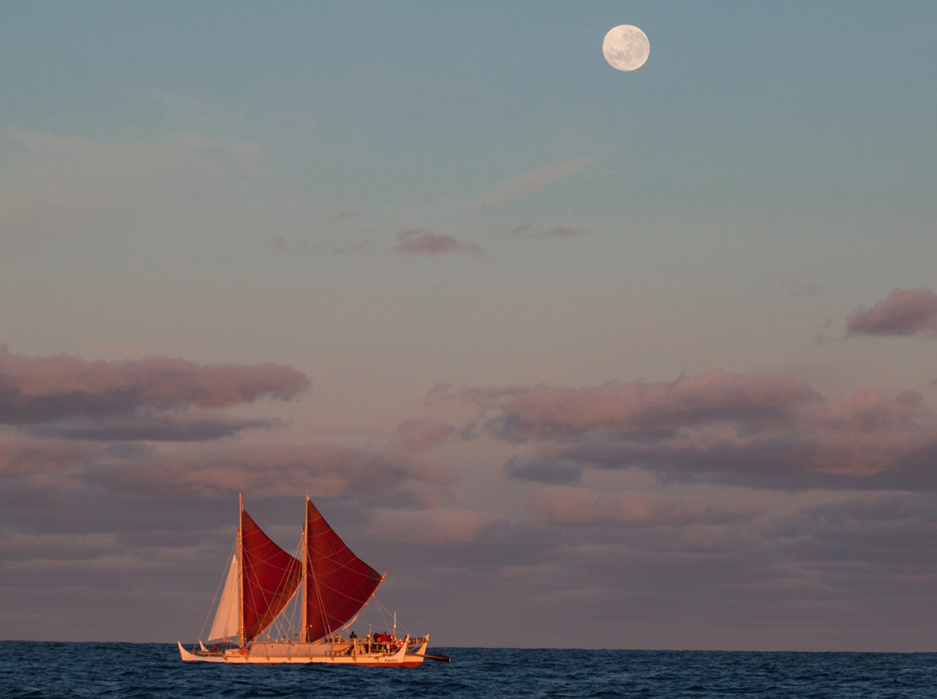
The Climate Catastrophe
and the Mālama Honua Worldwide Voyage of the Hōkūleʻa
How Can We Take Care of the Earth?
A deeper look into the Science, Philosophy, and Politics
of Climate Change
A Presentation by
Timothy J Freeman
Assistant Professor of Philosophy
University of Hawai'i at Hilo

Slide 2
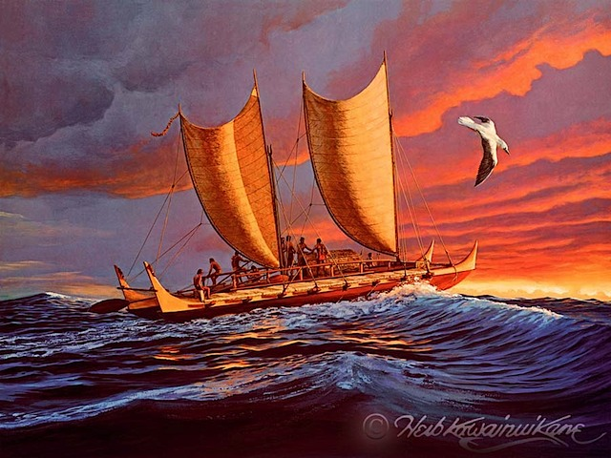
“She is more than a voyaging canoe—she represents the common desire shared by the people of Hawaii, the Pacific, and the World to protect our most cherished values and places from disappearing.”
Polynesian Voyaging Society
http://www.hokulea.com/voyages/our-story/
Hōkūleʻa © Herb Kāne

Slide 3
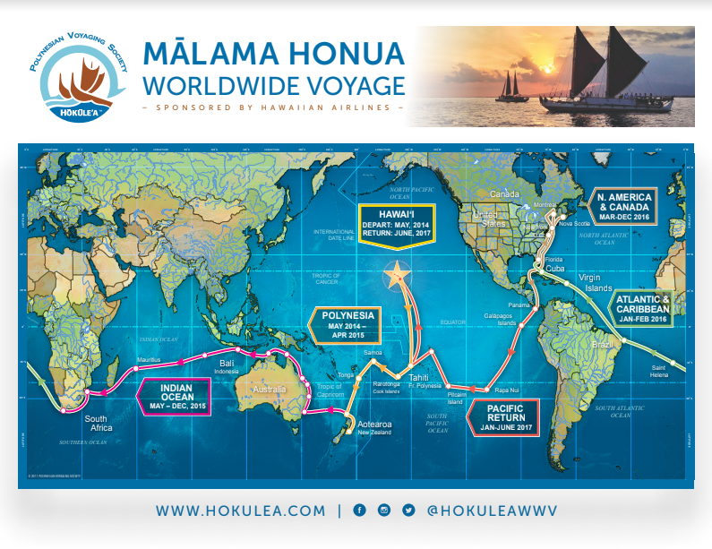
The Hawaiian name for this voyage, Mālama Honua, means “to care for our Earth.” Living on an island chain teaches us that our natural world is a gift with limits and that we must carefully steward this gift if we are to survive together. As we work to protect cultural and environmental resources for our children’s future, our Pacific voyaging traditions teach us to venture beyond the horizon to connect and learn with others. The Worldwide Voyage is a means by which we now engage all of Island Earth—bridging traditional and new technologies to live sustainably, while sharing, learning, creating global relationships, and discovering the wonders of this precious place we all call home.
Polynesian Voyaging Society
http://www.hokulea.com/worldwide-voyage/

Slide 4
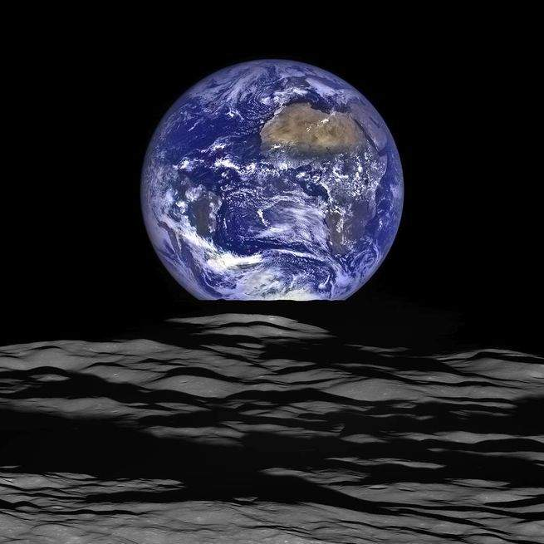
this precious place we call home
https://www.popsci.com/best-images-earth-from-space#page-2

Slide 5
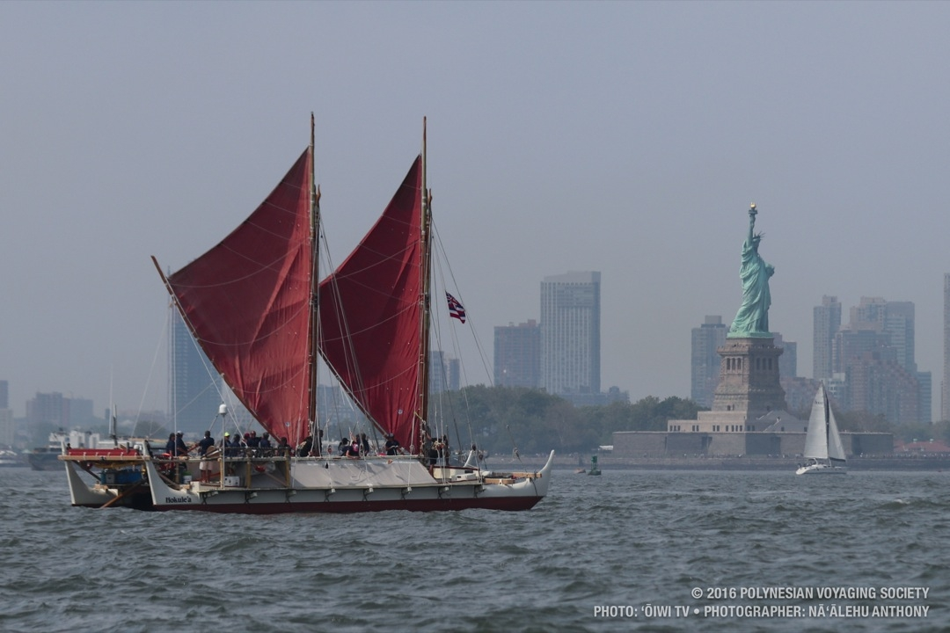

Slide 6
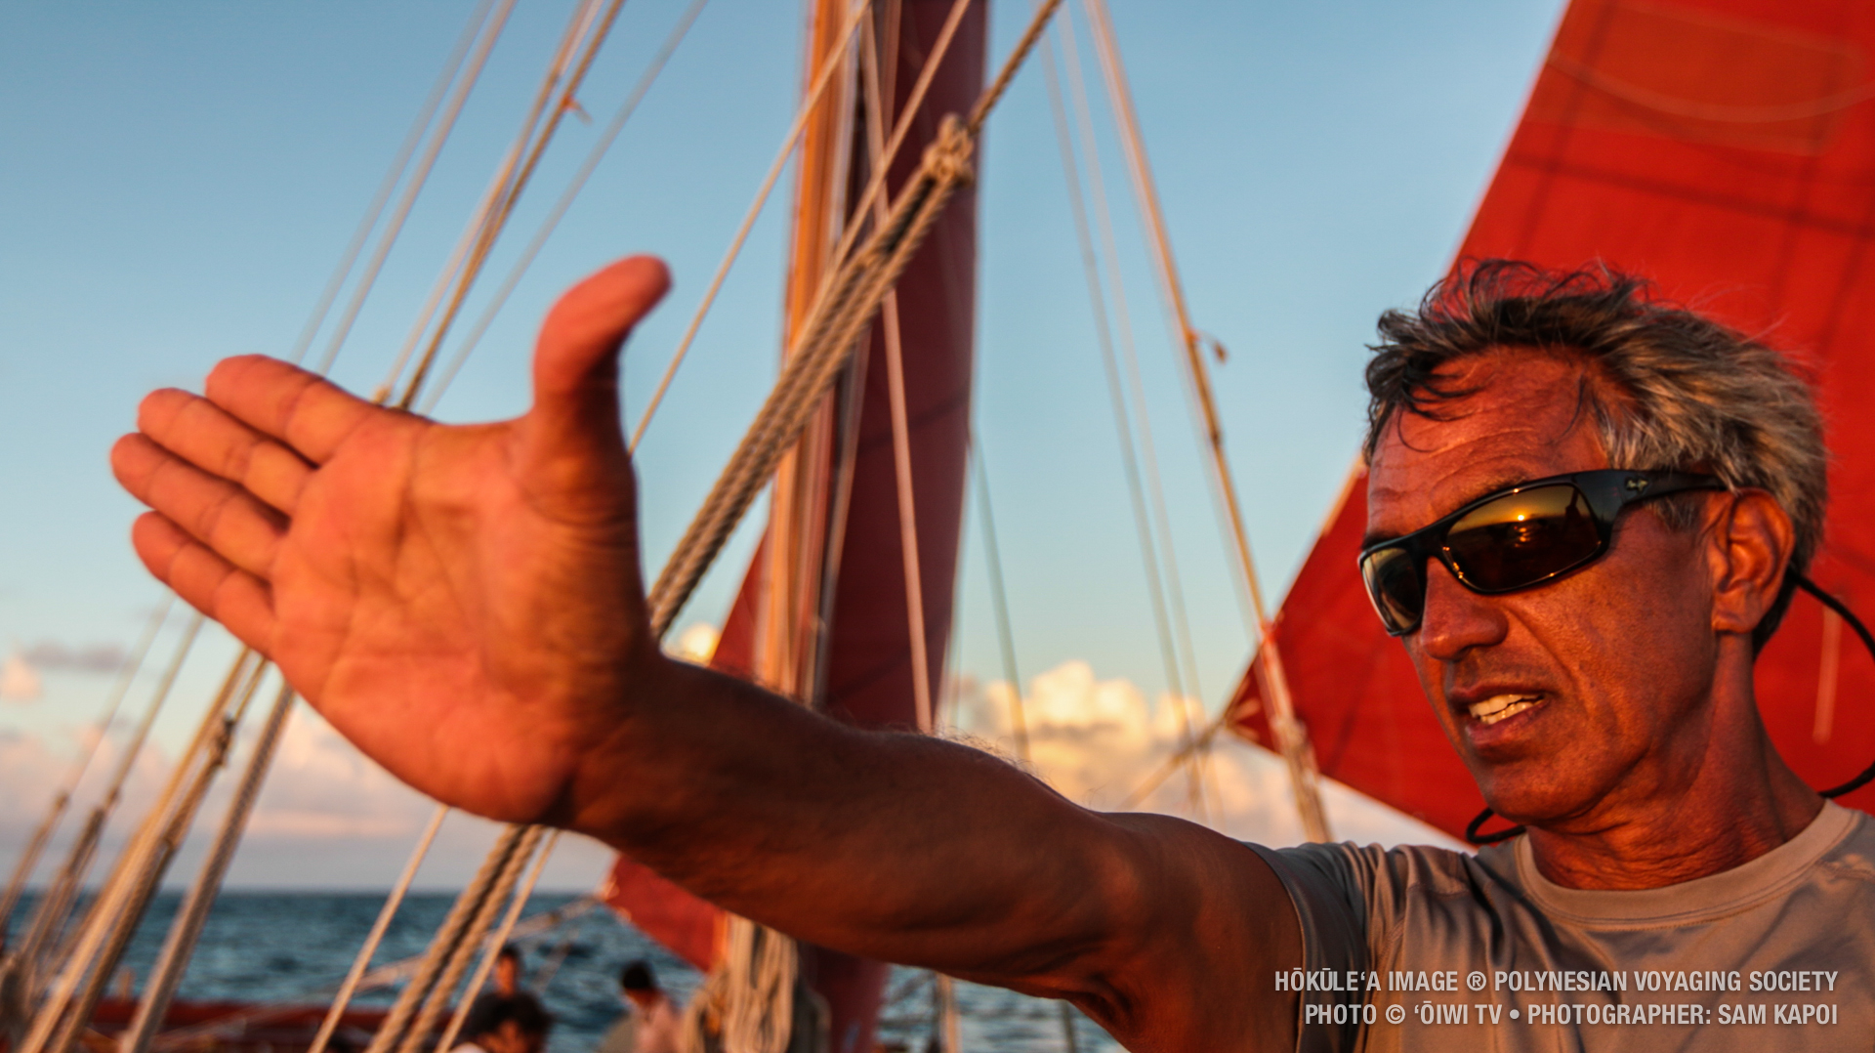

Slide 7
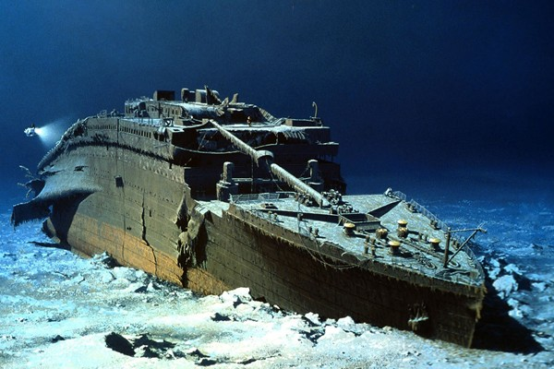

Slide 8
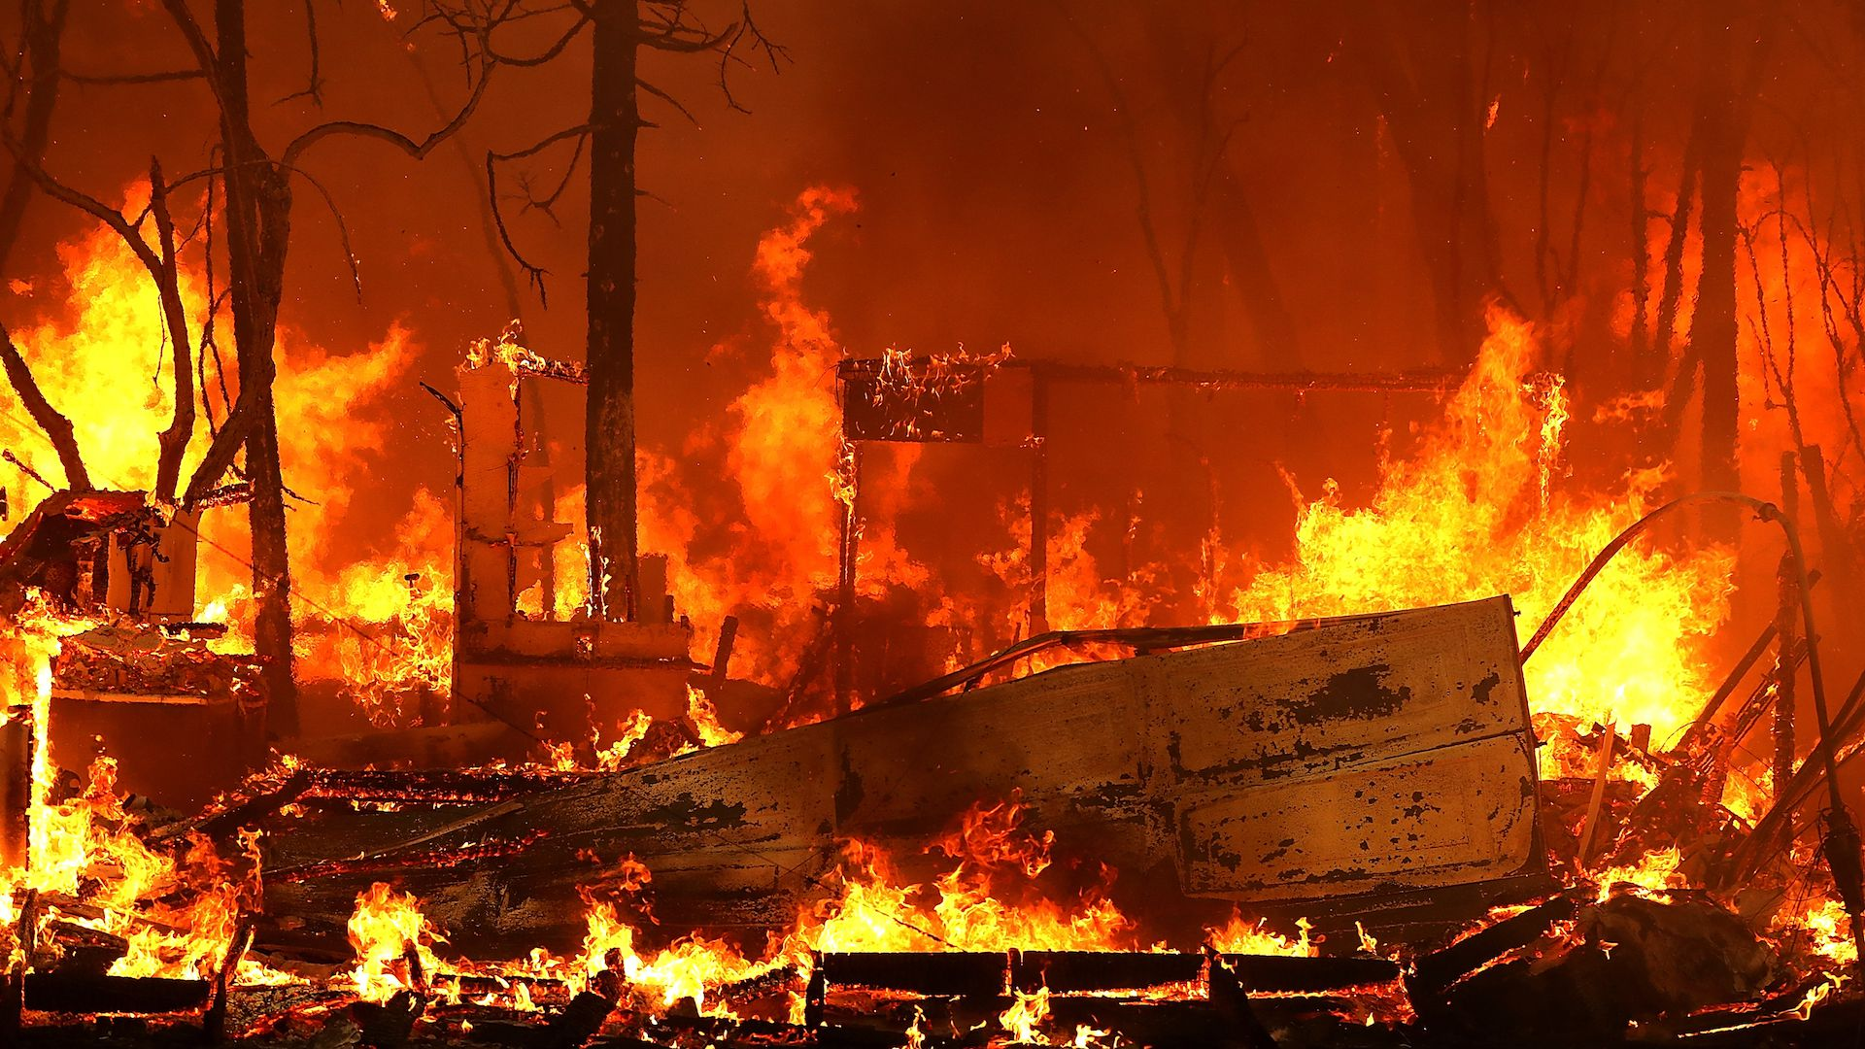

Slide 9
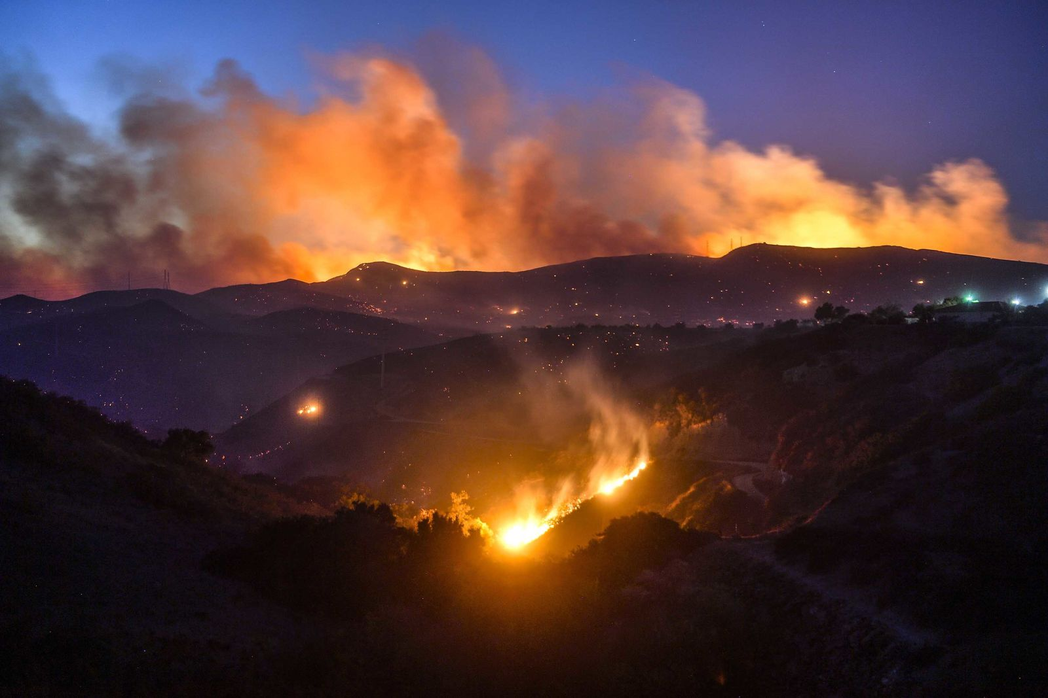

Slide 10
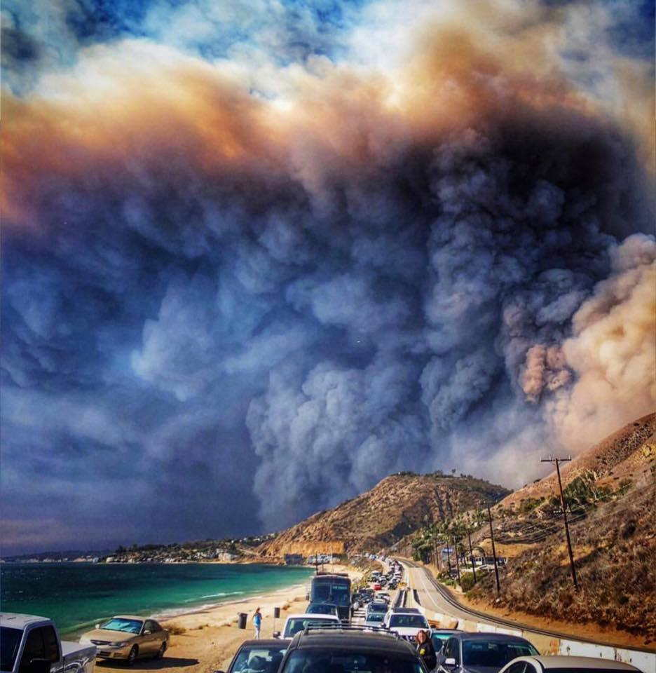

Slide 11
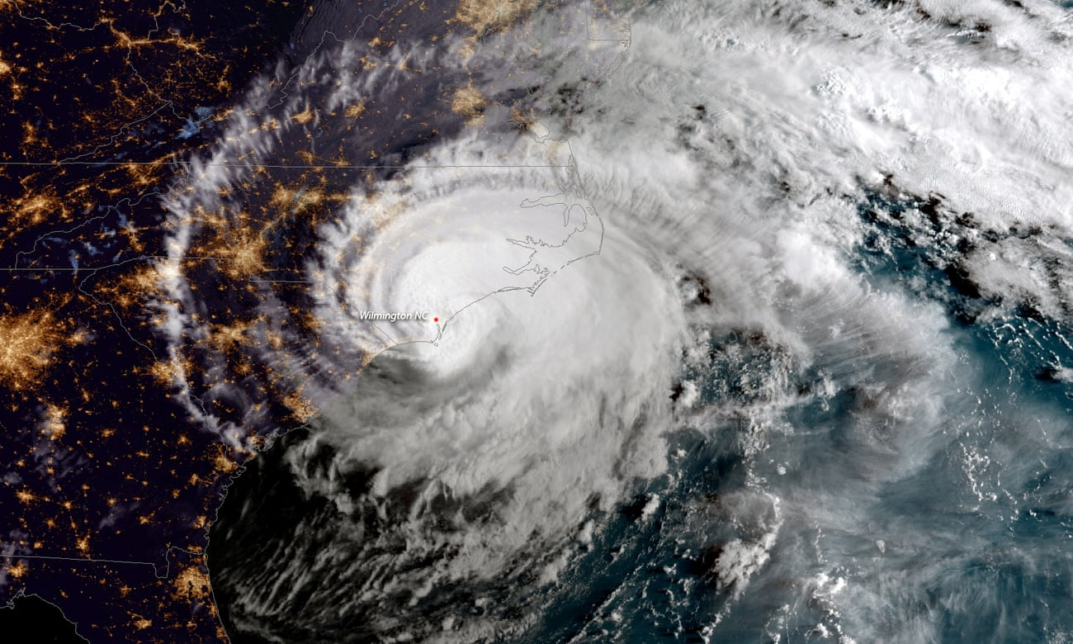

Slide 12
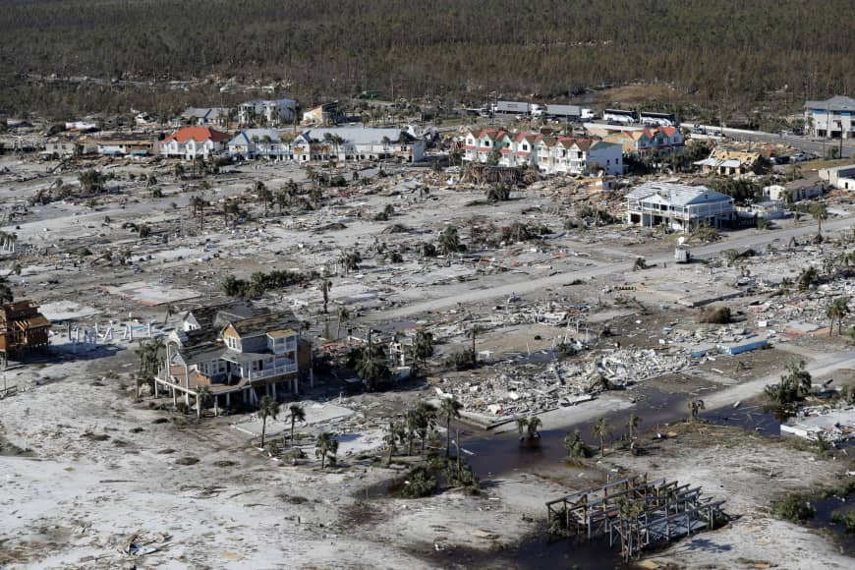

Slide 13
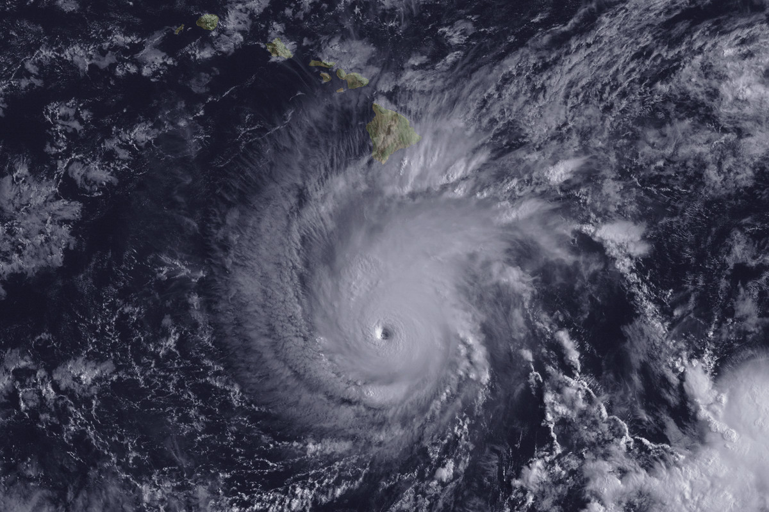

Slide 14
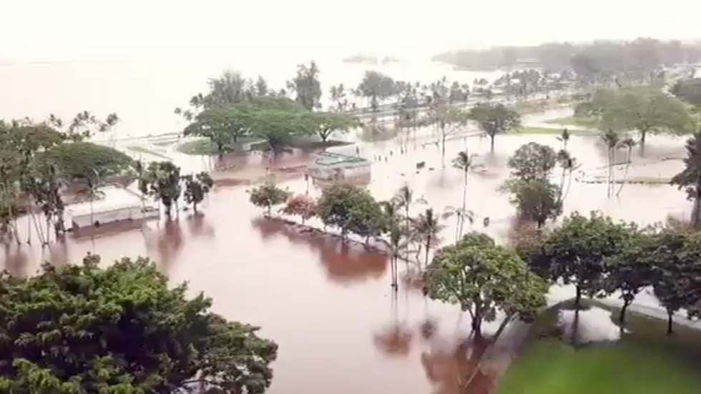

Slide 15
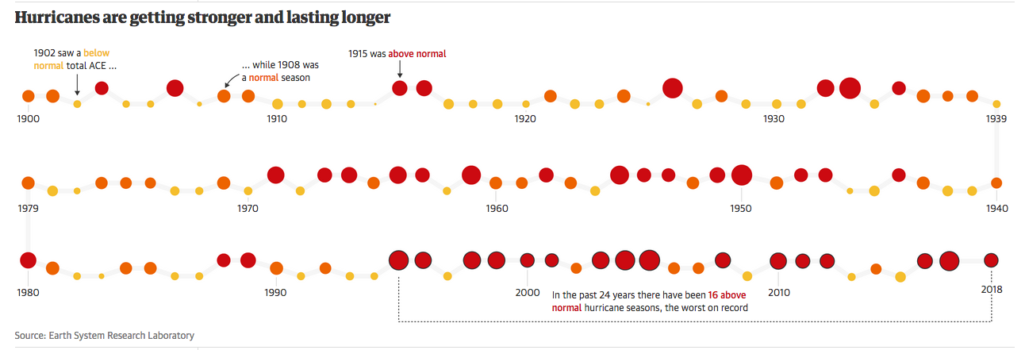
Hurricane seasons from 1900-2018
The data shows that Hurricanes are getting stronger and lasting longer.

Slide 16
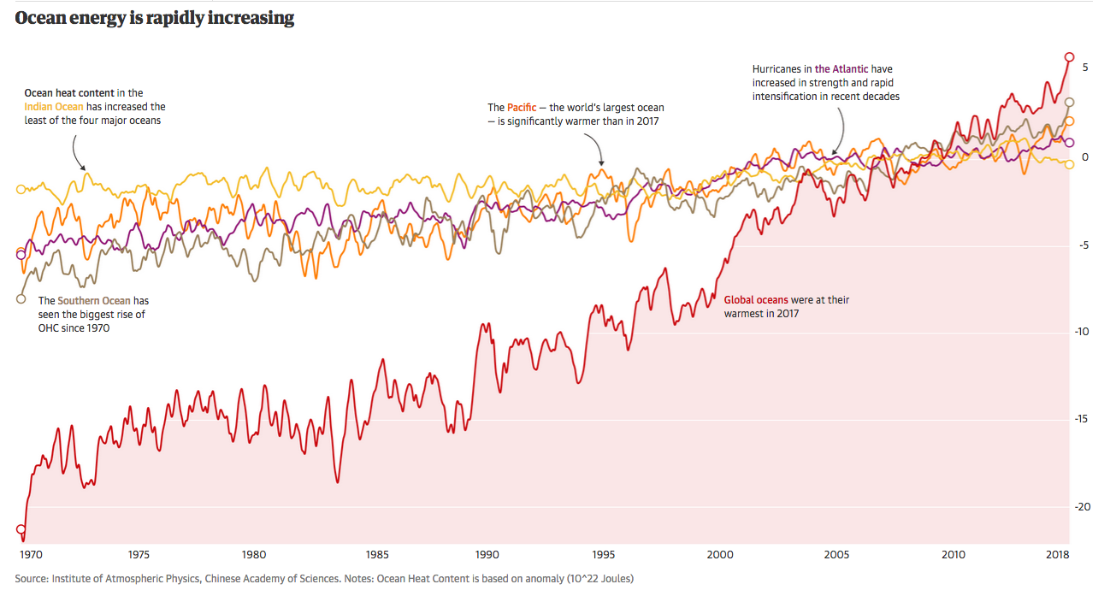

Slide 17
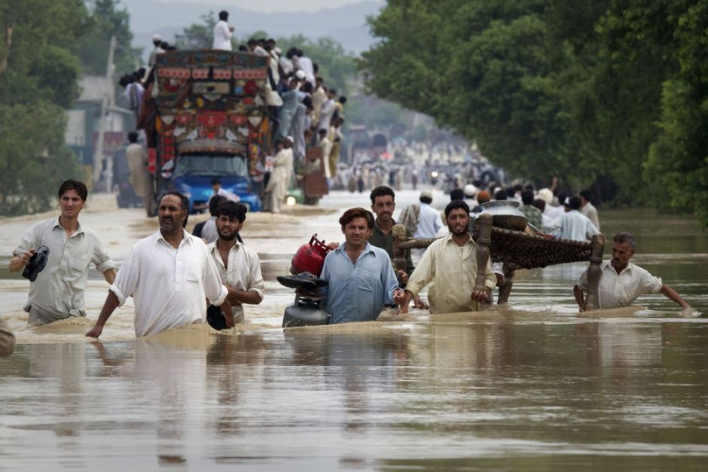

Slide 18
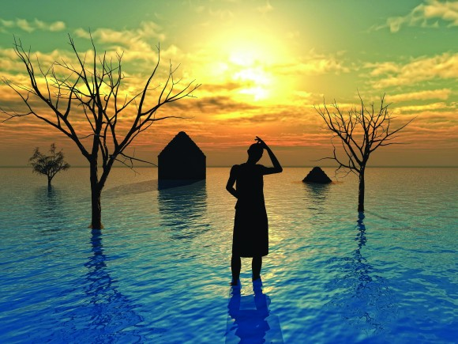

Slide 19
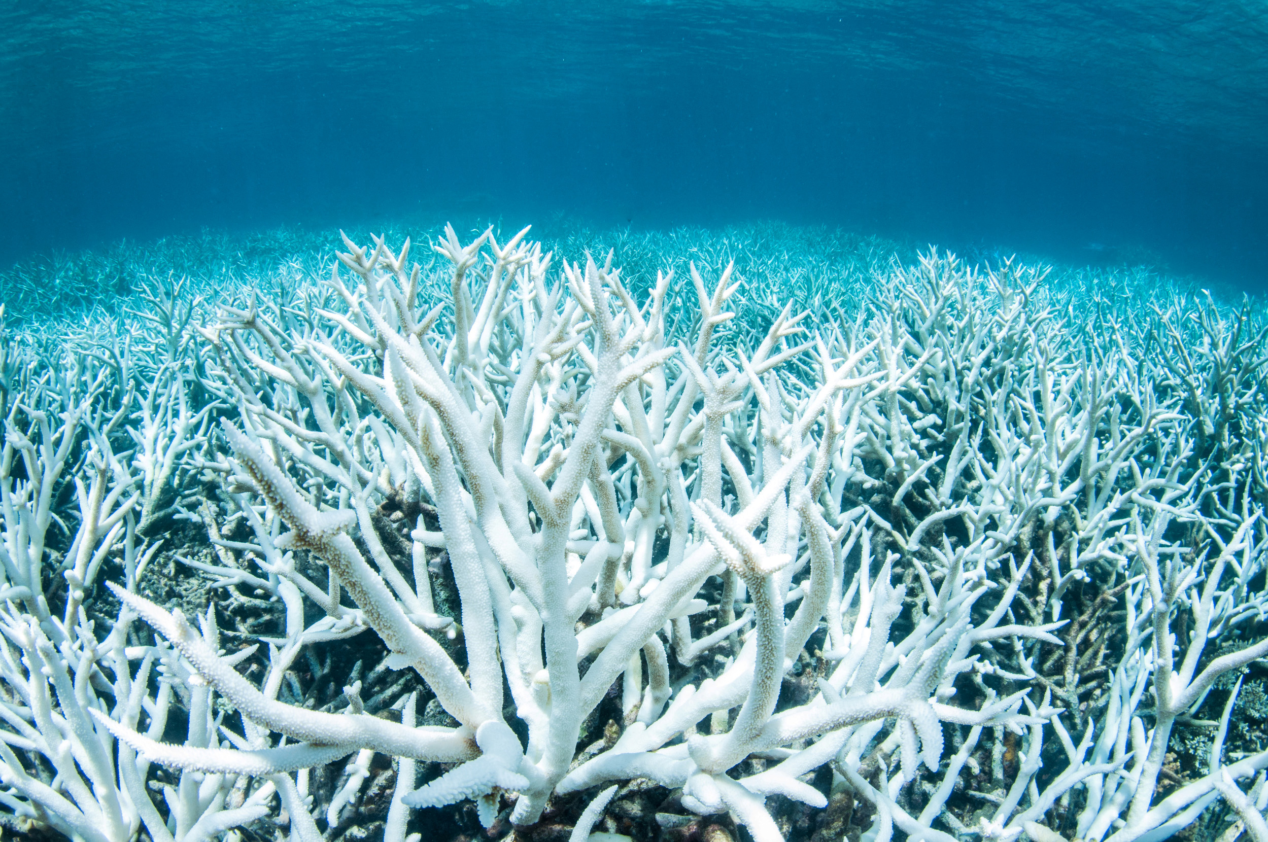

Slide 20
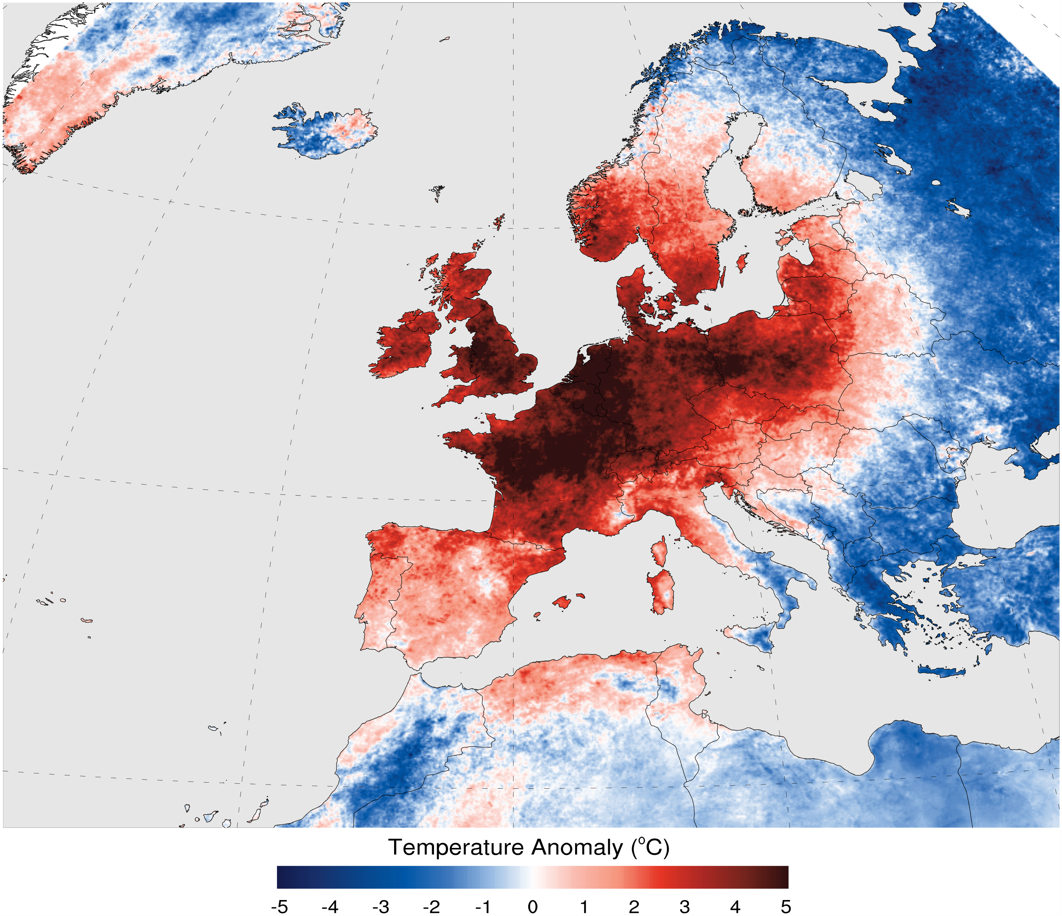

Slide 21
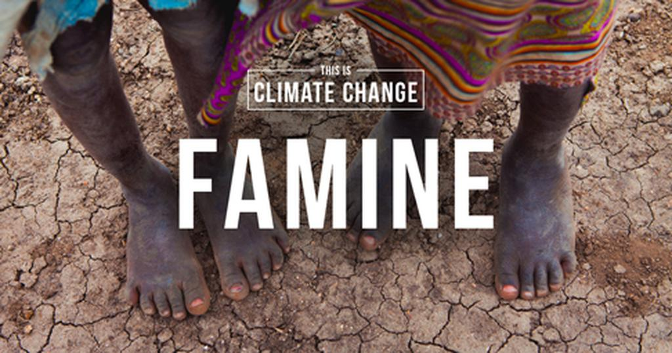

Slide 22
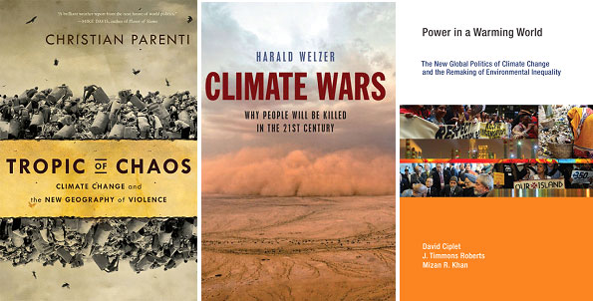

Slide 23

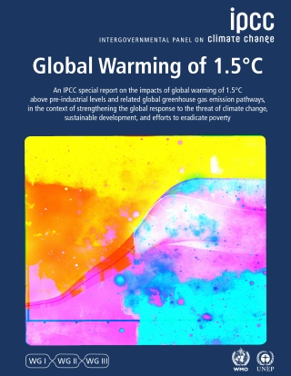

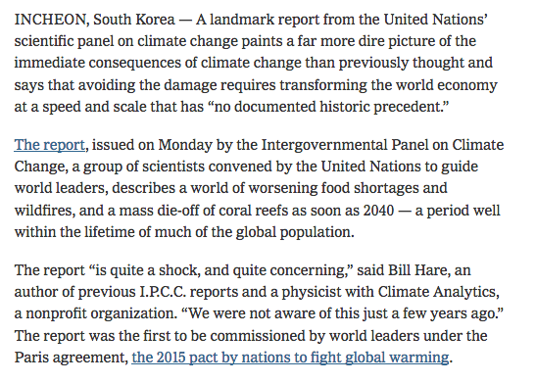

Slide 24
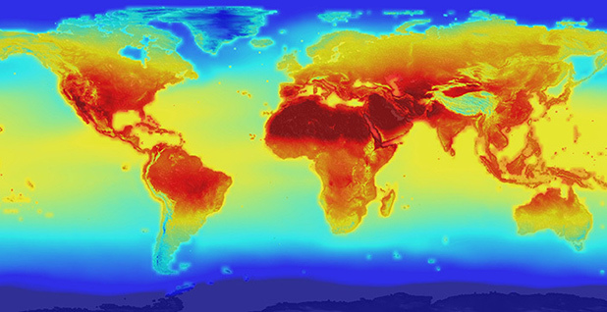
The Science of Climate Change

Slide 25
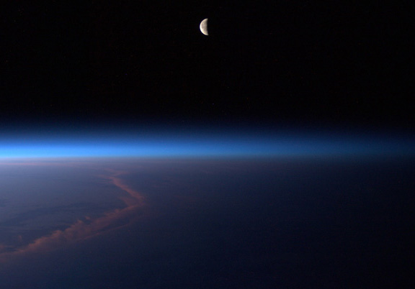

Slide 26
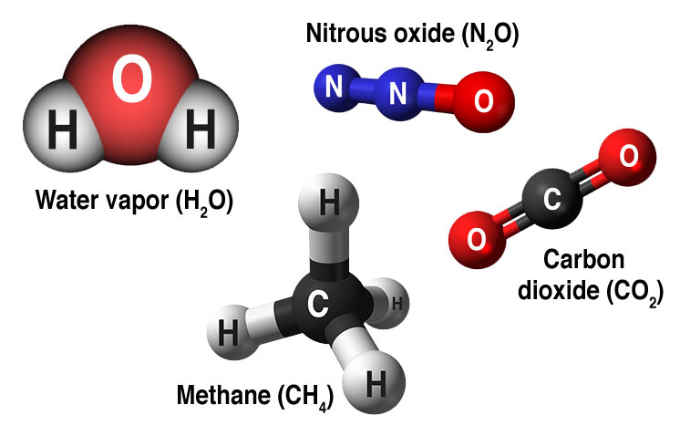

Slide 27
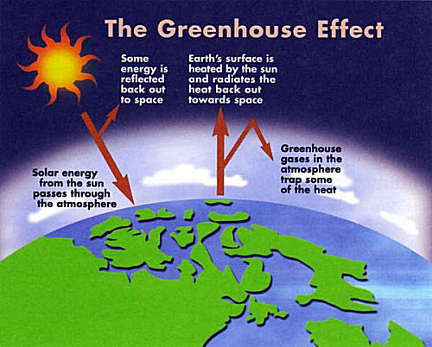

Slide 28
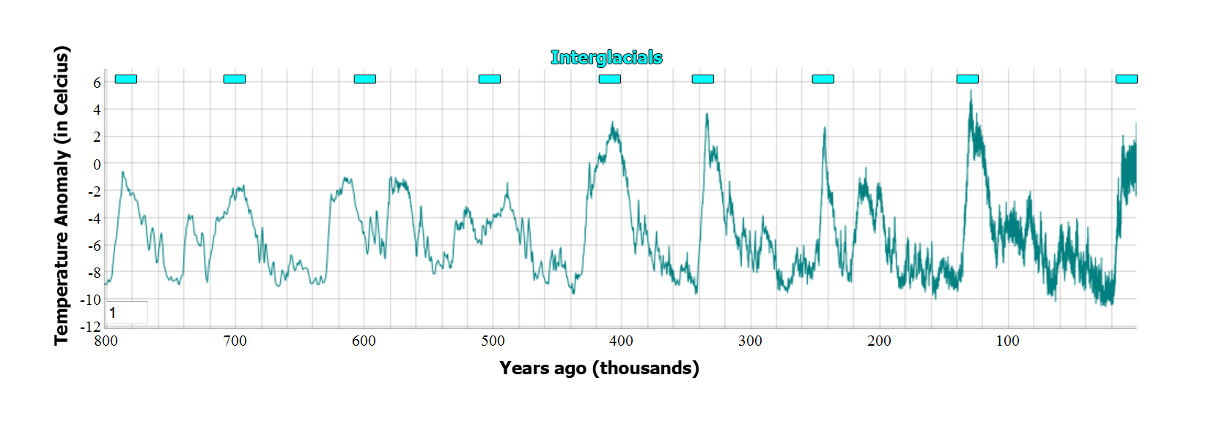
Oscillation of Global Temperature over 800,000 Years

Slide 29
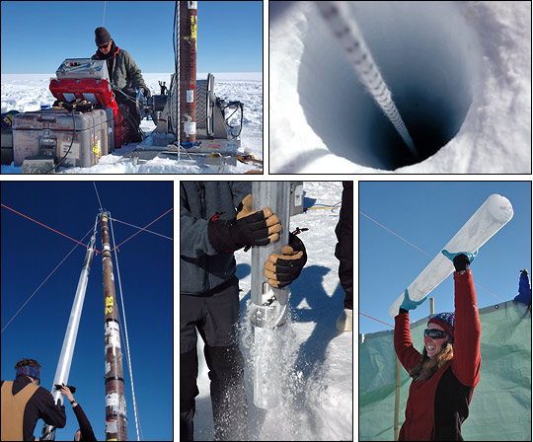
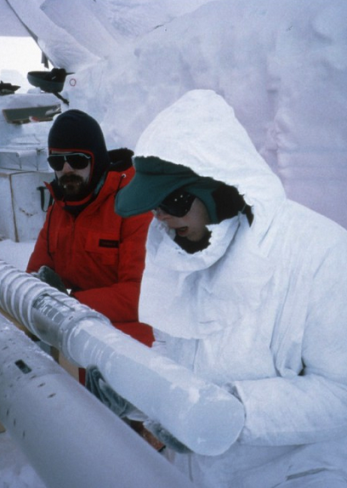

Slide 30
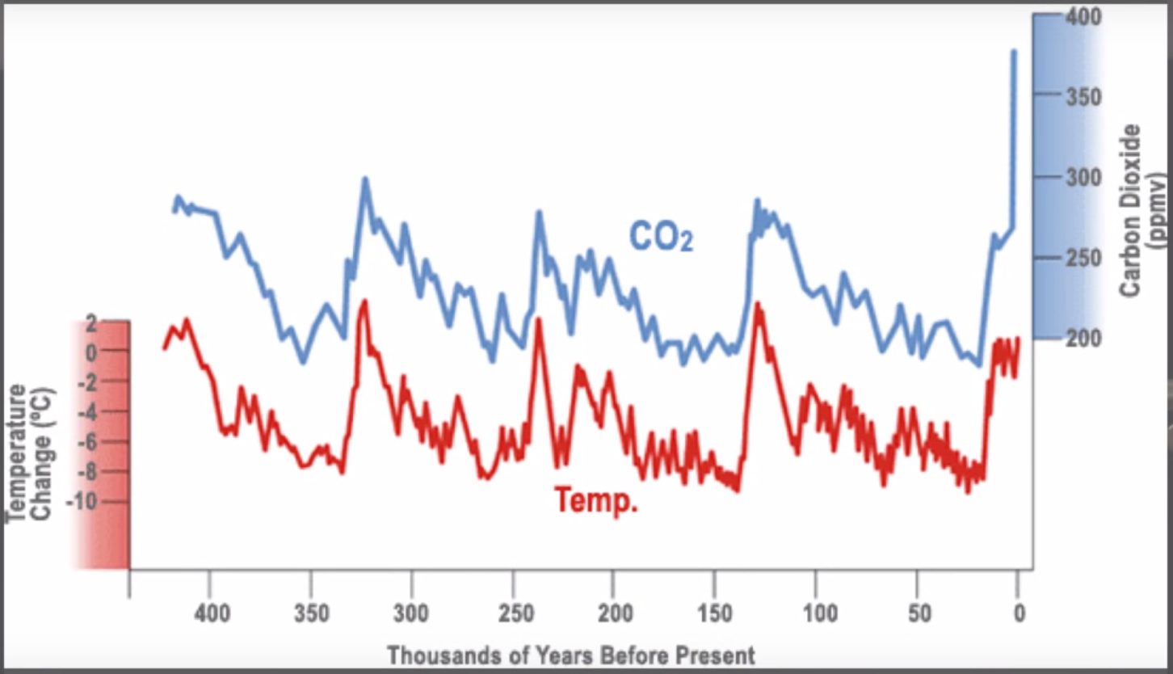

Slide 31
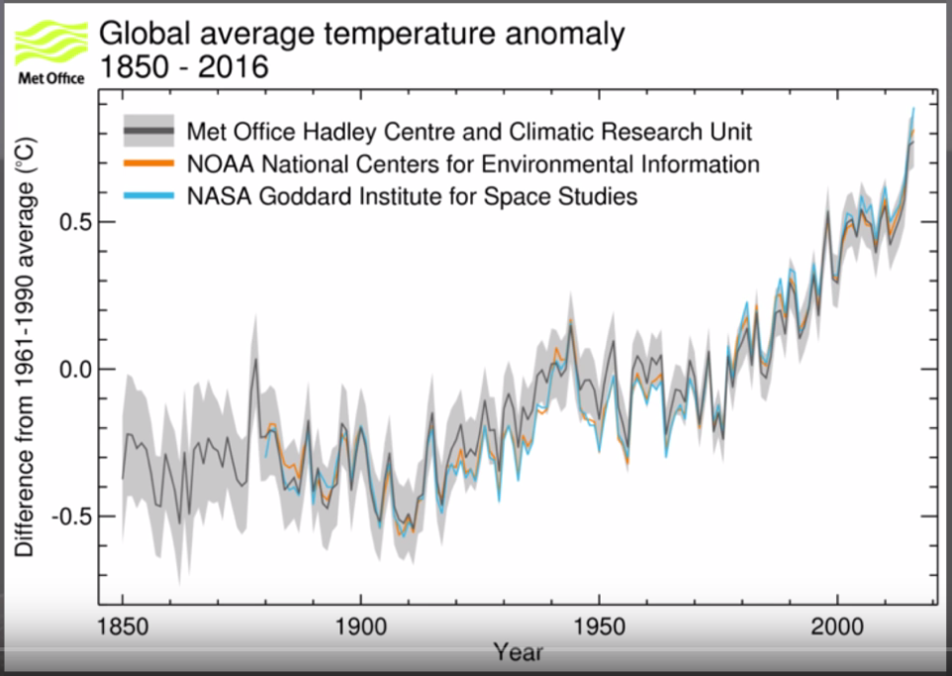

Slide 32
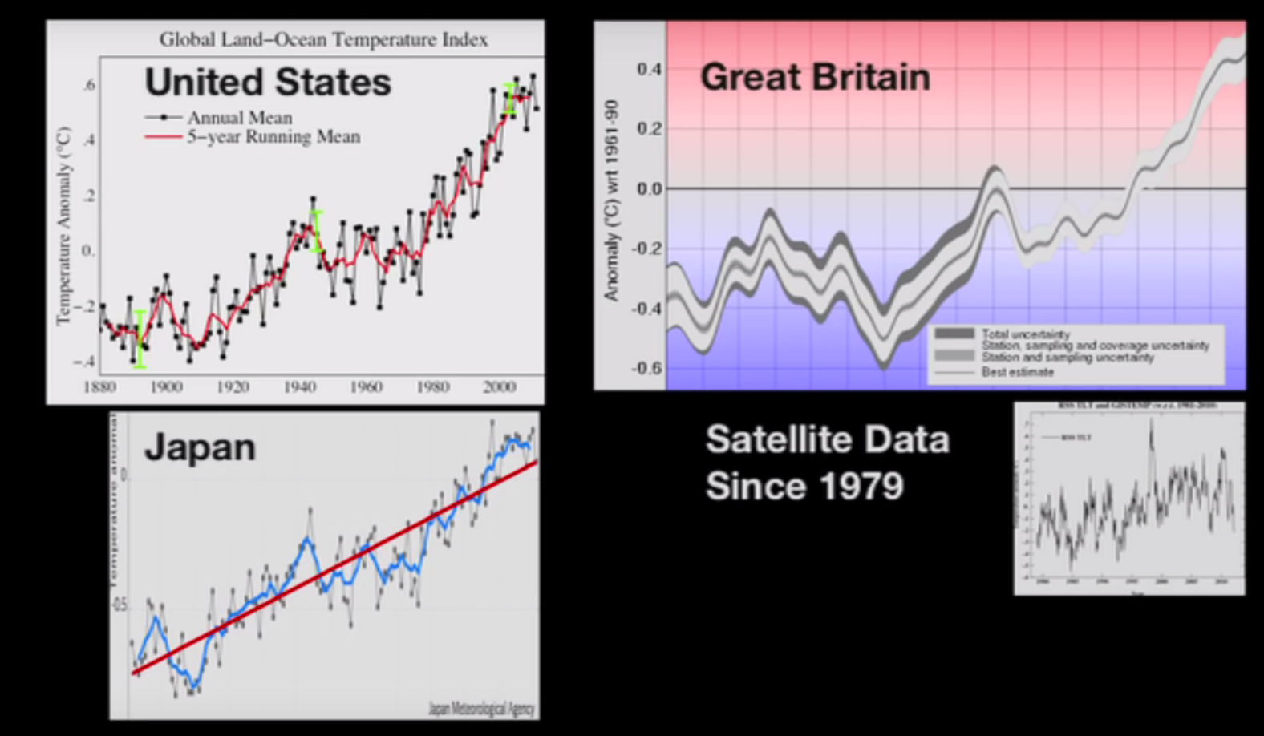

Slide 33
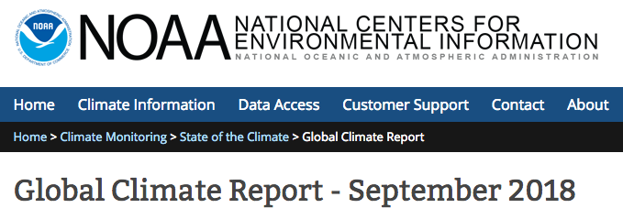
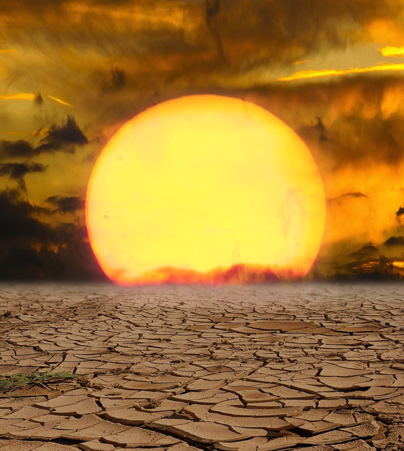
With global records dating back to 1880, the September 2018 global temperature across the world's land and ocean surfaces was 0.78°C (1.40°F) above the 20th century average of 15.0°C (59.0°F)—tying with 2017 as the fourth highest September temperature in the 139-year record. The ten warmest September global land and ocean surface temperatures have occurred since 2003, with the last five years (2014–2018) comprising the five warmest Septembers on record. September 2015 is the record warmest September at +0.93°C (+1.67°F). September 2018 also marks the 42nd consecutive September and the 405th consecutive month with temperatures, at least nominally, above the 20th century average.
NOAA National Centers for Environmental Information, State of the Climate: Global Climate Report for September 2018, published online October 2018, retrieved on November 15, 2018 from https://www.ncdc.noaa.gov/sotc/global/201809.

Slide 34
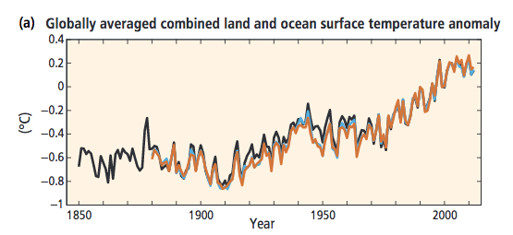
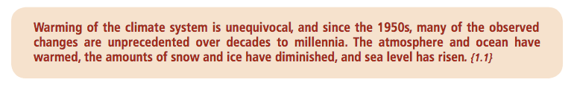
The 2014 Synthesis Report
The Intergovernmental Panel on Climate Change
IPCC, 2014: Climate Change 2014: Synthesis Report. Contribution of Working Groups I, II and III to the Fifth Assessment Report of the Intergovernmental Panel on Climate Change [Core Writing Team, R.K. Pachauri and L.A. Meyer (eds.)]. IPCC, Geneva, Switzerland, 151 pp

Slide 35
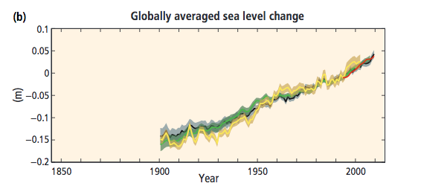
The 2014 Synthesis Report
The Intergovernmental Panel on Climate Change
IPCC, 2014: Climate Change 2014: Synthesis Report. Contribution of Working Groups I, II and III to the Fifth Assessment Report of the Intergovernmental Panel on Climate Change [Core Writing Team, R.K. Pachauri and L.A. Meyer (eds.)]. IPCC, Geneva, Switzerland, 151 pp

Slide 36
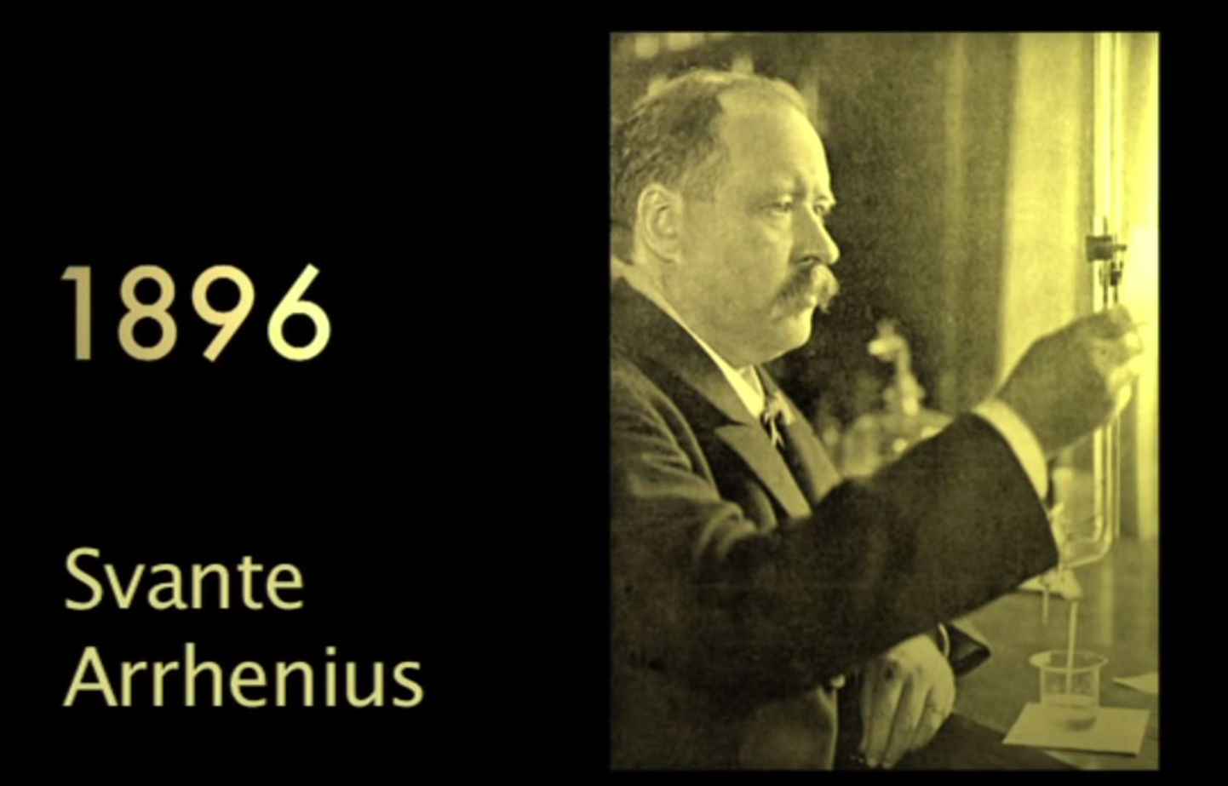

Slide 37
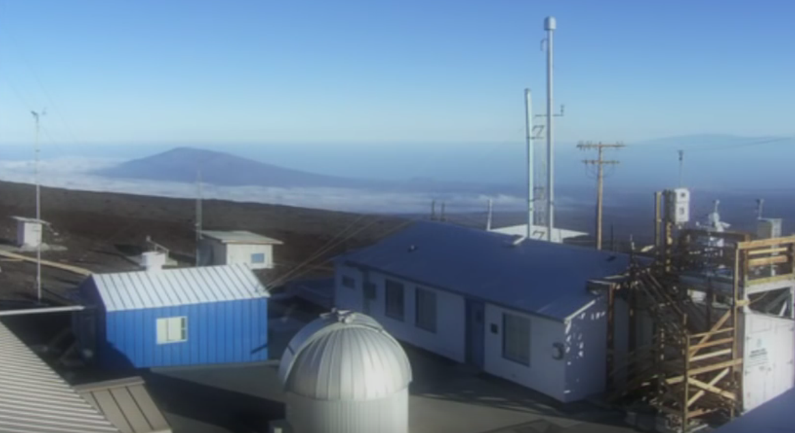

Slide 38
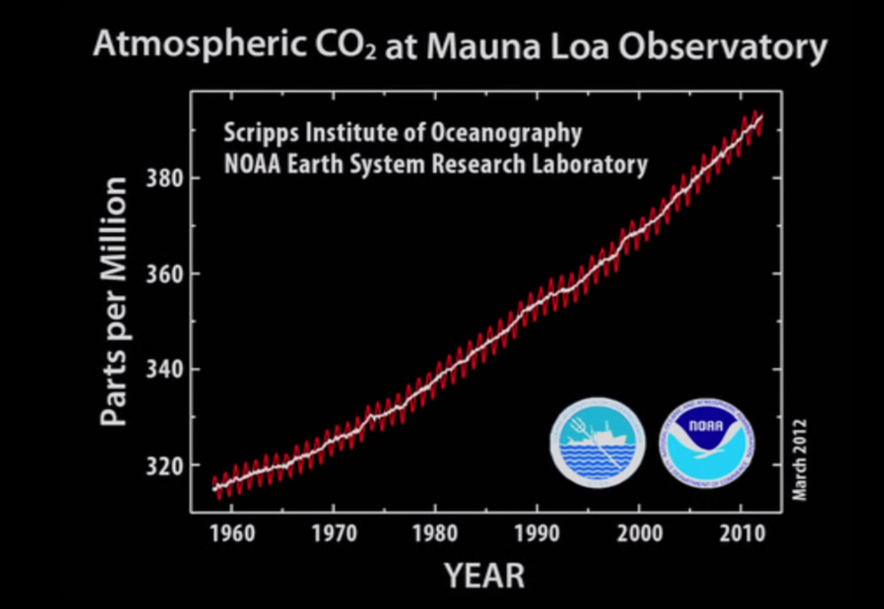

Slide 39
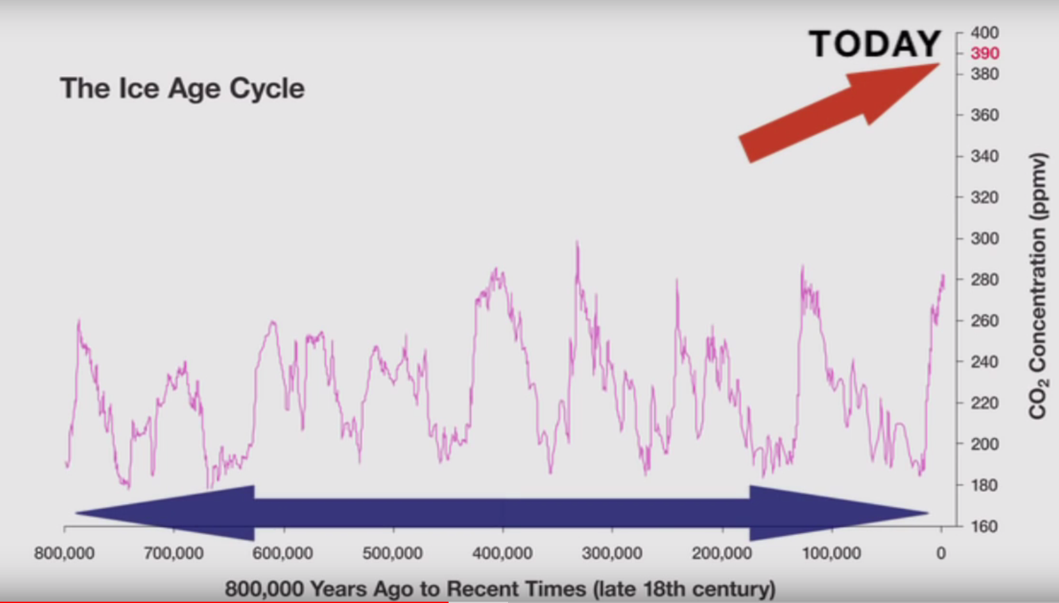

Slide 40
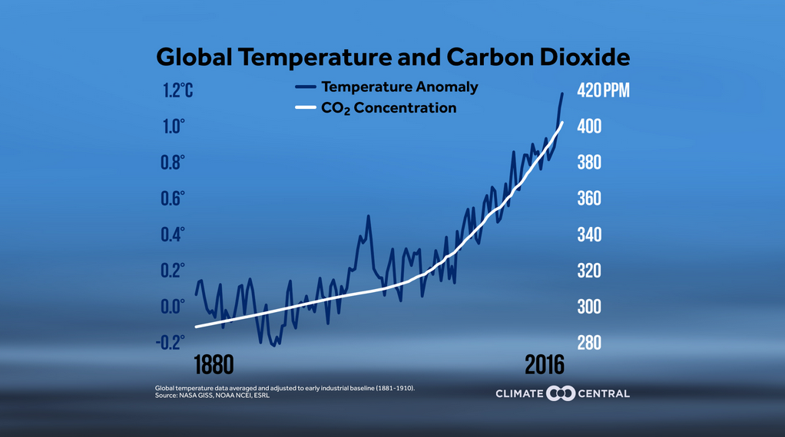

Slide 41
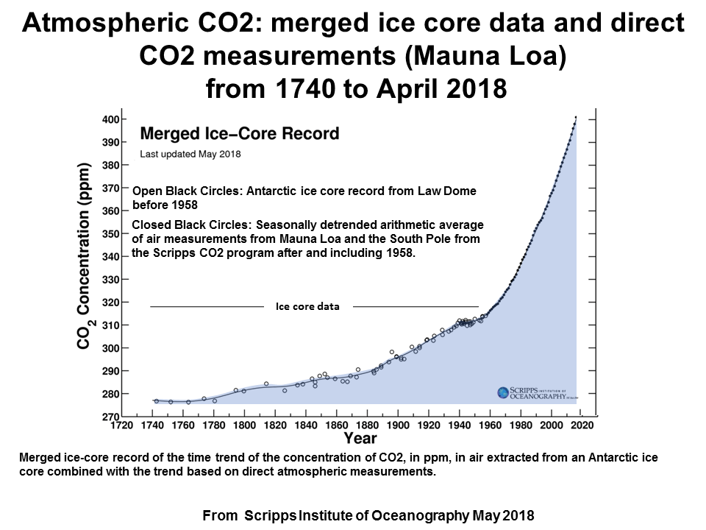

Slide 42
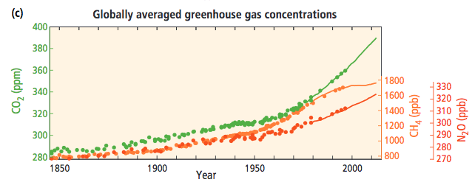
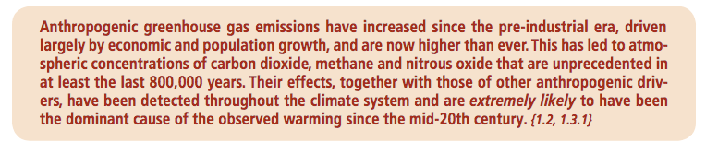
The 2014 Synthesis Report
The Intergovernmental Panel on Climate Change
IPCC, 2014: Climate Change 2014: Synthesis Report. Contribution of Working Groups I, II and III to the Fifth Assessment Report of the Intergovernmental Panel on Climate Change [Core Writing Team, R.K. Pachauri and L.A. Meyer (eds.)]. IPCC, Geneva, Switzerland, 151 pp

Slide 43
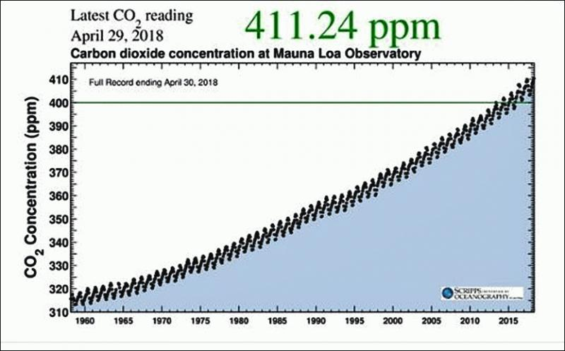

Slide 44
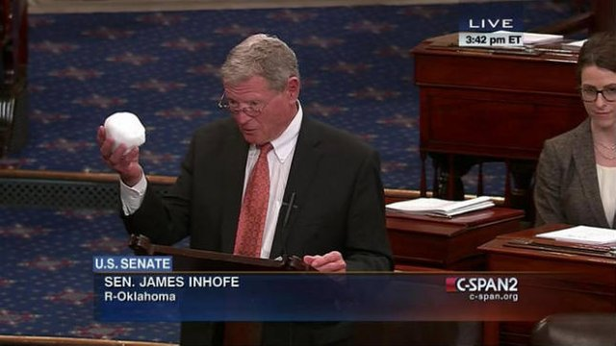

Slide 45
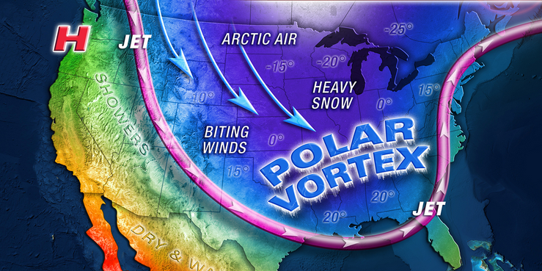

Slide 46


Slide 47


The 2014 Synthesis Report
The Intergovernmental Panel on Climate Change
IPCC, 2014: Climate Change 2014: Synthesis Report. Contribution of Working Groups I, II and III to the Fifth Assessment Report of the Intergovernmental Panel on Climate Change [Core Writing Team, R.K. Pachauri and L.A. Meyer (eds.)]. IPCC, Geneva, Switzerland, 151 pp

Slide 48


Slide 49


Slide 50


Slide 51


The 2014 Synthesis Report
The Intergovernmental Panel on Climate Change
IPCC, 2014: Climate Change 2014: Synthesis Report. Contribution of Working Groups I, II and III to the Fifth Assessment Report of the Intergovernmental Panel on Climate Change [Core Writing Team, R.K. Pachauri and L.A. Meyer (eds.)]. IPCC, Geneva, Switzerland, 151 pp

Slide 52


Slide 53


Slide 54


Slide 55


Slide 56


Slide 57

“Human activities are estimated to have caused approximately 1.0°C of global warming above pre-industrial levels, with a likely range of 0.8°C to 1.2°C. Global warming is likely to reach 1.5°C between 2030 and 2052 if it continues to increase at the current rate.”

Slide 58

Global Temperature Anomalies

Slide 59


Slide 60


Slide 61


Slide 62


Slide 63


Slide 64


Slide 65


Slide 66

Philosophy of Climate Change

Slide 67



Slide 68

Anthropocentrism
From Greek Ancient Greek: ἄνθρωπος, ánthrōpos, "human being"; and Ancient Greek: κέντρον, kéntron, "center") is the belief that human beings are the most important entity in the universe.

Slide 69


Slide 70

“If we could communicate with the gnat, we would learn that he likewise flies through the air with the same solemnity, that he feels the flying center of the universe within himself.”
Nietzsche,
“On Truth and Lies in an Nonmoral Sense,” 1873

Slide 71

It is the same with the human as with the tree. The more it aspires to the height and the light, the more its roots strive earthward, downward, into the dark, the depths…
Nietzsche, Thus Spoke Zarathustra, 1885

Slide 72

I beseech you, my brothers, remain loyal to the earth, and do not believe those who speak to you of otherworldly hopes! Poison-mixers are they, whether they know it or not. Despisers of life are they, decaying and poisoned themselves, of whom the earth is weary: so let them go.
"Once the sin against God was the greatest sin; but God died, and these sinners died with him. To sin against the earth is now the most dreadful thing.”
Nietzsche, Thus Spoke Zarathustra, 1885

Slide 73

The “kingdom of heaven” is a state of the heart—not something that is to come “above the earth” or “after death.”
The “kingdom of God” is nothing that one expects; it has no yesterday and no day after tomorrow, it will not come in “a thousand years”—it is an experience of the heart; it is everywhere, it is nowhere.
Nietzsche, The Antichrist. 1888

Slide 74

I go back, I tell the genuine history of Christianity. The very word “Christianity” is a misunderstanding: in truth, there was only one Christian, and he died on the cross.
It is false to the point of nonsense to find the mark of the Christian in a “faith,” for instance, in the faith in redemption through Christ: only Christian practice, a life such as he lived who died on the cross, is Christian.
Such a life is still possible today, for certain people even necessary: genuine, original Christianity will be possible at all times. Not a faith, but a doing; above all, a not doing of many things, another state of being.
Nietzsche, The Antichrist. 1888

Slide 75

The Land Ethic
“A land ethic changes the role of Homo sapiens from conqueror of the land-community to plain member and citizen of it.”
Aldo Leopold,
A Sand County Almanac, 1949.

Slide 76

Deep Ecology
In 1972, Arne Naess coined the term “deep ecology”, which he contrasted with “shallow ecology”: to him, “present human interference with the nonhuman world is excessive, and the situation is rapidly worsening” and all the answers that had been found at the time were superficial and anthropocentric. They addressed the symptoms rather than the causes, and aimed to perpetuate the human race’s domination of the earth.

Slide 77


The Question Concerning Technology
Martin Heidegger 1889-1976

Slide 78


Slide 79


Slide 80



Slide 81





Slide 82



Slide 83
“God wills the interdependence of creatures. The sun and the moon, the cedar and the little flower, the eagle and the sparrow: the spectacle of their countless diversities and inequalities tells us that no creature is self-sufficient. Creatures exist only in dependence on each other, to complete each other, in the service of each other.”

Slide 84


Slide 85

America
and
Climate Change
“There is no other society worldwide with such excessive consumption, waste, and greed for energy. Although the US American population constitutes less than five percent of the world population, it has produced more than a third of the cumulative greenhouse gas emissions of our species. Anthropogenic climate change is really Amerigenic climate change.”
Martin Schönfeld, Global Ethics on Climate Change, 6

Slide 86



Slide 87

“Our society is run by insane people for insane objectives. I think we're being run by maniacs for maniacal ends.”
John Lennon
BBC interview At The National Theatre, London, June 1968

Slide 88


Slide 89



