Slide 1
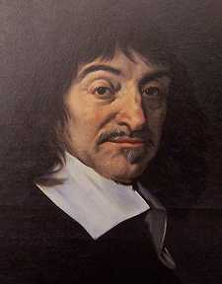
Descartes
“I think, therefore, I am”

Slide 2
Two Major Problems
Resolving the conflict between religion and science.
Finding a foundation for knowledge, thus defeating skepticism.

Slide 3
Finding a Foundation for Knowledge
The quest for certainty, the demolition phase (Meditation I)
1) dreaming hypothesis (casts doubt on senses)
2) evil genius hypothesis (cast doubt on math and geometry)
The foundation for knowledge (Meditation II)
The one thing that cannot be doubted: thinking
“I think, therefore, I am.
Descartes’ Epistemology: Rationalism (Meditation II)
The senses cannot be trusted, knowledge comes from pure reason.
The ball of wax example.

Slide 4
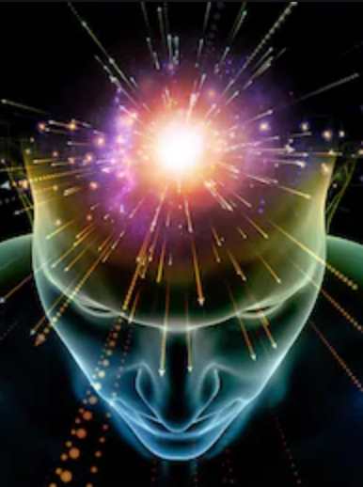
The Epistemological Problem
How do I know anything else exists outside my mind?
Solipsism:
only one’s own mind exists
Am I alone in the Universe?
Is the Universe just my mind?

Slide 5

Am I imprisoned
in my mind?

Slide 6
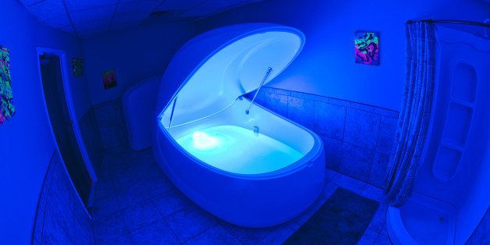

Slide 7

The Epistemological Problem
How do I know which ideas
I can trust
to give me accurate knowledge
of the world?
Which ideas are true?

Slide 8
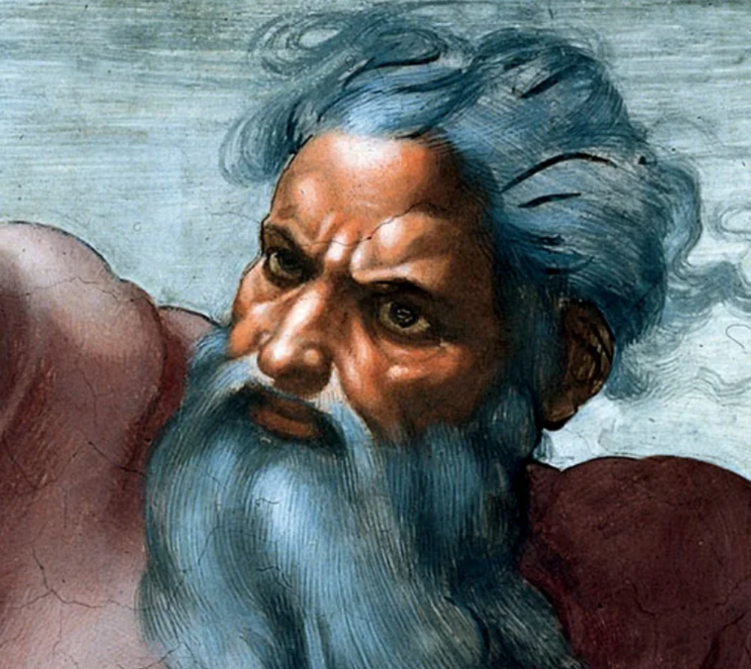
The Ontological Argument for God’s Existence
1) I have a clear and distinct idea of God
  That God is a Perfect Being
    Omnipotent, Omniscient, Benevolent
2) It is more perfect to exist than not to exist
3) Therefore, God must exist.

Slide 9
1) It is more perfect not to deceive
2) Thus God is not a deceiver,
not an Evil Genius
3) Therefore, I can trust my
  ‘clear and distinct’ ideas

Slide 10
Descartes’ Metaphysics
Dualism
Mind
Thinking
and
Unextended
Substance
Body
Extended
and
Unthinking
Substance

Slide 11
Motivations for Dualism
Resolving the Conflict Between Science and Religion
Immortality of the soul
Problem of Freedom

Slide 12
Problems with Dualism
The Mind/Body Problem
Evidence that the Mind and Body are much more connected than Descartes’ Dualism allows
Relationship between humans and nature

Slide 13
Descartes vs Hobbes
Descartes
Dualism
Minds and Bodies
Hobbes
Materialism
All that exists are
Atoms in motion

